Slide 1

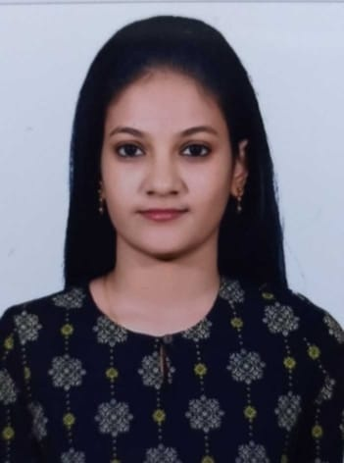





VAISHNAVI K
Education and certificates
Bachelor of Engineering(Computer Science): 2017 - 2021
Analyst/Software Engineer
Skills
Oracle
PL/SQL
SQL Server
Automation Testing-Selenium Robot Framework
Base Location: Bangalore
Email ID:
vaishnavi.e.k@capgemini.com
_{Mobile No:+91 9445807292}
Grade:
A4
Achivement
Escalation Application
Backend
Oracle
PL/SQL
MongoDB
Oracle Developer
Oracle PL/SQL Developer in Analysis, Design and Implementation of Business Applications using the Oracle (RDBMS).
Have knowledge on SDLC from analysis, design, development,testing,implementation and maintenance.
Hands on experience with Data flow diagrams, Data dictionary, Database normalization theory techniques, Entity relation modeling and design techniques.
Expertise in Client-Server application development using Oracle 11g/10g, PL/SQL, Oracle Enterprise Manager, SQL DEVELOPER.
Effectively made use of Table Functions, Indexes, Collections, Analytical functions, Materialized Views.
Created Tables, Views, Constraints, Index and also developed Complex database objects like Stored Procedures, Functions, Packages, Triggers, Synonyms and Exception handling using SQL and PL/SQL.
Hands on experience with Bulk collection, scheduled jobs.
Have developed Escalation is an AWS Cloud Based CSA Application used to calculate the Escalation Factor which in turn is used to revise the prices of the CSA as per the contract T&Cs agreed between GE and Customer . An Escalation clause is generally part of the CSA contract which is signed between the customer and GE . When prices are put into a contract , the prices are reflective of the economy at the time of the contract written . Escalation clauses allow the prices to adjust with economic trends over the lifespan of a contract.
Database
SQL database – MySQL, PL/SQL, Oracle
No SQL database – MongoDB
Web Technologies
HTML
CSS
Warehouse Management System
The Aim of the project is to develop the Database and Queries for the Warehouse Management System . This database is used for storing items and retrieve it
Add On Skills GitHub
Additional Details
Excellent communication skills Experience working with client
Self Learner
Check out my work on GitHub & Video Profile
Presentation Title | Author | Date © Capgemini 2017. All rights reserved | 1

