Slide 1
TASK MANAGEMENT
Project on EJS
Submitted By: Vaishnavi Kesherwani
NSTI: Allahabad

Slide 2
Acknowledgement
We thank the IBM organization and NSTI college for supporting us. We want to take this opportunity to express our deep gratitude and profound admiration to our Edunet mentors, Mr. Gufranullah Ansari and Mr. Nashit Humam, for providing assistance and guidance at every stage.
Furthermore, we would like to acknowledge the valuable input and assistance. His immense knowledge, profound experience, and professional expertise have enabled me to complete this project successfully.
In addition, to the Ministry of Skill Development & Entrepreneurship and IBM for granting us the diploma course. Their technical and financial support has enabled us to complete our diploma course studies successfully. We are thankful
to my family for their encouragement, understanding, and patience throughout and for being a constant source of motivation.
Lastly, we would like to express my heartfelt appreciation to everyone who provided moral support and engaged in meaningful discussions, enhancing my understanding.

Slide 3
Introduction to Problem
In today's fast-paced world, effective task management is crucial for individuals and organizations alike to stay organized, meet deadlines, and achieve goals efficiently. However, traditional methods of task management, such as handwritten to-do lists or basic digital tools, often fall short in providing the flexibility and functionality required in modern workflows.
Recognizing the limitations of conventional task management approaches, this project introduces a To-Do-List application developed using EJS (Embedded JavaScript). EJS offers a robust framework for creating dynamic web applications, leveraging the power of JavaScript to generate HTML content seamlessly.

Slide 4
Proposed Solution
Dynamic Task Creation and Editing
Real-Time Updates with EJS Templates
Task Categorization and Filtering
User Authentication and Authorization
Responsive Design for Multi-Device Compatibility
Intuitive User Interface and Interaction

Slide 5
Implementation Details
Project Setup and Configuration
User Authentication and Authorization
Task Management Features
User Interface Design and Interactivity
Error Handling and Validation
Testing and Debugging

Slide 6
Future Scope
Integration of Additional Features
Enhanced Collaboration Features
Advanced Task Analytics and Insights
Integration with External Tools and Services
Accessibility and Localization
Mobile Applications and Offline Support
User Feedback and Iterative Improvement

Slide 7
Conclusion
In conclusion, the development of the To-Do-List project using EJS has provided a solid foundation for efficient task management, offering a user-friendly interface, dynamic functionality, and seamless integration of modern web development technologies. Throughout the project, various features and components have been implemented to address the challenges associated with traditional task management methods and enhance productivity and organization for users.

Slide 8
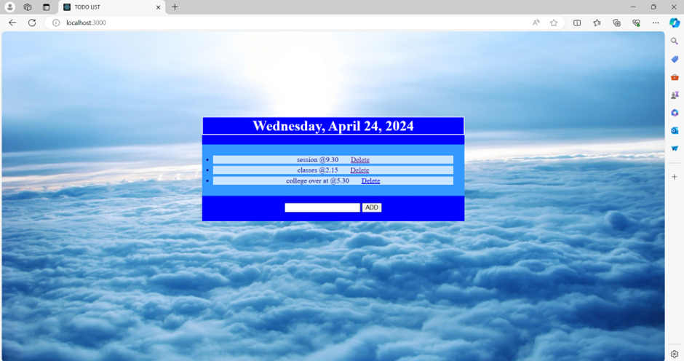
Screenshot of Project

Slide 9
Thank You

