Slide 1
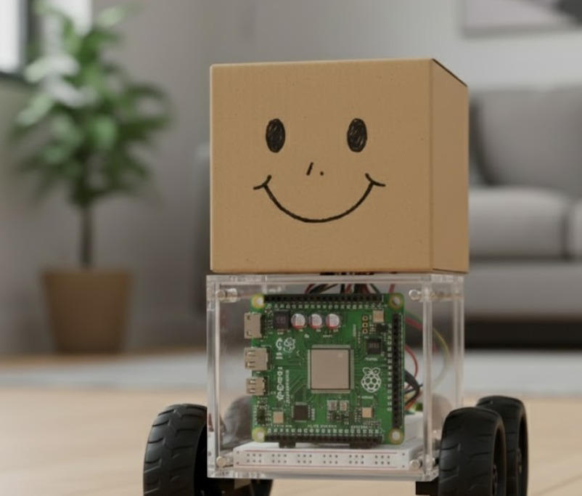
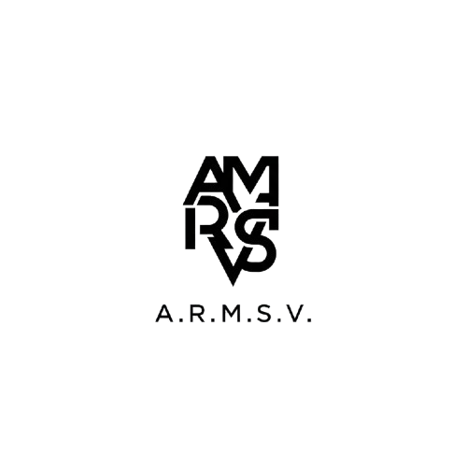
VibeBot: The Empathetic AI Companion- HealthTech
A.R.M.S.V | CIEL Kingston vibeAIthon 2025

Slide 2

Problem
Solution
Desirability
Feasibility
Viability
Prototype
For millions with mobility challenges, a reliable helper isn't a luxury—it's a necessity.
Yet,
current technology is costly, complex, and fails when it's needed most.

Slide 3

Problem
Solution
Desirability
Feasibility
Viability
Prototype
Our solution is an AI-powered healthcare companion that offers safety, support, and friendship.
The Brain: A powerful Raspberry Pi 5 runs all onboard AI, which ensures a fast and private user experience.
Constant Monitoring: It tracks the user's location through GPS and syncs with personal health devices, like a wearables to check vital signs.
A Friendly Voice: The bot can chat and engage in conversation, providing companionship and important reminders, even when offline.
Intelligent Awareness: With its camera module and ultrasonic sensors, it safely navigates the user's home, staying close without getting in the way.

Slide 4

Problem
Solution
Desirability
Feasibility
Viability
Prototype
It's proactive, not reactive. By tracking health data from a wearables, it provides insights and alerts without needing constant input.
It's always there. Its ability to work online and offline makes it a reliable partner, not just an internet-dependent tool.
It's a friend, not just a machine. The ability to have natural conversations makes it a welcome addition to the home, changing it from a utility to a desirable companion.

Slide 5
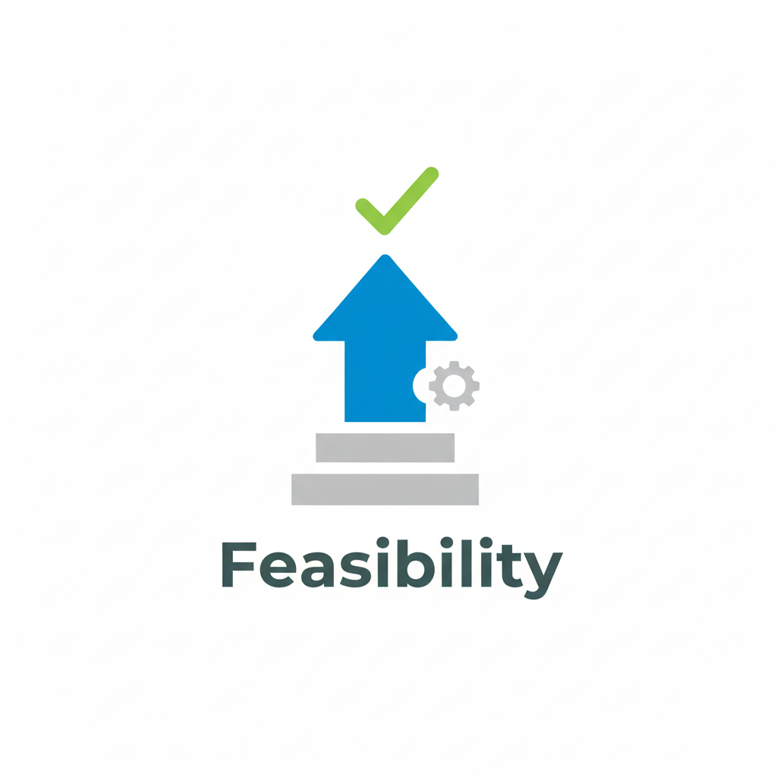
Problem
Solution
Feasibility
Viability
Prototype
This AI Healthcare Bot is very feasible. It uses low-cost, reliable technology and a simple, effective design.
Low-Cost and Proven Hardware: The bot is made with dependable, off-the-shelf components like Raspberry Pi 5 and Arduino.
Simple and Smart Design: The bot follows a person by detecting signals from a wearable smart band, avoiding cameras and preserving privacy, while ultrasonic sensors handle obstacle avoidance for safe, low-cost navigation.
Achievable Software: The AI brain runs on standard Python and well-documented APIs from services like OpenAI, making the voice interaction and logic easy to implement.

Slide 6

Problem
Solution
Feasibility
Viability
Prototype
This AI Healthcare Bot is a promising venture because it addresses an important market need with an affordable and appealing product.
Clear Market Demand: It addresses a significant and growing need for affordable assistive care, where current options are often too expensive or complicated.
Profitable & Accessible: With a build cost under ₹15000, it can be priced reasonably for users while still providing a strong profit margin, which makes the business case strong.
Trustworthy & Desirable Solution: Its camera-free, privacy-first design makes it reliable for home use, and features like "chitchat" make it a friendly companion.

Slide 7
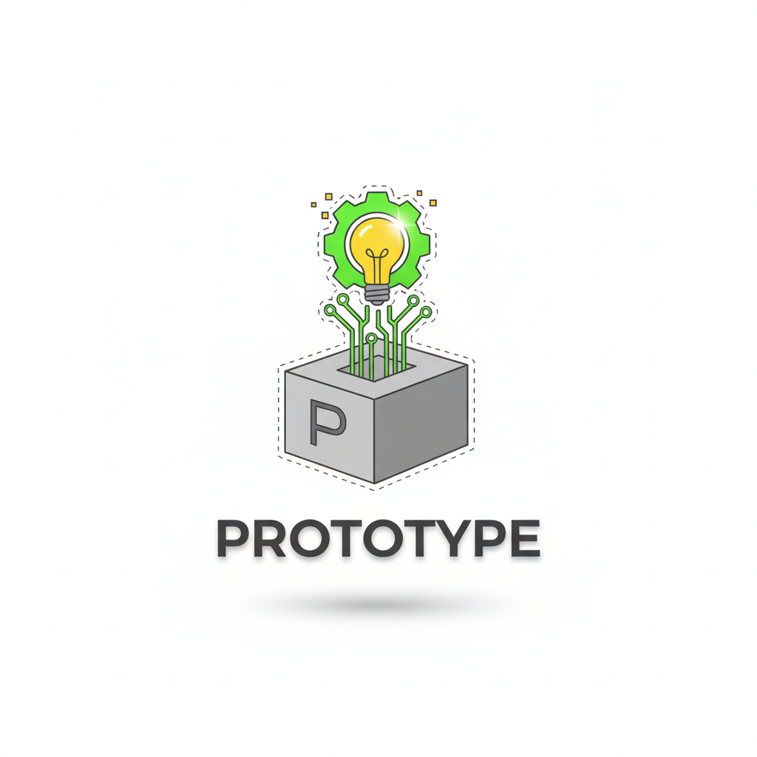
Problem
Solution
Feasibility
Viability
Prototype
How It Works:
Camera-Free Following: The bot tracks the user by sensing the Wi-Fi signal strength (RSSI) from their smartphone. It moves toward a stronger signal and changes direction when the signal weakens.
Intelligent Obstacle Avoidance: Onboard ultrasonic sensors constantly scan for obstacles and automatically stop the bot to avoid collisions.
Voice Interaction: The Raspberry Pi serves as the AI brain. This setup lets the user ask questions and get helpful spoken responses from AI models like Gemini and ChatGPT.
Key Components:
AI Brain: Raspberry Pi 5
Sensor & Motor Control: Arduino UNO and ESP8266 Wi-Fi Module
Movement: DC Motors with L298N Driver
Software: Python and Arduino linked via serial communication.

Slide 8
4
60–90 days Optimize path tracking, add obstacle avoidance and battery monitor
Future Scope OptiDevelop mobile app interface & publish open-source model
3
2
30–60 days Integrate Raspberry Pi AI assistant (speech I/O)
1
0–30 days Build basic prototype using Raspberry +Arduino + Wi-Fi + motors

Slide 9
Role
Hardware Engineer
Skills
Circuit design, motor driver control
AJISH V
MONISH
VAISHNAVI
RUDRESH
SAI VIKRAM BALAJI

Slide 10
Role
Innovation Manager
Skills
Raspberry Pi 5 AI integration
MONISH
RUDRESH
AJISH V
SAI VIKRAM BALAJI
VASHALI

Slide 11
Role
System Integration Engineer
Skills
Raspberry Pi, Arduino, sensors, and APIs.
SAI VIKRAM BALAJI
MONISH
VAISHNAVI
RUDRESH
AJISH V

Slide 12
Role
System Integration Engineer
Skills
Technical goals, and ensures feasibility
RUDRESH K
MONISH
VAISHNAVI
SAI VIKRAM BALAJI B
AJISH V

Slide 13
Role
AI Software Developer
Skills
Handling code, backend, and logic.
VAISHNAVI
MONISH
RUDRESH K
SAI VIKRAM BALAJI B
AJISH V

Slide 14

Thank You

