Slide 1


Slide 2

♥
TEAM 10 • PYMASTERS
♥
Heart Failure
Retrospective Study
Analysis
CARDIOLOGY
ANALYTICS
Turning Clinical Data into Actionable Insights
Clinical Data
2,008
168
4
→
Patients
Clinical Variables
Analytics Stages
Actionable Insight
Siva Sundari Murugan • Guna Thangavel
Poornima Srinivasan • Vaishnavi Dinesh

Slide 3
01 • INTRODUCTION
02
Heart Failure Retrospective Study Analysis
DATASET OVERVIEW
The Hospitalized Patients with Heart Failure dataset integrates comprehensive patient-level information including demographics, vital signs, laboratory results, cardiac function, echocardiographic measurements, medications, comorbidities, and hospitalization outcomes.
♥
2,008
hospitalized patients
168 clinical variables
OUR ANALYTICS OBJECTIVE
CLEAN
Clean and standardize data for reliable analysis
UNDERSTAND
Uncover patient and clinical patterns
RECOMMEND
Translate patterns into data-driven recommendations
PREDICT
Identify important variables and predictive relationships

Slide 4
02 • WORKFLOW
03
From Clinical Data Preparation to Predictive Insights
01
02
03
04
05
INTRODUCTION
DATA ANALYSIS & CLEANING
DESCRIPTIVE ANALYSIS
PRESCRIPTIVE & PREDICTIVE
SUMMARY
Analyze 2,008 hospitalized heart-failure patients using demographic, clinical, cardiac, hospitalization, history, complication and prescription information.
Check missing values, duplicates, data types, invalid values and clinical consistency before creating a reliable analytical dataset.
Explore patient characteristics, heart-failure types, clinical classifications, cardiac measurements, comorbidities, medications and outcomes.
Translate observed patterns into risk-based recommendations and evaluate predictive relationships using selected clinical and echocardiographic variables.
Combine data-quality findings, descriptive patterns, recommendations and predictive insights to communicate meaningful conclusions and future scope.
CLEAN → UNDERSTAND → RECOMMEND → PREDICT

Slide 5
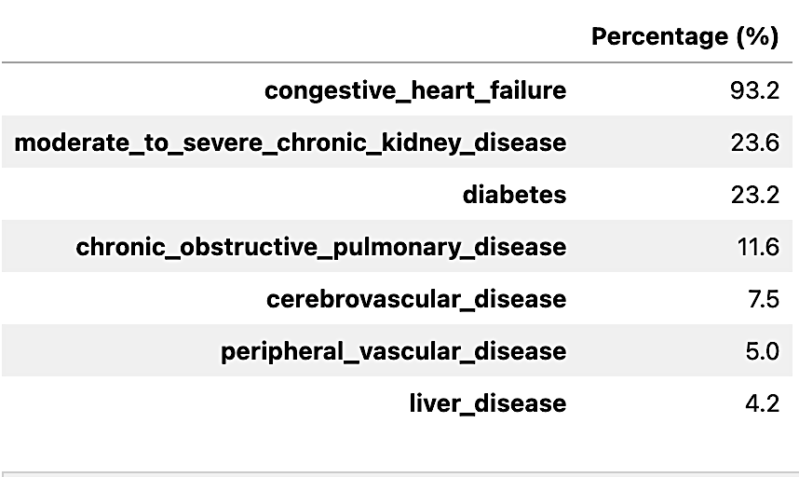
03 • DESCRIPTIVE ANALYSIS
04
Major Conditions & Comorbidities in Heart-Attack Patients
♥
KEY INSIGHT
Congestive heart failure is the dominant comorbidity among heart-attack patients (93.2%), followed distantly by chronic kidney disease (23.6%) and diabetes (23.2%).
CLINICAL CONTEXT
congestive heart failure is the overwhelmingly dominant comorbidity among heart-attack patients at 93.2%, with chronic kidney disease and diabetes also presenting in nearly a quarter of cases.

Slide 6
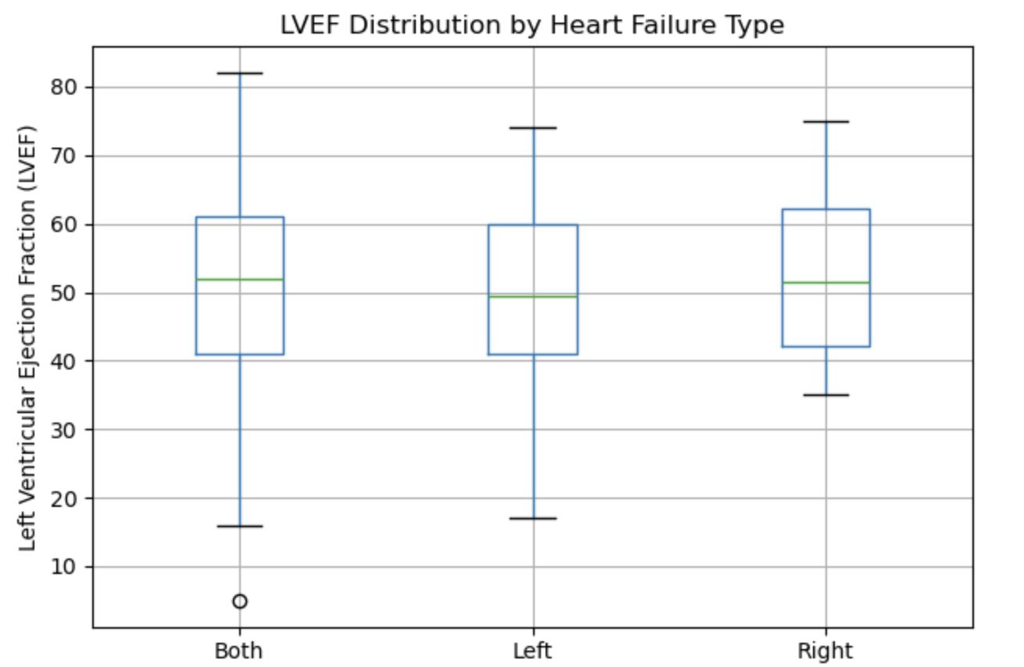
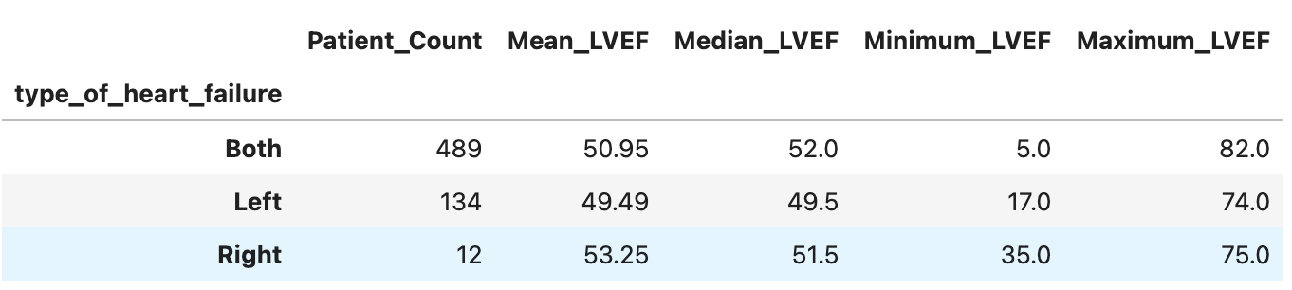
03 • DESCRIPTIVE ANALYSIS
05
Variation of LVEF
♥
KEY INSIGHT
Although average LVEF is consistent across groups, patients with both types of heart failure dominate the cohort and exhibit the most extreme variance in cardiac function, ranging from 5.0 to 82.0.
CLINICAL CONTEXT
Clinically, this represents a highly complex cohort of heart-attack survivors where a massive 93.2% prevalence of congestive heart failure—predominantly bilateral—drives extreme and unpredictable variations in left ventricular ejection fraction.

Slide 7
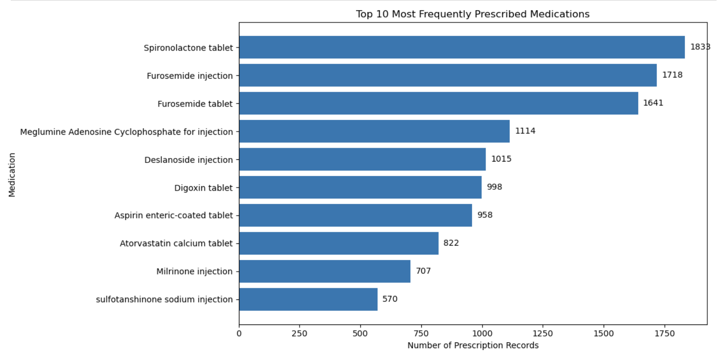
03 • DESCRIPTIVE ANALYSIS
06
Top 10 Frequently Prescribed Medicines
♥
KEY INSIGHT
The analysis identifies the medications most frequently recorded in the prescription dataset. The top medications can be
compared based on their prescription counts, allowing us to understand the medication utilization pattern among hospitalized heart-failure patients.
Place the final analytical chart here
CLINICAL CONTEXT
The list of medications in strongly suggests a clinical context focused heavily on managing cardiovascular conditions and heart failure.

Slide 8
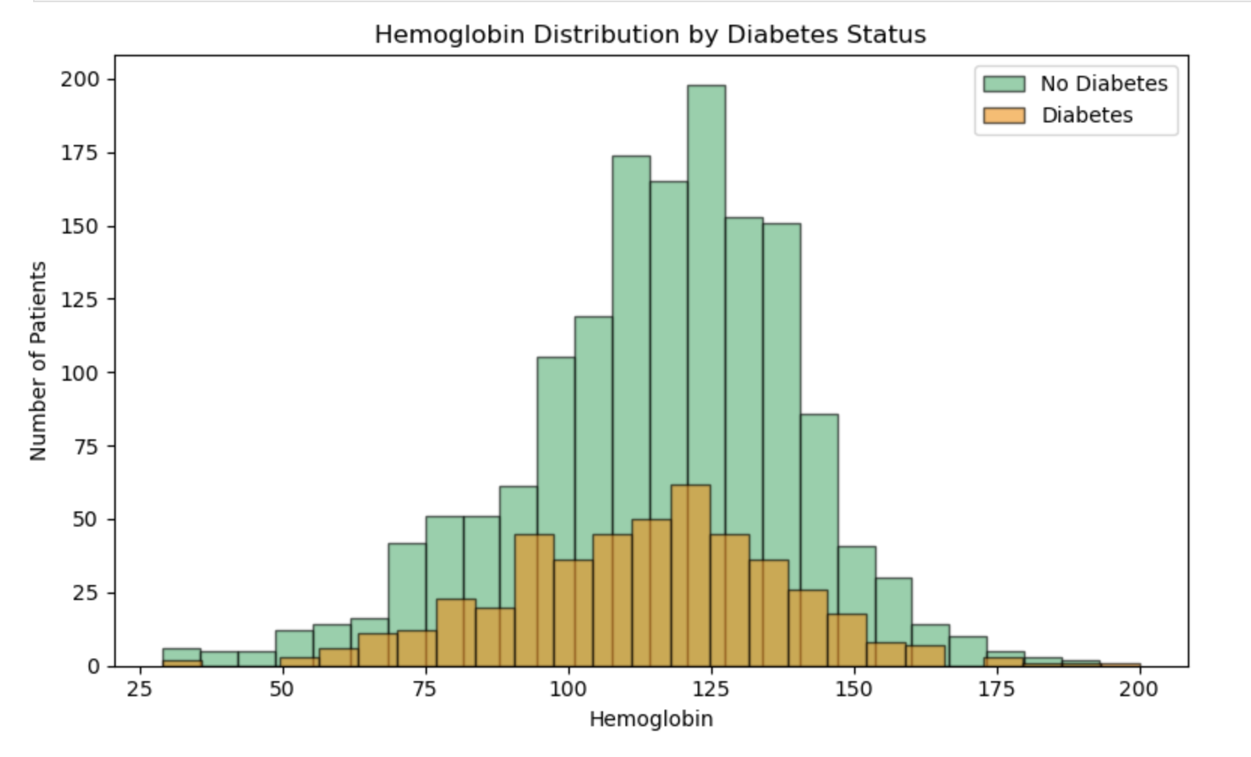
03 • DESCRIPTIVE ANALYSIS
07
Hemoglobin Distribution by Diabetes Status
♥
KEY INSIGHT
Hemoglobin levels follow nearly identical normal distributions for both groups, indicating that diabetes status does not meaningfully shift average hemoglobin values in this cohort.
CLINICAL CONTEXT
Clinically, because diabetes does not drive variations in hemoglobin for this cohort, providers should evaluate and manage potential anemia as an independent condition rather than assuming it is linked to diabetic complications.

Slide 9
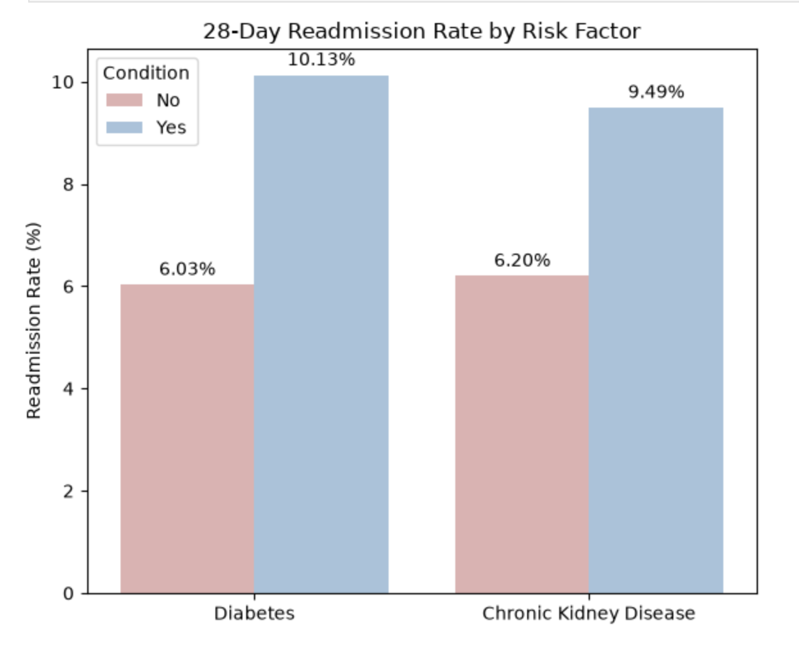
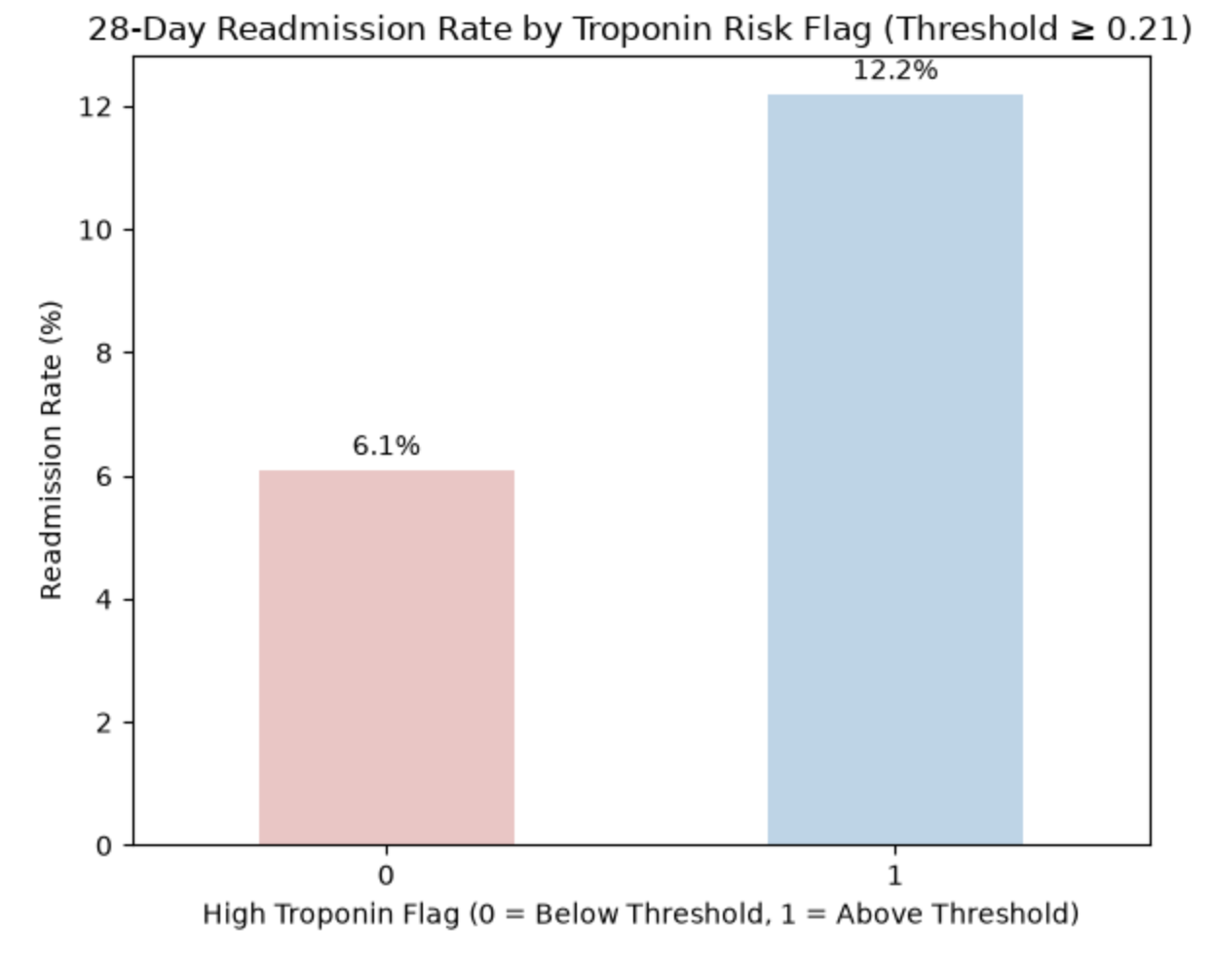
04 • PRESCRIPTIVE ANALYSIS
08
28-day Re-admission
♥
KEY INSIGHT
Patients with high-sensitivity troponin ≥ 0.21 at admission (279 of 2008 patients, ~14%) have a 12.2% 28-day readmission rate — roughly double the 6.1% rate for others. Recommend early follow-up for this high-troponin patients before it leads to readmission.
CLINICAL CONTEXT
The clinical context focuses on cardiovascular or acute coronary care, highlighting elevated troponin levels and comorbidities like diabetes and chronic kidney disease as major drivers for 28-day hospital readmissions.

Slide 10
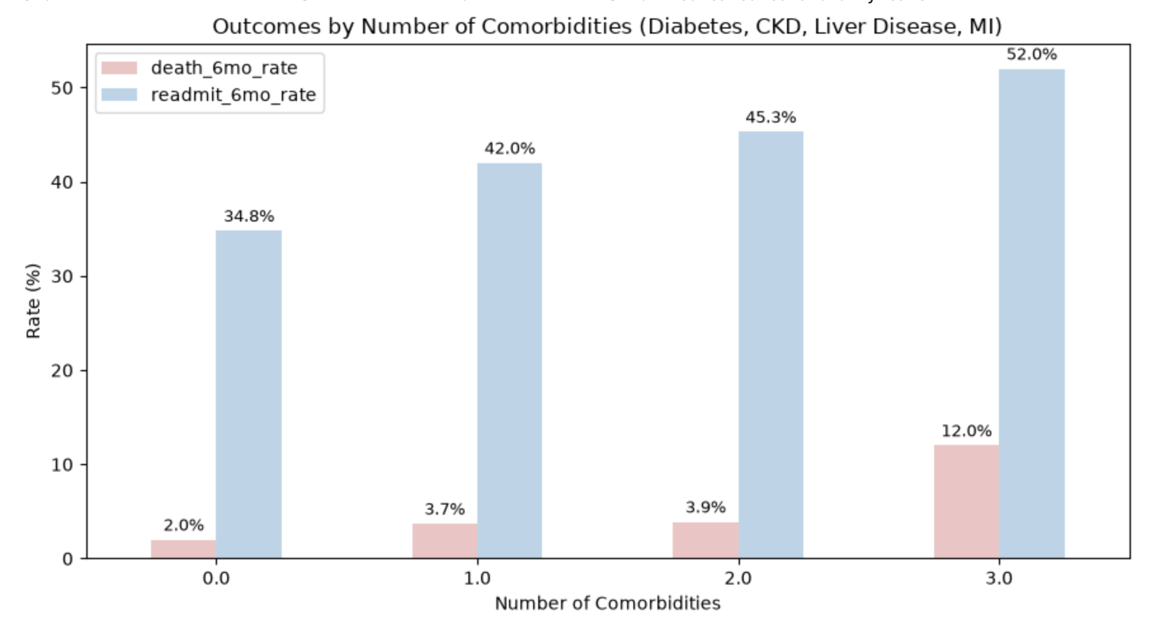
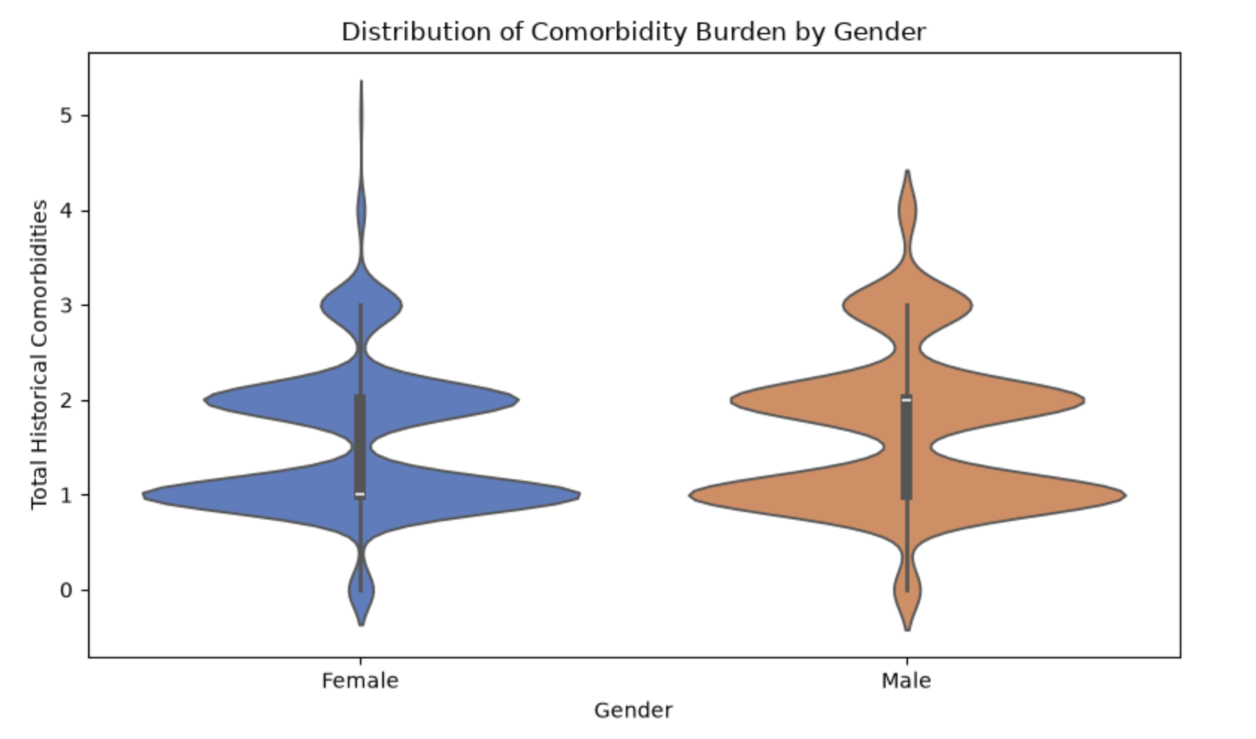
04 • PRESCRIPTIVE ANALYSIS
09
Comorbidities & Readmission Risk
♥
KEY INSIGHT
Higher comorbidity counts drastically increase 6-month readmission and mortality risks, peaking at 52.0% and 12.0% respectively for patients with three conditions. Meanwhile, the overall comorbidity burden is distributed similarly across both genders.
CLINICAL CONTEXT
The clinical context centers on evaluating how the accumulation of severe chronic conditions—such as diabetes, chronic kidney disease, liver disease, and myocardial infarction—impacts long-term hospital readmissions and patient mortality.

Slide 11
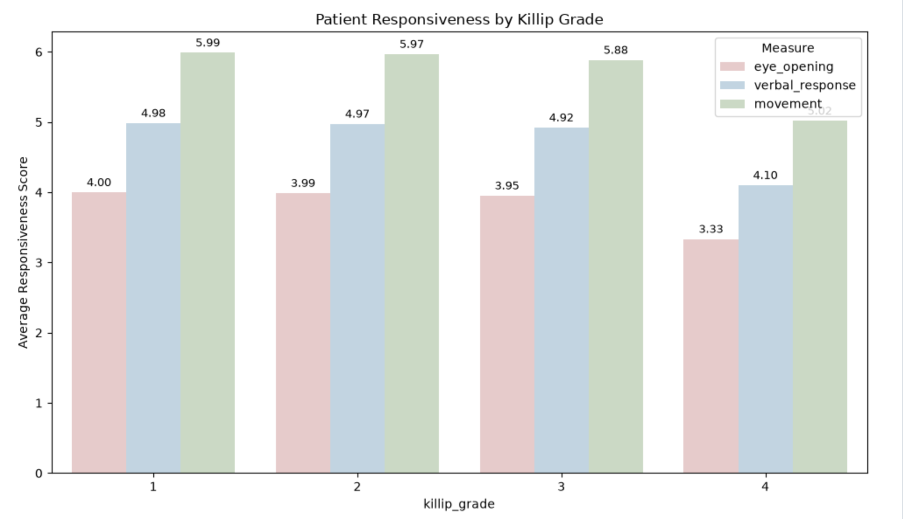
04 • PRESCRIPTIVE ANALYSIS
10
Does Heart Failure Severity Affect Responsiveness?
♥
KEY INSIGHT
Patient responsiveness stays nearly unchanged in Killip grades 1-3 but drops clearly in grade 4, the most severe stage
CLINICAL CONTEXT
Killip grade 4 indicates cardiogenic shock, where poor blood flow to the brain and body can reduce alertness and responsiveness, so lower scores in this group are clinically expected

Slide 12
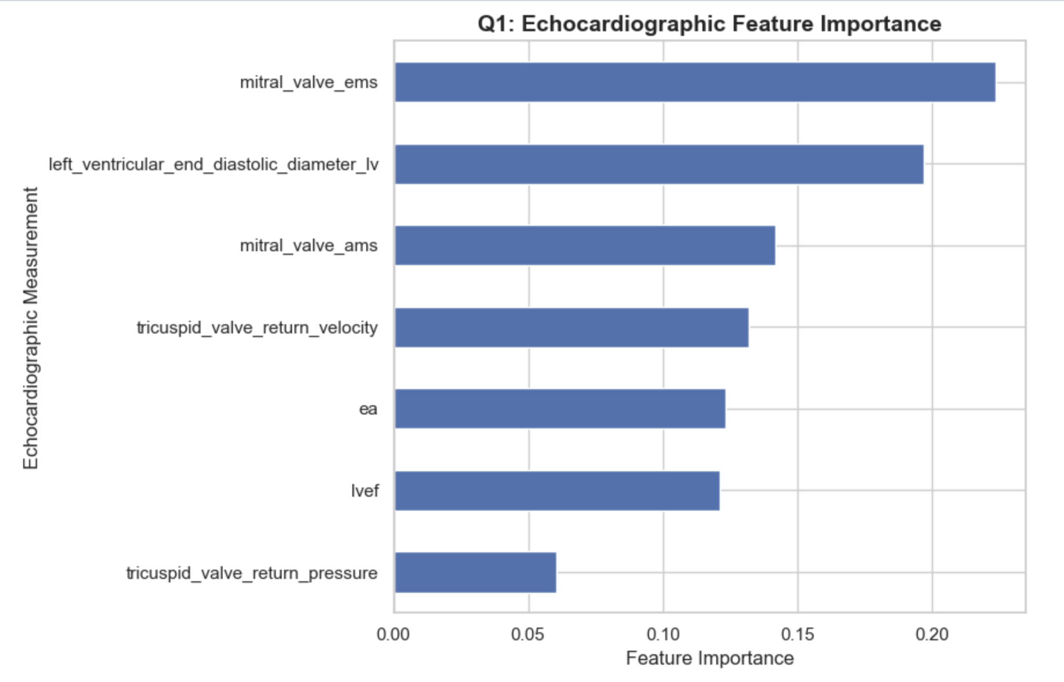
05 • PREDICTIVE ANALYSIS
11
Predictive Analysis : Top Key Echo Predictors of Heart Failure Type
♥
KEY INSIGHT
combined echo measurements can help distinguish heart failure types. Mitral valve EMS is the strongest predictor.
CLINICAL CONTEXT
Mitral valve and left ventricle measurements suggest a focus on valve function and heart size in heart failure. Echo is a routine, non-invasive heart scan, so identifying heart failure types from it could support faster, earlier diagnosis and treatment decisions.

Slide 13
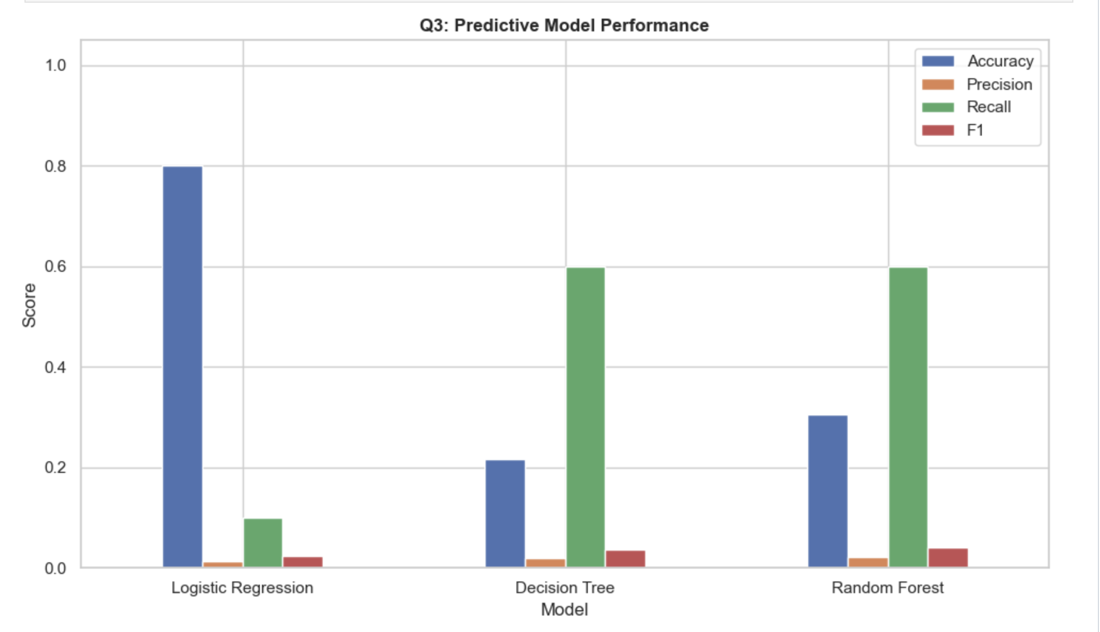
05 • PREDICTIVE ANALYSIS
12
Predicting Right-Sided Heart Failure from Tricuspid Measurements
♥
KEY INSIGHT
Tricuspid velocity and pressure rise together almost linearly, but right-sided cases are barely visible, so there is no clear separation
CLINICAL CONTEXT
Tricuspid velocity and pressure move together and reflect right-heart pressure load, but in this dataset they did not reliably identify right-sided heart failure.

Slide 14
06 • SUMMARY
13
Key Insights
Beyond heart failure (93.2%), chronic kidney disease (23.6%) and diabetes (23.2%) are the most frequent.
LVEF is similar across heart failure type, so failure type alone does not separate pumping function.
Diabetes (10.1% vs 6.0%), CKD (9.5% vs 6.2%) and high troponin (12.2% vs 6.1%) are each linked to higher readmission.
Mitral valve EMS and LV end-diastolic diameter rank highest, and tricuspid return velocity outweighs return pressure.
Spironolactone, furosemide injection and furosemide tablets are the top three, and the same drugs dominate across all heart failure types.
Patients with multiple comorbidities or elevated troponin should be prioritized for closer follow-up after discharge.

Slide 15
♥
THANK YOU
Heart Failure Retrospective Study Analysis
TEAM 10 • PYMASTERS
Siva Sundari Murugan • Guna Thangavel • Poornima Srinivasan • Vaishnavi Dinesh

