Slide 1
VAISHNAVI V
Final Project
3/21/2024 Annual Review

Slide 2
VEGETABLE CLASSIFICATION USING CNN
3/21/2024 Annual Review

Slide 3


AGENDA
Data collection: Gather diverse labeled vegetable images.
Model design: Select CNN architecture, design model layers.
Training: Train model on labeled data, optimize hyperparameters.
Evaluation: Assess model performance on validation and testing datasets.
Deployment: Deploy model in production environment, integrate into existing systems.
Monitoring: Implement monitoring mechanisms, provide ongoing maintenance and support.
3/21/2024 Annual Review

Slide 4

PROBLEM STATEMENT
Develop a CNN model to accurately classify various types of vegetables from images. The model should be trained on a dataset of labeled vegetable images and evaluated based on metrics such as accuracy, precision, and recall. The goal is to create a robust system capable of automating vegetable classification tasks in agricultural, food processing, and nutritional applications.
3/21/2024 Annual Review

Slide 5

PROJECT OVERVIEW
This project focuses on building convolutional neural network (CNN) model for vegetable classification, using a dataset comprising labeled vegetable images. The objective is to train the model to accurately classify various types of vegetables from input images. The ultimate aim is to deploy the trained model in practical applications such as agricultural automation and food processing, streamlining vegetable classification processes and enhancing overall efficiency in relevant industries.
3/21/2024 Annual Review

Slide 6

WHO ARE THE END USERS?
End users of the vegetable classification system include farmers for efficient sorting, food processors for streamlined production, nutritionists for dietary analysis, and consumers for convenient vegetable identification and meal planning.
3/21/2024 Annual Review

Slide 7

YOUR SOLUTION AND ITS VALUE PROPOSITION
The solution is a CNN-based vegetable classification system that automates sorting processes for farmers, streamlines production for food processors, aids dietary analysis for nutritionists, and provides convenient vegetable identification for consumers. Its value proposition lies in improving efficieny and decision – making across agricultural, food processing, and nutritional domains
3/21/2024 Annual Review

Slide 8

THE WOW IN YOUR SOLUTION
With its advanced CNN technology, the system revolutionizes sorting for farmers, production for food processors, dietary analysis for nutritionists, and vegetable identification for consumers. Its precision, automation, and convenience redefine efficiency in vegetable-related tasks, marking a significant leap forward in optimizing workflows and decision-making processes.
3/21/2024 Annual Review
8

Slide 9
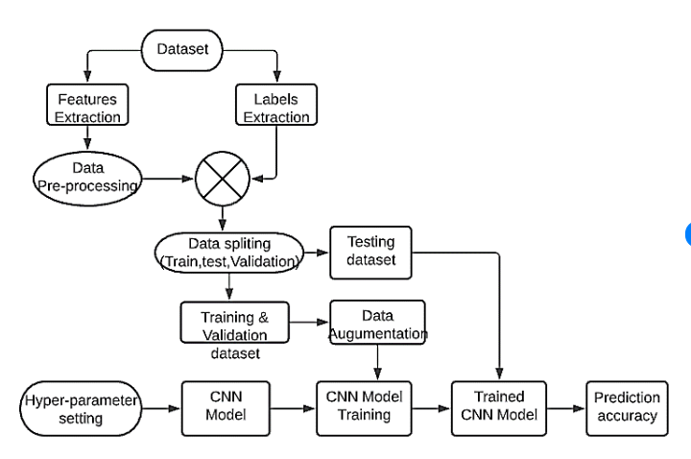
MODELLING
3/21/2024 Annual Review
9

Slide 10
RESULTS
Implementation of the vegetable classification system results in streamlined vegetable sorting, reduced errors, time-saving automation, improved decision-making for nutritionists and consumers, cost-efficiency in agricultural and food processing operations, scalable deployment across various scales, and heightened customer satisfaction with accurate vegetable identification.
Demo Link
3/21/2024 Annual Review
10

