Slide 1


Operation Analytics & Investigating Metric spike
PROJECT_3
Author : Vaishnavi Patel

Slide 2
PROJECT_DESCRIPTION
My task was to provide insights and prepare a report for Operation analytics and Investigating metric. I analyzed the available data and identified key metrics and indicators. I then provided a detailed report with actionable recommendations and insights to drive operational improvements.
The questions which were asked to provide the insight from data analyst are listed :
Number of jobs reviewed
Weekly or daily throughput
percentage share of language
duplicated data
User engagement
User growth
Weekly retention (Cohort Analysis)
Weekly engagement
Email Engagement

Slide 3




Approach and Tech-Stack Used
The first step for a data analyst is to identify the format of the data and determine whether it is in raw form or not.
The next step is to identify any blank, duplicate, or null data and address these issues.
It is recommended to prepare the data in a tabular format to better understand and analyze different events and attributes.
Different database query tools and other analytical tools can be used to obtain answers to specific questions.
Visual graphs can be created to retrieve insights and present findings in a clear and concise manner.
Finally, a report can be prepared summarizing the findings and recommendations for improving data quality and decision-making.

Slide 4
OPERATION_1 JOB_DATA
Number of jobs reviewed
Throughput
Percentage share of each language
Duplicate rows
Calculate the number of jobs reviewed per hour per day for November 2020
Calculate 7-day rolling average of throughput. Do you prefer daily metric or 7-day rolling and why?
Calculate the percentage share of each language in the last 30 days.
How will you display duplicates from the table?
1.
2.
3.
4.

Slide 5
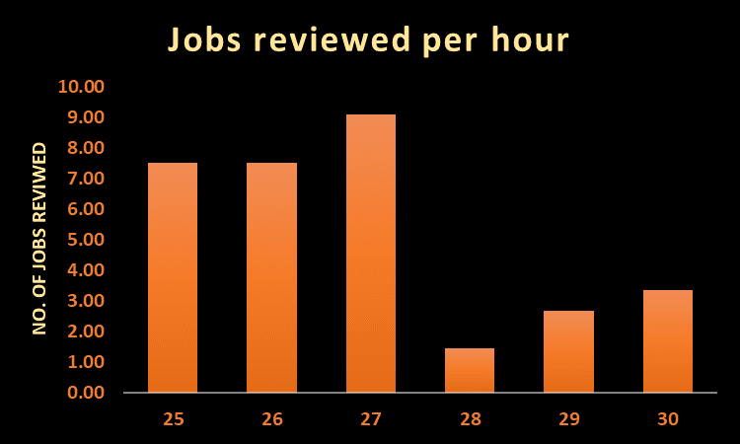

Number of Jobs reviewed per hour per day for 30 days
0.0083
The number of jobs reviewed per hour is maximum on 27-11-2020 and the overall jobs reviewed per hour per day is 0.0083.

Slide 6
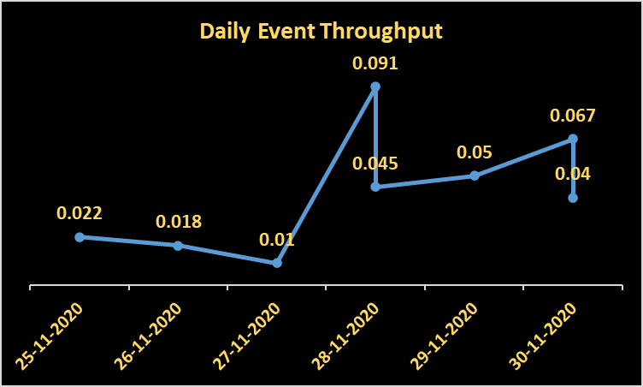
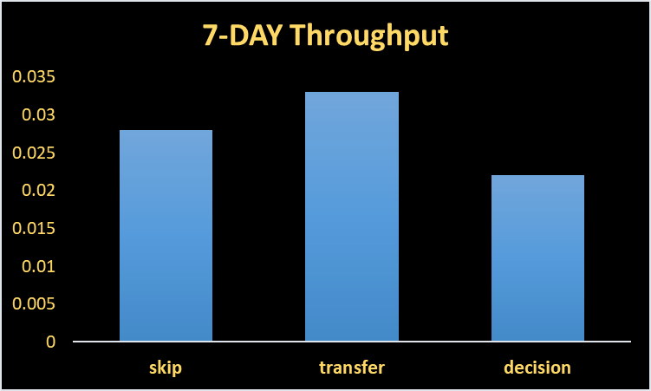
Do you prefer daily metric or 7-day rolling and why??
1st graph shows daily event throughput : It generally shows the metrics for monitoring and identifying daily trends and pattern.
2nd graph shows weekly (7-day rolling average) throughput : This metric helps identifying longer term trends and smooth out daily fluctuation.
Both are useful. But which should be prefer depends upon the context and specific use.
On 28-11-2020: spike was 0.091 which is highest and the lowest spike was 0.01 reported on 27-11-2020.
It shows major daily fluctuation., but for which event we can not say from this.
On the other hand, maximum spike for event transfer was reported which is between 0.03 to 0.035.
I will prefer daily metric which gives very useful information and used to control events, managing throughput for better actions.

Slide 7
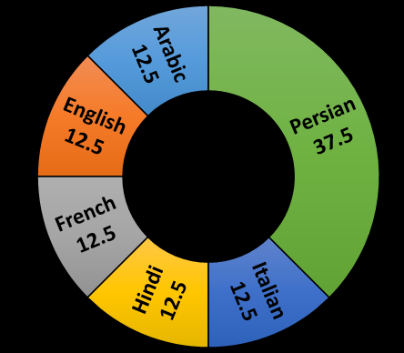
Percentage share of each language :
Share of each language for different contents are shown in percentage.
The percentage share of Persian language is maximum which is 37.5 %
Display duplicates:
There are No duplicates rows in table. But, job_id, actor_id, events have some common attributes.

Slide 8
User engagement
User growth
Weekly retention
Weekly engagement
Calculate the weekly user engagement
Calculate the user growth for product?
Calculate the weekly retention of users-sign up cohort
Calculate the weekly engagement per device
Email Engagement
Calculate the email engagement metrics
OPERATION_2 Investigating Metric spike
1.
2.
3.
4.
5.

Slide 9
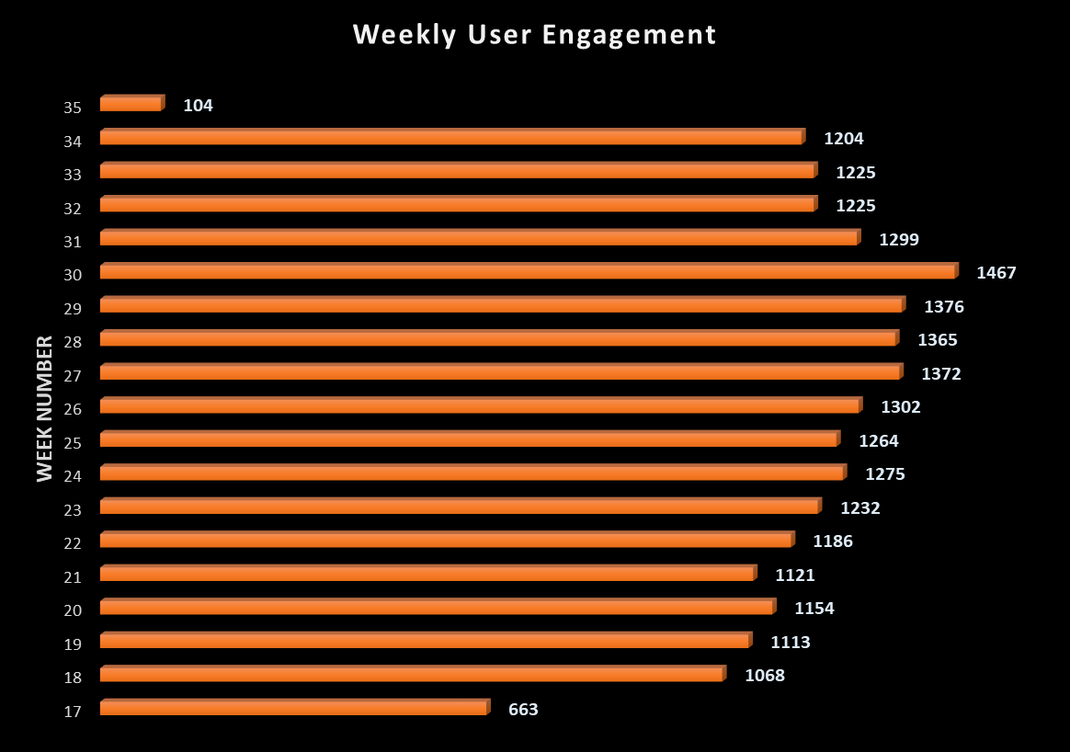

Activeness of a user in week:
Measuring if the user finds quality in a product
Weekly user engagement is maximum for 30th week and overall engagement is in growing nature indicates users find quality in products/service , except for the week 17th and 31st.

Slide 10
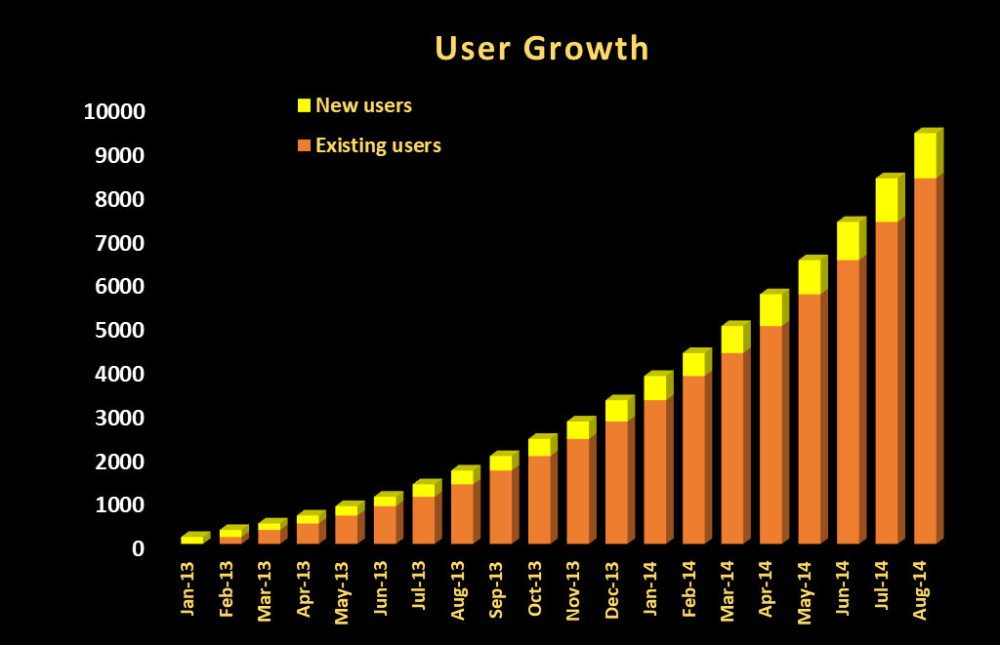
User Growth: (MOM)
Average MOM growth
2013 – 30.5%
2014 – 14.0%

Slide 11
Weekly retention:
Users getting retained weekly after signing-up for a product
Weekly retention for a sign-up cohort can provide insights about how successful a product is :
Users who have sign-up are indicated as signup-week and retention rate by weekly as week 0 to 18.
Users who have sign-up are indicated as signup-week and retention rate by weekly as week 0 to 18.
It is seen that, the retention rate is good in initial weeks after sign up but as week increases retention rate decreases.
Users who have sign-up are indicated as signup-week and retention rate by weekly as week 0 to 18.
It is seen that, the retention rate is good in initial weeks after sign up but as week increases retention rate decreases.
This behaviour should be considered and steps should be taken to improve the retention rate.

Slide 12
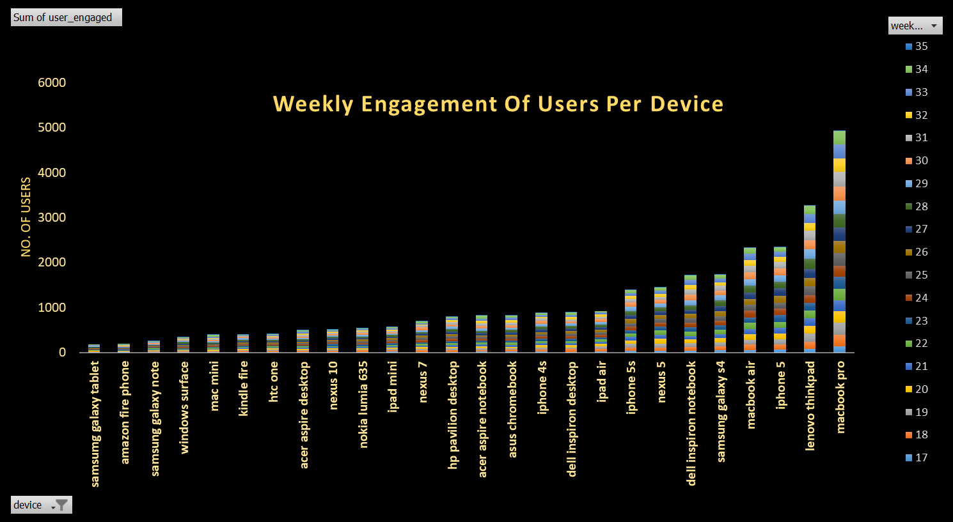
Weekly Engagement:
Maximum in
Macbook_pro

Slide 13
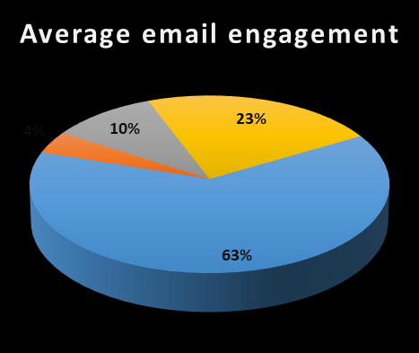
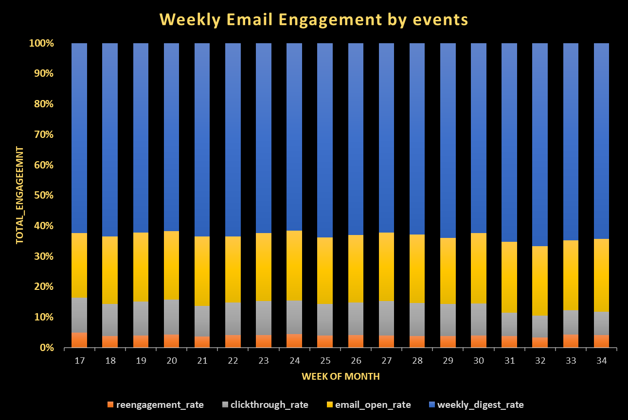
Weekly Email Engagement (in %)
The weekly email engagement by different events are seen as column 100% charts and contribution of each event in email engagement as PI chart.
Maximum weekly engagement :
63% from weekly digest rate.

Slide 14
Result
Through this project I gained basic and advanced level knowledge of business , operation analysis and how companies finds areas on which work must improve upon through data analytics.
Investigating metric spike helps firm to take required steps on growing products and sale.
I learned basic to advanced level SQL language to work on database.
Using Ms EXCEL and SQL gives proper visualization and insights on work given.
Below are the links for SQL query : (Google drive link, .text files)
https://github.com/Vaishnavi179/SQL-QUERY-.git

