Slide 1
E-retail factors for customer activation and retention: A case study from Indian e-commerce customers
Rajesh Kakumanu
1843

Slide 2
PROBLEM STATEMENT :-
Customer satisfaction has emerged as one of the most important factors that guarantee the
success of online store; it has been posited as a key stimulant of purchase, repurchase intentions
and customer loyalty.
A comprehensive review of the literature, theories and models have been
carried out to propose the models for customer activation and customer retention.
Five major factors that contributed to the success of an e-commerce store have been
identified as: service quality, system quality, information quality, trust and net benefit.
The research furthermore investigated the factors that influence the online customers
repeat purchase intention. The combination of both utilitarian value and hedonistic
values are needed to affect the repeat purchase intention (loyalty) positively.
The data is collected from the Indian online shoppers. Results indicate the e-retail success
factors, which are very much critical for customer satisfaction.

Slide 3
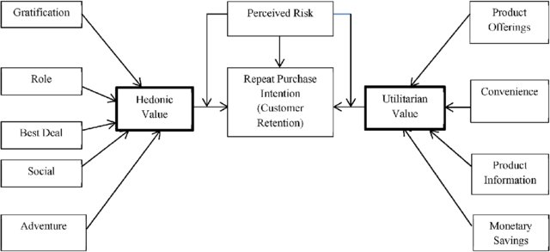
UNDERSTANDING THE CRITERIA

Slide 4
We have Imported the libraries like
-import pandas as pd
-import numpy as np
-import matplotlib.pyplot as plt
-import seaborn as sns
-import warnings warnings.filterwarnings('ignore’)
-!pip install openpyxl
STEPS MADE
READING THE DATA
SET THE MAX ROWS AND MAX COLUMNS
MADE THE HEAD OF THE DATA

Slide 5
EXPLORATORY DATA ANALYTICS
Cheked the shape of the data
Checked all the data types
Checked the Null count for each Column
Cheked the uniquiness of the data
Implemneting Univariate Analysis
Checking the Personal Information
Intention of the Repeat purchase
Getting online Retailing Process

Slide 6
9.Checking the Brand Image
10.Checked the Loyalty
11.Processed the dataframe
12.Encoding the Categorial Features
13.DoneScaling Process
14.Used Chi2 test
15.Used Feature importance of a RandomForest
16.PCA Analysis

Slide 7
17. Modelling Phase
18. RandomForest Analysis
19. Hyperparameter Tuning
20. Xgboost
21. Finalizing the Best model
22. Saving the Model
23. Conclusion

Slide 8
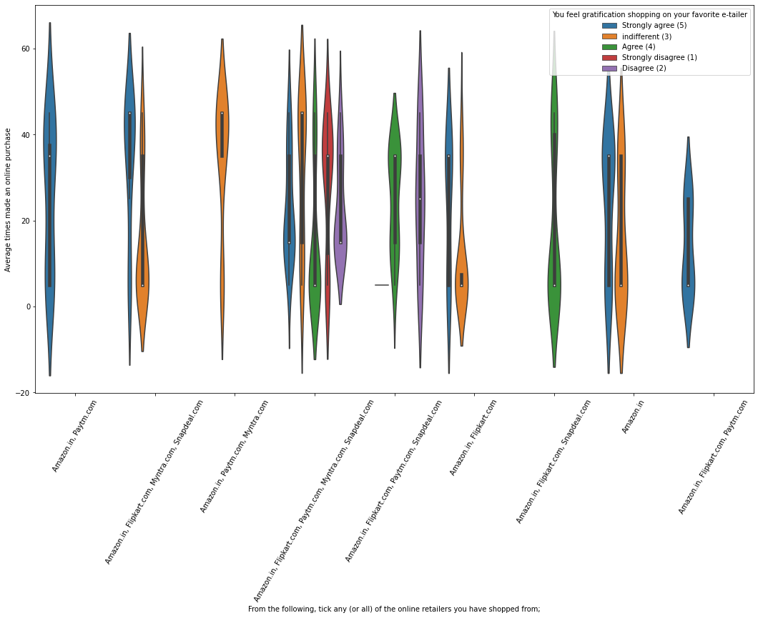
In Intention of the Repeat purchase
Most of the shoppers who shop more than 41 times a year shop from all the online brands, some of the people who shop for 32-40 and less than 10 times a year seem to exclude myntra. People shop from flipkart and Amazon whatever be the case.
From the graph analysis,All the people who have shopped from amazon,paytm, flipkart are satisfied. People who shop from a more number of online brands dosnot get satisfied.

Slide 9
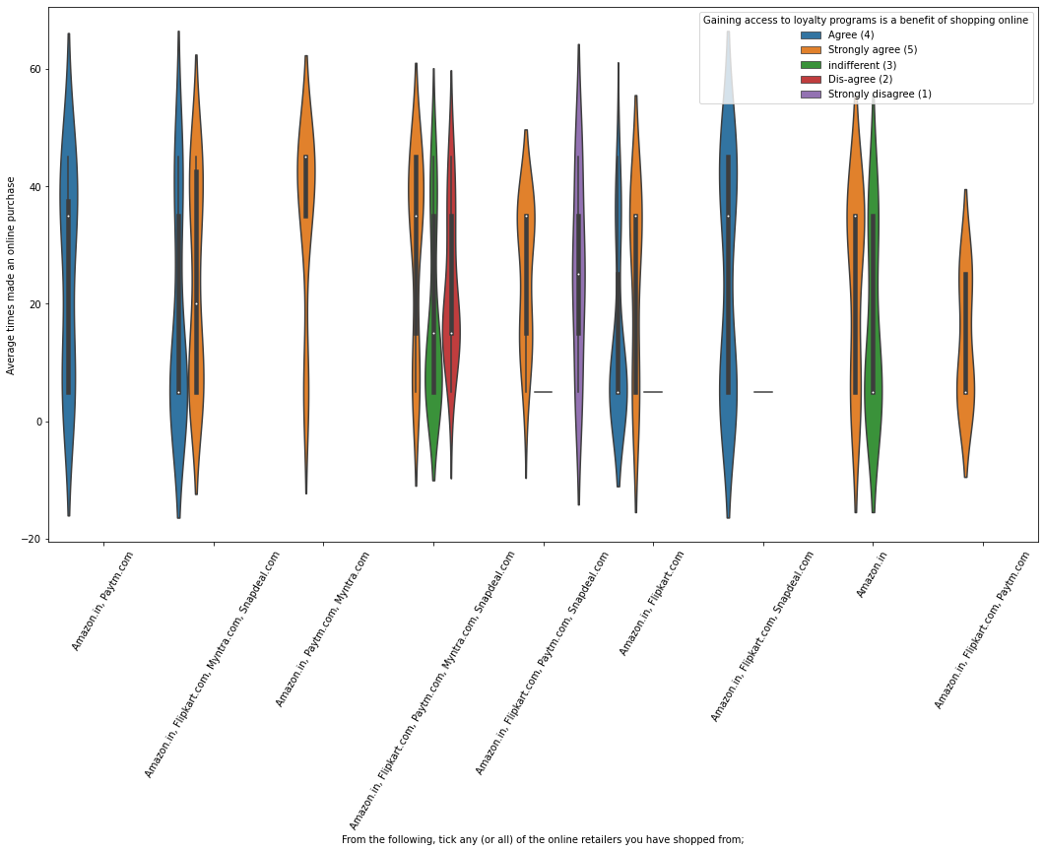
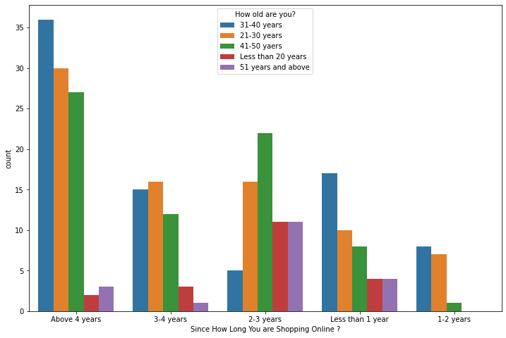
From the Grapgh analysis, people shopping from flipkart and sanpdeal seems to give such benefits but people who shop from almost everywhere disagree with this statement too. Moreover, People of Amazon and paytm are getting benefits from the loyalty points
Getting Online Retailing Analysis
More and Highest number of people have been shopping online for above 4 years except for the age group below 20 years and above 50 years.People who are shopping online for 1-2 years does not include teenagers and elder people

Slide 10
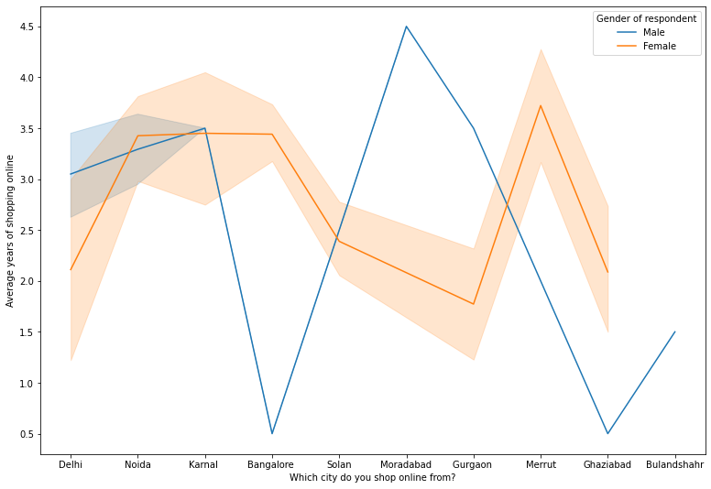
Converting Years to numbers for better analysis
In the above given data lines,one can say that, the density of female customers is more than male. Highest number of men shopping online belong from delhi and noida, whereas, men from moradabad have been shopping online for the longest. Men living in banglore and ghaziabad shop have shopped online for less than 1 year. Women from meerut and noida have shopped the longest

Slide 11
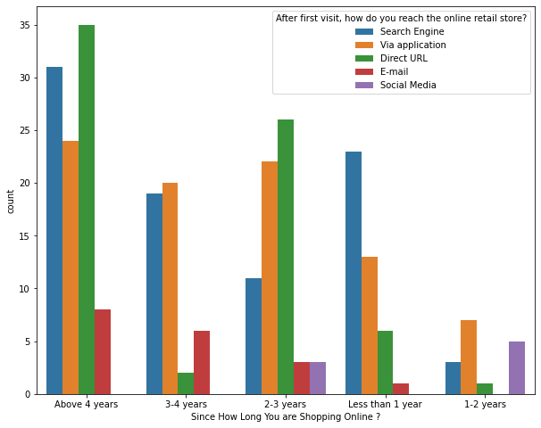
Moreover, people who are shopping online for more than 3 years donot use the application rather use search engine and direct url's in large number which indicates that online brands should update all their platforms rather than just application.

Slide 12
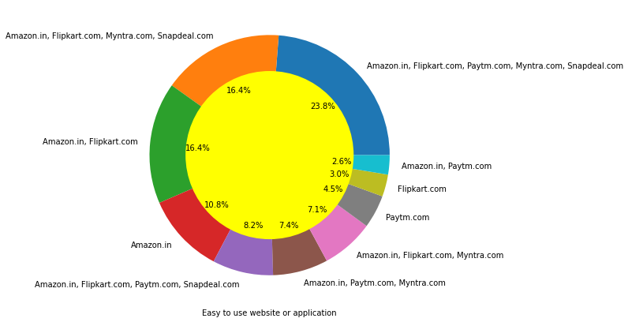
Checking for Brand image
PERFORMANCE
'Easy to use website or application’,
'Visual appealing web-page layout’,
'Wild variety of product on offer’,
'Complete, relevant description information of products’,
'Fast loading website speed of website and application’,
'Reliability of the website or application’,
'Quickness to complete purchase’,
'Availability of several payment options’,
'Speedy order delivery', 'Privacy of customers’ information’,
'Security of customer financial information’,
'Perceived Trustworthiness’,
'Presence of online assistance through multi-channel'
Flipkart,Amazon have been the highest votes for having all the positive points and have maintained a very good brand image followed by paytm and the myntra.

Slide 13
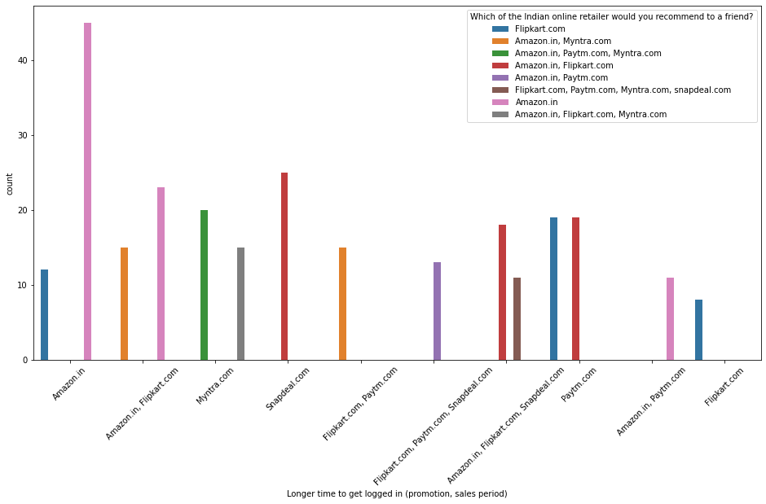
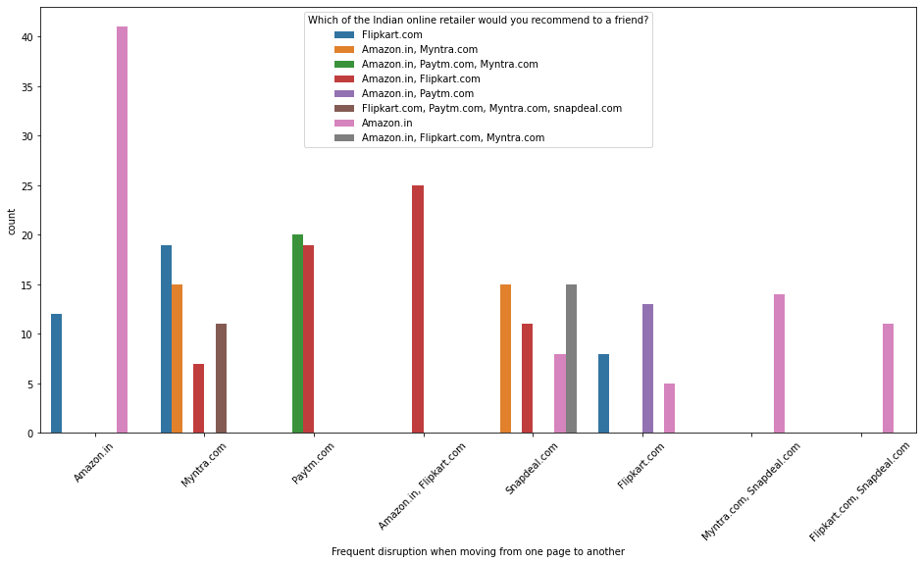
Checking Loyalty
The people who are Loyal customers keep using the same brand even if it is not good as other brands
*Customers seem to be more loyal to amazon, flipkart and paytm as even though many of them have given negative remarks about them still they would recommend these platforms to their friend

Slide 14
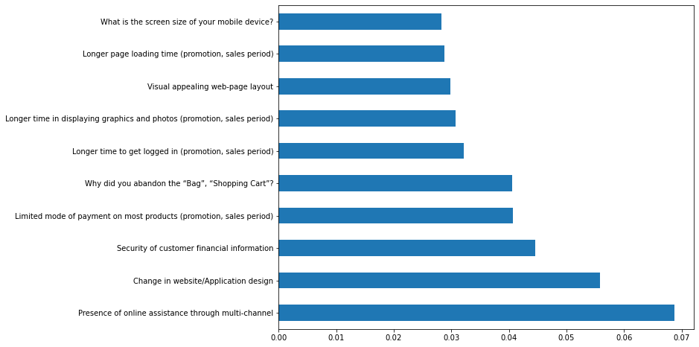
PROCESSING THE DATAFRAME
Encoding Categorical Features
Doing Scaling Process
Using chi2 test
USING FEATURE IMPORTANCE OF RANDOM FORREST

Slide 15
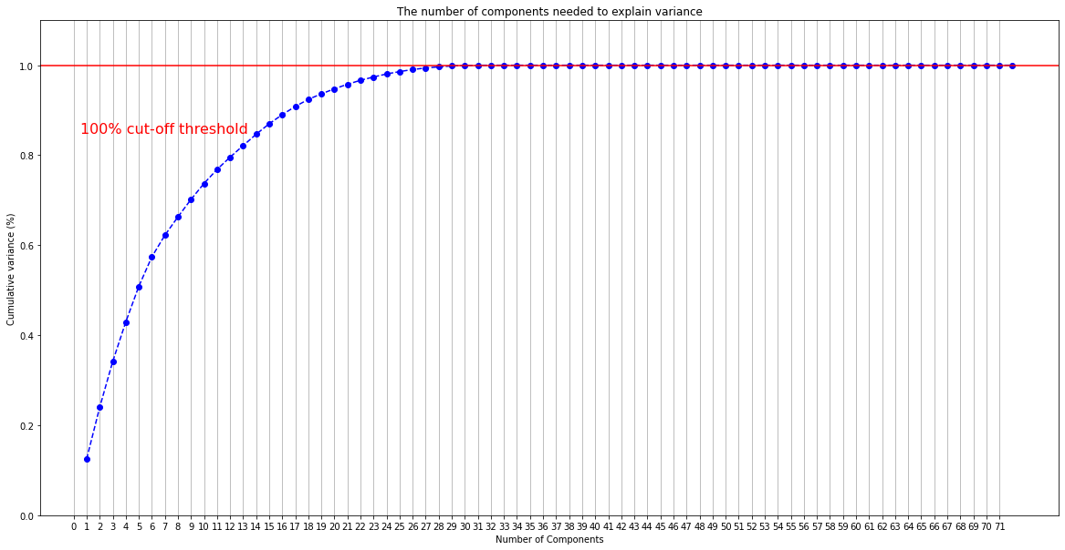
Conducted PCA Anaysis
The grapgh shows number of components are increased from 0.1 to 1.0 and growing constantl

Slide 16
Modelling Phase
The Accuracy what we have got is 1.0
and the Mean of Cross Validation Score 0.9889, which is good in condition.
Random Forest Analysis
Hyperparameter Tuning
Herwe the Accuracy is 1.0 and the Mean of Cross Validation Score 0.9889, which is same for both the analysis
Finally the model has Saved
Finalizing the best Model

Slide 17
Conclusion
*All the websites were not equally preferred by online customers.
*Amazon was the most preferred followed by Flipkart.
*These two companies are most trusted in the industry and
hence, have a huge reliability.
*Also, the sellers listed on these websites are generally from
Tier 1 cities as compared to Snapdeal and PayTM which
have more sellers from tier 2 and 3 cities.

Slide 18
*The cost of the product, the reliability of the E-commerce company and the return policies play an equally important role in deciding the buying behaviour of online customers.
*The cost is an important factor as it was the basic criteria used by online retailers to
attract customers.
*The reliability of the E-commerce company is also important, as it is even required in offline retail.
*It is important because customers are paying online, so they need to be sure of security of the online transaction.
* The return policies are important because in online retail customer does not get to feel the product.Thus, he wants to be sure that it will be possible to return the product if he does not like it in real.
*Whereas, the logistics factor, which included Cash on delivery option,
One day delivery and the quality of packaging plays a secondary role in this process
though these are Must-be-quality. *

Slide 19
*This is so because these does not interfere with the real product and people believe that this is the basic value that E-commerce websites provide.
*Also, these websites have the most lenient return policies as compared to others and also the time required to process a return is low.
----------------------------END--------------------------

