Slide 1

Customer Relationship and Product Management System
By
Vaithealingham A

Slide 2
Features
1. Customer Management
Add a Customer
View Customers
Delete/Deactivate a Customer.
2. Product Management:
Add a Product
View Products
Delete/Deactivate a Product
3. Sales Management:
Add a Sale
View Sales
Delete/Deactivate a Sale
4. Analytics:
Sales Report
Top Customers
Top Products

Slide 3
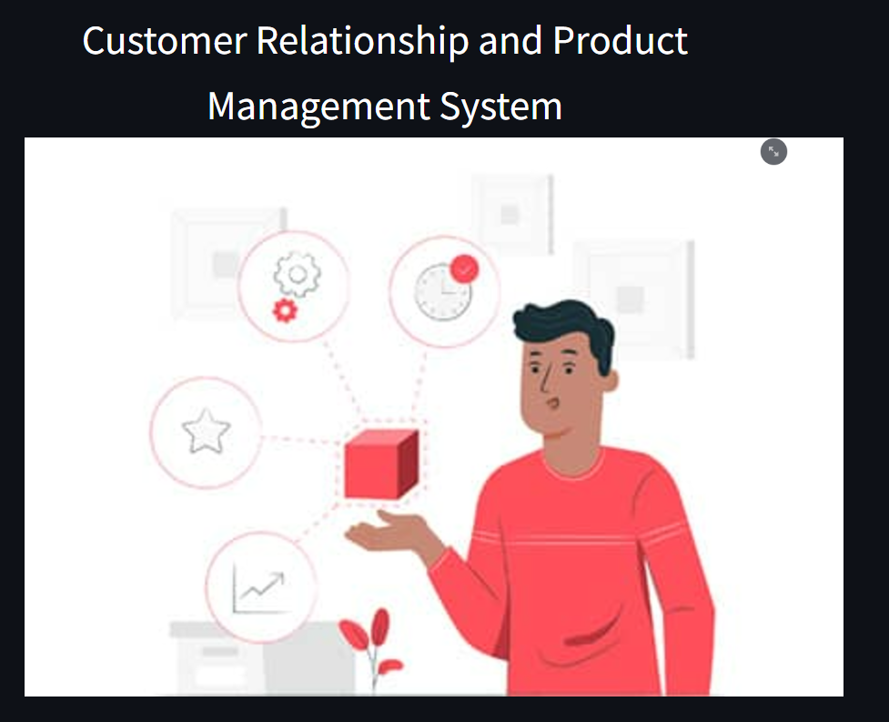
Home Page:

Slide 4
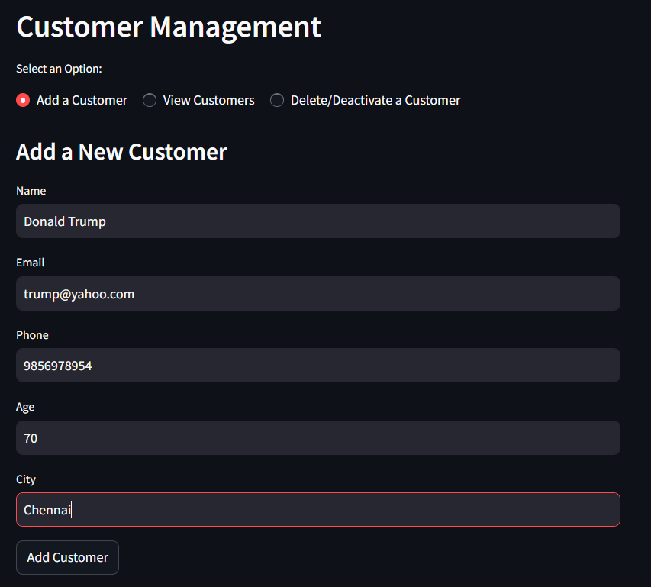
Customer Management
Add a customer Page:

Slide 5
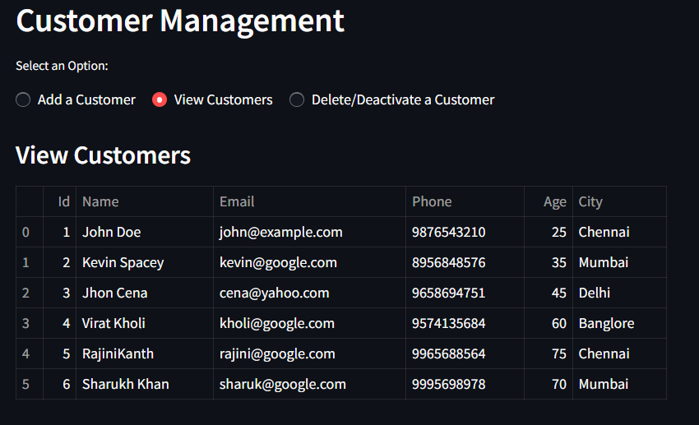
Customer Management
View Customers Page:

Slide 6
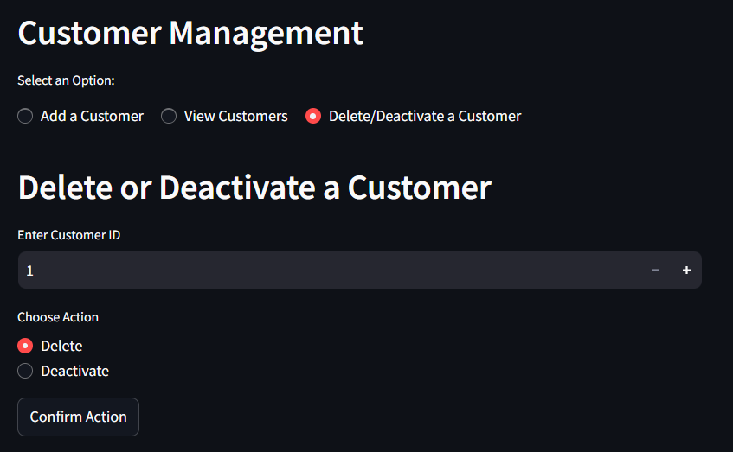
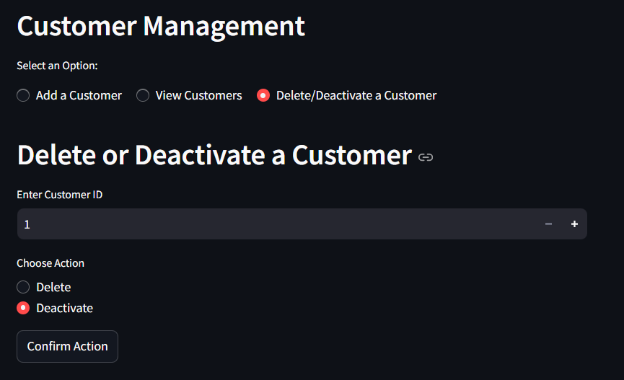
Customer Management
Delete/Deactivate a Customer page:

Slide 7
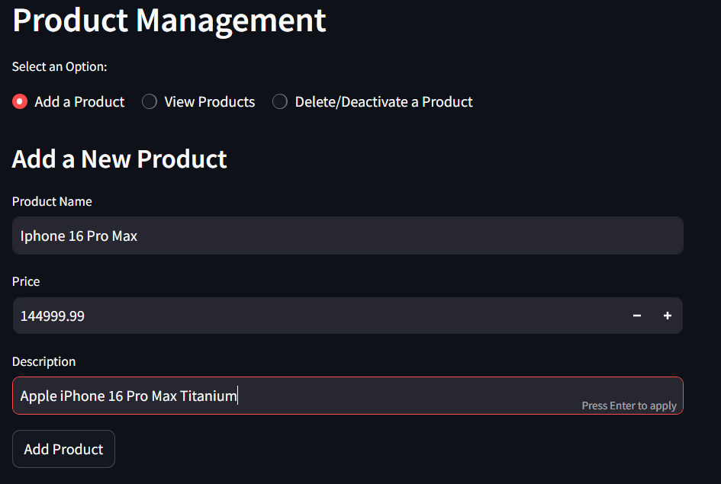
Product Management
Add a Product Page:

Slide 8
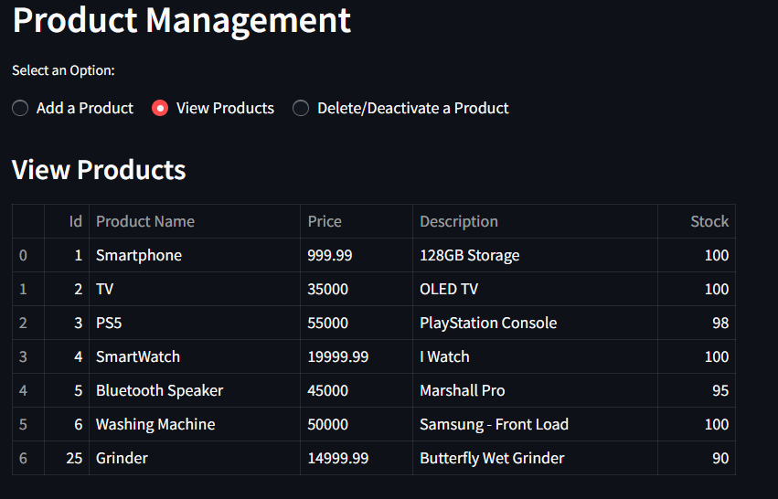
Product Management
View Products Page:

Slide 9
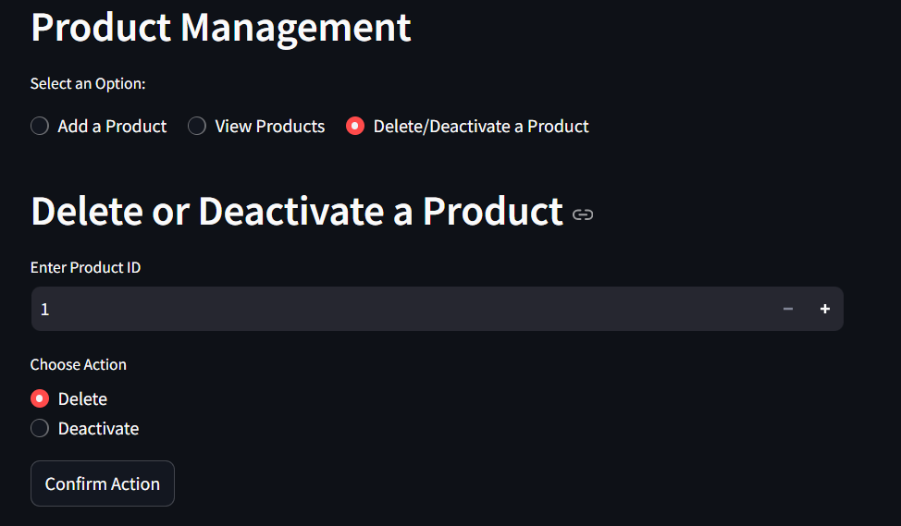
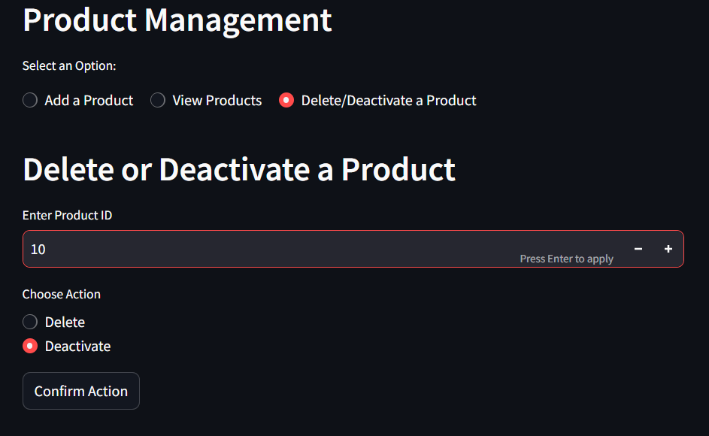
Product Management
Delete/Deactivate a Product Page:

Slide 10
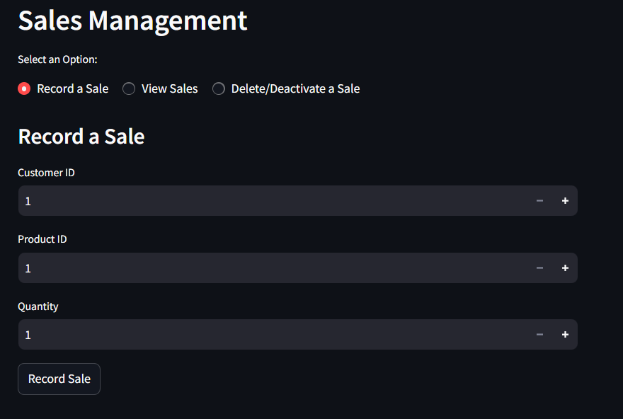
Sales Management
Add a Sale Page:

Slide 11
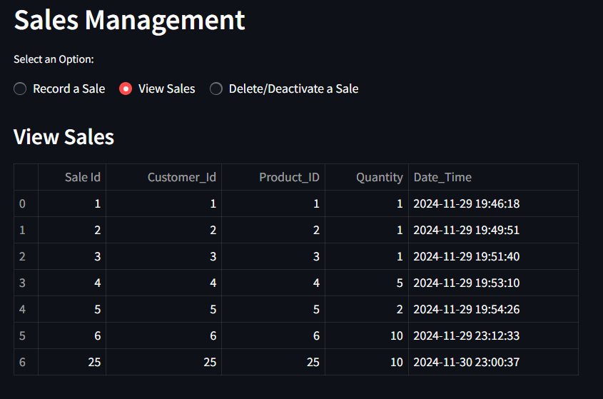
Sales Management
View Sales Page:

Slide 12
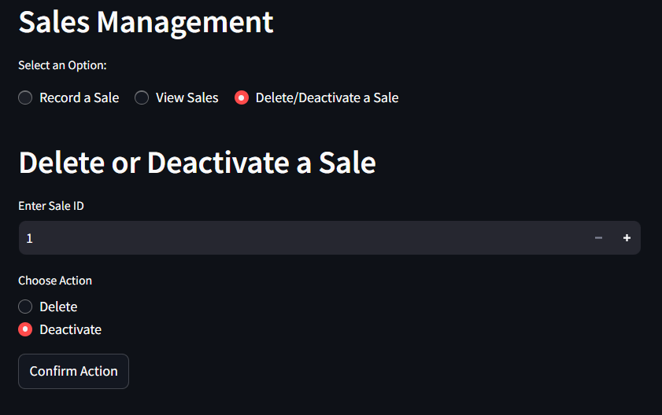
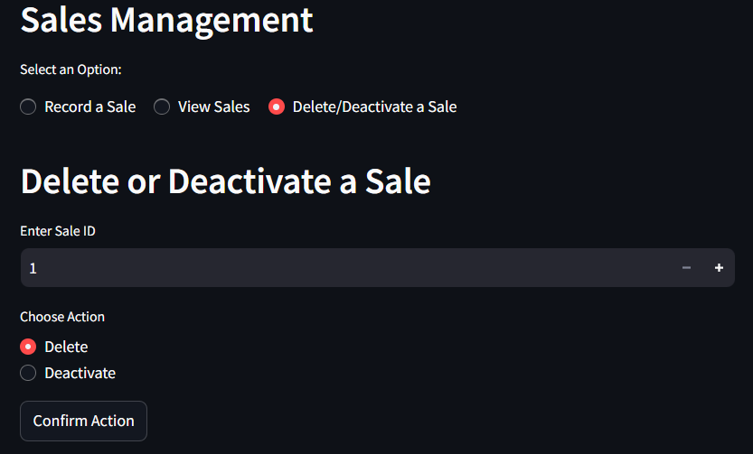
Sales Management
Delete/Deactivate a Sale Page:

Slide 13
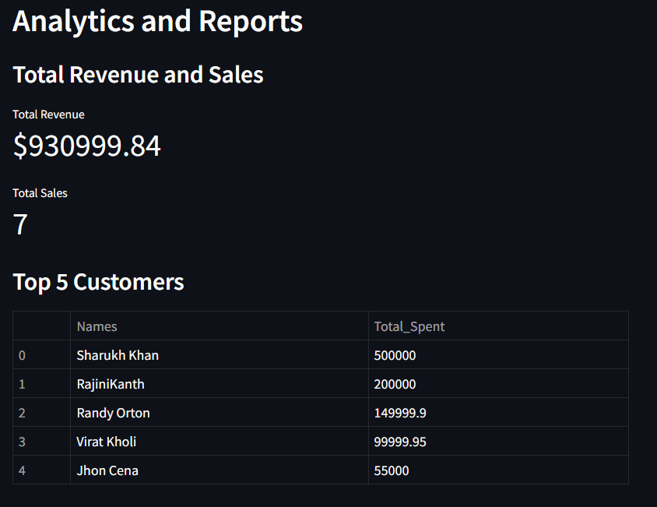
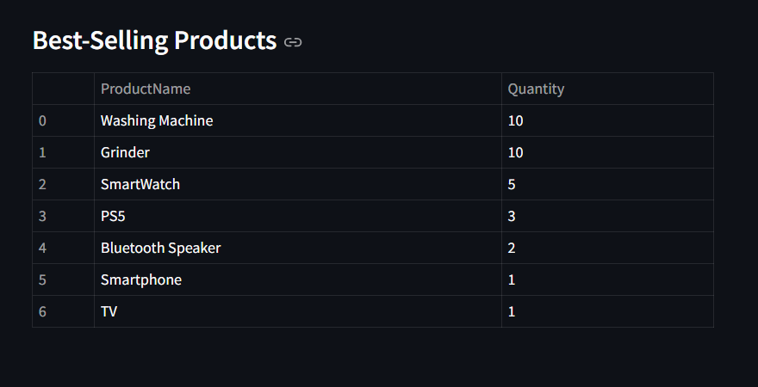
Analytics and Reports
View Sales Page:

Slide 14

The END

Slide 15
The END

