Slide 1

CAPSTONE – 1
REDBUS DATA SCARPING WITH SELENIUM & DYNAMIC FILTERING USING STREAMLIT
VAITHEALINGHAM A

Slide 2
Objective of the project:
The aim of the project is to scrape the data from RedBus website for
10 states using selenium and build a streamlit application
using the scraped data.
Data Scraping:
The data scraped from RedBus website includes: bus routes, schedules,
prices, and seat availability.
Data Storing:
Store the scraped data in a SQL database.
Streamlit application:
Develop a Streamlit application to display and filter the scraped data.

Slide 3
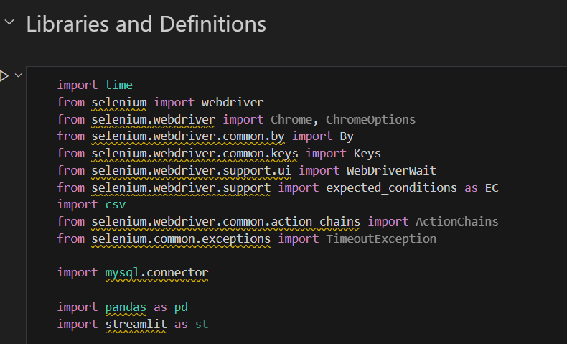
Libraries used:

Slide 4
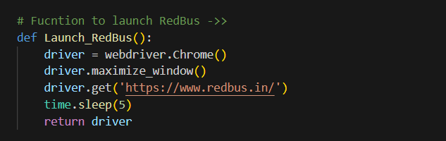
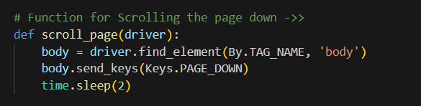
Functions:
Function to launch RedBus app in chrome:
Function to scroll the page down:

Slide 5
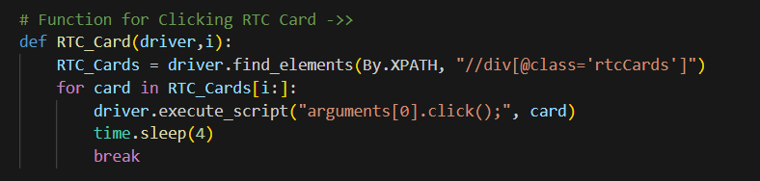
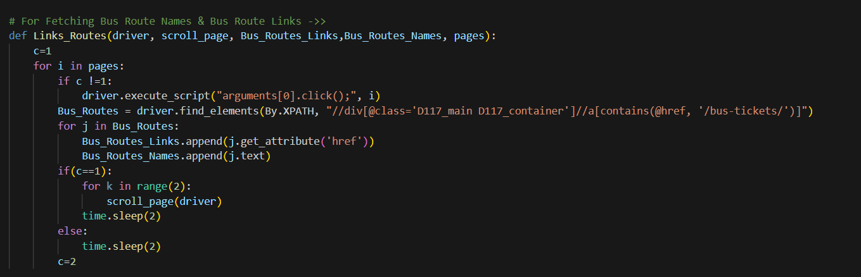
Function for clicking the RTC card in RedBus app:
Function to fetch Bus route Links & Names:

Slide 6
Steps that I followed for fetching and storing bus details for each state are as follows:
Declaring empty lists for storing the bus details
Launching the RedBus application
Scrolling the page down for RTC cards section
Clicking the RTC card for the state
Fetching all the page numbers and storing it as pages
Fetching the bus route links and bus route link names
Iterating through each bus route link and fetching the required
bus details and appending it to the lists
Creating a CSV file for the state
Writing the bus details stored in the lists to the CSV file
These are the steps which I followed for fetching the details for
10 different states.

Slide 7
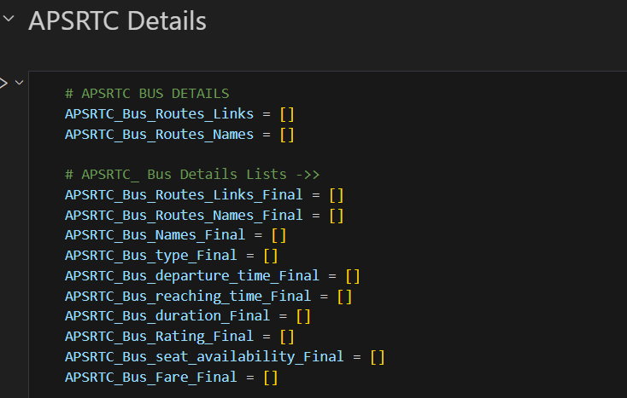
Lists for storing APSRTC bus details:

Slide 8
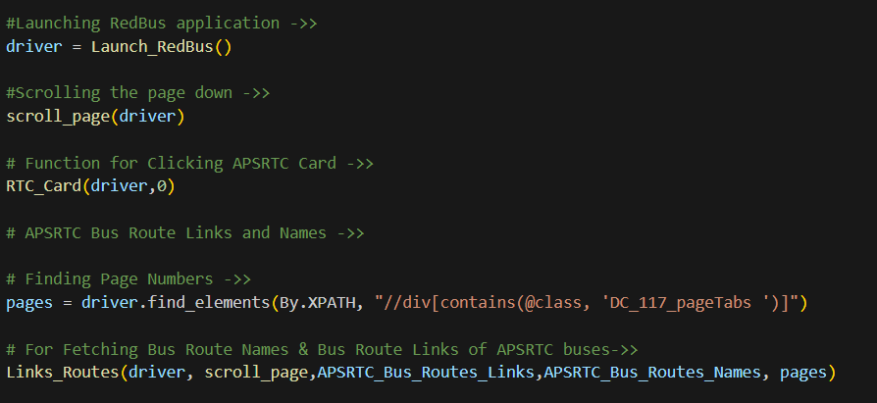
Launching the RedBus application, scrolling the page down and clicking the RTC card for APSRTC, fetching the page numbers and Fetching the bus route links and names

Slide 9
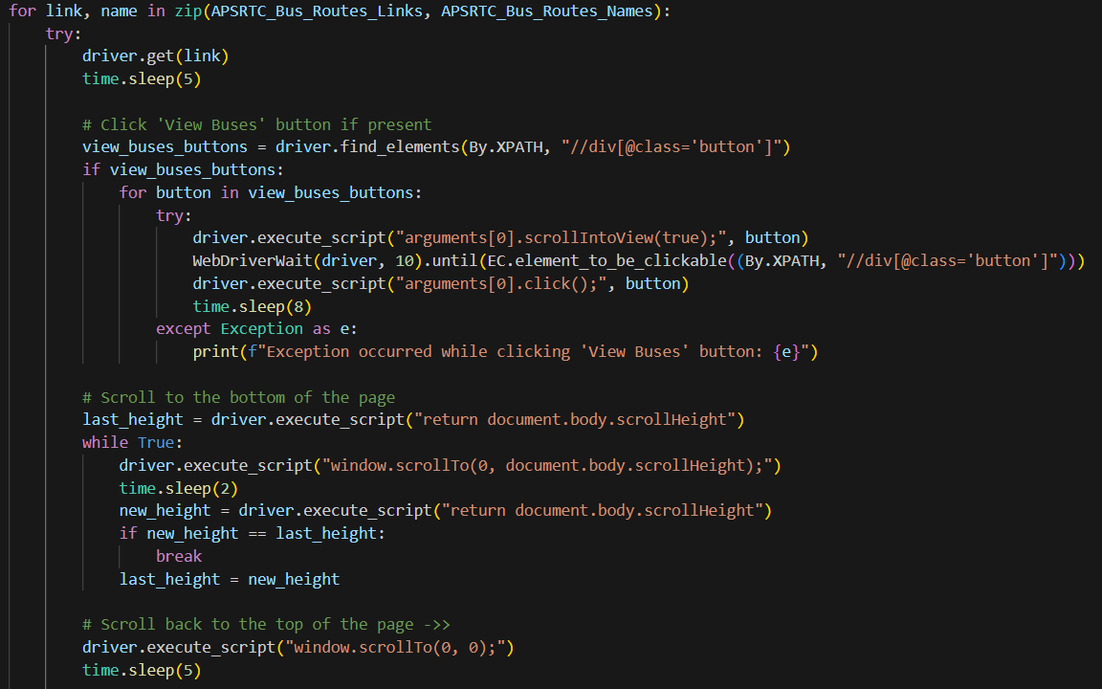
Iterating through each link, clicking the view buses button if present, scrolling the page to the very bottom and scrolling back to top

Slide 10
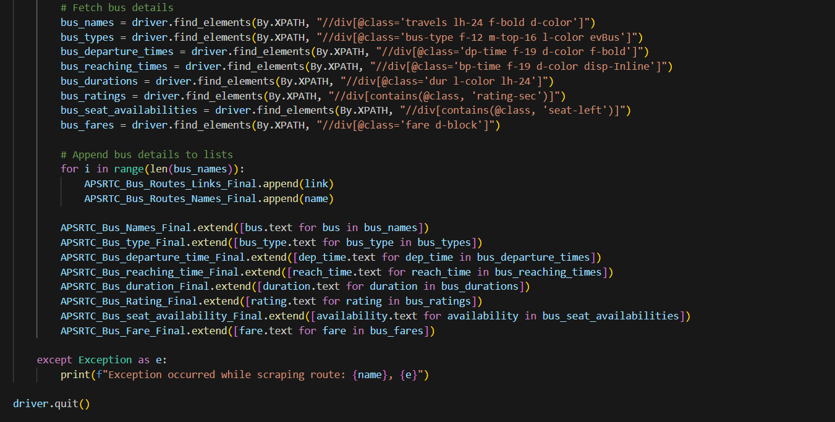
Fetching the bus details and appending them to the lists

Slide 11
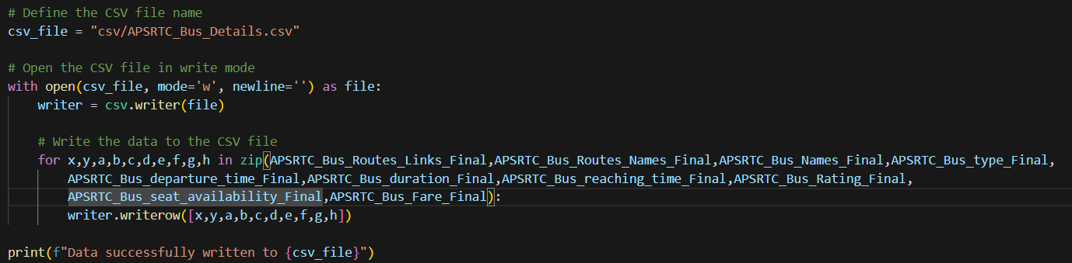
Creating a new CSV file in the name of the state which we scraped the details for and write the details
stores in the lists to the CSV file

Slide 12
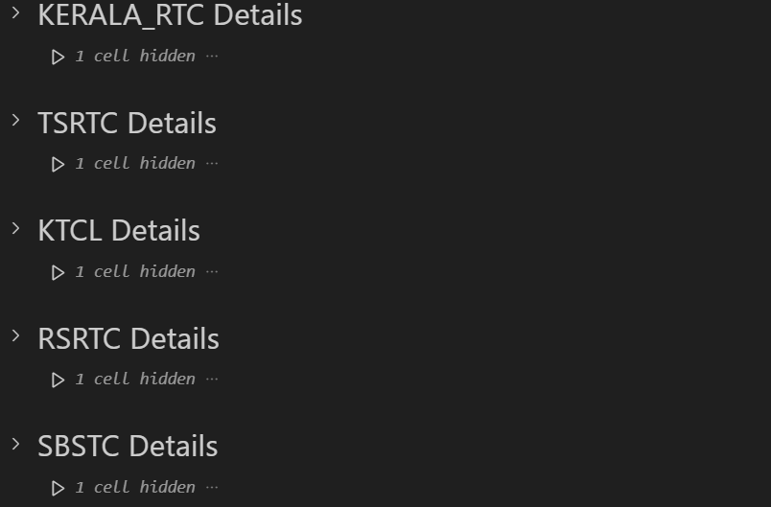
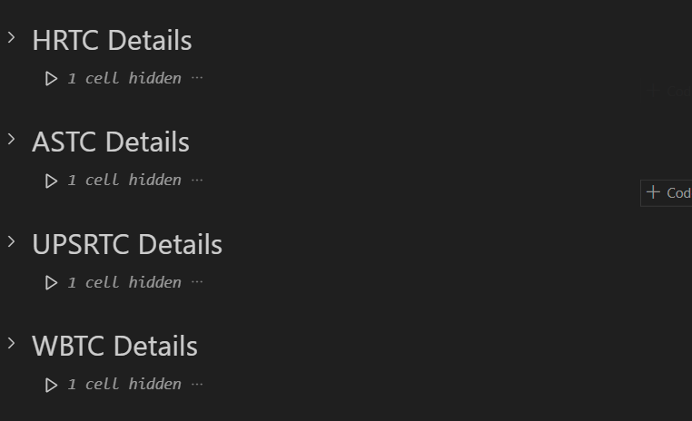
Follow the same steps and fetch the bus details for 10 different states

Slide 13
Steps that I followed after fetching the bus details for 10 states:
After fetching the bus details for 10 states, we will be left with 10 csv files,
one for each state.
I have read the csv files one by one as a dataframe and appended them
all together to form a single dataframe.
Then I have converted the final dataframe to one CSV file.

Slide 14
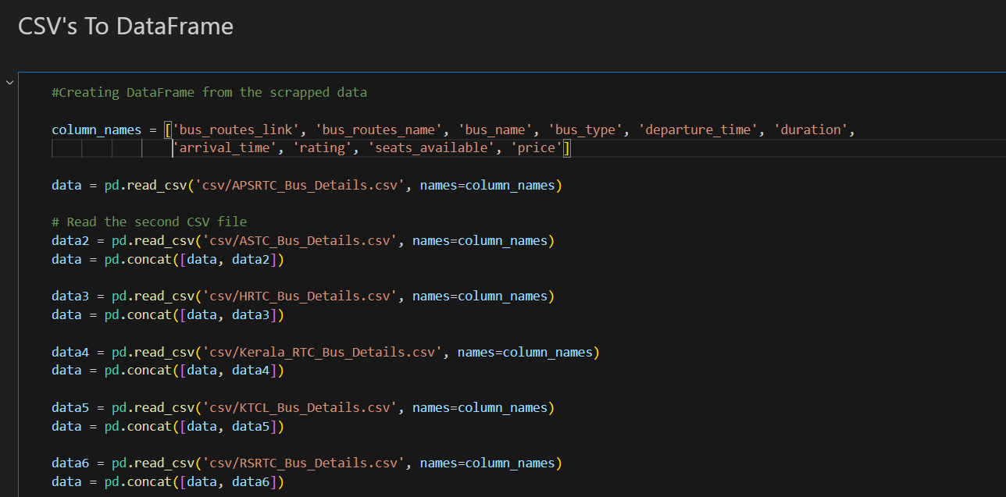
Reading the csv files one by one as a dataframe and appending them all together

Slide 15
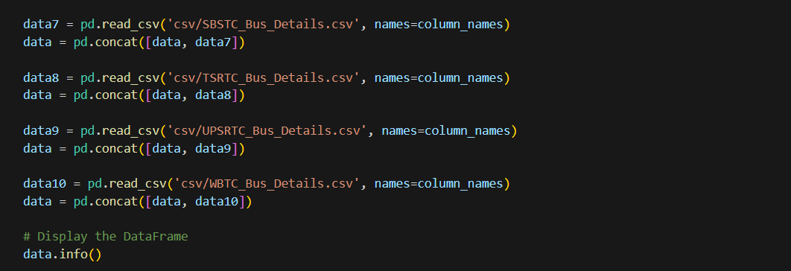
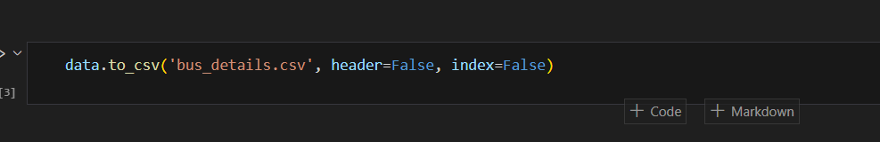
Read all the 10 CSVs and appended them all together as a single dataframe.
Converted the final dataframe to a CSV file named as ‘bus_details.csv’

Slide 16
Steps that I followed to insert the bus details to database are as follows:
Create a connection to the data base using host_id, database name,
user_id and password.
Create a table with appropriate column names.
Iterate through the rows of the final dataframe and store the details
to the table in the database.
Close the connection.

Slide 17
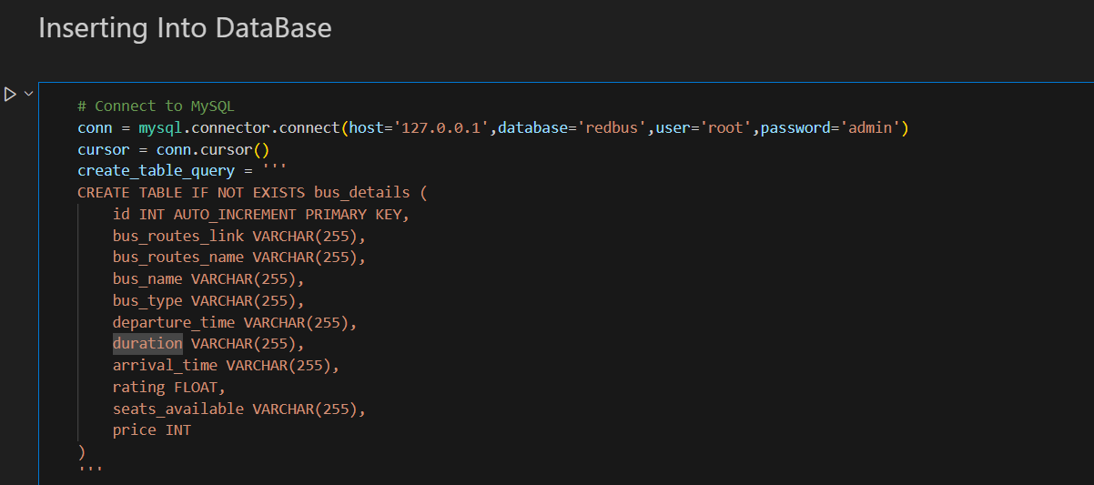
Create a connection to the database and create a table with appropriate columns

Slide 18
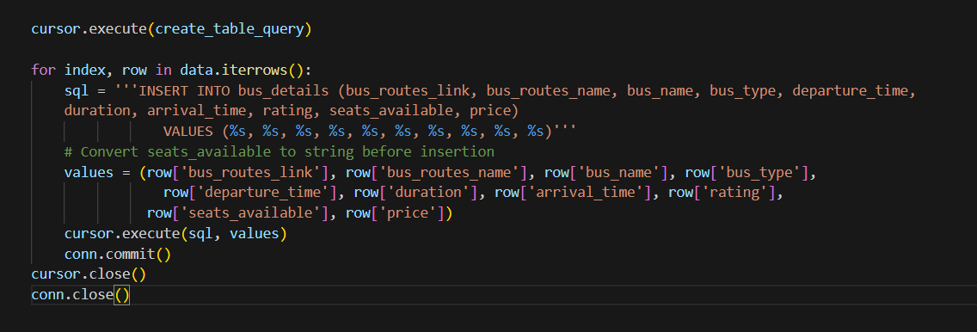
Iterate through the rows of the final dataframe and store the details to the table in the database.
Close the connection after storing the details in the database.

Slide 19
Steps that I followed for creating a streamlit application from my data are as follows:
Creating a file path for reading the CSV file.
Reading the ‘bus_details.csv’ file as a dataframe.
Created functions for rating range, departure time range and
price range.
Created two different options: ‘Home’ and ‘Select the bus’ buttons
on the home screen.
Created dropdowns for ratings, route, departure time, price range,
seat type and A/C type.
Filtering and displaying the data from the dataframe with respect to the
options selected from the dropdowns.

Slide 20
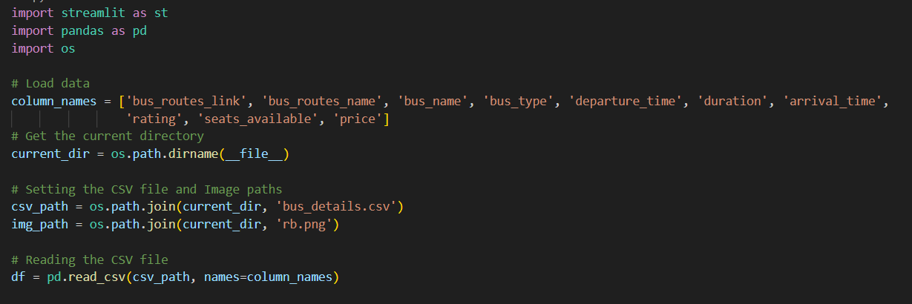
Creating a file path for reading the CSV file and reading the ‘bus_details.csv’ file as a dataframe.

Slide 21
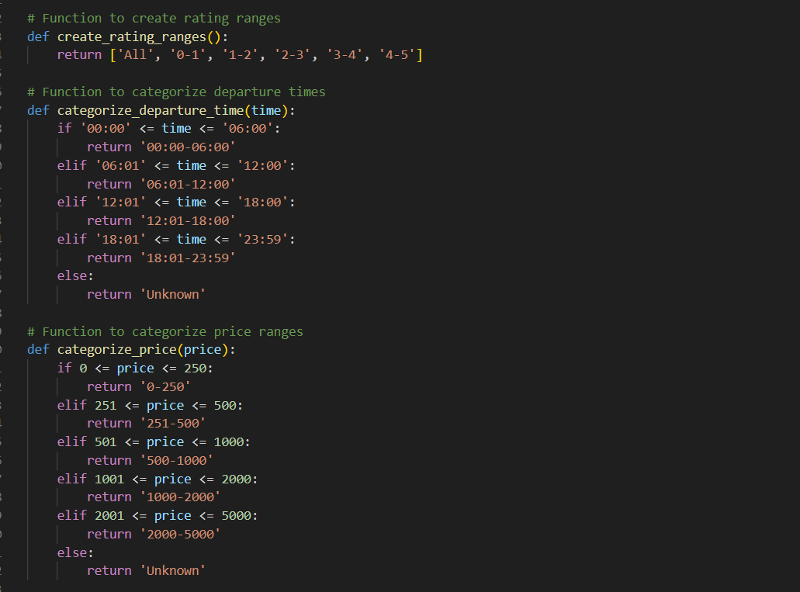
Created functions for rating range, departure time range and price range.

Slide 22
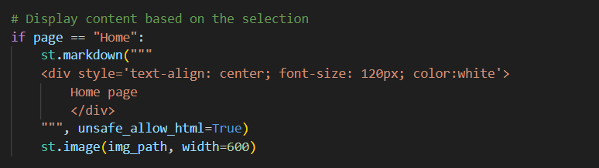
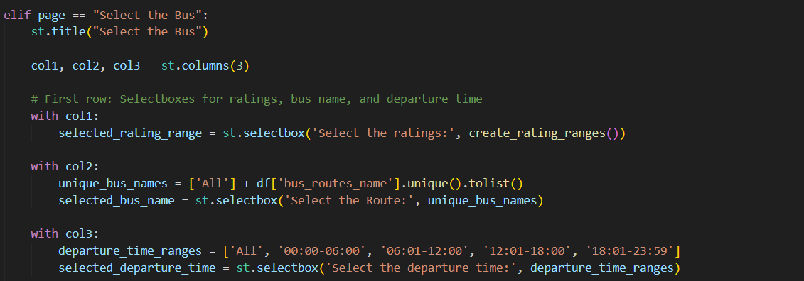
Created two different options: ‘Home’ and ‘Select the bus’ buttons on the home screen and created dropdowns for ratings, route, departure time, price range, seat type and A/C type

Slide 23
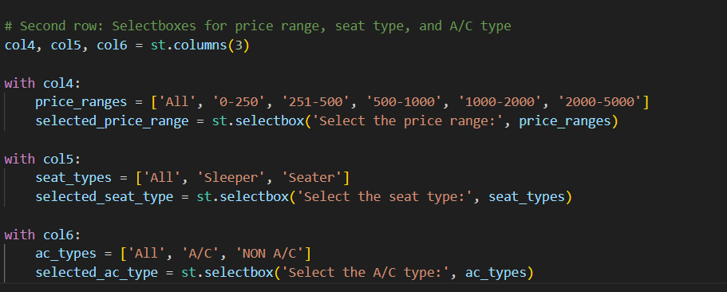

Slide 24
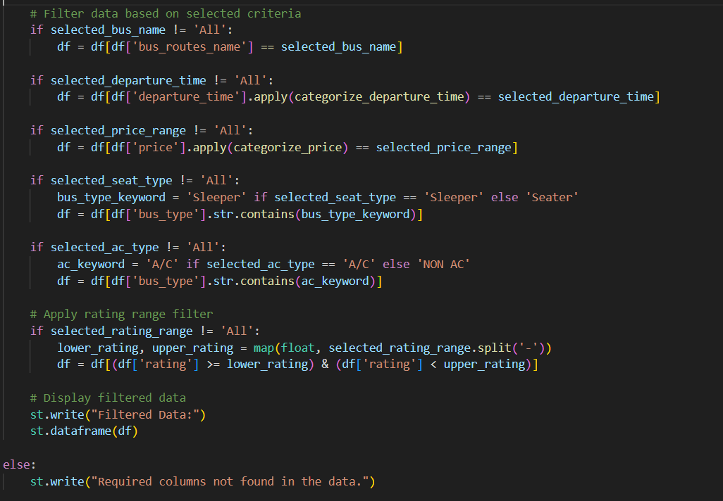
Filtering and displaying the data from the dataframe with respect to the options selected from the dropdowns.

Slide 25
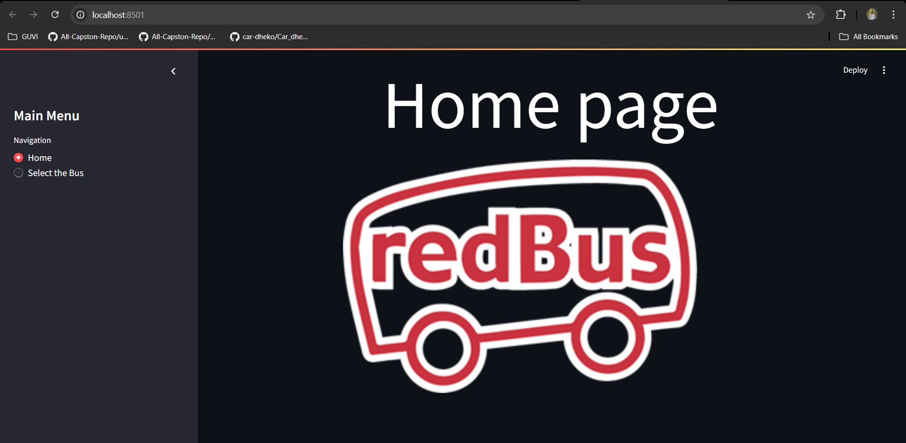
Home Page of my streamlit application

Slide 26
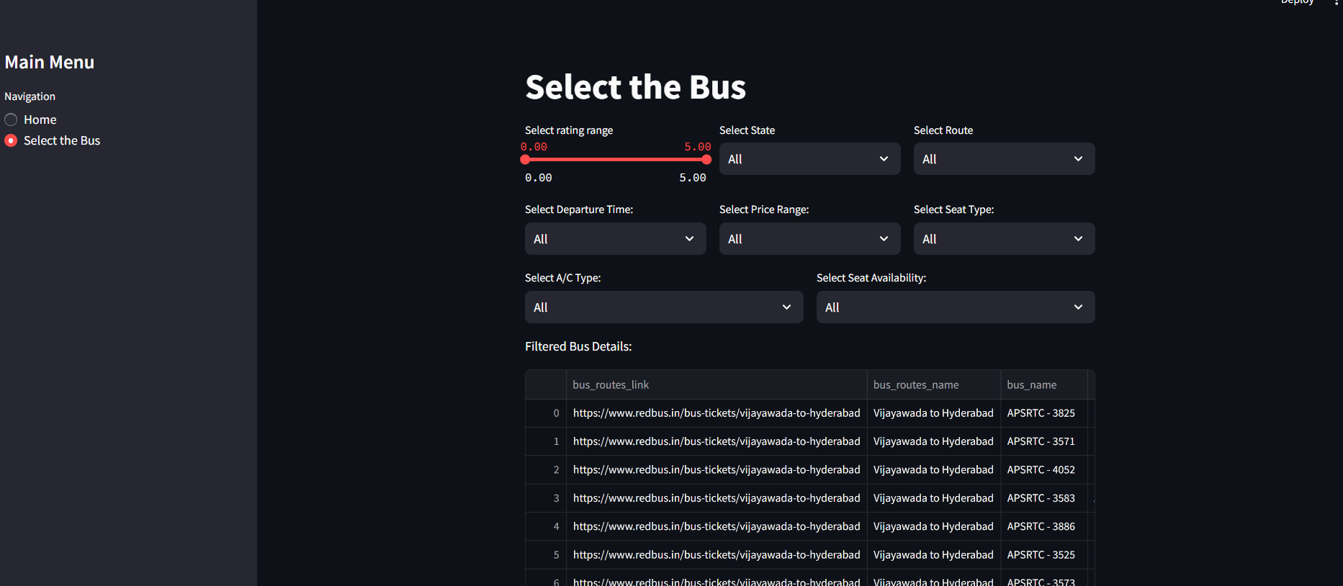
Select the bus Page:

Slide 27
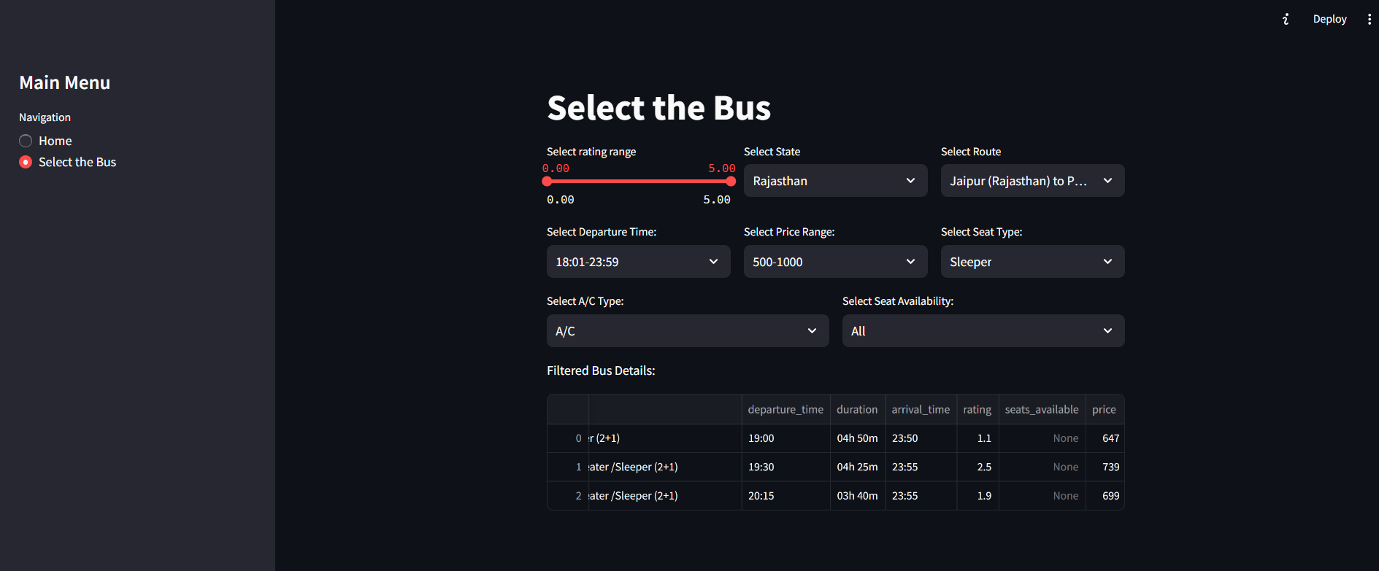
Displaying the bus details for the selected filter options:

Slide 28
THE END …

