Slide 1

Using the Explainable AI SS3 Classification Model
Muneeb Vaiyani, Florian Angermeir
Technical University Munich
Department of Informatics
Munich, 22. June 2020

Slide 2
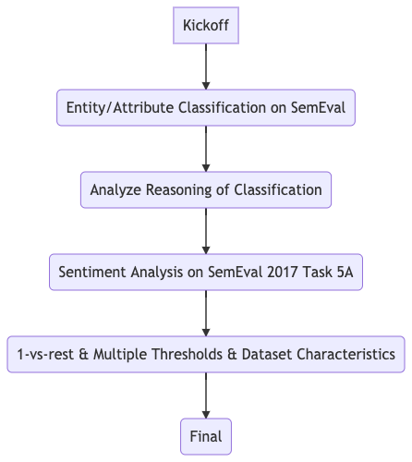
What happened so far?
1-vs-rest Classification
Class specific CV-Thresholds
Dataset Characteristics

Slide 3
1-vs-rest Classification
Single Label:
Policy for selection:
Class with the highest confidence value
DATASET | One vs rest (Macro F1) | Default classifier (Macro F1) | One vs rest (Micro F1) | Default classifier (Micro F1)
Movie reviews | 0.86 | 0.86 | 0.86 | 0.86
Beer review | 0.60 | 0.60 | 0.70 | 0.69
SemEval2017 | 0.54 | 0.51 | 0.55 | 0.52
IMDB reviews | 0.83 | 0.83 | 0.83 | 0.83

Slide 4
1-vs-rest Classification
Multi Label:
Policy for selection:
Specific class from each classifier (ignoring “rest”)
DATASET | One vs rest (Macro F1) | Default classifier (Macro F1) | One vs rest (Micro F1) | Default classifier (Micro F1)
Restaurant | 0.53 | 0.52 | 0.74 | 0.58
Movie Genre | 0.54 | 0.50 | 0.56 | 0.51

Slide 5
Class Specific CV-Threshold
Increased the dimension of alpha (each class having its own alpha)
Not related to the training
For proof of concept work on semeval 2017 (3 alphas) to investigate the variation in performance (if any) from the default one
CLASSIFIER | F1 (Macro)
Default | 0.57
Class specific alphas | 0.56

Slide 6
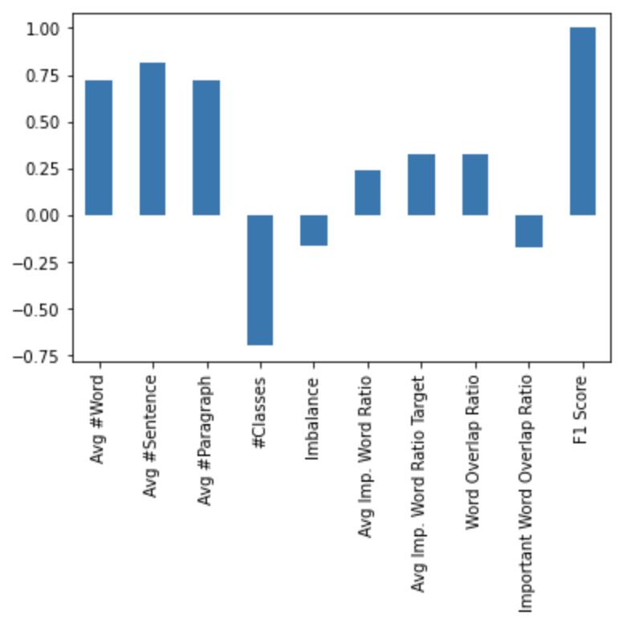
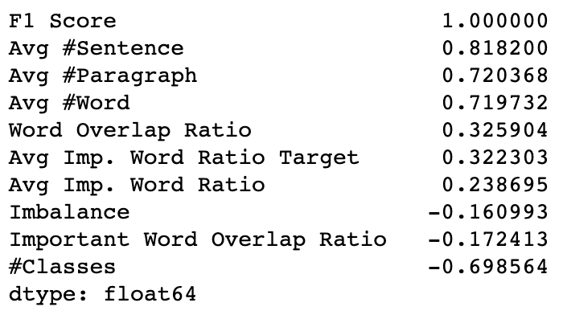
Dataset Characteristics (1) - 8 Datasets

Slide 7
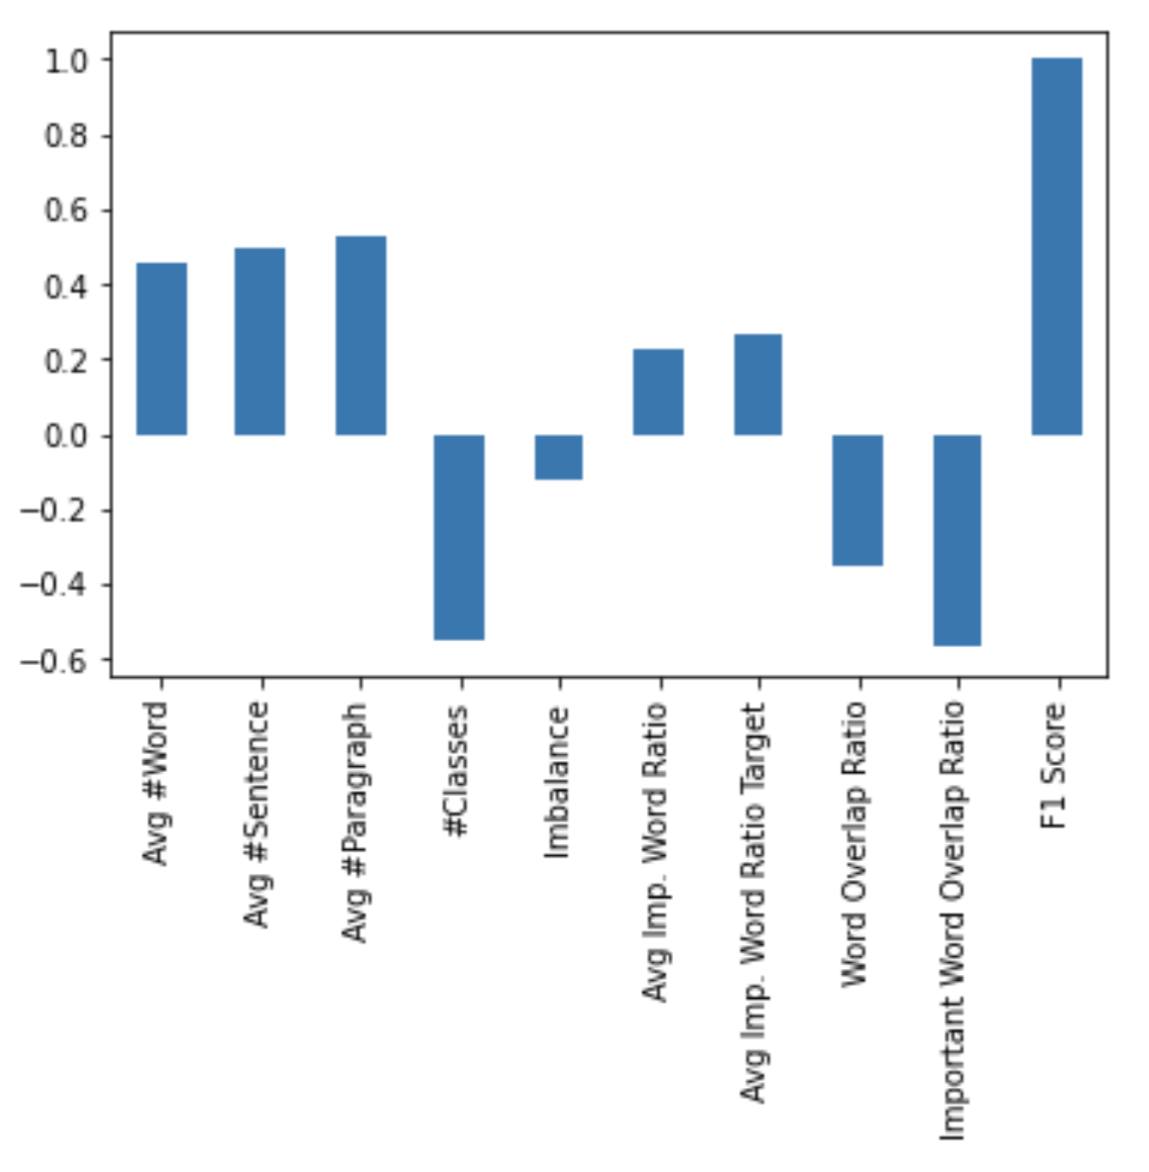
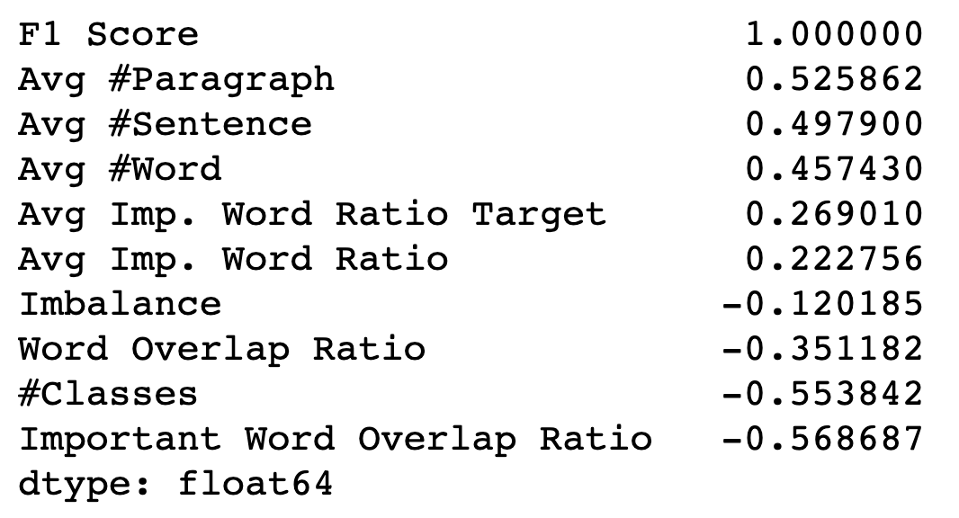
Dataset Characteristics (2) - 12 Datasets

Slide 8
Dataset Characteristics (3)
Not representative, too few datasets
Different Tasks (Topic Classification, Sentiment Classification, ...)
No hyperparameter optimization

Slide 9
Next Steps
Class Specific Hyperparameters (s,l,p)
Policy for number of output for multi label classification?
Back Correlation with more datasets?

Slide 10
Backup

Slide 11
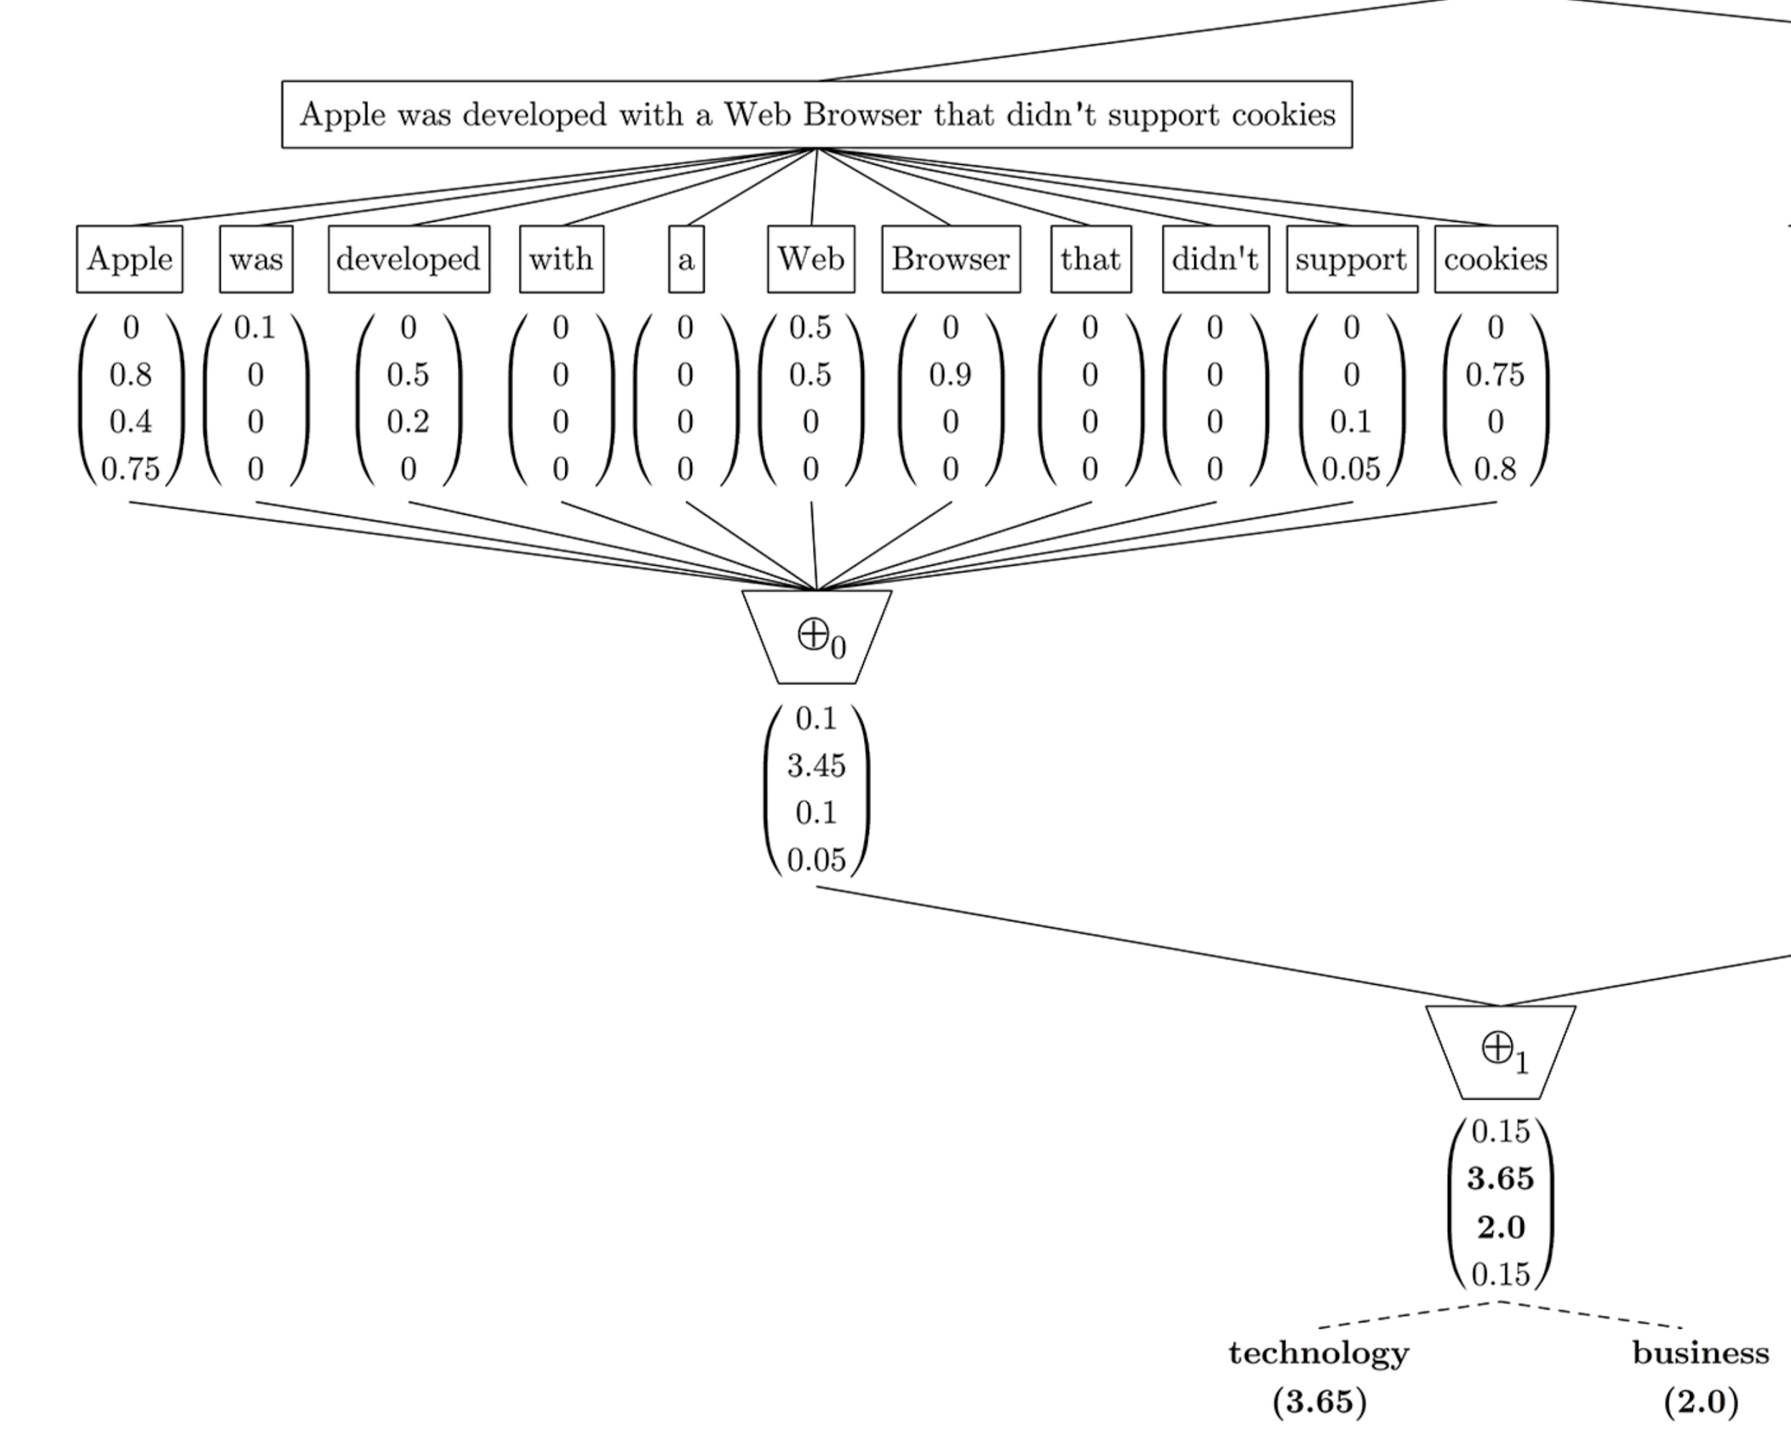
Different confidence value for different classes
<a1
<a2
<a3
<a4
<a

Slide 12
Dataset Characteristics
Use multiple datasets to find correlation.
SemEval 2017 Task 4 A
Amazon Alexa Review (5 Classes)
IMDB Review (2 Classes)
SS3 Tutorial Datasets (2 Classes/8 Classes)
Characteristics:
Overlap of Words
Overlap of important words (Important = confidence value > 0)
Average # of important words per sample (per class)
Ratio of important to unimportant words per sample (per class)
Average CV for sample for target class
Average # of sentences/paragraphs per sample (per class)

Slide 13
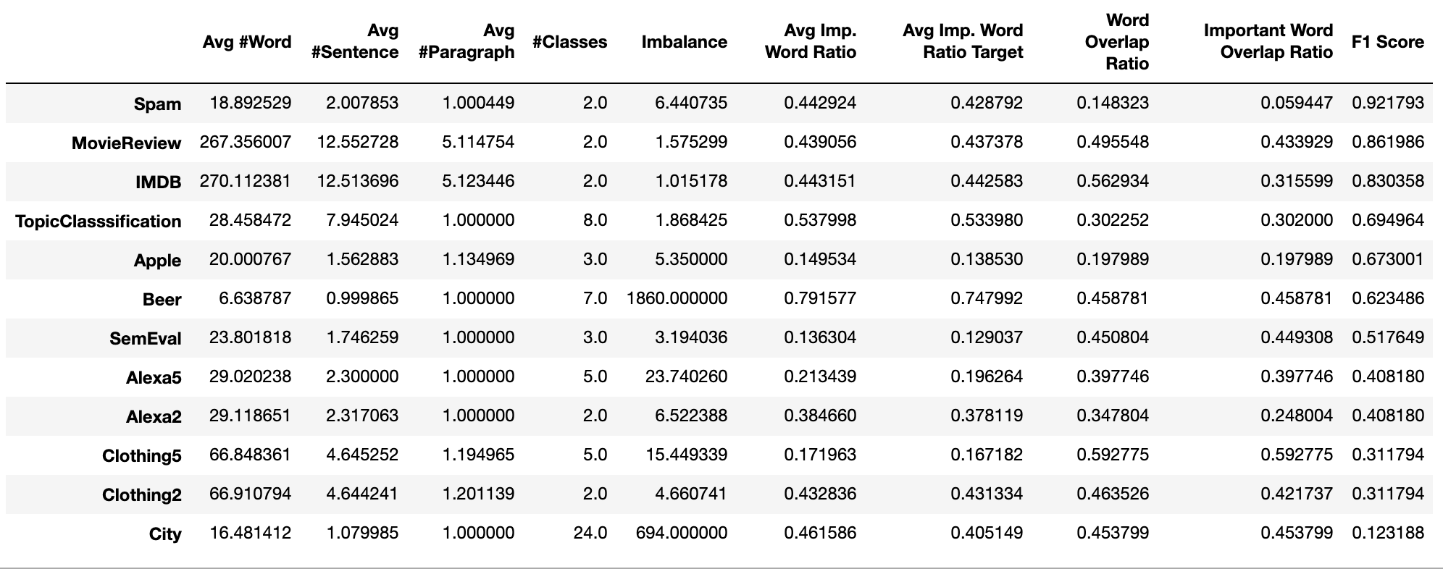
Dataset Characteristics

Slide 14
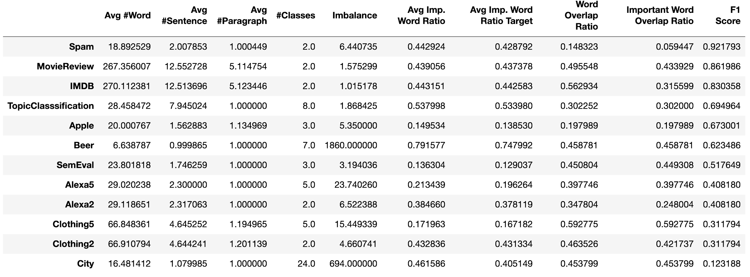
Dataset Characteristics

