Slide 1

Using the Explainable AI SS3 Classification Model
Muneeb Vaiyani, Florian Angermeir
Technical University Munich
Department of Informatics
Munich, 11. May 2020

Slide 2
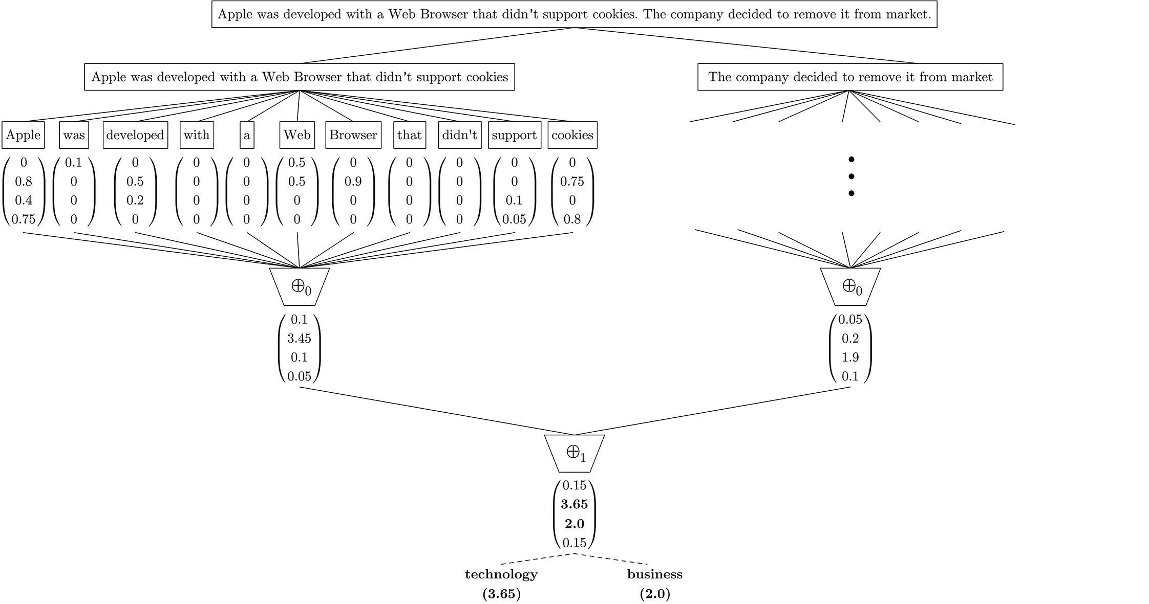
SS3 Model – Quick Refresher
Levels
Global Vector
Score Calculation/Level
Burdisso, Sergio & Errecalde, Marcelo & Montes, Manuel (2019):
“A Text Classification Framework for Simple and Effective Early Depression Detection Over Social Media Streams."

Slide 3
Redefined Action Items
Use SS3 for
Entity/Attribute classification on SemEval 2016 Task 5
Analyze reasoning of classifier
to show, that SS3 suited for this task
Apply SS3 for
Entity/Attribute Classification on Organic Dataset
to determine inconsistent annotations, annotator decreasing performance

Slide 4
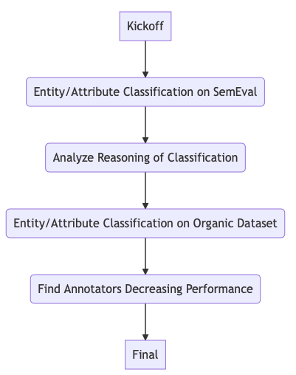
Our Roadmap

Slide 5
What happened so far?
Finished up reading
Datasets Exploration
Framework Exploration
Parsing of Dataset
Basic Helper functions
First tests with SemEval for Entity/Attribute Classification
Challenges
In contact with PySS3 creator

Slide 6
Next Steps
Multilabel evaluation (waiting for PySS3 Creator)
Extract insights and reasoning to see if they make sense on the dataset

Slide 7
Questions
Which Metrics to use for multilabel classification?
If the support for multilabel evaluation is not included in library soon, should we move to single label at sentence level?

