Slide 1

Using the Explainable AI SS3 Classification Model
Muneeb Vaiyani, Florian Angermeir
Technical University Munich
Department of Informatics
Munich, 11. May 2020

Slide 2
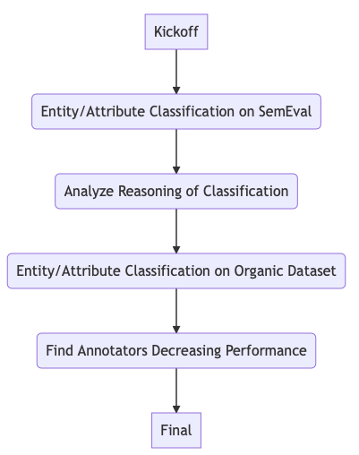
What happened so far?
Multilabel evaluation
Different techniques to improve classification
Analyze Problems with Classifier and Dataset

Slide 3
Different Approaches
Approach | Entity (Macro F1) | Attribute (Macro F1)
Vanilla SS3 | 0.45 | 0.45
n-Gram SS3 | 0.46 | 0.48
Different Operators | 0.46 | 0.40
Classes Removal | 0.59 | 0.65
Glove Embeddings | - | 0.55

Slide 4



Vanilla SS3
Globalvalue (gv) = local value * significance * sanction
Local value (lv)
Significance (sg)
Sanction value (sv)

Slide 5
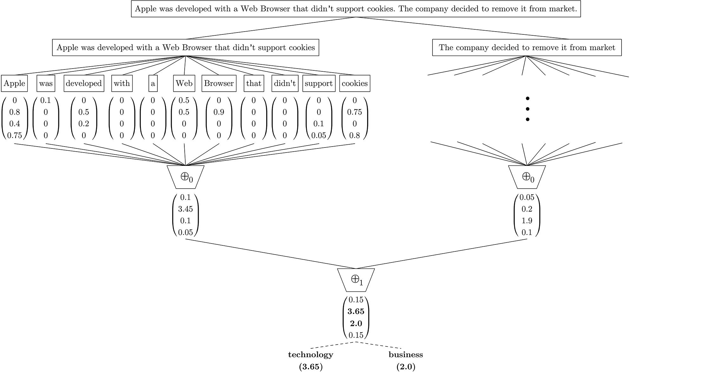



Different Operators
Default Operation (F1=n-Gram)
Max Operation (F1= 0.47/0.33)
Average Operation (F1= 0.46/0.40)
Problem:
Review mainly consists of one sentence.
Only one level operation can be used – will be same for Organic Dataset

Slide 6
Classes Removal
Took powerset of all labels, tested on all subsets
(Attribute:) removing General, Quality, Connectivity F1: 0.65
Example:
(“Some text here”, [General, Price]) (“Some text here”, [Price])
(“Some other text”, [Quality]) ()
Problem
Removes ~50% of the dataset
Fewer classes doesn’t have a big impact

Slide 7
Glove
Problem
A lot of samples can’t be classified assigned to (overall) most probable class
Proposed Solution
Increase number of relevant words for smaller classes in train process
Approach:
Tokenize + Remove Stopwords
Calculate the x “closest” words and append to sample
Example
I go to the restaurant. I go to the restaurant. go come gone restaurant cafe eatery
Problem
Lot of words not in embedding: I

Slide 8
Problems with Dataset/Classifier
Imbalanced
Samples to small
Big overlap between classes (Merge classes)
Classifier assigns most probable if can’t classify (Glove)

Slide 9
Next Steps
Use Glove to classify if SS3 can classify sample (for unknown test case)
Improving Preprocessing, since simply removing stopwords improves F1-Score by ~7% (Attribute)

Slide 10
Questions
How to tackle small sample size?
Ideas/Suggestions?

Slide 11
Backup

Slide 12
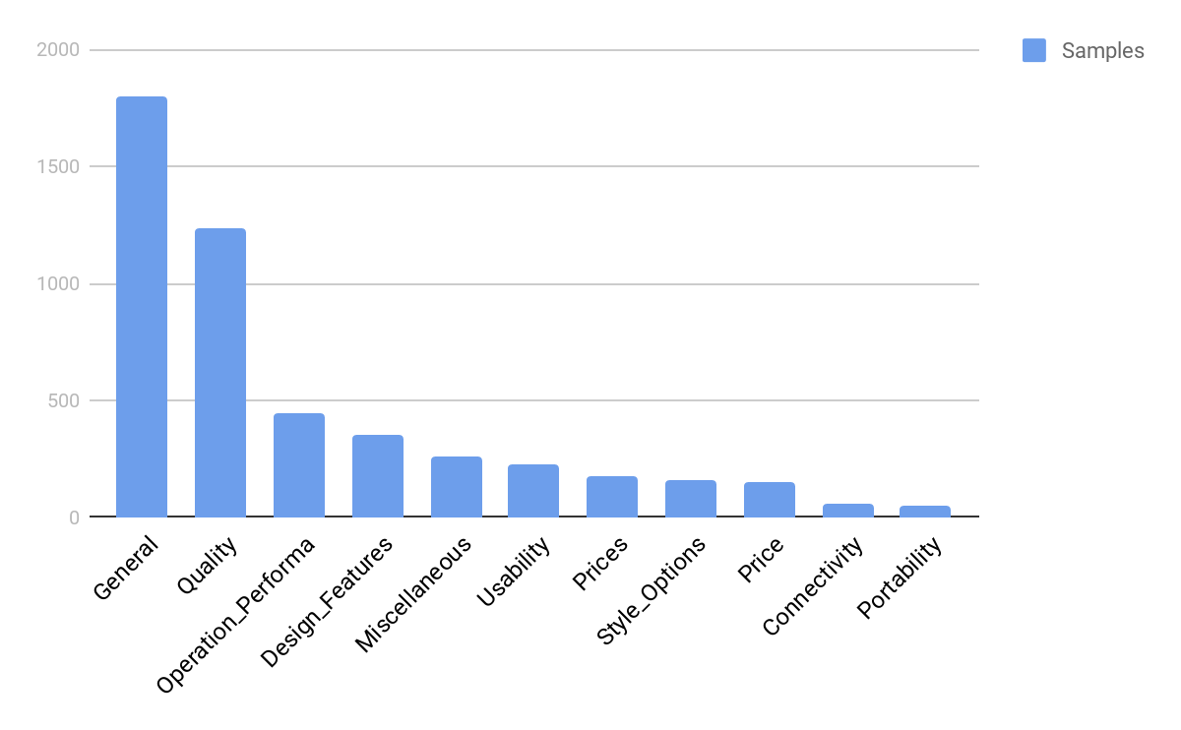
SemEval Dataset
(Attribute)

Slide 13
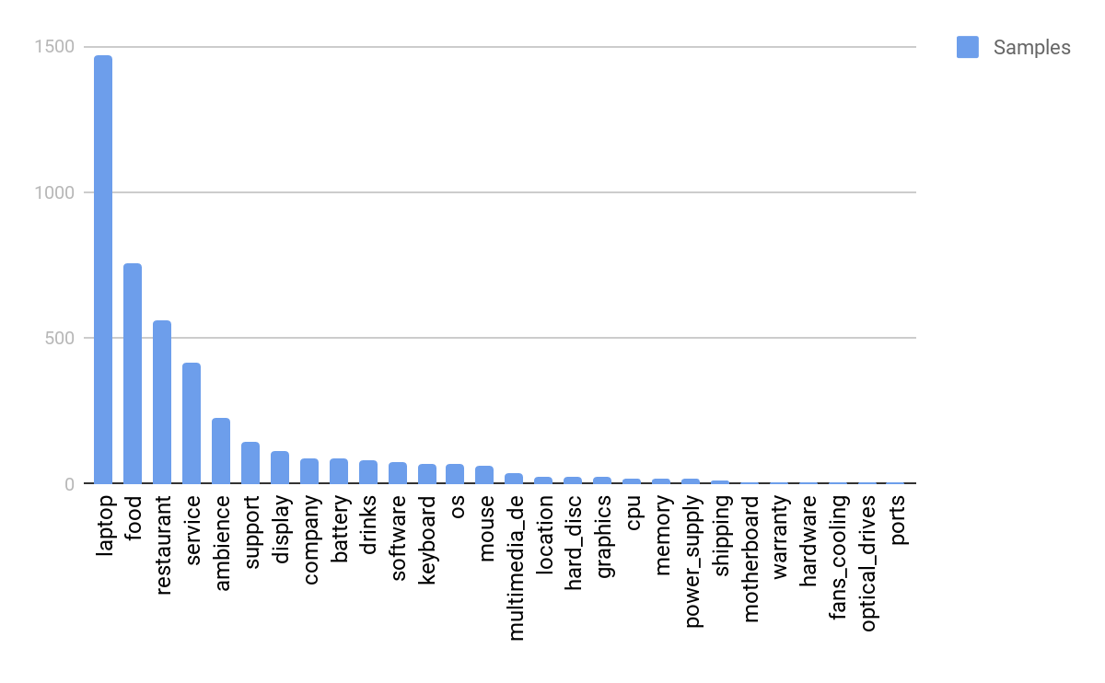
SemEval Dataset
(Entity)

Slide 14
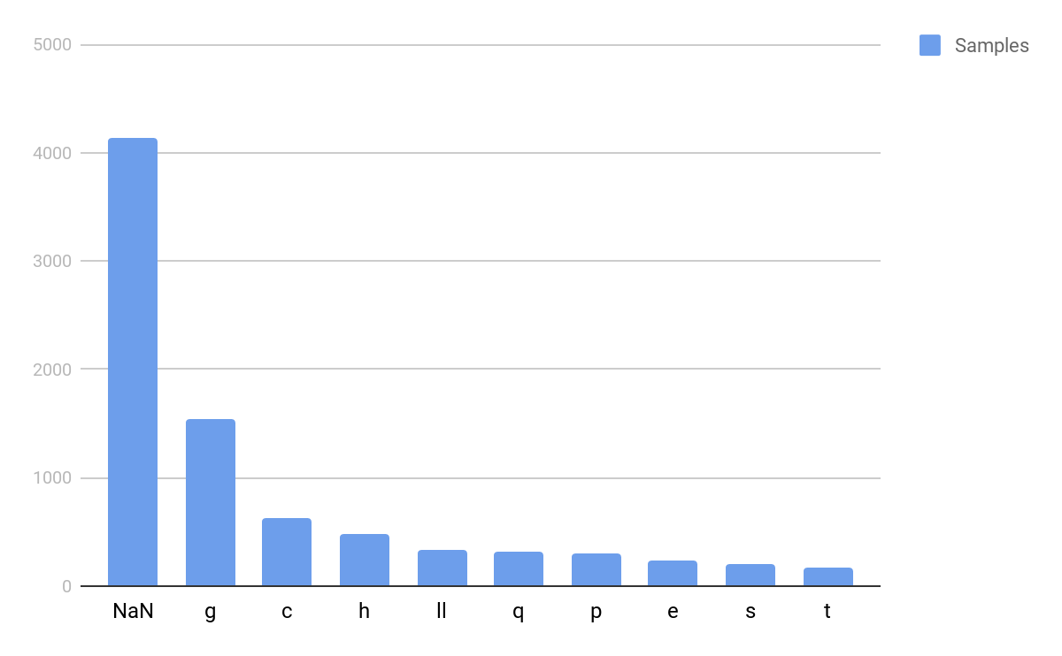
Organic Dataset
(Attribute)

Slide 15
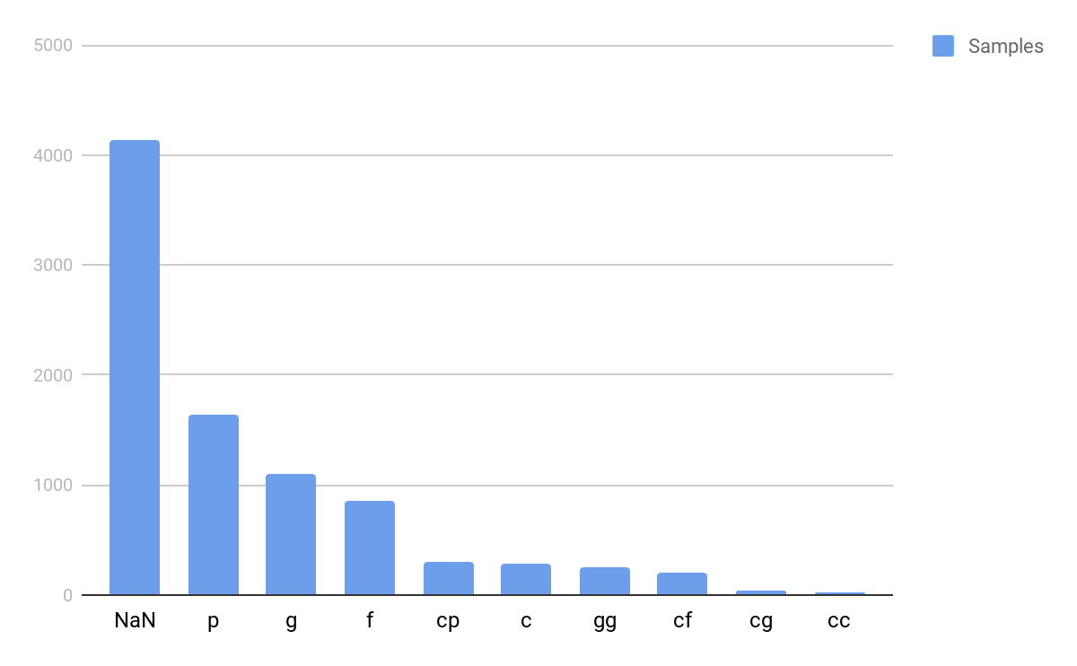
Organic Dataset
(Entity)

