Slide 1

Using the Explainable AI SS3 Classification Model
Muneeb Vaiyani, Florian Angermeir
Technical University Munich
Department of Informatics
Munich, 27. April 2020

Slide 2
SS3 Model – Origin
Initially early risk detection system
Key Aspects
Incremental classification
Support for early classification
Explainability

Slide 3
SS3 Model – How it works
Training: dictionary of words for each category with frequency
Classification: calculate global value and recursively scale up

Slide 4
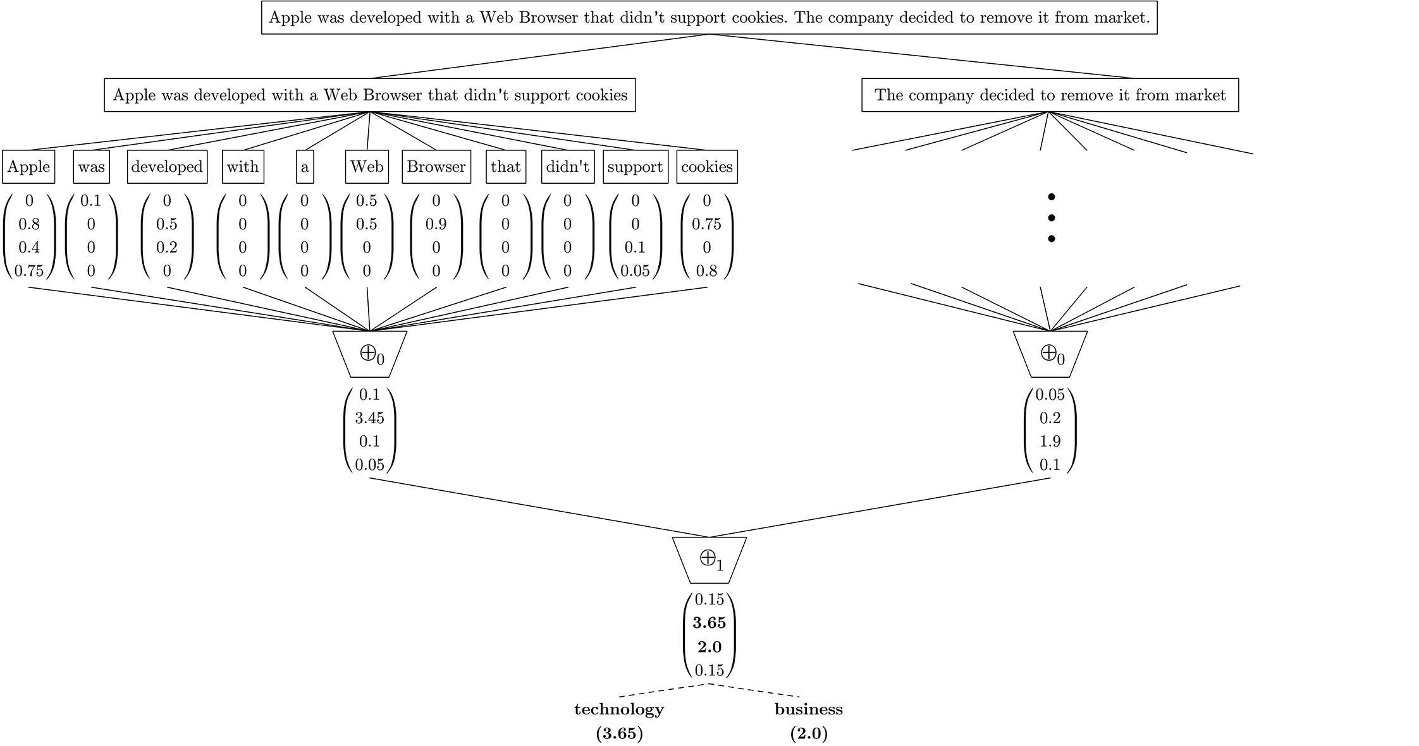
SS3 Model – Classification
Levels
Global Vector
Score Calculation/Level

Slide 5
SS3 Model – Terminology
SS3: Sequential S3 (Smoothness, Significance, Sanction)
Global Value: Confidence that word belong exclusively to category
Defined as Local Value x Significance x Sanction
Local Value: What is the local value?
Hyperparameter 1: Smoothness
Significance: How significant is word for category
Hyperparameter 2: Significance
Sanction: Small if significant for many categories
Hyperparameter 3: Sanction

Slide 6
Next Steps
Getting familiar with model
Finish Background Reading
Familiar with Framework
Apply model to organic food datasets
Determine where/how to integrate word embeddings

Slide 7
Questions
Where can we get access to datasets?
Is the data incremental or is it a complete dataset?

