Slide 1

Using the Explainable AI SS3 Classification Model
Muneeb Vaiyani, Florian Angermeir
Technical University Munich
Department of Informatics
Munich, 08. June 2020

Slide 2
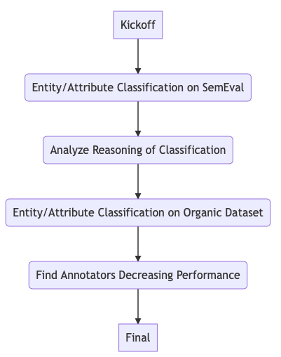
What happened so far?
SS3 does not perform well on SemEval 2016 Task 5
Analysis of Reasoning pretty hard due to multilabel classification

Slide 3
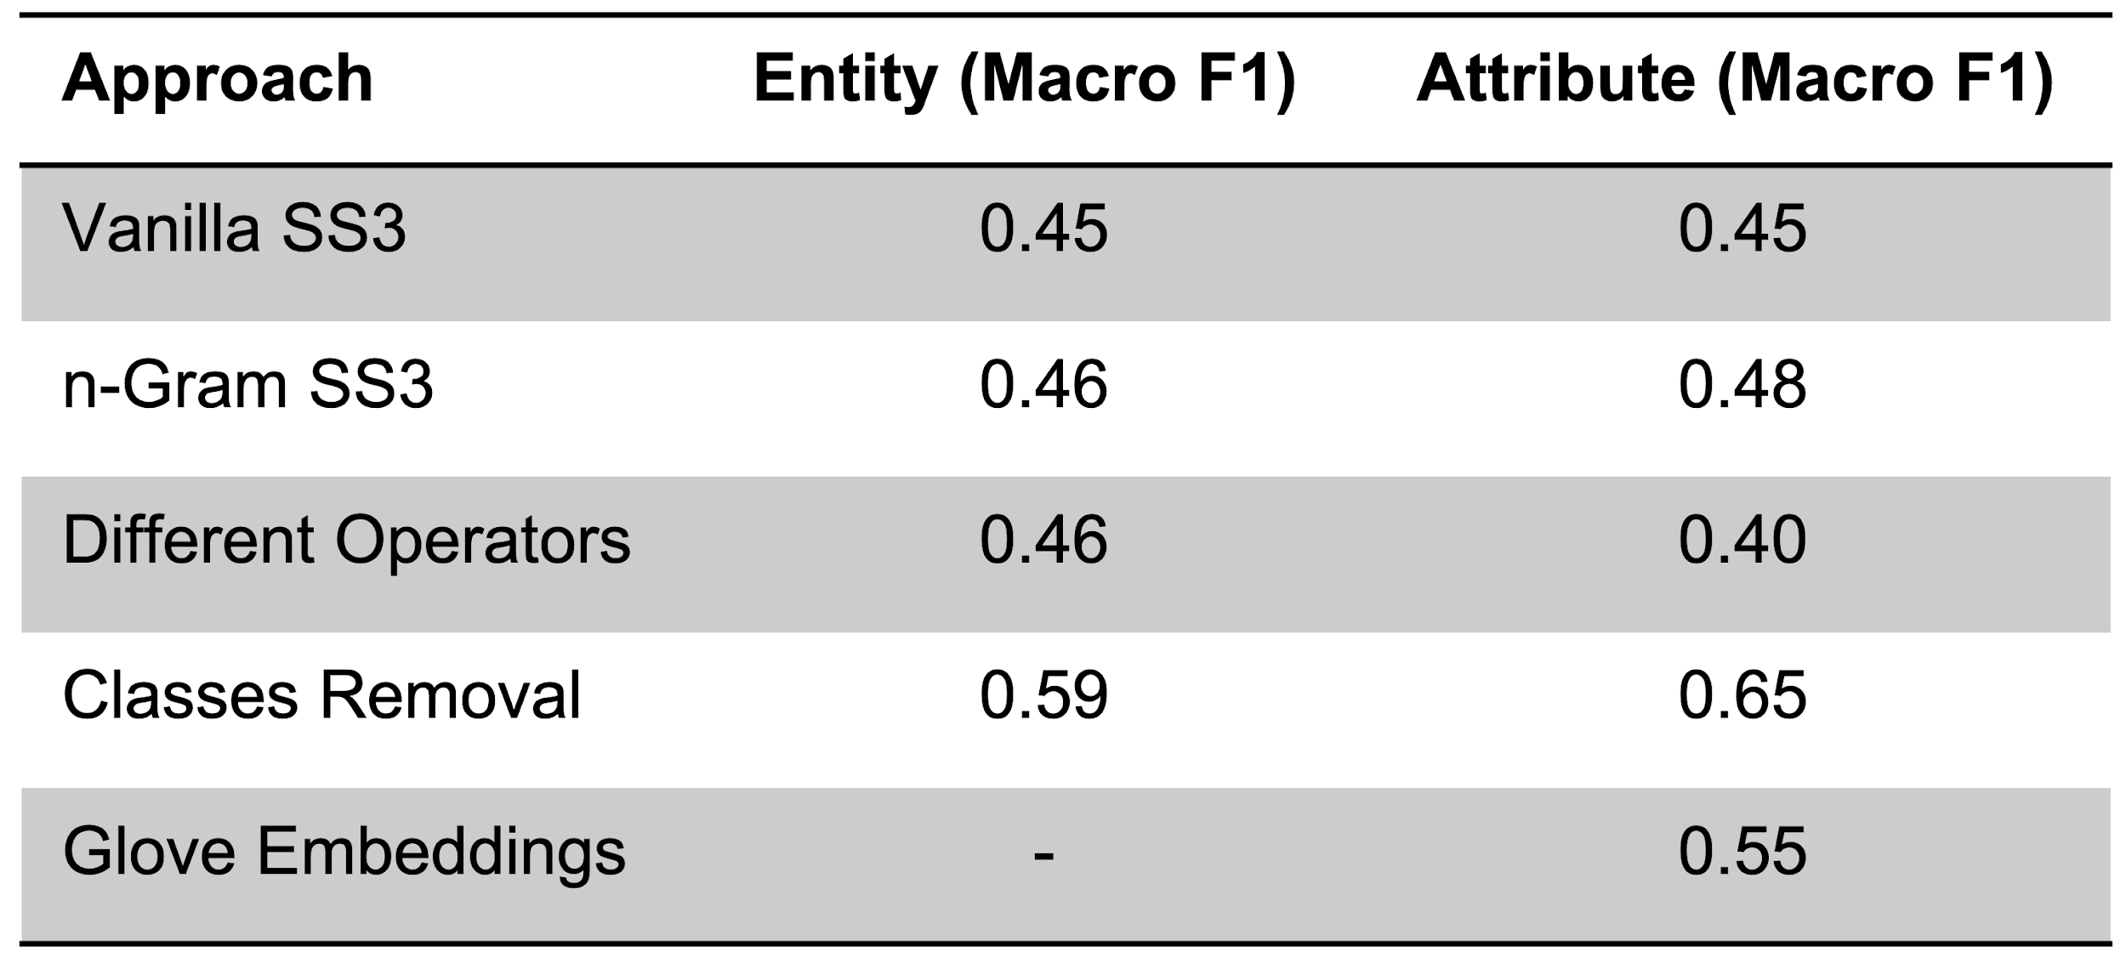
SS3 Performance on SemEval 2016 Task 5
At Sentence Level

Slide 4
Analysis of Reasoning
Live Test
Our findings:
False Negatives
Overlap of words from vocabulary

Slide 5
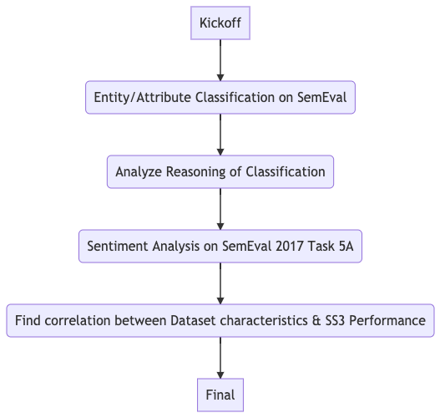
What is the new plan?
Try out SemEval 2017 Task 4 Subtask A (Sentiment Analysis)
Search for correlation between characteristics of dataset and SS3 performance

Slide 6
SS3 on SemEval 2017 Task 4 Subtask A
Bad results on vanilla (~50% F1 Score)
Multiple 1-vs-rest Classifiers: 58%

Slide 7
Correlation of Dataset characteristics and SS3 performance
Use multiple datasets to find correlation.
SemEval 2017 Task 4 A
Amazon Alexa Review (5 Classes)
IMDB Review (2 Classes)
SS3 Tutorial Datasets (2 Classes/8 Classes)
Characteristics:
Overlap of Words
Overlap of important words (Important = confidence value > 0)
Average # of important words per sample (per class)
Ratio of important to unimportant words per sample (per class)
Average CV for sample for target class
Average # of sentences/paragraphs per sample (per class)

Slide 8
Next Steps
Apply different metrics to (hopefully) find correlation
Different confidence value thresholds for different classes

Slide 9
Backup

Slide 10
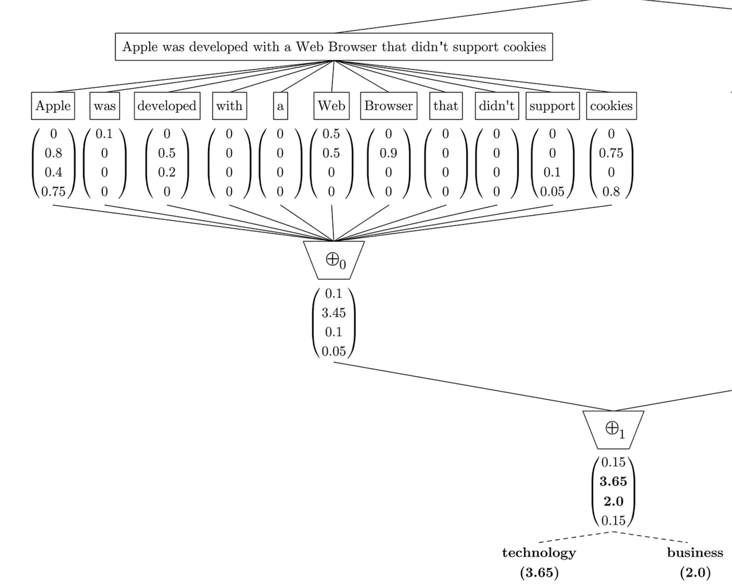
Different confidence value for different classes
<a1
<a2
<a3
<a4
<a

