Slide 1
Data Science for Psychologists
Ven Popov, PhD
Week 2, Workflow, Data Organization & Reproducibility
3/2/2021

Slide 2
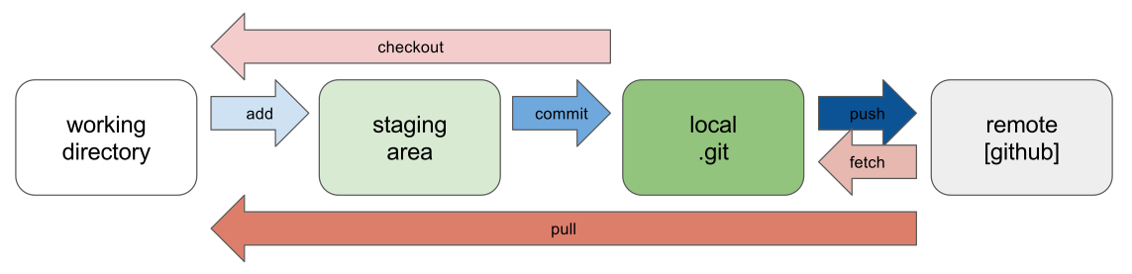
Notes on github

Slide 3
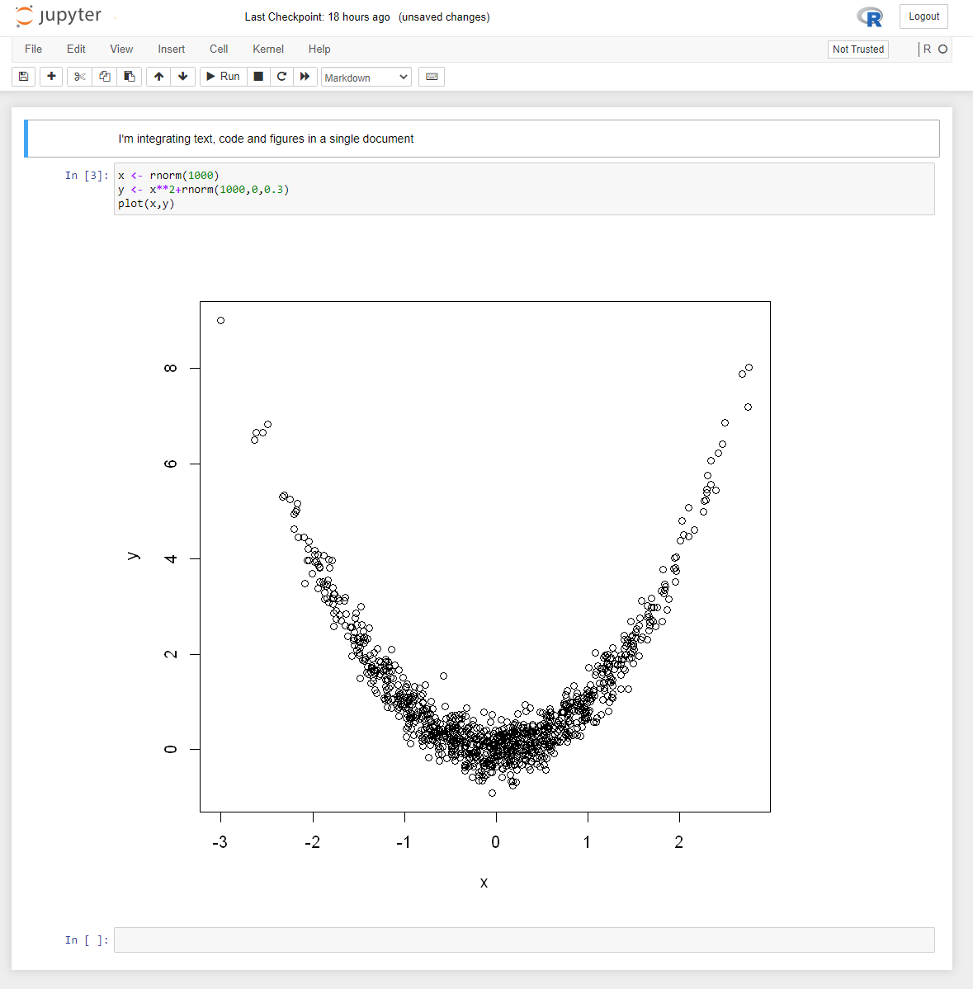
Intro to Jupyter notebooks

Slide 4
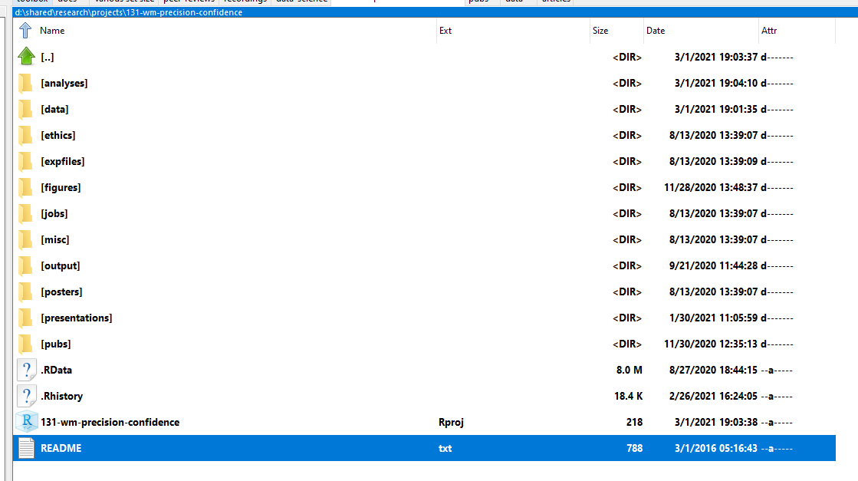
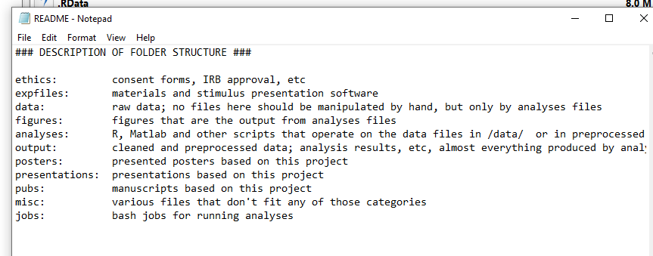
Workflow – consistent folder structure for projects

Slide 5
Example workflow from a current project

Slide 6
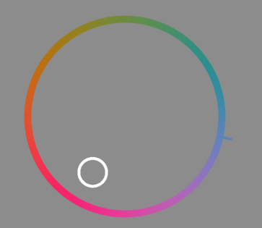
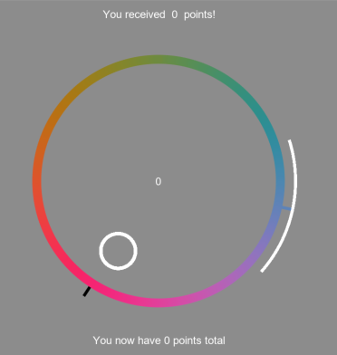
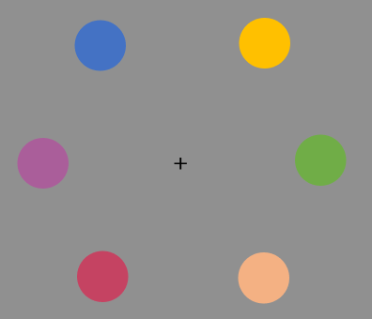
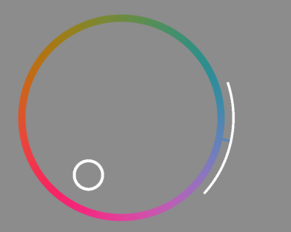
+
+
+
+
Fixation
Memory display
Maintenance
Color report
Until click
Arc size report
Until click
Feedback
+
+
……
+
+
+
Fixation
6 displays
Maintenance
Color report
Until click
Arc size report
Until click
Feedback
Time

Slide 7
Breakout Discussion Questions
These rules and reproducibility procedures will save time in the long run and increase trustworthiness. But reproducible practices require investment of time and energy, and few researchers are willing to invest that. Also, not everyone is comfortable with sharing “hard earned data”, even though they might know that they would benefit from it. What other arguments could there be to convince researchers to collaborate and document all their steps clearly?
Given the reproducibility/replication crisis, it can be hard to build your own hypotheses upon existing research while not being really sure of their “truth” in the first place. How do you find the right balance between skepticism of and building on existing findings?
In what way could researchers show that they actually tried to make their study as reproducible as possible? Should those that refuse to follow the rules of reproducibility or lie about the correct usage be punished?

