Slide 1
Data Science for Psychologists
Ven Popov, PhD
Week 1, Introduction to Data Science
2/23/2021

Slide 2
What is Data Science and why should a psychologist care?

Slide 3

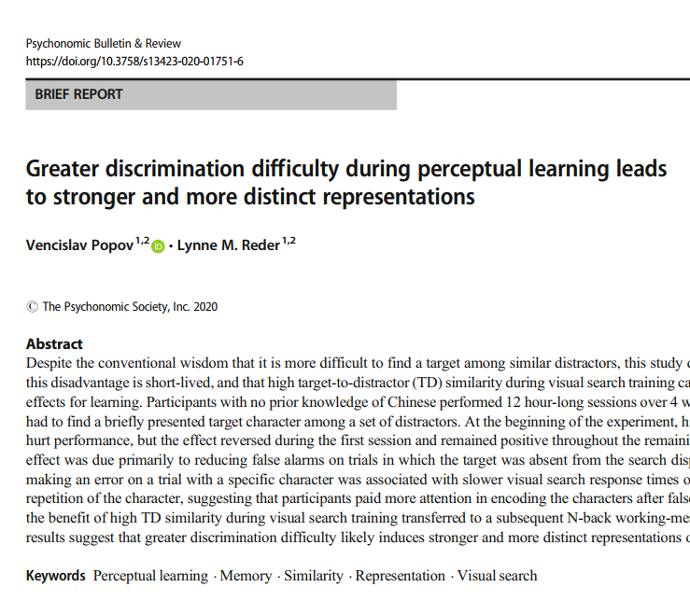
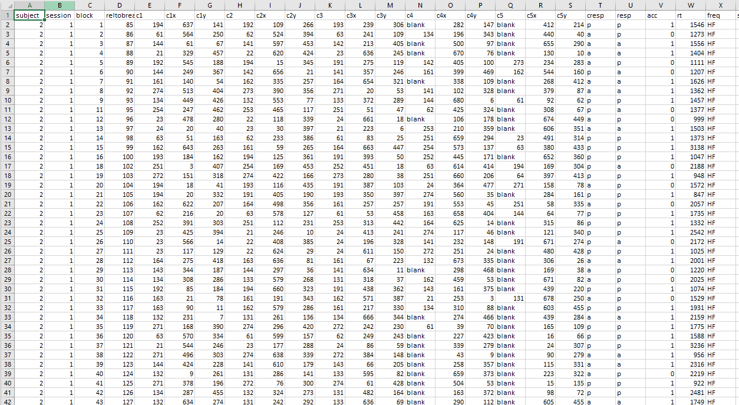
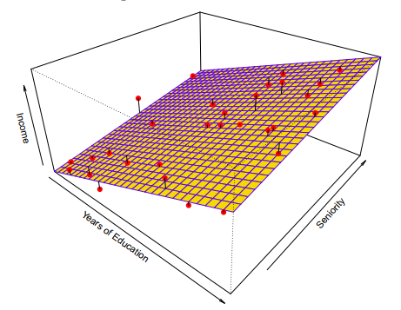
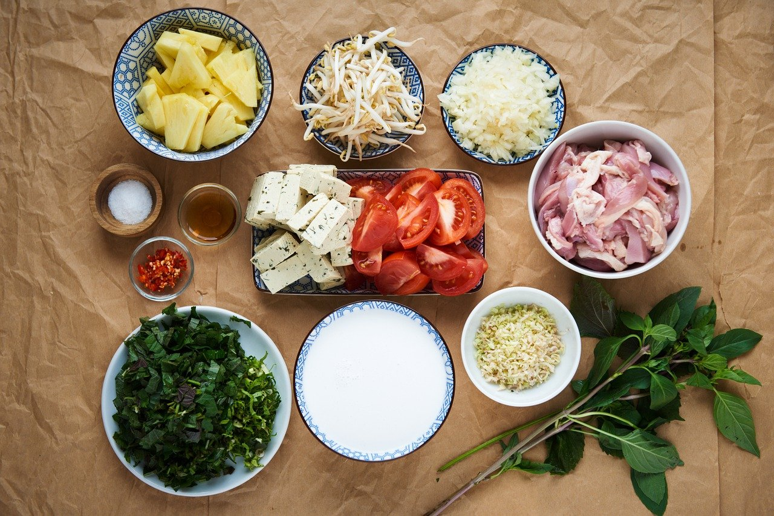

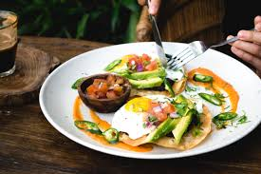
Data Science is like cooking

Slide 4
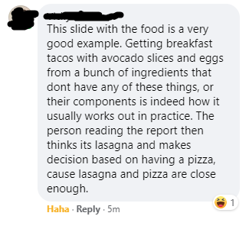

Slide 5
Data Science is like cooking
Numbers and data are meaningless on their own
There is no one “correct” recipe – multiple appropriate tools depending on type of data, goals of analysis, etc
Learning Data Science requires learning:
to recognize different data types and data problems (ingredients)
to know how to use various analytical tools (recipes)
to understand how your project goals (meals) determine the most appropriate tools for analysis

Slide 6


Data Science Chef vs Data Science Cook *
A cook
A chef
Knows how to apply a prespecified recipe to a fixed set of ingredients
Does not understand how or why the recipe works and cannot adapt it to novel problems
Cannot develop new recipes
Can be successful as long as they deal with repeating simple problems
Deeply understands different ingredients and recipes
Knows how and why different recipes work and can apply, adapt and extend them to novel problems
Can develop new recipes to deal with novel problems, or to better solve existing problems
Has a broad toolkit that allows them to address a variety of different problems and questions
* Analogy borrowed from Brandon Sanderson who uses these terms to describe the difference between novice and expert writers

Slide 7
Learning goals for the class
Become Data Science Chefs
understand and practice proper data organization, archiving and cleansing
learn how to create reproducible data processing workflows
learn how to use extensive visualization techniques in order to gain a deeper understanding of your data
understand the difference between inference and prediction, between regression and classification problems, and learn how to select the proper statistical tools for each
understand model overfitting and how to avoid it

Slide 8
A brief round of introductions
Name?
Why are you taking this class?
What previous statistical classes have you taken?

Slide 9
Class structure
Each class will involve a mixture of segments of lectures, breakout discussions and Q&A sessions. Except for the first week, students are expected to have finished the assigned readings and tutorials prior to the corresponding class. Students should submit two questions on the assigned readings by 2pm on the Monday before each class. Classes will have the following structure:
1-3 short lecture segments (20-40 minutes total)
1-3 Q&A sessions interspersed between lecture segments (20 minutes)
Small groups break-out discussion sessions (see below for more information; 20 minutes)
Summary of break-out sessions (10 minutes)

Slide 10
Structured discussion sessions
After the lecture segments and Q&A sessions, students will split into separate breakout groups of 4-5 to discuss the topic of the day.
Each group should select one student who will summarize the discussion of their group for the rest of the class during the final summary sessions.
Each group should after class submit a short written summary of their discussion.
If a student is unable to be present for the in-class discussions, they should contact the instructor beforehand to organize an alternative for in-class participation.

Slide 11
Grading
Data Science is learned through practice and the grading of this course will reflect this. Grades will be composed of:
30% homeworks
15% submission of two questions on the weekly readings prior to class
15% participation in class discussions
40% final project

Slide 12
Final project
At the end of this class you will have to submit a final project
This project will involve an analysis of a dataset of your choosing, using the techniques acquired in the class
Ideally, the dataset you choose will either be part of research you are currently involved in or related to your interests
You will have to select a dataset for your final project by April 13th. You should submit a short written summary of why you have chosen this dataset for your final project before the start of the April 13th class.
The dataset must be sufficiently complex to allow you to use a variety of the methods presented in the class.
You will be notified by April 19th whether your final project proposal is approved
If you do not have access to a dataset from your research, please contact the instructor to help you find an appropriate publicly available dataset for your final project.
To complete the final project, you must submit a 10 minute pre-recorded video presentation by May 28th and a written description of the project in the form of a Jupyter notebook by June 6th.

Slide 13
Materials & Tools
Tools
GitHub
Jupyter notebooks
Rstudio
Required textbook: James, G., Witten, D., Hastie, T., & Tibshirani, R. (2013). An introduction to statistical learning (Vol. 112, p. 18). New York: springer. Freely available for download at https://www.statlearning.com/
Most weekly required readings come from this textbook
Recommended textbook: Wickham, H. & Grolemund, G. (2016). R for Data Science. O’Reilly. Freely available at https://r4ds.had.co.nz/
No required readings, but a great reference for how to use many of the techniques discussed in class with the R statistical programming language
Tutorials: the practical side of the course will involve tutorials related to the homeworks. These tutorials will be available as Jupyter notebooks on the class GitHub page
GitHub repository: https://github.com/venpopov/DataSciencePsychUZH

Slide 14
Class schedule
Week | Date | Topic | Readings | Homework Due
1 | 23.02.2021 | Intro to Data Science
2 | 02.03.2021 | Data organization & reproducibility | TBD | Homework 1
3 | 09.03.2021 | Data structures and data cleaning | Wickham (2014); Mueller & Freytag (2003) | Homework 2
4 | 16.03.2021 | Data visualization | TBD | Homework 3
5 | 23.03.2021 | The bias-variance trade-off | James et al. Chapters 1 & 2
6 | 30.03.2021 | Linear models | James et al. Chapter 3
7 | 13.04.2021 | Mixed-effects models | TBD; http://mfviz.com/hierarchical-models/ | Homework 4
8 | 20.04.2021 | Classifiers (Part 1) | James et al. Chapter 4
9 | 27.04.2021 | Classifiers (Part 2) | James et al. Chapter 4 | Homework 5
10 | 04.05.2021 | Cross-validation | James et al. Chapter 5
11 | 11.05.2021 | Bootstrapping | James et al. Chapter 5 | Homework 6
12 | 18.05.2021 | Power analyses via simulation | Smith & Little (2018)
13 | 25.05.2021 | Model selection | James et al. Chapter 6 | Homework 7
14 | 01.06.2021 | Dimensionality reduction | James et al. Chapter 10

