Slide 1
Randomness from a Qubit
QUANTUM RANDOM NUMBER GENERATOR (QRNG)
Problem
Our Solution
Conventional random generators are algorithmic and produce pseudorandom values.
High-security applications require reliable and unpredictable randomness.
Developed a 1-qubit QRNG using Qiskit.
A Hadamard (H) gate creates an equal superposition of 0 and 1.
Measurement produces a random bit.
|0⟩
H Gate
Measurement
0 / 1
Experiment: 10,000 quantum measurements using Qiskit.
Notes:
Pseudorandom generators are deterministic algorithms. A single qubit put into superposition by a Hadamard gate gives a 50/50 outcome on measurement. We ran 10,000 measurements in Qiskit.

Slide 2
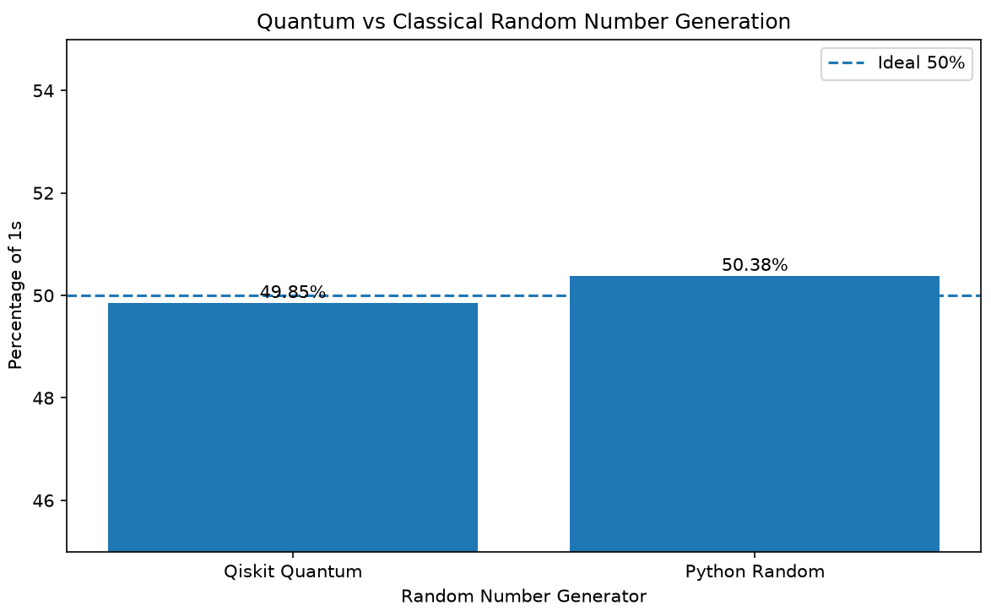
Quantum vs Classical Randomness
EXPERIMENT & RESULTS
Metric | Quantum | Classical
Total bits | 10,000 | 10,000
Zeros | 5,015 | 4,962
Ones | 4,985 | 5,038
1 Percentage | 49.85% | 50.38%
Chi-square | 0.09 | 0.5776
P-value | 0.7642 | 0.4473
Result | PASS | PASS
0.30%
Quantum imbalance
KEY FINDING
Both outputs are consistent with a 50/50 split.
Same bit count and same test: a fair comparison.
Notes:
Both generators pass a chi-square test at 10,000 bits (p > 0.05). The quantum run is off 50/50 by 0.30 percentage points, the classical run by 0.38.

Slide 3





Industry Relevance & Future Scope
FROM QUANTUM PROTOTYPE TO REAL-WORLD APPLICATIONS
Industry Applications
VALUE
Demonstrates quantum measurement for random-bit generation.
Provides a measurable comparison with a classical random generator.
Cybersecurity & cryptography
Financial security
CURRENT LIMITATION
Authentication and key generation
Uses Qiskit StatevectorSampler (a simulator).
It does not demonstrate physical quantum entropy.
Secure communications
FUTURE SCOPE
Run the QRNG on real IBM Quantum hardware
Generate larger random sequences
Apply additional randomness tests
Explore integration with cryptographic systems
Research and technology
Notes:
The current run is a simulator, so it shows the method but not true physical entropy. Next step is real IBM Quantum hardware, longer sequences, and a broader randomness test suite.

