Slide 1

Note: The data and information in this document is reflective of a hypothetical situation and client. This document is to be used for KPMG Virtual Internship purposes only.
Sprocket Central Pty Ltd
Data analytics approach
[Division Name] - [Engagement Manager], [Senior Consultant], [Junior Consultant]

Slide 2
Note: The data and information in this document is reflective of a hypothetical situation and client. This document is to be used for KPMG Virtual Internship purposes only.
Agenda
Introduction
Data Exploration
Model Development
Interpretation

Slide 3
Note: The data and information in this document is reflective of a hypothetical situation and client. This document is to be used for KPMG Virtual Internship purposes only.
Introduction
Place headline insight or information here. This should be the most important point for this slide.
1000 potential customers do not have prior transaction history
Generate useful customer insights
optimise resource allocation for targeted marketing.
Focus on High Value Customers

Slide 4
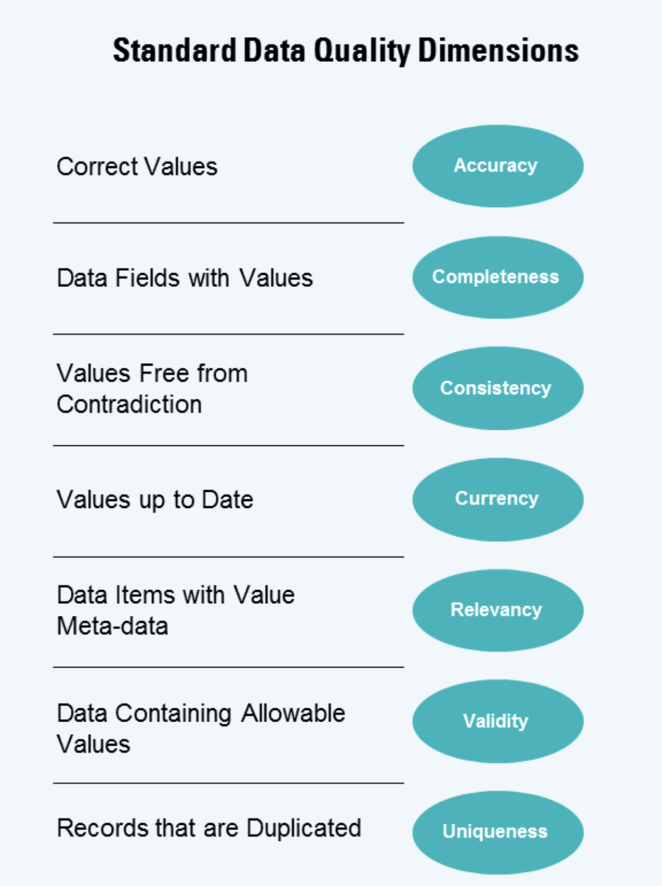
Data Exploration
Data Cleaning & Quality Assessment
Perform Data cleaning and quality assessment on the dataset.
Determine Data Integrity
eg. Accuracy ,Completeness, Consistency ,Currency, Relevancy,Uniqueness

Slide 5
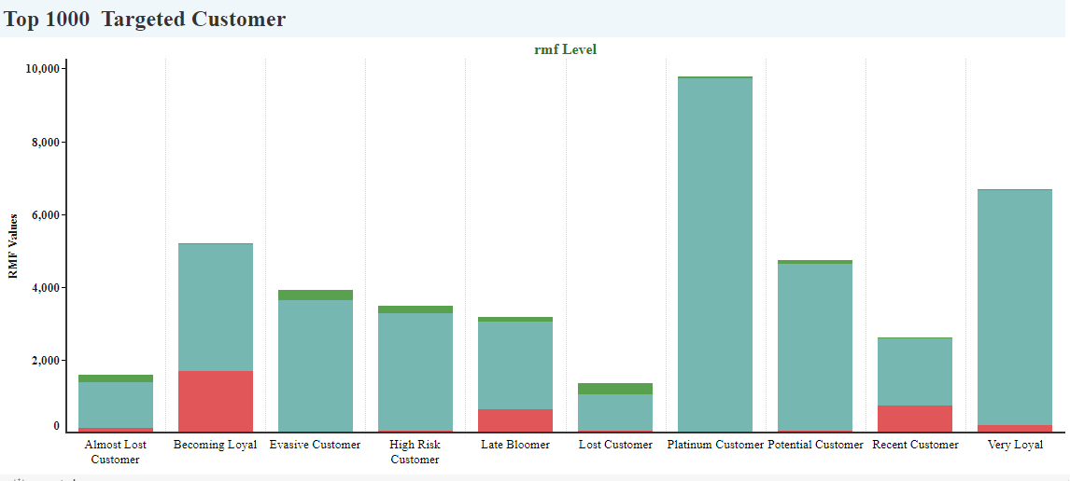
Note: The data and information in this document is reflective of a hypothetical situation and client. This document is to be used for KPMG Virtual Internship purposes only.
Model Development
The graph shows top 1000 customers.
Customers are likely divided into 10 categories
like Platinum customers, potential customers etc.
Categories made by calculating Their RFM values.

Slide 6
Note: The data and information in this document is reflective of a hypothetical situation and client. This document is to be used for KPMG Virtual Internship purposes only.
Model Development
What is RFM?
Behavioral segmentation by 3 important features:
Recency — number of days since the last purchase
Frequency — number of transactions made over a given period
Monetary — amount spent over a given period of time

Slide 7
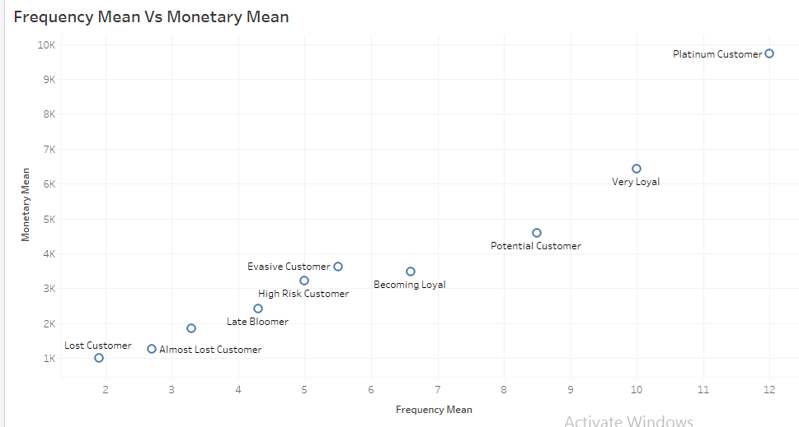
Note: The data and information in this document is reflective of a hypothetical situation and client. This document is to be used for KPMG Virtual Internship purposes only.
Interpretation
Correlation Between Frequency Mean and Monetary Mean
It shows the highest frequency and monetary that customer buy frequently

Slide 8
Note: The data and information in this document is reflective of a hypothetical situation and client. This document is to be used for KPMG Virtual Internship purposes only.
Appendix

