Slide 1
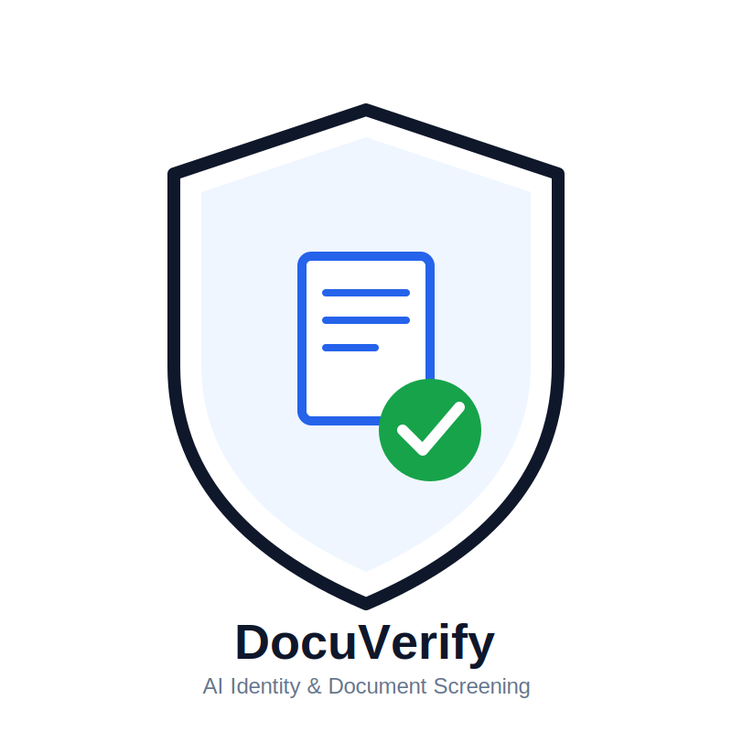


SMART INDIA HACKATHON 2026
TEAM & PROBLEM STATEMENTS
Problem Statement ID : 26188
Problem Statement Title :
AI-Based Fake Identity & Document Screening System
Theme :Blockchain & Cybersecurity
PS Category : Software
Team ID :
Team Name: BYTESENTINEL

Slide 2
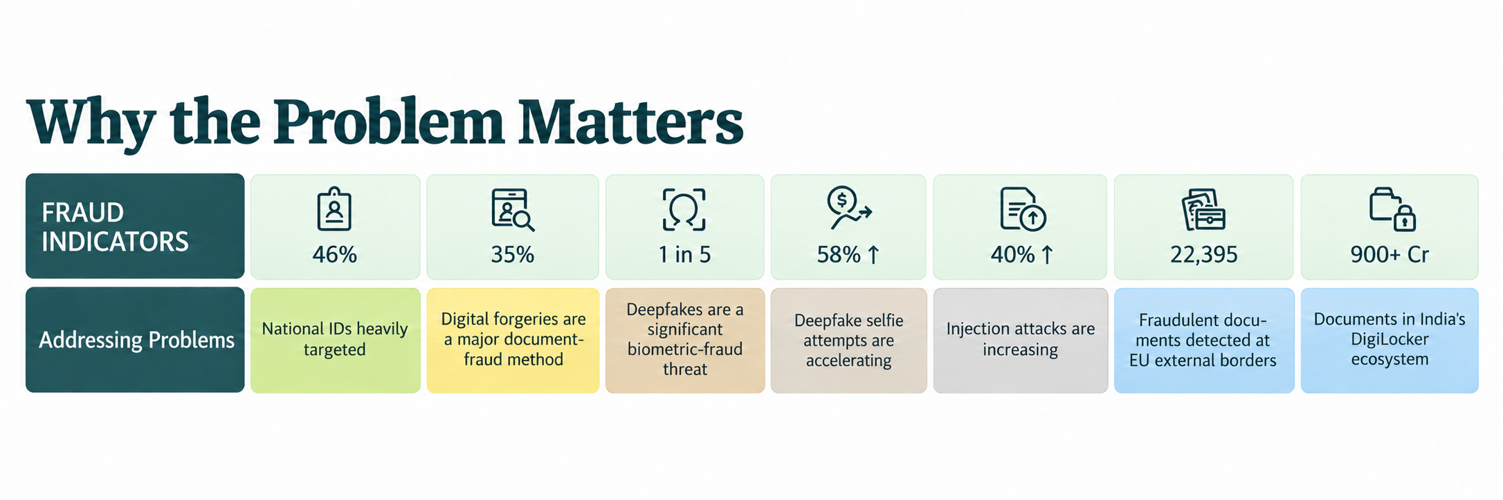
IDEA /APPROACH DETAILS
BYTESENTINEL
Proposed Solution :
Unified AI-powered screening platform that automates identity document verification in real time.
❖ OCR + MRZ triggered automatic data extraction from passports, visas & IDs.
❖ Checksum-based document validation engine.
❖ Error Level Analysis (ELA) and metadata scan to detect tampering & forgery
❖ Biometric face verification to match person with document photo.
❖Explainable risk score to supports the final decision.
UNIQUENESS DIFFERENTIATOR :
Explainable risk scoring to tell why the document is flagged.
Multi-layer verification — OCR + forensics + biometrics + rules
Verification done within seconds.
Create a Digital auto trial for further investigation
Cross document verification for lesser risks.

Slide 3
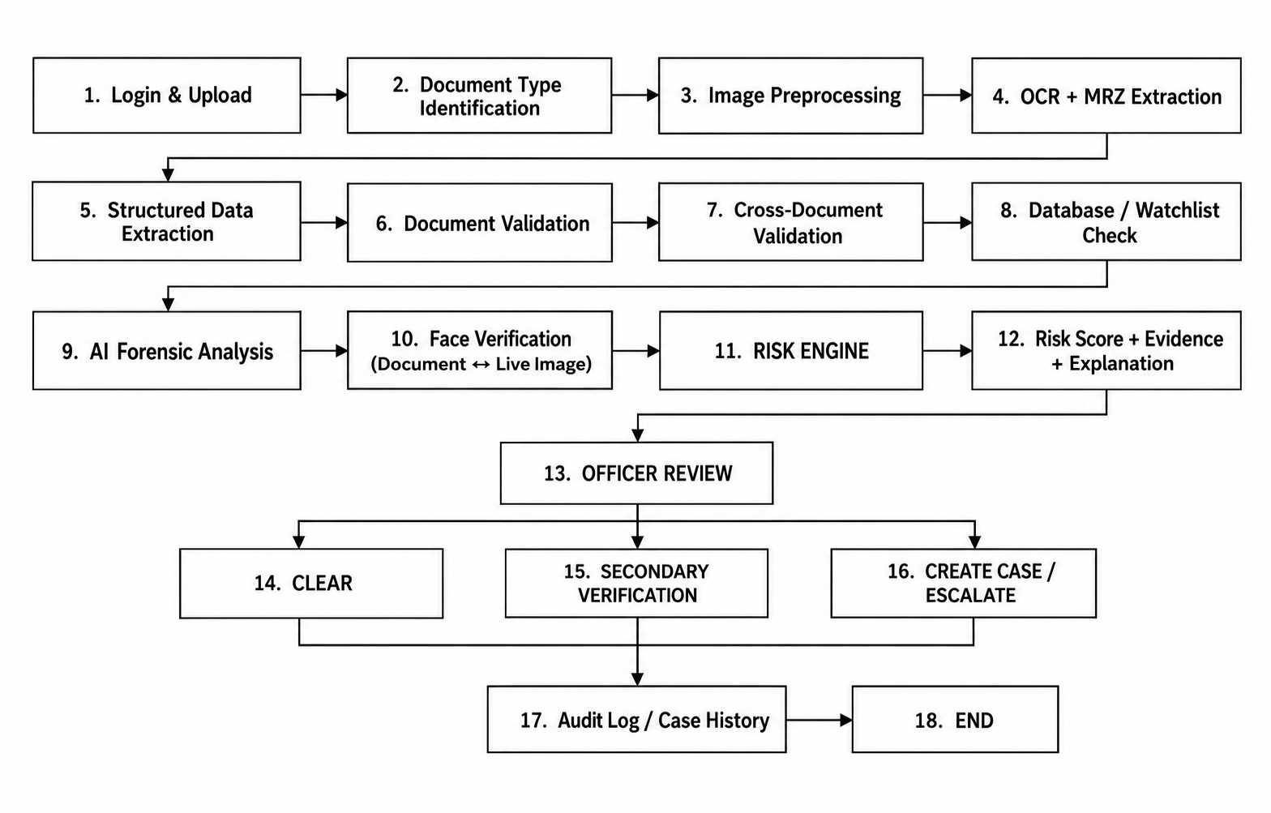
TECHNICAL APPROACH
BYTESENTINEL
Technology Stack:
Backend & API: Python 3.12 + Flask 3 + SQLAlchemy — REST API
Document Data Extraction: PaddleOCR (PP-OCRv5) + mrzscanner — MRZ + OCR + Tesseract
Deterministic Validation: ICAO 9303 check digits + Verhoeff checksum
Biometric Verification: InsightFace (buffalo_l) on ONNX Runtime
Console, Data & Risk Engine: React 19 + Vite + Tailwind; Next.js 16 landing SQLite / MySQL; weighted 0–100 risk score

Slide 4
FEASIBILITY AND VIABILITY
BYTESENTINEL
Category | 🟢 Feasible | 🔴 Challenge | 💡 Strategy
⚙️ Technical | • OCR + CV tools are mature • MRZ validation is standardized | • 35% of document fraud was digital forgery • Deepfakes are harder to detect | • OCR + MRZ + forensics • Layered AI detection
💰 Financial | • Open-source tools reduce MVP cost • Cloud enables pay-as-you-go scaling | • Commercial IDV platforms already exist • AI models need continuous updates | • Build low-cost MVP • Scale after validation
📊 Market | • 70+ Cr DigiLocker users • 900+ Cr documents issued | • 46% of fraudulent submissions target National IDs • Trusted-source access may require authorization | • India-first deployment • Integrate authorized sources
👮 Operational | • Automated checks can run in seconds • Human review can be retained | • 1 in 5 biometric fraud attempts involve deepfakes • False positives remain possible | • Risk-based thresholds • Human-in-the-loop

Slide 5
IMPACT AND BENEFITS
BYTESENTINEL
Impact Area | Indian Data / Evidence | Benefits
💰 Financial Protection | ₹11,158+ Cr fraud amount saved by I4C | Earlier detection → faster fraud intervention
⚡ Faster Verification | 19.36 Cr Aadhaar face-auth transactions/month | Quick, contactless identity verification
📄 Less Paperwork | 39.47 Cr Aadhaar e-KYC transactions/month | Digital verification → less manual work
👮 Officer Efficiency | 32.80 lakh complaints handled by CFCFRMS | Risk-based screening → focus on high-risk cases
🛡️ Trust & Security | 200 Cr Aadhaar face-auth transactions | Secure identity verification at scale
📈 Scalability | 2,707 Cr Aadhaar authentications in FY 2024–25 | Supports high-volume verification

Slide 6
RESEARCH AND REFERENCES
BYTESENTINEL
Details / Links of the reference and research work
Source | Used For | Link
Entrust Identity Fraud Report | Fraud, deepfake & forgery statistics | Entrust Report
Research & Markets | Document verification market data | Research and Markets
Mordor Intelligence | Identity verification market data | Mordor Intelligence
PIB / MHA–I4C | Indian cyber-fraud & Aadhaar data | Press India Release
DigiLocker | Digital document usage statistics | DigiLocker
ICAO Doc 9303 | MRZ & document validation standards | ICAO
NIST | Face-morph detection research | NIST
Frontex | Border document-fraud evidence | Frontex

