Slide 1
WORKING OF HIVE
Name: VAKA PRASANNA
Roll No: 20BQ1A05O6
Subject: Big Data Analytics
Section: 4-CSE-D
College: Vasireddy Venkatadri Institute of Technology

Slide 2
Content Layout
A
What is HIVE?
B
Features of HIVE
C
Working of HIVE

Slide 3

WHAT
IS HIVE?

Slide 4
WHAT IS HIVE?
Hive is a data warehouse infrastructure tool to process structured data in Hadoop.
It resides on top of Hadoop to summarize Big Data and makes querying and analyzing easy.
Initially Hive was developed by Facebook, later the Apache Software Foundation took it up and developed it further as an open source under the name Apache Hive.
It is used by different companies.
For example, Amazon uses it in Amazon Elastic MapReduce.

Slide 5
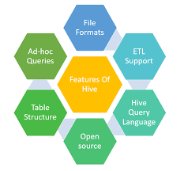
Features
Of
HIVE

Slide 6
FEATURES OF HIVE
It stores schema in a database and processes data into HDFS.
It is designed for OLAP.
It provides SQL-type language for querying called HiveQL or HQL.
=> It is: 1) familiar
2) fast
3) scalable
4) extensible.

Slide 7
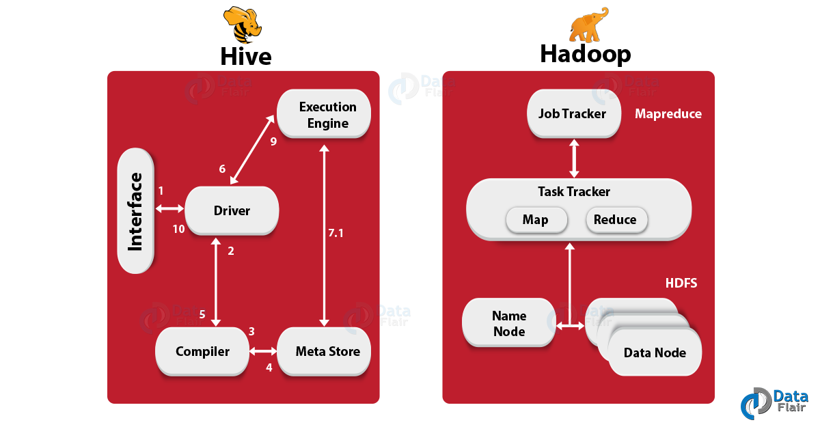
Working of HIVE

Slide 8
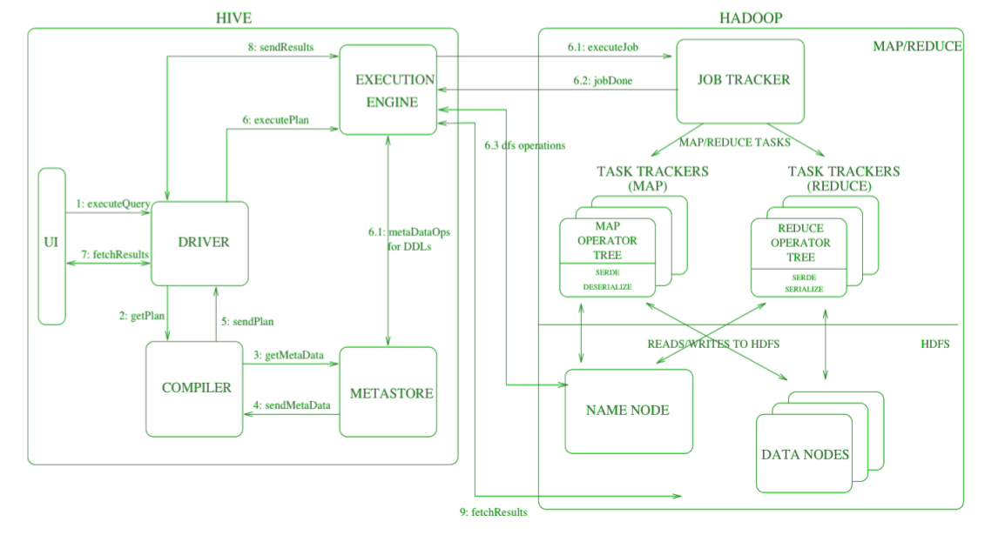
WORKING OF HIVE:

Slide 9
Working of HIVE
1) Execute Query:
The Hive interface such as Command Line or Web UI sends a query to the Driver (any database driver such as JDBC, ODBC, etc.) to execute.
2) Get Plan:
The driver takes the help of a query compiler that parses the query to check the syntax and query plan or the requirement of the query.
3) Get Metadata:
The compiler sends metadata requests to Metastore (any database).
4)Send Metadata:
Metastore sends metadata as a response to the compiler.

Slide 10
Working of HIVE
5) Send Plan:
The compiler checks the requirement and resends the plan to the driver.
Up to here, the parsing and compiling of a query is complete.
6) Execute Plan:
The driver sends the execute plan to the execution engine.
7) Execute Job:
Internally, the process of execution job is a MapReduce job. The execution engine sends the job to JobTracker, which is in Name node and it assigns this job to TaskTracker, which is in Data node. Here, the query executes MapReduce job.

Slide 11
Working of HIVE
7.1)Metadata Ops:
Meanwhile in execution, the execution engine can execute metadata operations with Metastore.
8) Fetch Result:
The execution engine receives the results from Data nodes.
9) Send Results:
The execution engine sends those resultant values to the driver.
10) Send Results:
The driver sends the results to Hive Interfaces.

Slide 12


