Slide 1

Abstract Factory design pattern
Name: Vaka Prasanna
Roll No: 20BQ1A05O6
Section: 4-CSE-D
Subject: Design patterns
College: vasireddy Venkatadri institute of technology

Slide 2
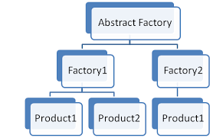
Abstract Factory Intent
Abstract Factory is a creational design pattern that lets you produce families of related objects without specifying their concrete classes.

Slide 3
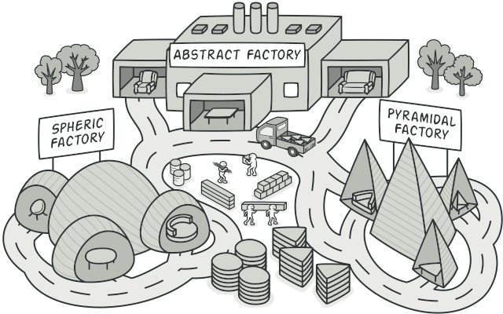
Abstract Factory Problem

Slide 4
Abstract Factory Problem
Imagine that you’re creating a furniture shop simulator. Your code consists of classes that represent:
A family of related products, say: Chair + Sofa + CoffeeTable.
Several variants of this family.
For example, products Chair + Sofa + CoffeeTable are available in these variants: Modern
Victorian
ArtDeco.

Slide 5
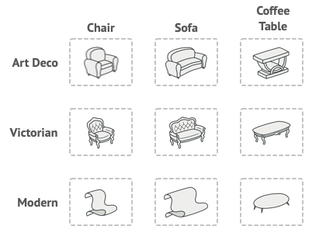
PRODUCT OF FAMILIES AND THEIR VARIANTS:

Slide 6
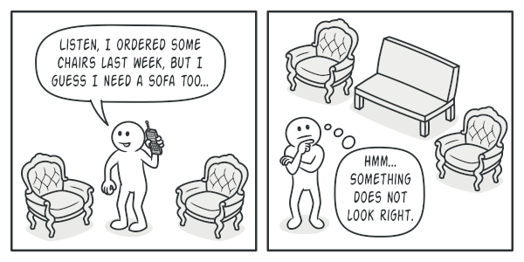
Abstract Factory Problem
You need a way to create individual furniture objects
so that they match other objects in the
same family.
You don’t want to change the existing
code when adding new products or
families of products to the program.

Slide 7
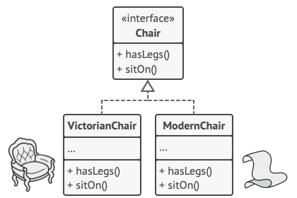
Abstract Factory design pattern Solution
STEP-1:
Abstract Factory pattern suggests explicitly declaring interfaces for each distinct product of the product family (e.g., chair, sofa, or coffee table).
Then you can make all variants of products follow those interfaces. For example, all chair variants can implement the Chair interface, and so on.
All variants of the same object must be moved to a single class hierarchy.

Slide 8
Abstract Factory design pattern Solution
STEP-2:
Declare the Abstract Factory—an interface with a list of creation methods for all products that are part of the product family (for example:
createChair
createSofa
createCoffeeTable).
These methods must return abstract product types represented by the interfaces we extracted previously: Chair, Sofa, CoffeeTable, and so on.

Slide 9
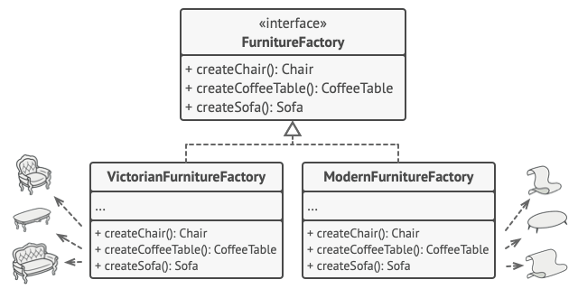
Abstract Factory design pattern Solution
Each concrete factory corresponds to a specific product variant.

Slide 10
Abstract Factory design pattern Solution
STEP-3: How about the product variants?
For each variant of a product family, we create a separate factory class based on the AbstractFactory interface.
A factory is a class that returns an interface. A factory is a class that returns products of a particular kind.
For example, the ModernFurnitureFactory can only create:
ModernChair
ModernSofa
ModernCoffeeTable objects
The client code has to work with both factories and products via their respective abstract interfaces.

Slide 11
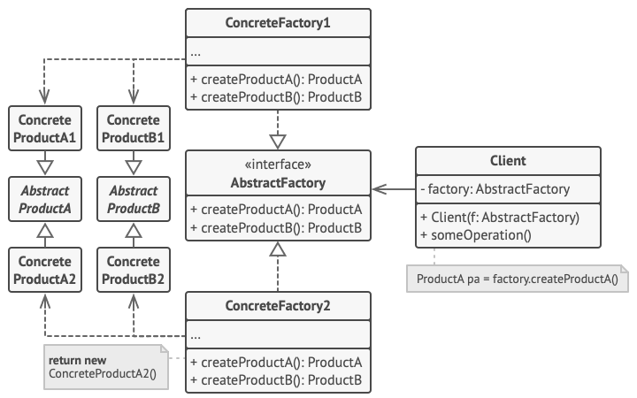
Structure of Abstract Factory design pattern

Slide 12
Participants of Abstract Factory design pattern
Abstract Products declare interfaces for a set of distinct but related products that make up a product family.
Concrete Products are various implementations of abstract products, grouped by variants. Each abstract product (chair/sofa) must be implemented in all given variants (Victorian/Modern).

Slide 13
Participants of Abstract Factory design pattern
3) The Abstract Factory interface declares a set of methods for creating each of the abstract products.
4) Concrete Factories implement creation methods of the abstract factory
5) The Client can work with any concrete factory/product variant, as long as it communicates with their objects via abstract interfaces.

Slide 14
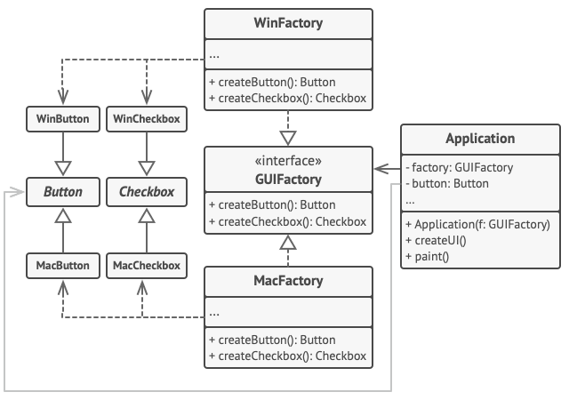
Pseudocode

Slide 15
Applicability:
Use Abstract Factory Design Pattern when:
To work with various families of related products, but you don’t want it to depend on the concrete classes of those products.
Consider implementing the Abstract Factory when you have a class with a set of Factory Methods that blur its primary responsibility.

Slide 16


