Slide 1


SMART INDIA HACKATHON 2024
TITLE PAGE
Problem Statement ID - 1583
Problem Statement Title - Condition-Based
Monitoring And Maintenance System
Theme - Miscellaneous
PS Category - Hardware
Team Name - PrimeHex
Team ID – RMKSIH24HW021

Slide 2

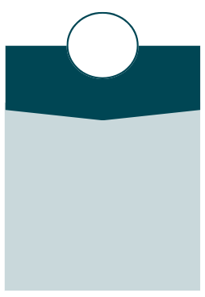
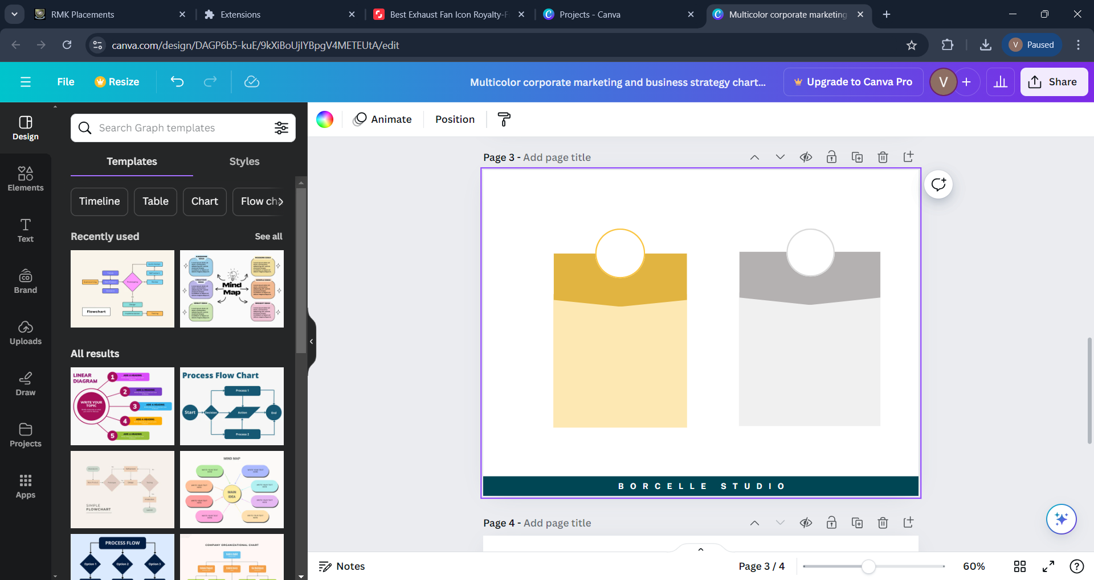



IDEA TITLE
PrimeHex
Uniqueness of the solution
Proposed solution
Addressing the problem
Sensor Data Collection: Sensors on TBFs capture operational data during drills, providing essential insights into fan condition.
Condition-Based Maintenance: The system shifts from scheduled maintenance to condition-based, ensuring maintenance is performed only when needed.
AI-Powered Alerts: The AI system sends alerts for deviations, optimizing maintenance and reducing manpower and operational risks.
Efficient Data Collection: Sensors on TBFs gather precise operational data during drills, reducing the need for manual inspections.
Optimized Maintenance: Condition-based maintenance eliminates unnecessary routine checks, focusing on actual equipment needs.
Risk and Cost Reduction: The AI system alerts for deviations, minimizing manpower usage and safety risks, especially in high-risk environments.
Targeted Maintenance Approach: Shifting from scheduled to condition-based maintenance ensures resources are used only when necessary, reducing waste.
Real-Time AI Insights: The integration of AI provides predictive maintenance alerts, offering proactive solutions instead of reactive fixes.
Cost and Risk Efficiency: Minimizes operational costs and safety risks by optimizing manpower deployment and reducing high-risk manual inspections.

Slide 3
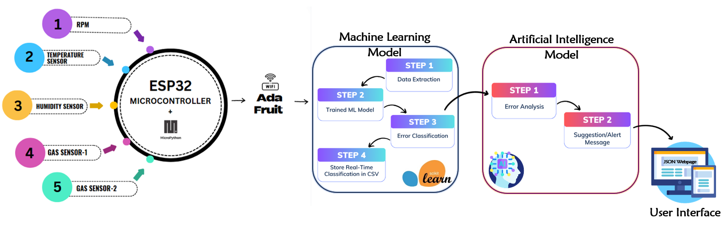

TECHNICAL APPROACH
PrimeHex
TBF
[Power Supply]
[Temperature]
[Humidity]
[Smoke]
[Smoke]
Technology used
Micropython
Sklearn library
LLM Model
Frontend with Flask (Interface)

Slide 4
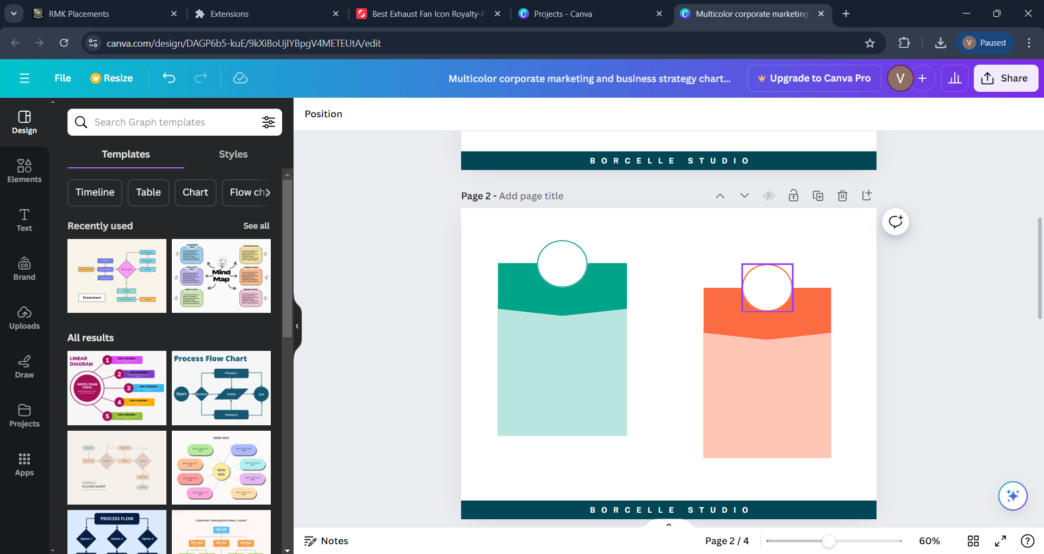
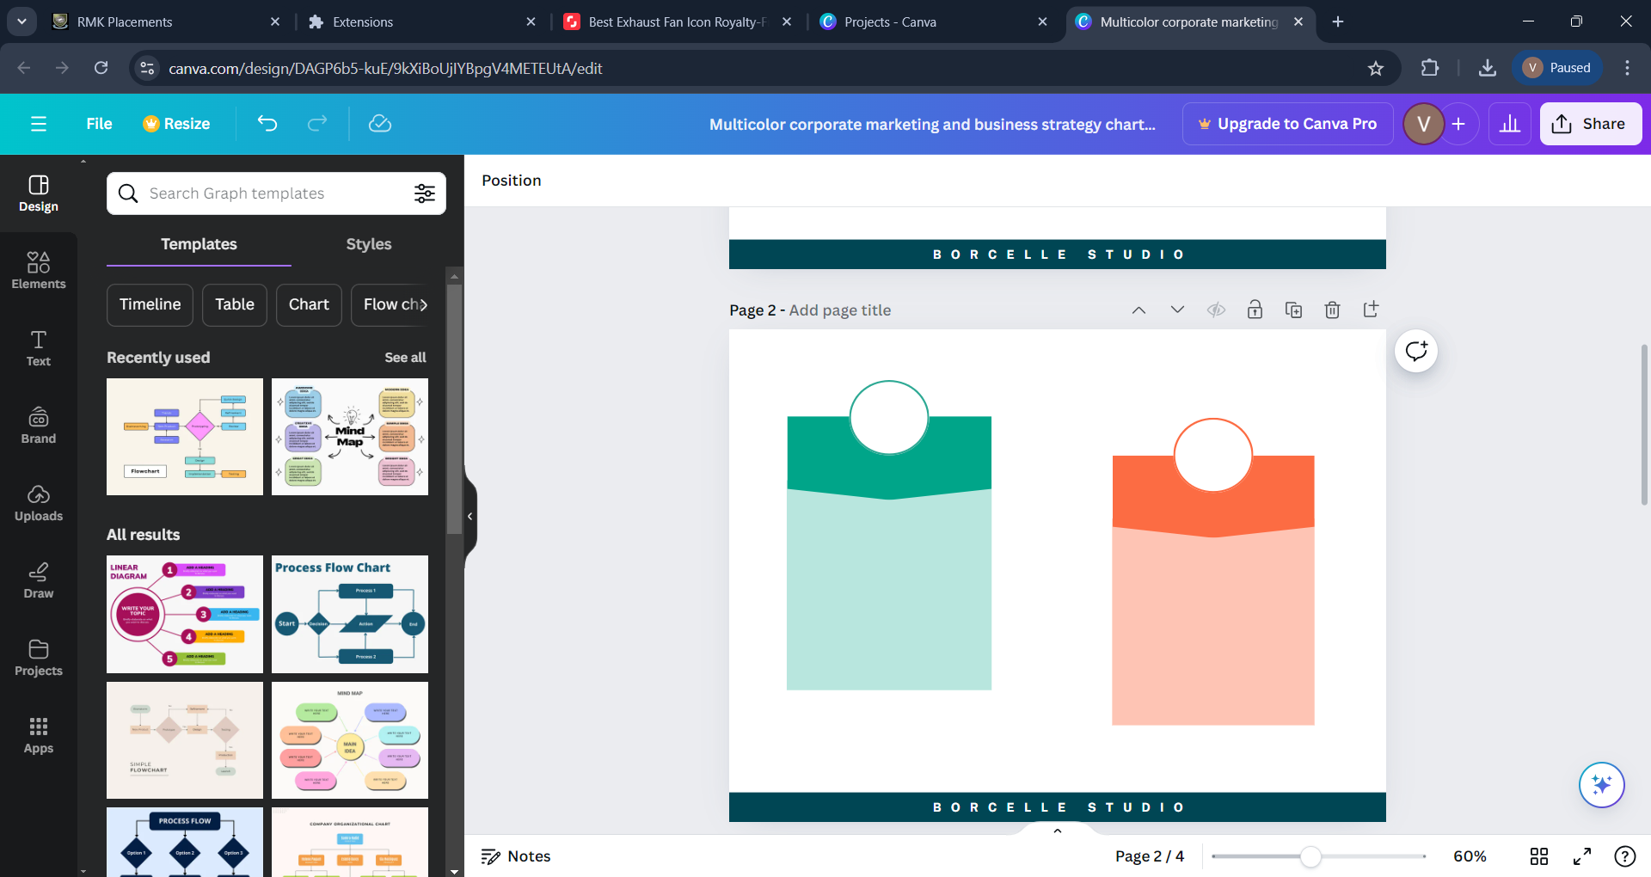




FEASIBILITY AND VIABILITY
PrimeHex
Feasibility
Hardware Selection
Data Processing: Store and manage data with Adafruit Cloud.
AI/ML Integration: Employ AI/ML to analyze data and detect faults.
Development and Integration: Program and integrate components with MicroPython.
Scalability
Challenges & Overcomes
Viability
Cost Efficiency: Initial costs are balanced by significant long-term savings.
Return On Investment : High return through cost reductions and increased asset value
Energy Savings: Continuous monitoring cuts energy use and utility bills.
Automation
Enhanced Safety
Flexible
ML Algorithm Selection and Training: Beginning with simpler models, then evolve to more complex ones using diverse, well labeled data for improved predictions.
Integration and Maintenance: Design modular system with API-based communication and automated health monitoring for easy updates and efficient maintenance
Enhanced Detection: Utilize ensemble learning methods and adjust dynamic thresholds to minimize false alarms and improve overall fault detection performance

Slide 5


IMPACT AND BENEFITS
PrimeHex
Impact
Benefits
Predictive Maintenance: AI-driven error detection supports proactive maintenance, reducing downtime and emergency situations.
Efficient Resource Allocation: Early issue identification allows better prioritization and resource management for maintenance teams.
Data-Driven Strategies: Error data informs predictive maintenance, leading to improved long-term system performance and reliability.
Enhanced Safety: Early error detection prevents potential hazards, ensuring tunnel safety during emergencies.
Operational Continuity: Regular checks and quick repairs maintain uninterrupted tunnel ventilation system performance.
Extended Equipment Lifespan: Prevents excessive wear and tear, prolonging the life of the fans.

Slide 6
RESEARCH AND REFERENCES
PrimeHex
A Review of Gas Measurement Practices and Sensors for Tunnels
https://www.mdpi.com/1424-8220/23/3/1090
IoT-Based Temperature Monitoring and Automatic Fan Control Using ESP32
https://www.irejournals.com/paper-details/1705183
Enhancing Tunnel Fan Reliability Through Advanced Factory Acceptance Test (AFAT)
https://www.krugerfan.com/public/uploads/cs-pdf-202420242024202405050909101005053333.pdf
Condition-Based Maintenance Using Machine Learning and Role of Interpretability
https://link.springer.com/article/10.1007/s13198-022-01843-7

