Slide 1
Data acquisition system Signal conditioning
Student: Vakutz Alexandru-Andrei
Group: 2031
Notes:
today I will talk about which temperature sensor I chose for the greenhouse and explain why I chose it.

Slide 2
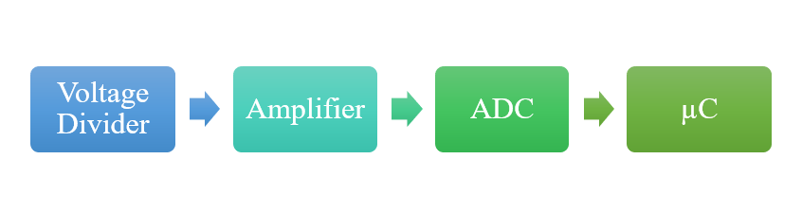
Block Diagram
Notes:
Here we have block diagram of the greenhouse system.

Slide 3
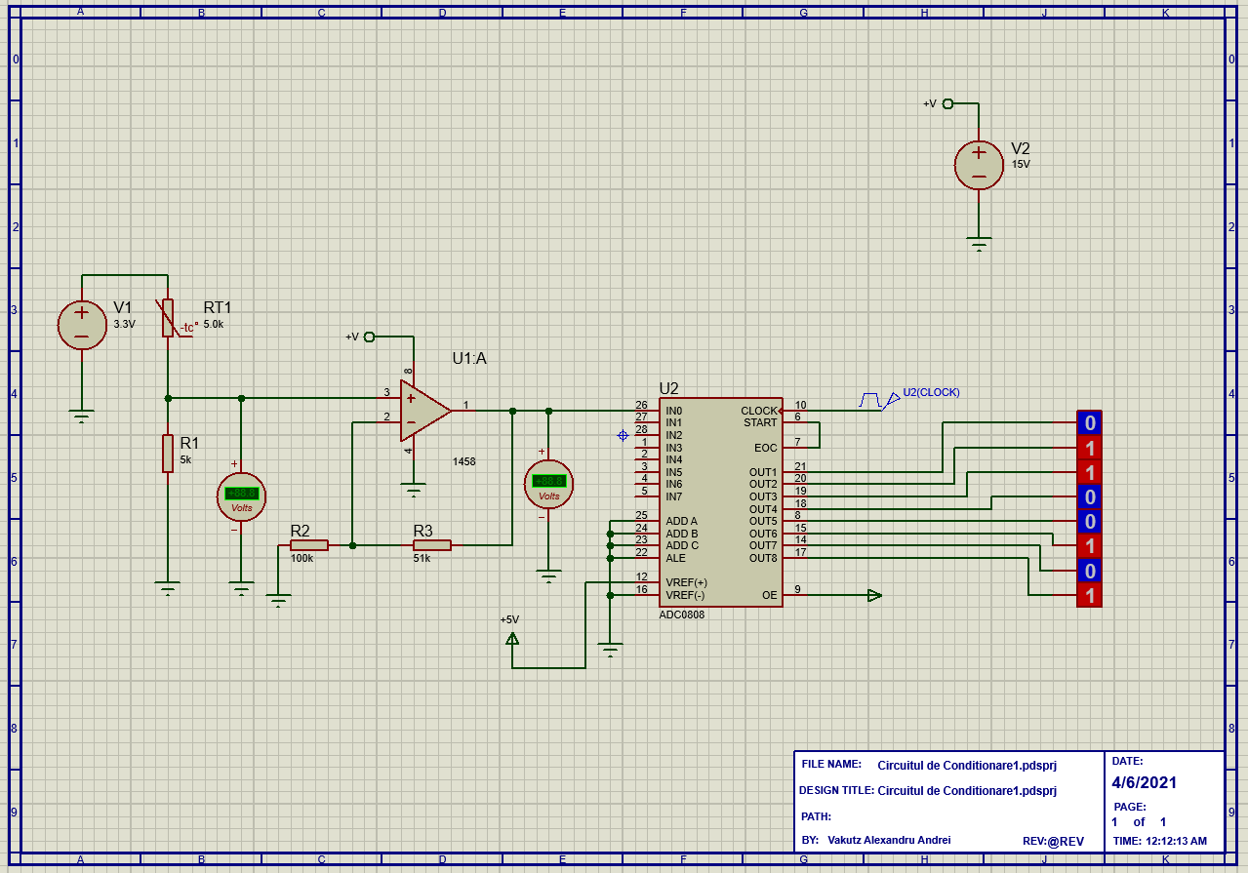
Circuit

Slide 4







Calculus
Vcc = 3.3V; Vref = 5V;
Vo1 = 1.65V; Av = 0.51V; R2 = 100k; R3 = 51k
Vo2 = 2.49V; N = 8
ADC = 128

Slide 5
Simulations
Rt@25℃ => 10000000 => Rt = 5k
Rt@45℃ => 10101111 => Rt = 2.3k
Rt@28℃ => 10001000 => Rt = 12.65k
Rt@10℃ => 01100101 => Rt = 9.4k

Slide 6

Thank you for your time

