Slide 1
Data acquisition system
Student: Vakutz Alexandru-Andrei
Group: 2031
Notes:
today I will talk about which temperature sensor I chose for the greenhouse and explain why I chose it.

Slide 2
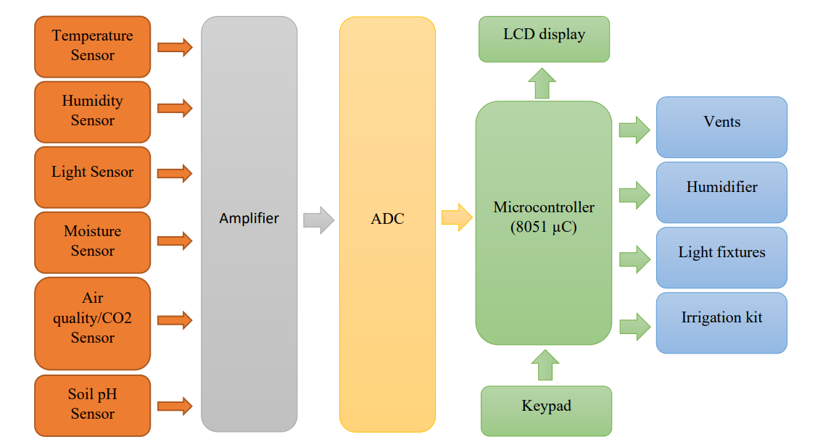
Block Diagram
Notes:
Here we have block diagram of the greenhouse system.

Slide 3
Table of contents
1. Measurement methods
2. Proposed methods
3. Sensor Comparison
4. Proposed sensor
Notes:
Today I will talk about the types of measurement methods, then I will try and explain why I chose a certain method and not the others. After that, I will present 3 possible sensors and finally explain which one I chose and why.

Slide 4
1. Measurement Methods
Thermocouples
Resistance temperature Measurement Device
Thermistor
Infrared Sensors
Bimetallic sensors
Thermometers
Change of state sensors
Silicone Diode
Notes:
Thermocouples – voltage devices that indicate temperature measurement with a change in voltage, as temperature goes up. But are mainly meant to work with high temperature, which we do not require in our greenhouse.
Resistance temperature sensor (RTD) – is a contact sensor. It uses the variation of the resistance of a metal according to the temperature. This type of sensor uses several metals that offer different measuring ranges.
Thermistor – another type of resistance sensor, that uses the variation of metal oxides according to the temperature. There are 2 types: NTC (as the temp increases, the resistance decreases) and PTC (the temperature rises, so does the resistance)
Infrared sensor – non-contacting sensors. It measures the radiation of a surface in the infrared range to derive the surface temperature. The only downside to this sensor is that it can only measure the surface temperature of the target, and the measurement can be influenced by quite a few factors, such as the condition of the target, the condition of the lenses and cleanliness of the optical path.
Bimetallic sensors – take advantage of the expansion of metal when they are heated, so two metals are bonded together and mechanically linked to a pointer. When heated, one side of the sensor strip will expand more than the other. Although it may be portable, it is less accurate than other sensors and one cannot easily record the temperature.
Thermometers - well known liquid expansion devices also used for temperature measurement. Breaking a mercury thermometer is hazardous, because mercury is considered an environmental contaminant.
Change-of-state sensors – measure a change in the state of a material brought about by a change in temperature, as in a change from ice to water and then steam. But it does have a slow response time and the accuracy is not as high as of the other sensors.
Silicone Diode – is a device developed specifically for the cryogenic temperature range. Which is not ideal for a greenhouse.

Slide 5
2. Proposed method: Thermistor
Sensor type | Thermistor | RTD
Temperature range | -100 to 352℃ | -200 to 650℃
Accuracy | 0.05 to 1.5℃ | 0.1 to 1℃
Long-term stability@100℃ | 0.2℃/year | 0.05℃/year
Linearity | Exponential | Fairly linear
Power required | Constant voltage/current | Constant voltage/current
Response time | Fast (0.12 to 10s) | Slow (1 to 50s)
Susceptibility to electrical noise | Rarely susceptible High resistance only | Rarely Susceptible
Cost | Low to moderate | High
Notes:
Taking into account the information presented earlier, we find ourselves with two options left: the thermistor and the RTD sensors. Considering the temperature range, the accuracy and the long-term stability, The RTD clearly comes out on top.
Considering the lower cost and the fast response time, due to its exponential linearity, of a thermistor combined with the fact that there is not such a huge difference when it comes to accuracy between the two, the thermistor would be the natural choice.

Slide 6
3. Sensor Comparison
Model | B57881S | NTCLE100E3 | NI24MA0502H
Accuracy | High | Over a wide temperature range | High
Availability | Yes | Yes | Yes
Price | 11.07 RON | 1.71 RON | 6.61 RON
Applications | Temperature measurement | Temperature measurement Compensation | Temperature measurement Air intake temperature Evaporator probe
Operating Temperature | -55℃ to 155℃ | -40℃ to 125℃ | -55℃ to 150℃
Resistance Tolerance | ±1% | ±5% | ±3%
Notes:
Here we have 3 similar thermistors not so different from one to another. The only notable differences are in the price and the applications range.
Price wise, the NTC would be the obvious choice, but it does have a quite high resistance tolerance, which might prove to be a problem. The next natural choice would be the NI24. Quite a large variety of applications, high accuracy, wide temperature range and an acceptable tolerance.

Slide 7
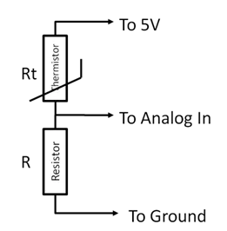
3.1. Interfacing
Notes:
But before I reveal my sensor of choice, I would like to present the interface which is used to send the data from the sensor to the uC since, it is the same for all thermistors.
Microcontrollers read voltages and not resistances, so, the simplest circuit to convert the resistance change, generated by the thermistor, to voltage change is a voltage divider. Therefor the variation of the resistance can be measure in the middle of the two (at analog in), when the resistance changes, so does the voltage.

Slide 8
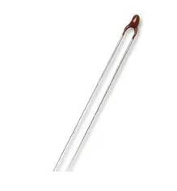
4. Proposed sensor
NI24MA0502H sensor
Notes:
In the end, I decided to go with the NI24 sensor, because it is superior to the NTC and when compared to the B57, the differences are not enough of a justification to pay the extra money.

Slide 9

Thank you for your time

