Slide 1
Data acquisition system Humidity sensor
Student: Vakutz Alexandru-Andrei
Group: 2031

Slide 2
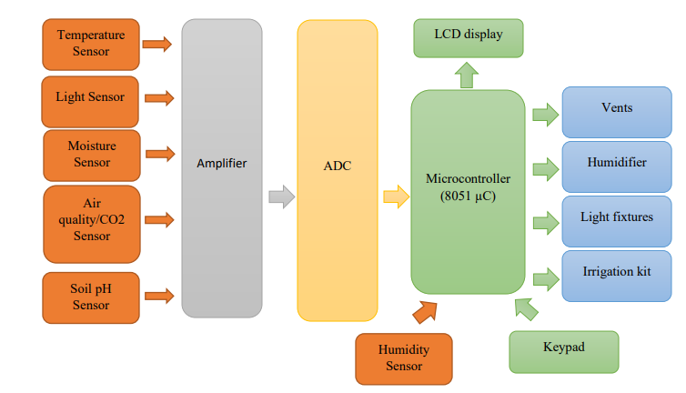
Block Diagram

Slide 3
Table of contents
1. Measurement methods
2. Proposed methods
3. Sensor Comparison
4. Proposed sensor

Slide 4
1. Measurement Methods
Capacitive
Resistive
Thermal

Slide 5
2. Proposed method: Thermal Humidity Sensor

Slide 6
3. Sensor Comparison
Model | HDC1010YPAT | SI7021-A20-GM | SHT31-DIS-B
Output | Digital | Digital | Digital
RH operating range | 0-100% | 0-100% | 0-100%
Stability | Excellent at high humidity | Excellent long term | High
Relative Humidity Accuracy | ±2% RH | ±3% RH | ±1.5% RH
Temperature accuracy | ±0.2 ℃ | ±0.4℃ | ±0.1 ℃
Operating temperature | -40℃ to 85℃ | -40℃ to 125℃ | -40℃ to 125℃
Availability | Yes | Yes | Yes
Interface | I2C | I2C | I2C
Price | 15.47 RON | 15.50 RON | 18.10 RON

Slide 7
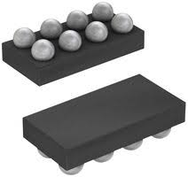
4. Proposed sensor
HDC1010YPAT sensor

Slide 8

Thank you for your time

