Slide 1
Data acquisition system
Student: Vakutz Alexandru-Andrei
Group: 2031

Slide 2
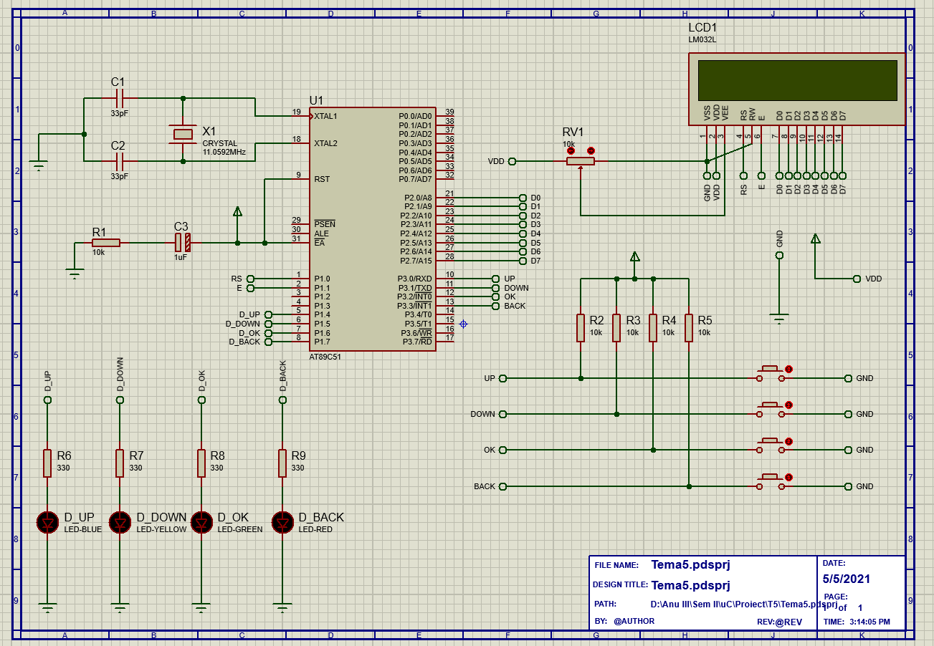
Circuit

Slide 3
µC Model Comparison
Model | CY7C68013A-56LTXC | AT89C51 | DS80C320-MNL+
Availability (market) | Yes | Yes- AT89C51CC03CA-RLTUM | Yes
Availability (Proteus) | *Yes | Yes | *Yes
I2C | Yes | With bit banging | -
CPU speed | 48 MHz | 60 Mhz | 33 Mhz
Core size | 8 bits | 8 bits | -
ROM size | - | 64 Kb | 64 Kb
RAM size | 16 Kb | 2 Kb | 256 Bytes (scrtachpad)
Architecture | 8051 | 80C51 | 8051
Price [RON] | 60.80 | 41.05 | 78.40

Slide 4
LCD Model Comparison
Model | MC22005A6WK-BNMLW-V2 | FC1602N04-RNNYBW-16*E | PC1601LRU-AWB-B-Q
Availability (market) | Yes | Yes | Yes
LCD type | STN | STN | STN
Display appearance | White on blue | Black on yellow/green | Black on yellow/green
Display mode | Transmissive | Reflective | Transreflective
Character (count x line) | 20x2 | 16x2 | 16x1
Interface | Parallel | - | Parallel
Price [RON] | 56.70 | 67.80 | 53.10

Slide 5

Thank you for your time

