Slide 1

Web3.js
Demo
By Singvalliyappa Velayutham

Slide 2

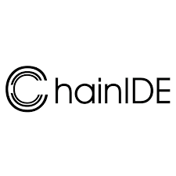
The Problem
Smart contract development
There are many IDEs for smart-contract development, but integrating these contracts into real applications requires additional tooling— libraries , API’s that connect on-chain logic with off-chain programs.
Remix
ChainIDE

Slide 3
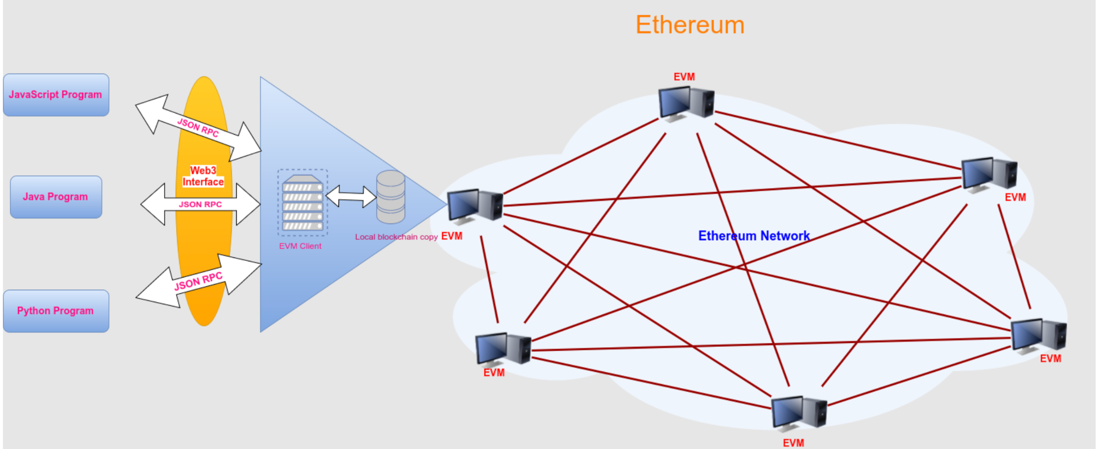
Providers
Alchemy
Infura
AWS of the Blockchain - it gives you a fully-fledged backend to deploy your decentralized Applications on most of the popular chains + gives you APIs to fetch data from the blockchain without having to scrape it all yourself

Slide 4
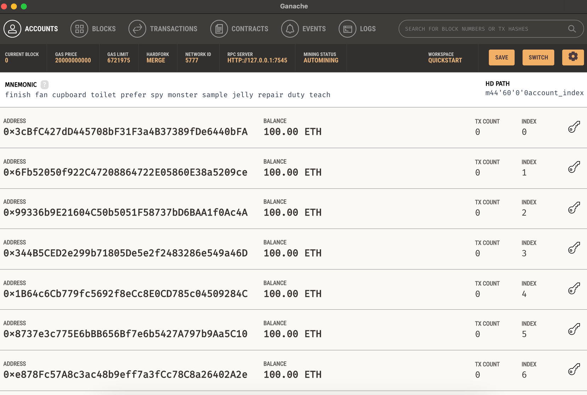
Local Environment ?
GANACHE
Ganache is a local blockchain simulator that lets developers deploy smart contracts quickly, providing deterministic environments for Ethereum development without relying on live networks for experimentation

Slide 5
Some
Code

Slide 6
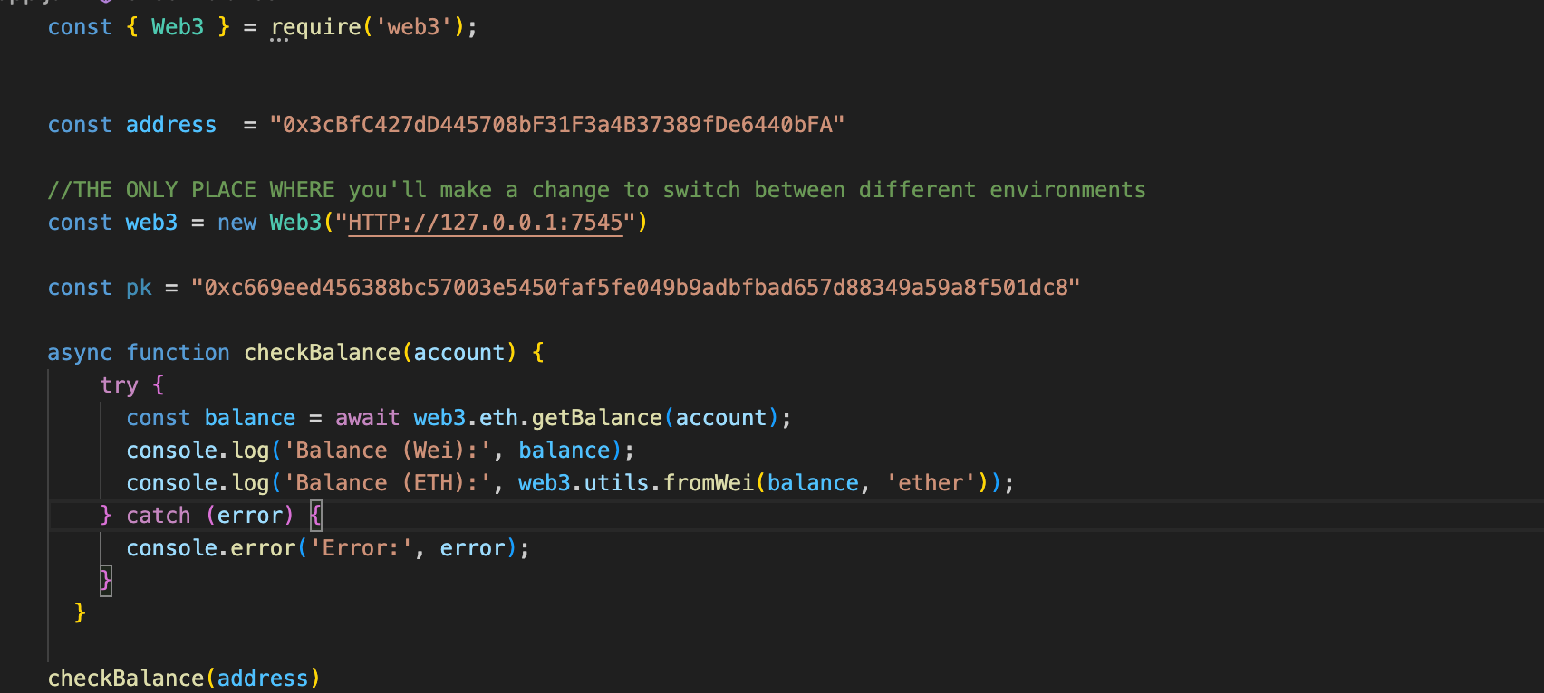
Read an account’s balance

Slide 7
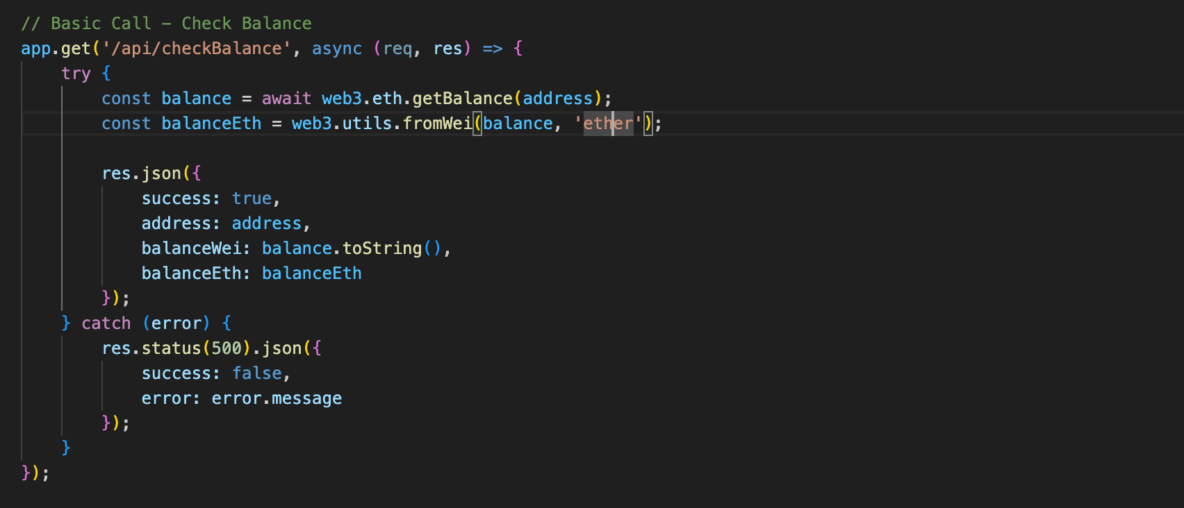
Read an account’s balance

Slide 8
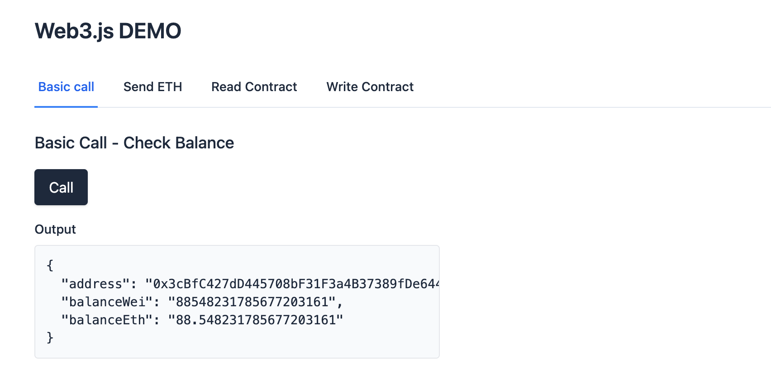
Read an account’s balance

Slide 9
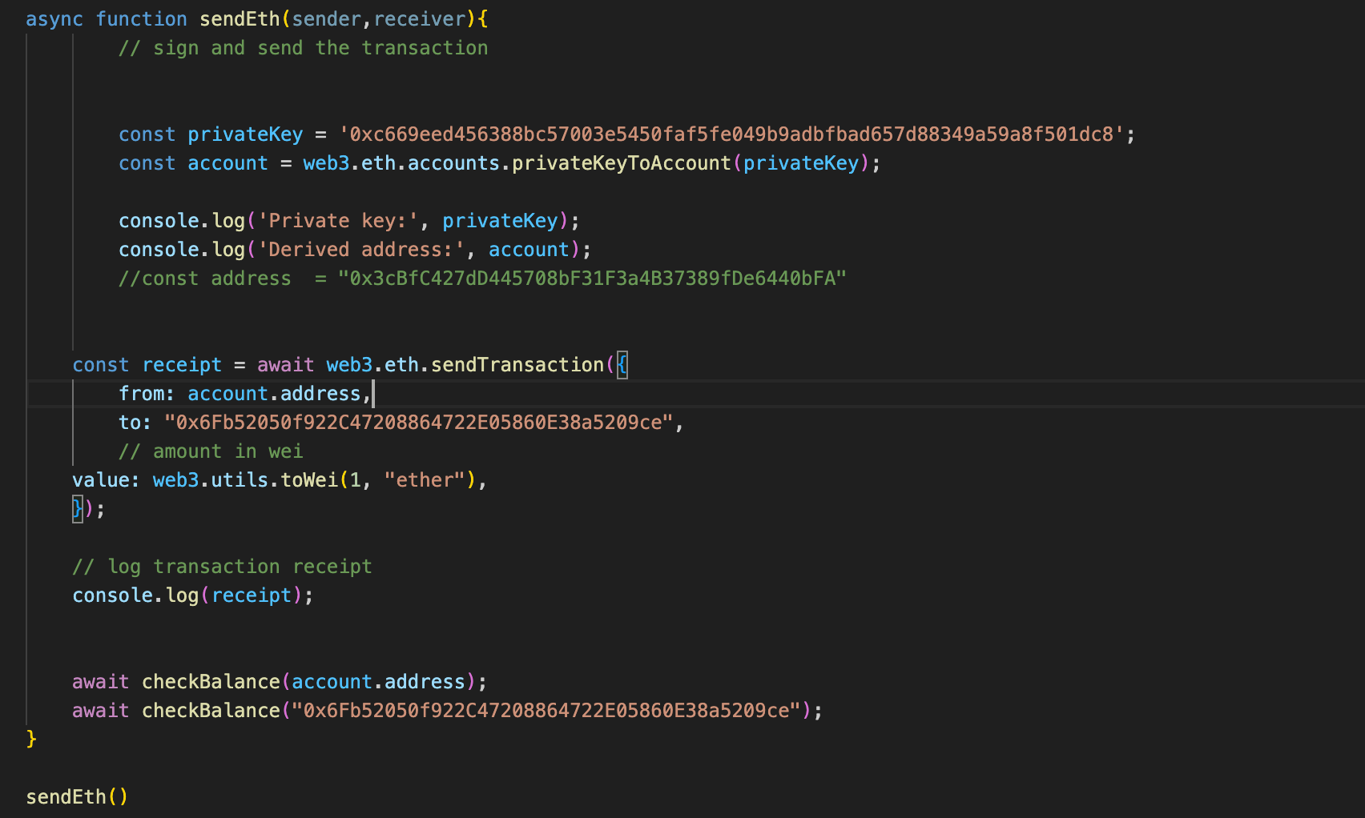
Transfer some ETH

Slide 10
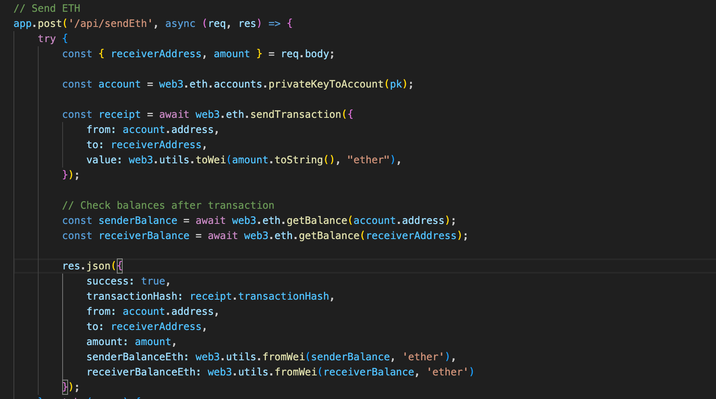
Transfer some ETH

Slide 11
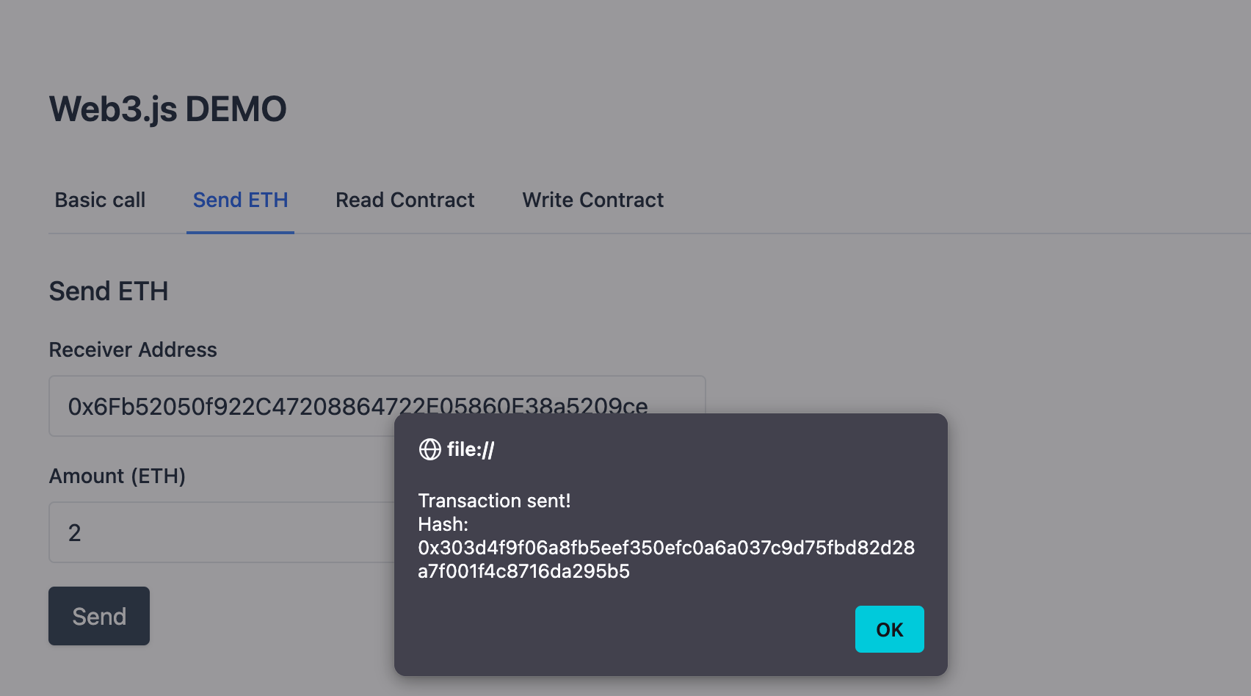
Transfer some ETH

Slide 12
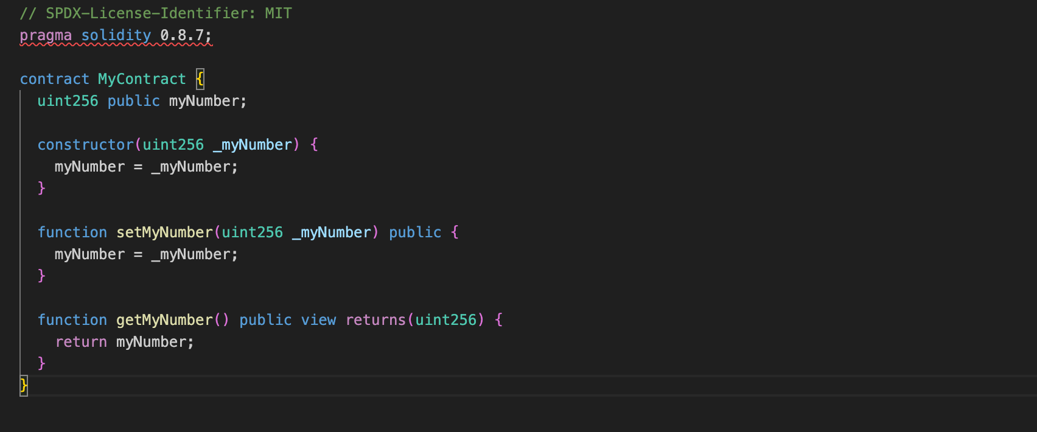
Deploy a smart contract

Slide 13
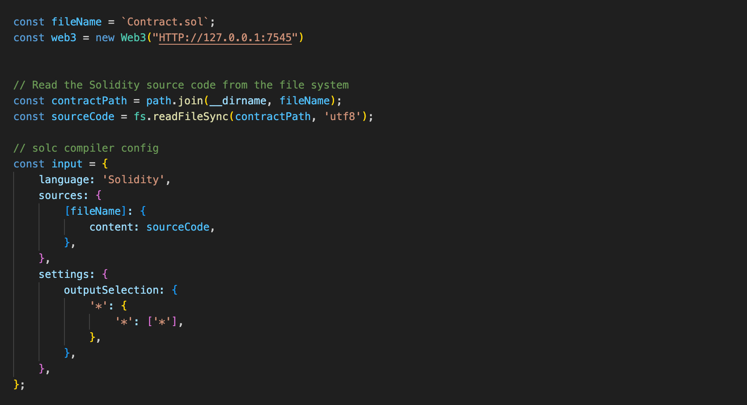
Deploy a smart contract

Slide 14
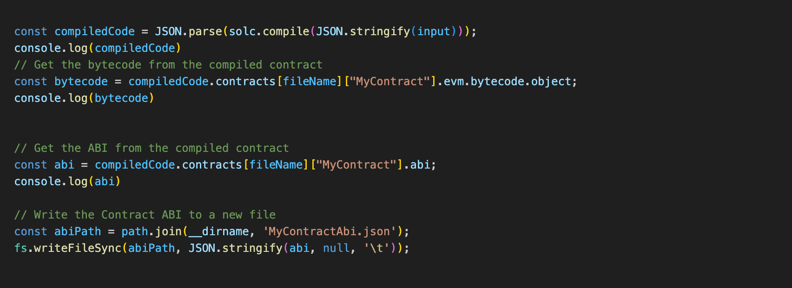
Deploy a smart contract

Slide 15
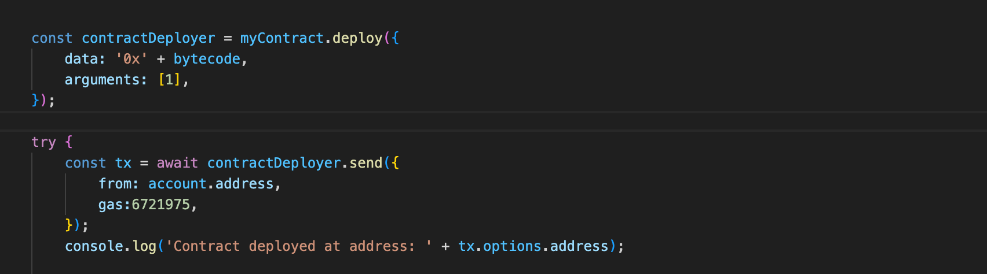
Deploy a smart contract

Slide 16
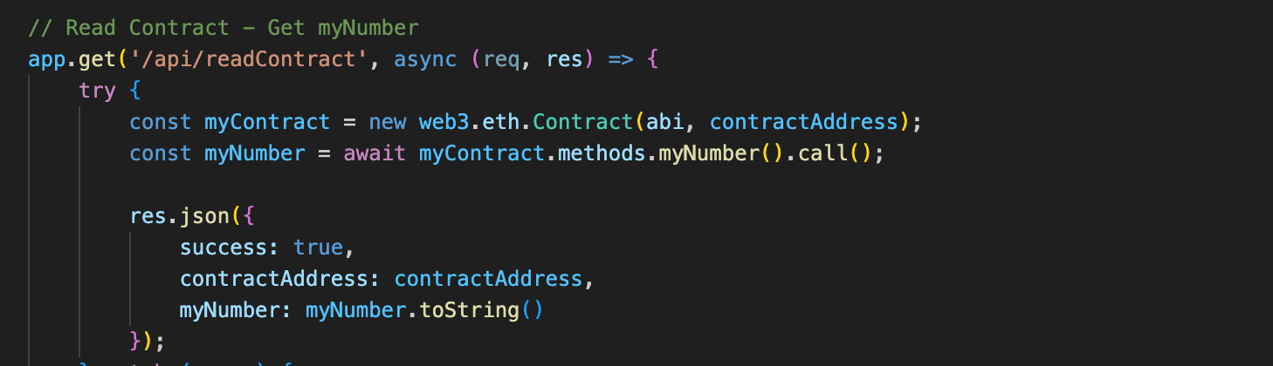
Call a smart contract

Slide 17
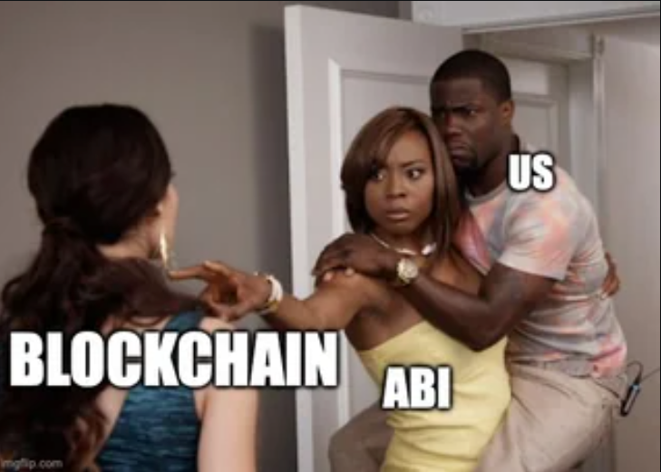
Call a smart contract
ABI?
Abi is used to convert the functions to encoded call data that contains the function selector (which function in the smart contract we want to call and the parameter in its encoded form)
Bytecode reads the call data and executes accordingly
callData =functionSelector + parameters

Slide 18
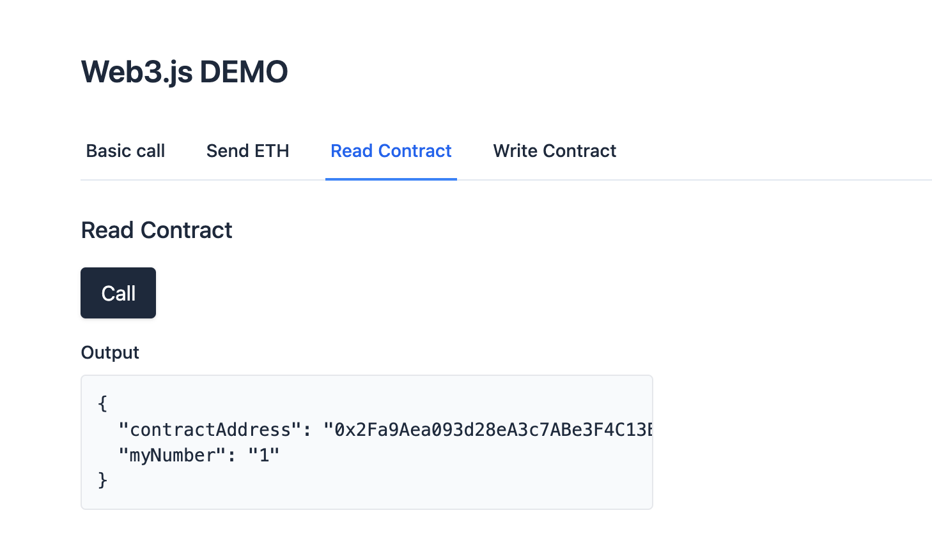
Call a smart contract

Slide 19
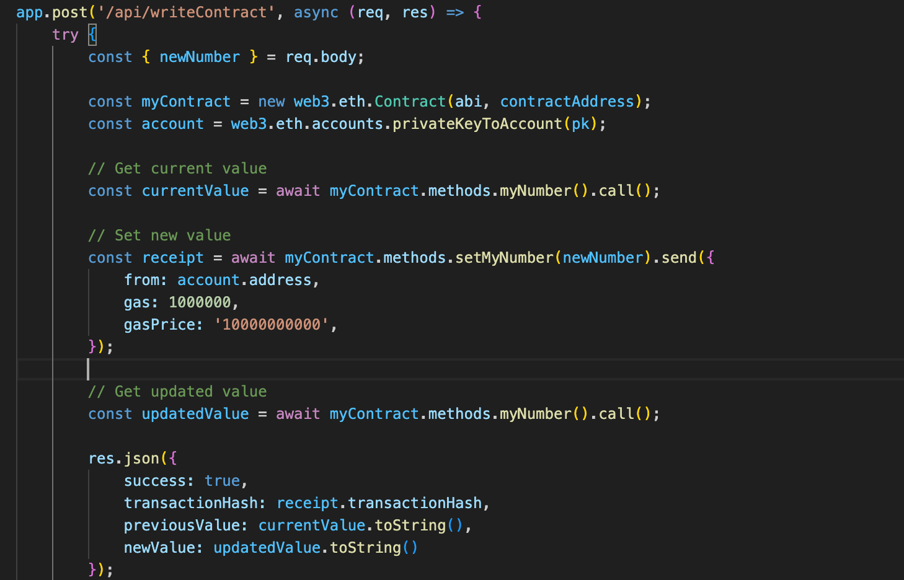
Write to a smart contract

Slide 20
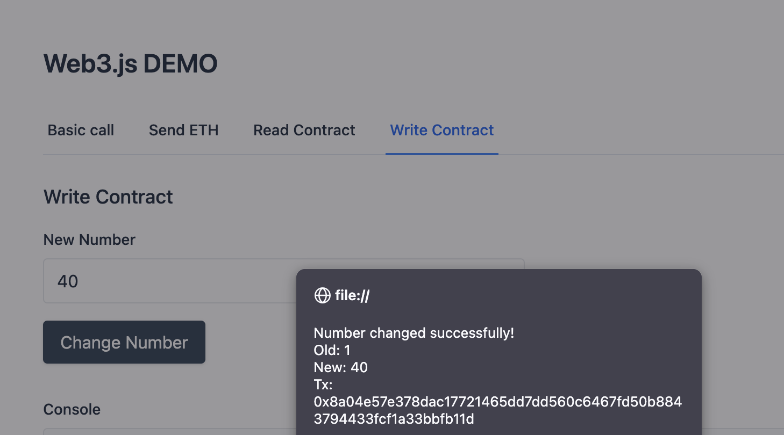
Write to a smart contract

