Slide 1

SMART INDIA HACKATHON 2026
Problem Statement ID – 26098
Problem Statement Title-
Development of a Low-Cost Precision Guidance and Smart Electronic Fuze System for a 155 mm Artillery Shell
Theme- Smart Vehicles
PS Category- Hardware
Team Name : Black Bulls

Slide 2
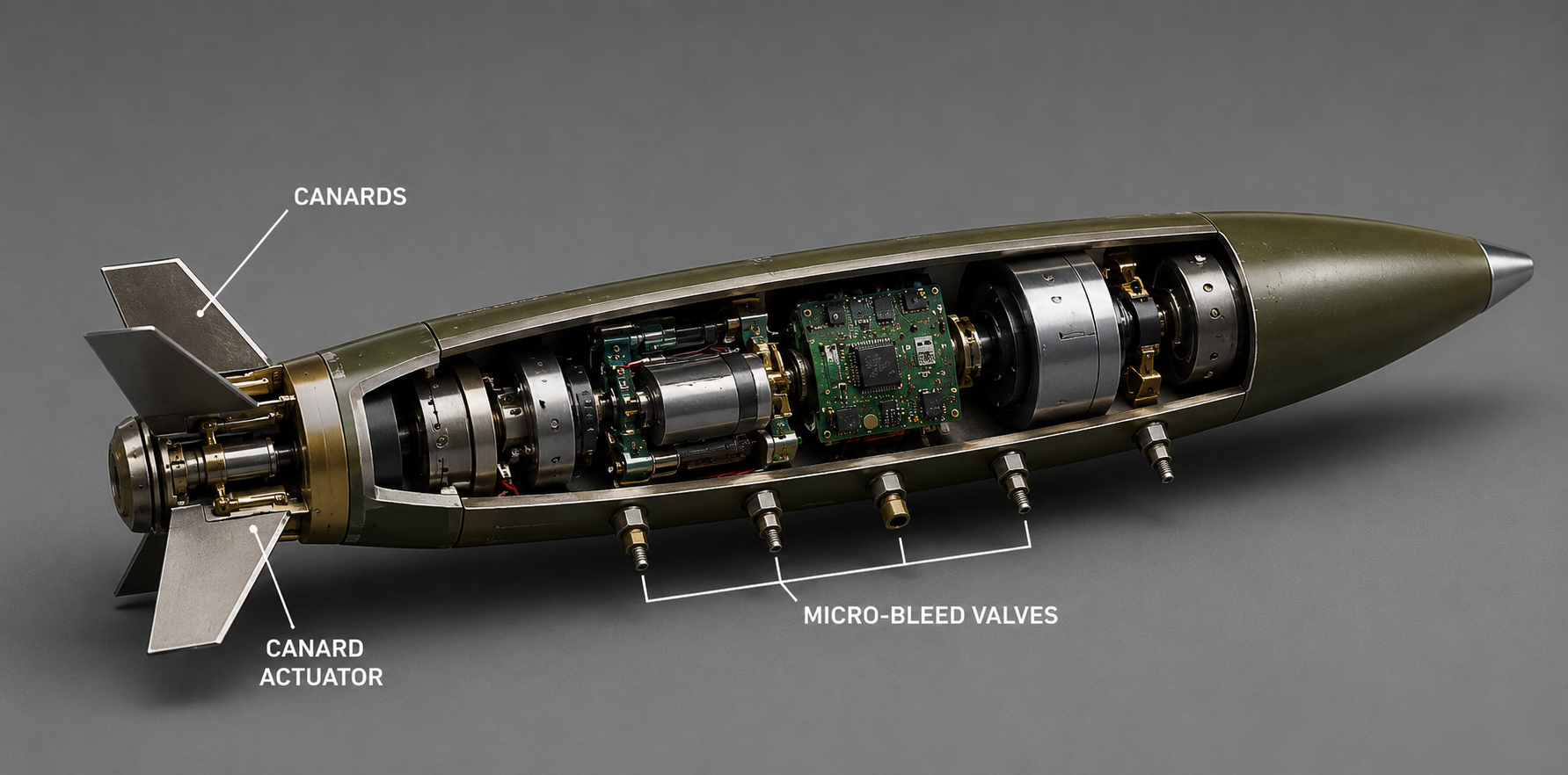
PNavs – Precision Navigation System
BLACKBULLS
Problems:
Not accurate landings
Deviation from trajectory due to wind and other causes
Expensive technology
Failure to withstand harsh conditions
Single mode fuze
Features:
Pressure Controlled
Micro-bleed valves
Deployable Canards
Live trajectory correction
Can sustain Harsh
Weather and Machine
Conditions
Cost effective components
-> Multi mode Electronic Fuze
A Precision Navigating System that constantly corrects the trajectory of the artillery to make sure the CEP<= 30m.
What makes us unique:
State of the art equipment at low costs
In flight trajectory control and precise live tracking
Hybrid combination of canards and micro-bleed valves for faster course correction

Slide 3
TECHNICAL APPROACH
Black Bulls
HOW IT WILL WORK
Use Real time state estimation to remove Unwanted noise
TECHNOLOGY :
ARM BASED MICROCONTROLLER
SIMU/GNSS INTERFACE
SENSORS TO GATHER REAL TIME DATA
C++ AND MATLAB TO CREATE THE FLIGHT SIMULATOR
Using Sensors to Get flight State data
Trajectory error and correction Using flight control Algorithm
Deploying canards and Presure controeld micro-bleed valves to correct the course
REPEAT FOR THE WHOLE COURSE OF THE FLIGHT
MULTI-MODE ELECTRONIC FUZE DO DEFUSE THE BOMB

Slide 4
FEASIBILITY AND VIABILITY
Black Bulls
ECONOMIC FEASABILITY: -> LOW COST SYSTEMS
REUSABLE HARDWARE
SIMULATION FIRST DEVELOPMENT REDUCES TESTING COST
DEVLOPED TO WITHSTAND HARD WEATHER AND MACHINE CONDITIONS
KEY CHALLENGES: ->MAKING IT AERODYNAMIC
->MAKING IT WITHSTAND HARSH CONDITIONS
->sensor noise
->complex integration
->power usage
TECHNOLOGICAL FEASIBILITY:
->DESIGING ON EXISTING SHELL INSTEAD OF COMPLETE REDESIGN
->SENSOR FUSION AND HARDWARE INTEGRATION WILL BE TESTED USING SOFTWARE SIMULATION BEFORE HARDWARE IMPLEMENTATION

Slide 5
IMPACT AND BENEFITS
Black Bulls
A) more precise bombing will increase national security (social)
B) reduced usage of artillery shells due to re-bombing of missed targets (economical and environmental)
C) increased safety of the fighters due to reduced risk of missing targets

Slide 6
RESEARCH AND REFERENCES
Black Bulls
1. NASA — Guidance, Navigation & Control (GNC) NASA's GNC overview covers navigation, inertial sensing, GPS/GNSS, state estimation, and guidance/control architectures. NASA — Guidance, Navigation & Control
2. NASA — Navigation Filter Design Best Practices Used as a reference for robust navigation-filter design, uncertainty handling, sensor biases and measurement weighting. NASA — Navigation Filter Design Best Practices
3. NASA NTRS — GPS/INS State Estimation with Kalman Filtering Supports the use of integrated navigation measurements and Kalman-filter-based state estimation for obtaining position and attitude estimates. NASA NTRS — Integrated GPS/INS State Estimation
4. NASA NTRS — Kalman Filtering for Navigation Research demonstrating the relationship between position, air-data and acceleration measurements, state estimation, trajectory tracking and simulation. NASA NTRS — Kalman-Filter Navigation Study
5. IEEE — Kalman Filter-Based Sensor Fusion Reference for Kalman-filter-based approaches to multi-sensor fusion. IEEE Xplore — Kalman Filter-Based Sensor Fusion

