Slide 1

From General Programming to C++ Data Structures
Week 1 · BS0013 Data Structures
Riga Business School · Riga Technical University

Slide 2
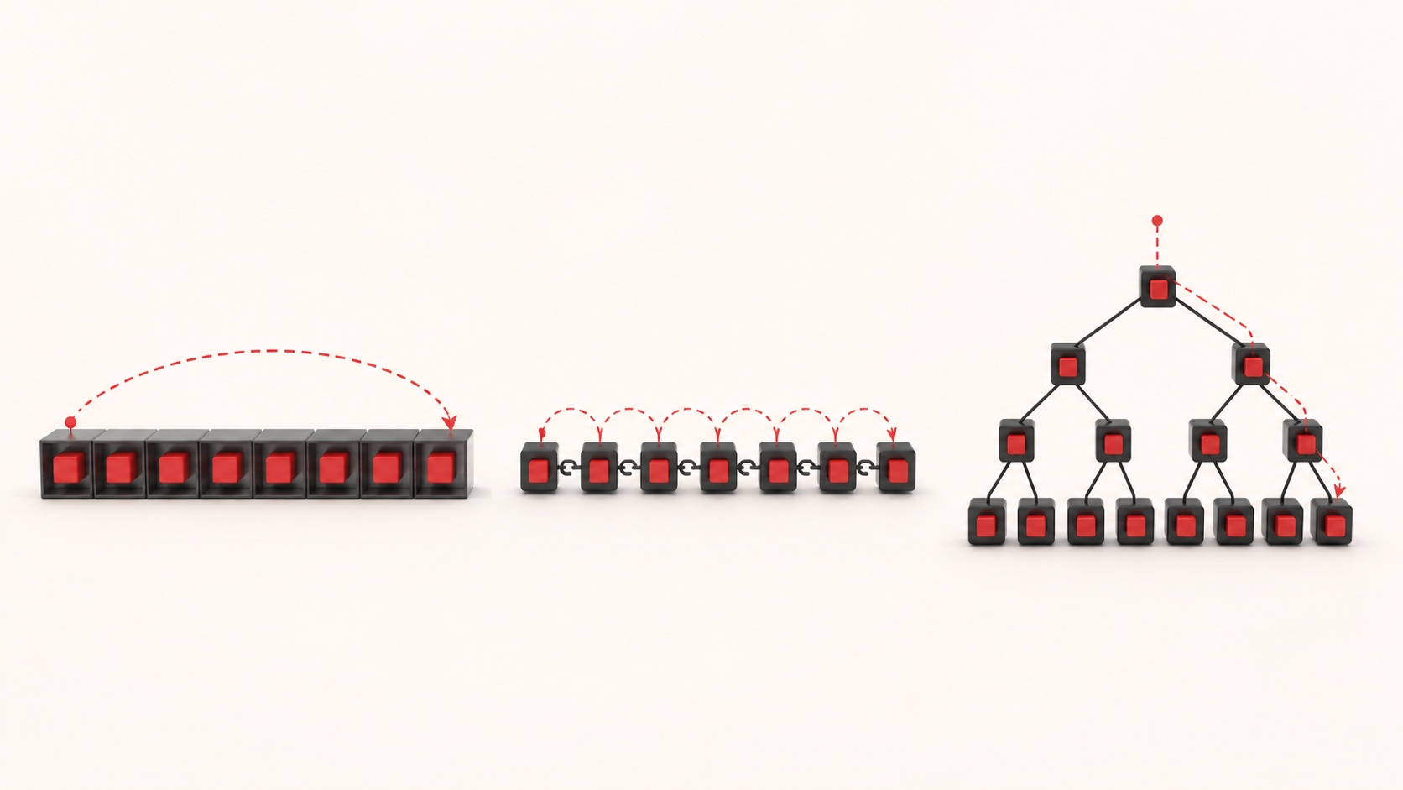
Same data. Different structure. Different cost.
Notes:
[Sources]
- Course asset: `../visuals/rendered/w01-10-opening-representation.png`; generation prompt and provenance are stored in `../visuals/src/w01-10-opening-representation.prompt.md`.

Slide 3
Today’s target is an engineering mental model
By the end, you should be able to:
• separate an ADT contract from its implementation;
• explain why the workload influences representation choice;
• trace C++ values, copies, references, and mutation;
• connect representation to invariants and operation costs.

Slide 4
One million values is not yet a design
What must the program do most often?
• access element number 742,381;
• append new elements;
• insert at the beginning;
• test whether a value exists;
• retrieve the smallest value;
• maintain sorted order.
Different workloads reward different representations.

Slide 5
Why can identical data have different costs?
Representation idea • Access element 742,381
Directly indexed storage • Calculate its location
Chain of linked elements • Follow links until reaching it
The logical values may be identical. The path to the value is not.

Slide 6
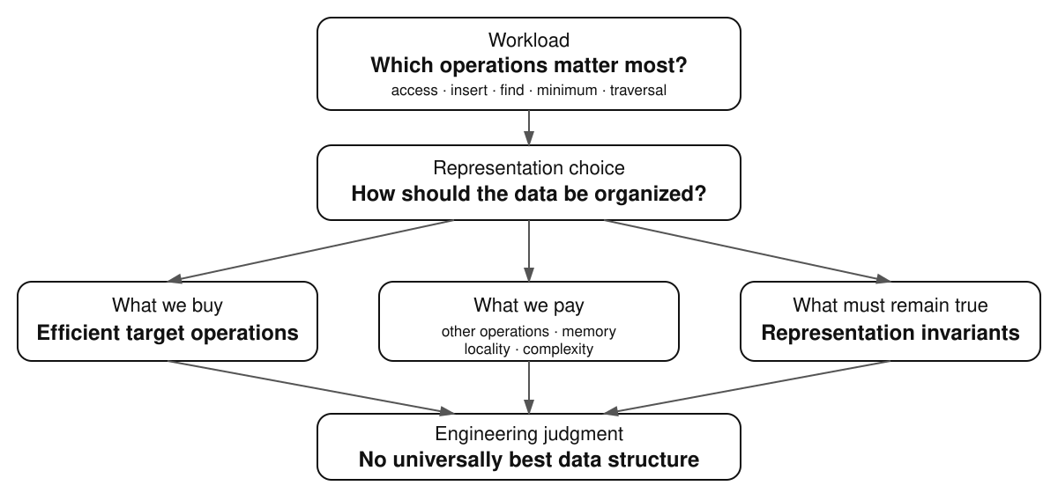
Data-structure choice is a trade-off

Slide 7
Start with operations, not names
What matters most in each situation?
1. A music player asks for the next song.
2. Triage repeatedly asks for the most urgent patient.
3. A spell-checker asks whether a word exists.
4. Navigation asks which roads leave an intersection.
5. An editor inserts and removes material from a sequence.

Slide 8
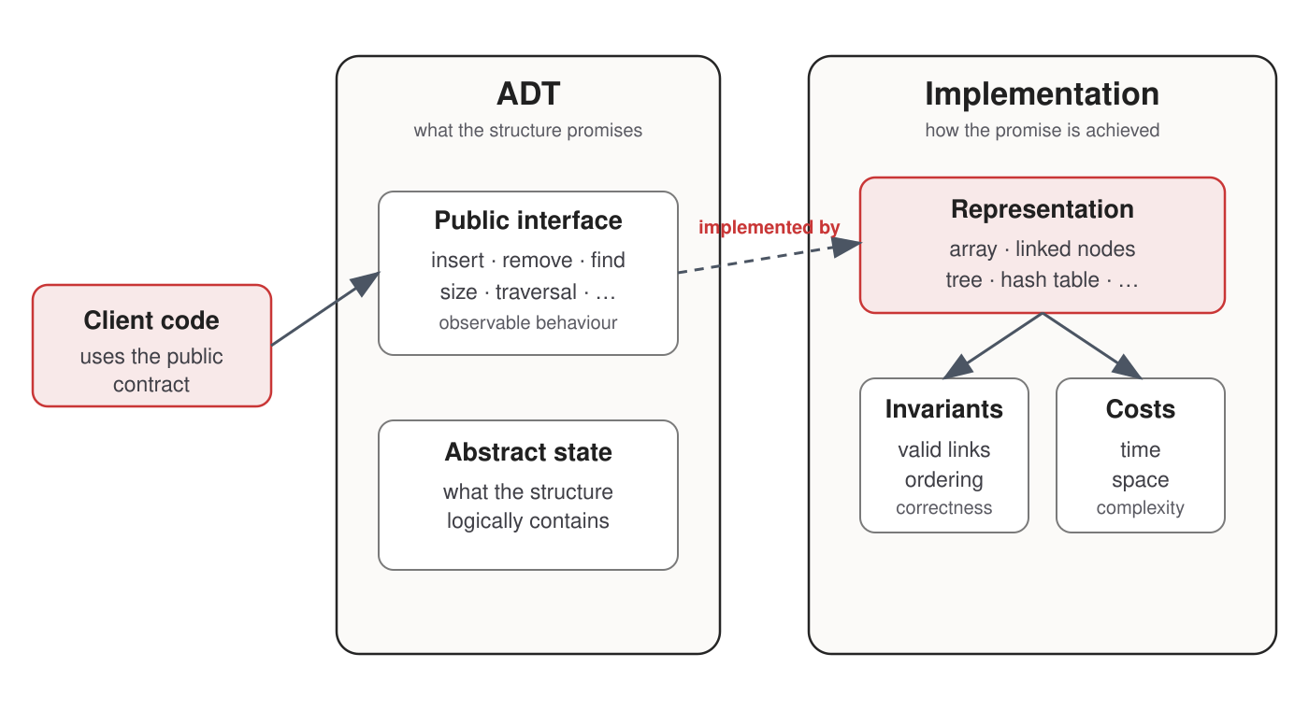
ADT promises; data structures realize
Notes:
[Sources]
- C++ Core Guidelines, “Interfaces”: https://isocpp.github.io/CppCoreGuidelines/CppCoreGuidelines#S-interfaces

Slide 9
One interface can hide several representations
A stack promises operations such as:
push(value) pop() top() empty()
It could be represented by:
• a fixed array;
• a dynamic array;
• linked nodes.
Client code may stay unchanged while performance and memory behaviour change.

Slide 10
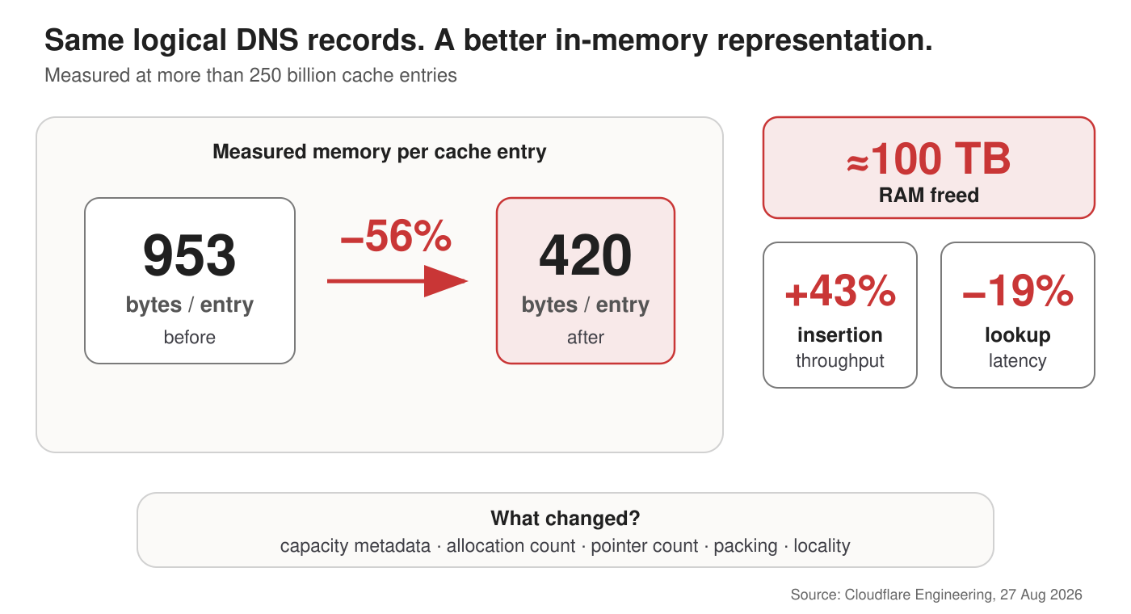
Representation matters at production scale
Notes:
[Sources]
- Cloudflare Engineering, “How we saved 100 terabytes of memory by optimizing 1.1.1.1's DNS cache,” 27 August 2026: https://blog.cloudflare.com/dns-cache-memory-optimization-1111/

Slide 11
Pay only for flexibility the workload needs
Growable storage • Fixed-size storage after construction
pointer + length + capacity • pointer + length
may reserve unused space • no spare growth capacity
supports future growth • smaller immutable representation
Cloudflare’s cached DNS responses did not need to grow after insertion.
A growable vector is not bad. It is unnecessary overhead when growth is not required.
Notes:
[Sources]
- Cloudflare Engineering, “How we saved 100 terabytes of memory by optimizing 1.1.1.1's DNS cache,” 27 August 2026: https://blog.cloudflare.com/dns-cache-memory-optimization-1111/

Slide 12
C++ makes representation visible
High-level abstraction without hiding every implementation cost

Slide 13
C++ began with a systems-design tension
Stroustrup’s problem was practical:
“How can programmers build stronger abstractions without giving up C-like efficiency and systems control?”
1979 C with Classes → 1983 C++ → 1998 ISO standard
→ 2011 modern C++ → C++20 in this course
Simula contributed abstraction ideas; C contributed efficiency and low-level control.
Notes:
[Sources]
- Bjarne Stroustrup, “A History of C++: 1979–1991”: https://www.stroustrup.com/hopl2.pdf
- Bjarne Stroustrup, FAQ: https://www.stroustrup.com/bs_faq.html

Slide 14
In C++, we can inspect both levels
We can treat std::vector as a container and still ask:
• Are its elements contiguous?
• When is storage reallocated?
• When are values copied or moved?
• Which references remain valid?
• What does an operation cost?
Pedagogical implementation: expose mechanics.
Production engineering: normally prefer tested standard containers.

Slide 15
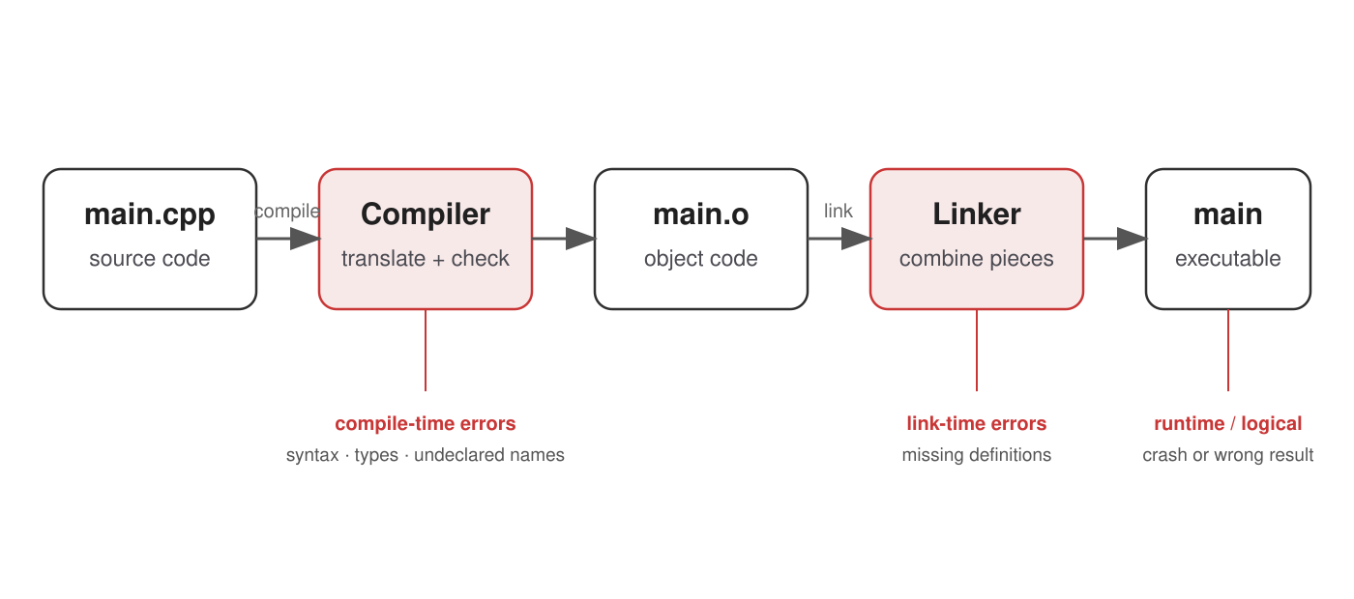
A C++ program has distinct build stages
Notes:
[Sources]
- GCC documentation, “Invoking GCC”: https://gcc.gnu.org/onlinedocs/gcc/Invoking-GCC.html

Slide 16
Predict when each problem is discovered
int number = "Riga";
std::cout << total; // total was never declared
int divide(int a, int b) { return a / b; }
// later: divide(10, 0)
Compile time, link time, runtime, or logical error?

Slide 17
Static types are representation promises
std::vector<int> values;
This declaration promises:
“Every element stored in this vector is an int.”
Compare:
values = [42, "Riga", 3.14, True]
Neither model is universally better. They support different forms of reasoning and flexibility.
Notes:
[Sources]
- C++ working draft, sequence containers: https://eel.is/c++draft/sequences.general

Slide 18
std::vector is our first concrete container
# Python
values = [10, 20, 30]
values.append(40)
// C++
std::vector<int> values{10, 20, 30};
values.push_back(40);
Similar intent does not imply identical representation or semantics.
Notes:
[Sources]
- cppreference, `std::vector`: https://en.cppreference.com/w/cpp/container/vector.html

Slide 19
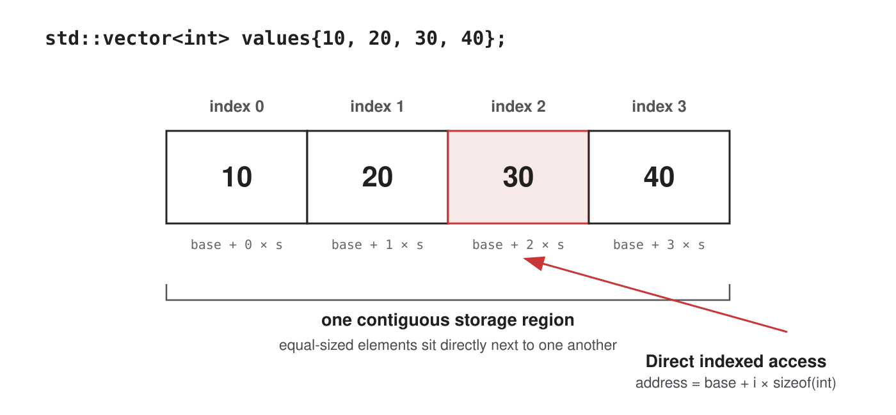
Contiguous storage enables indexed access
Notes:
[Sources]
- C++ working draft, sequence containers: https://eel.is/c++draft/sequences.general
- cppreference, `std::vector`: https://en.cppreference.com/w/cpp/container/vector.html

Slide 20
Which vector operation looks expensive?
• read element 500;
• change element 500;
• add an element at the end;
• insert an element at index 0.
If elements occupy one contiguous region, inserting at the front may require moving every existing element.
Representation is already predicting cost.

Slide 21
Objects, copies, and aliases
Trace object identity—not punctuation

Slide 22
Does the caller’s value change?
void increment(int x) {
++x;
}
int value = 10;
increment(value);
std::cout << value;
Commit to an answer before running the program.

Slide 23
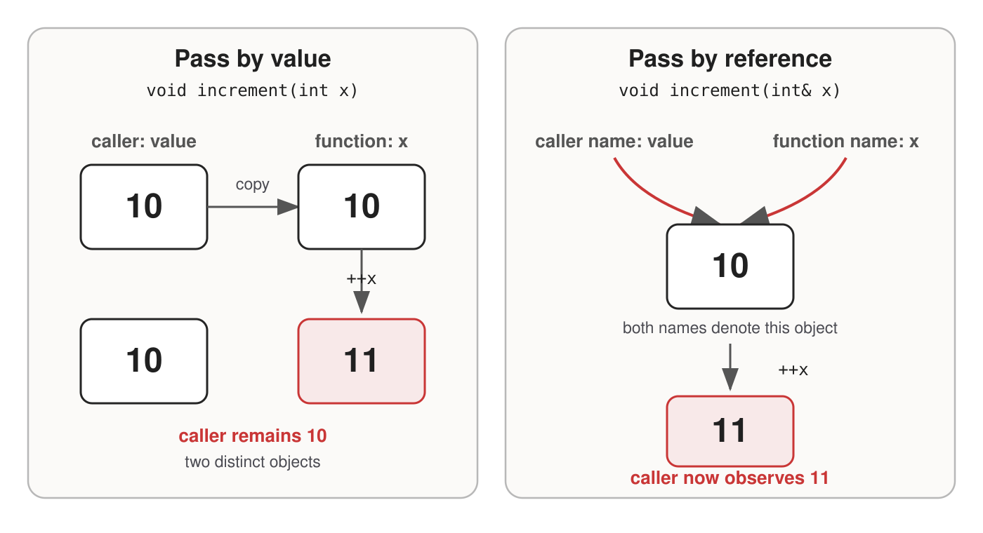
Value parameters copy; references alias
Notes:
[Sources]
- C++ working draft, references: https://eel.is/c++draft/dcl.ref

Slide 24
Mini-trace: follow objects and aliases
void add_one(int x) { ++x; }
void add_two(int& x) { x += 2; }
int value = 10;
add_one(value);
add_two(value);
std::cout << value;
What is printed—and why?

Slide 25
Function signatures are contracts
Parameter form • Full object copy? • May modify caller’s object?
T value • yes • no
T& value • no • yes
const T& value • no • no
int maximum(const std::vector<int>& values);
The function can inspect a large vector without copying it or mutating it through this reference.
Notes:
[Sources]
- C++ Core Guidelines, “Constants and immutability”: https://isocpp.github.io/CppCoreGuidelines/CppCoreGuidelines#S-const
- C++ Core Guidelines, “Functions”: https://isocpp.github.io/CppCoreGuidelines/CppCoreGuidelines#S-functions

Slide 26
What does a contain?
std::vector<int> a{10, 20, 30};
auto b = a;
b[0] = 99;
Is a[0] now 10 or 99?

Slide 27
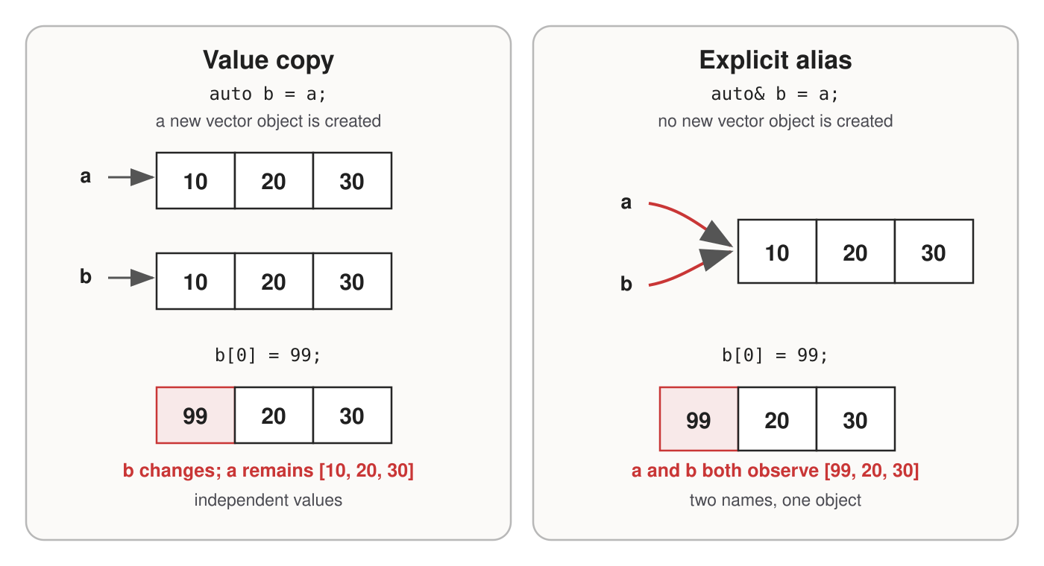
Copying creates a value; & requests an alias
Notes:
[Sources]
- C++ working draft, memory and objects: https://eel.is/c++draft/intro.object
- C++ working draft, references: https://eel.is/c++draft/dcl.ref

Slide 28
Integrated trace: copy, alias, then mutate
std::vector<int> a{1, 2, 3};
auto b = a;
auto& c = a;
b[0] = 10;
c[1] = 20;
a.push_back(4);
Determine the final contents of a, b, and c.

Slide 29
The object model predicts the result
Name • Final contents • Why
a • [1, 20, 3, 4] • original vector object
b • [10, 2, 3] • independent copy
c • [1, 20, 3, 4] • reference: another name for a
The important result is not the numbers. It is the object model that makes them predictable.
Notes:
[Sources]
- C++ working draft, memory and objects: https://eel.is/c++draft/intro.object

Slide 30
From records to data structures
Representation + relationships + invariants

Slide 31
A struct groups values into one logical record
struct Measurement {
std::string name;
double value;
};
Measurement cpu{"CPU temperature", 61.5};
A future node begins the same way:
struct Node {
int value;
// relationships to other nodes come next
};
Complex structures are simpler records plus relationships.

Slide 32
Classes separate interface from representation
class IntSequence {
public:
void append(int value);
std::size_t size() const;
int at(std::size_t index) const;
private:
std::vector<int> data_;
};
Client code sees append, size, and at.
The current representation is std::vector<int>.

Slide 33
The same interface can hide different costs
Suppose IntSequence preserves these methods:
append(value) size() at(index)
Internal representation • at(index)
Contiguous vector • direct indexed access
Linked sequence • traverse from a known end
Existing client code may still compile. Its performance assumptions may no longer hold.

Slide 34
Duplicated state creates a new invariant
class IntSequence {
private:
std::vector<int> data_;
std::size_t size_;
};
Now every mutating operation must preserve:
size_ == data_.size()
If data_.size() is already available, what justifies storing size_ again?

Slide 35
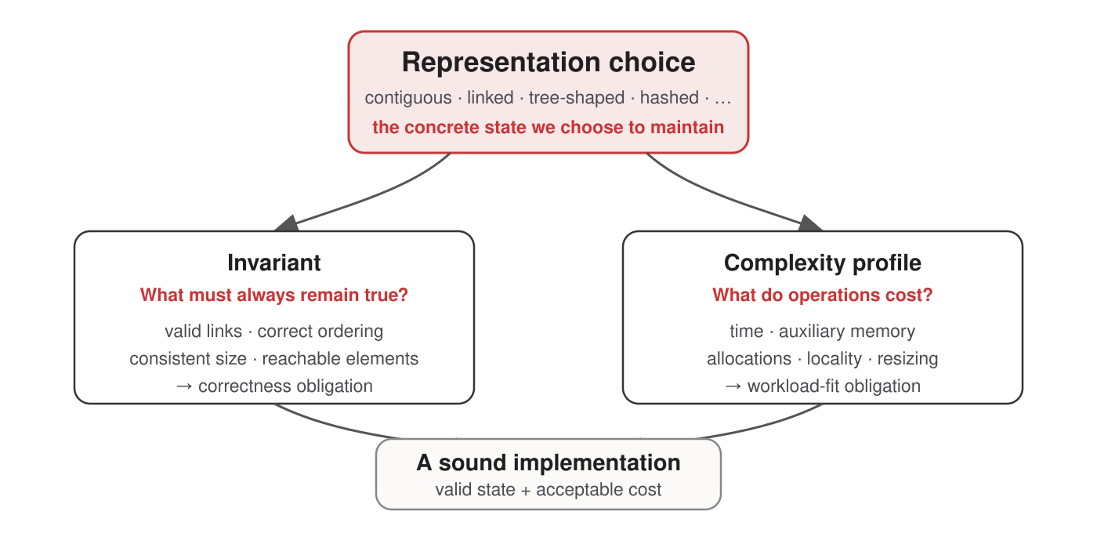
Representation drives correctness and cost

Slide 36
Complexity is essential—but not sufficient
For a vector-backed sequence:
Operation • Initial complexity claim
at(index) • Θ(1)
append(value) • amortized Θ(1)
insert at front • Θ(n)
Also inspect:
locality · allocations · pointer chasing · resizing · memory overhead · constants
Notes:
[Sources]
- cppreference, `std::vector` complexity: https://en.cppreference.com/w/cpp/container/vector.html

Slide 37
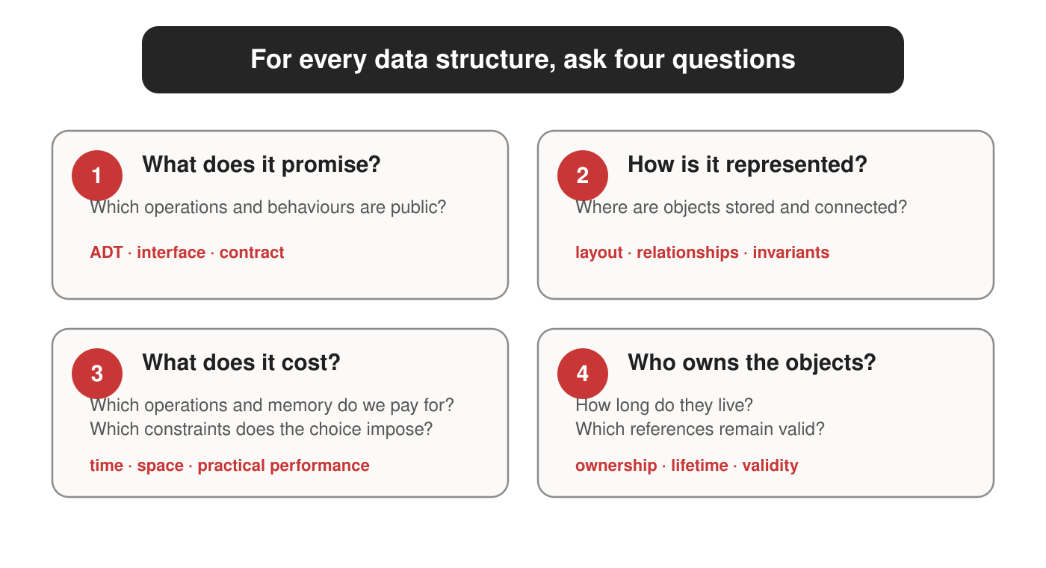
Carry four questions into every new structure

Slide 38
AI does not remove the design obligation
When an AI proposes a container or implementation, someone must still ask:
• Does the representation match the workload?
• What invariants must remain true?
• What are the time and space costs?
• Are copying, ownership, and lifetime correct?
• Do the tests demonstrate the required behaviour?
“If you cannot explain why a solution works, you cannot reliably recognize when it does not.”

Slide 39
Practical work: predict, run, explain
In the Week 1 practical session you will:
• compile and run C++20 code;
• interpret compiler diagnostics;
• use std::vector and small records;
• diagnose value versus reference behaviour;
• trace copies and aliases before execution;
• explain what representation a small class uses.
The objective is not syntax memorization. It is a mental model accurate enough to implement data structures.

Slide 40
Week 2: pointers, lifetime, and ownership
Node 10 → Node 20 → Node 30
How can one node store the location of another—and who owns those nodes?
Next: pointers, lifetime, ownership, RAII, and templates.

Slide 41
Authoritative references and further reading
• Bjarne Stroustrup — A History of C++: 1979–1991
• Bjarne Stroustrup — A Tour of C++, 3rd edition
• Stroustrup and Sutter — C++ Core Guidelines
• C++ working draft: Memory and objects
• C++ working draft: Sequence containers
• cppreference
Use references to resolve precise language and library questions—not as a substitute for tracing the program’s objects and operations.
Notes:
[Sources]
- Links shown on the slide are the authoritative references preserved in `../lecture.md`.

