Slide 1
AI Machine Learning Models
Valdis Saulespurēns – lecturer RTU/RBS

Slide 2
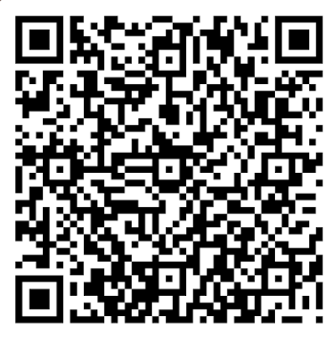
Please provide your feedback! Please evaluate the satisfaction of the course.

Slide 3
Novērtē savu kursa pieredzi! Pastāsti, kas Tev patika, un ko Tu ieteiktu uzlabot!

