Slide 1
Rules in Exact String Matching Algorithms
李家同

Slide 2
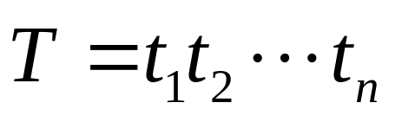
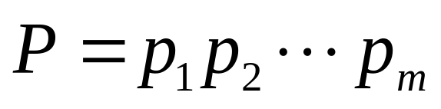
The Exact String Matching Problem:
We are given a text string
and a pattern string
and we want to find all occurrences
of P in T.

Slide 3
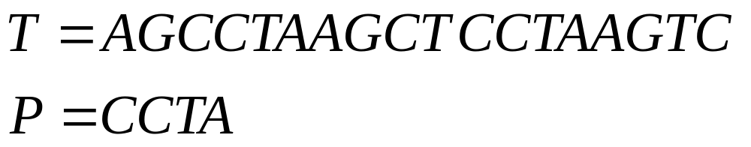
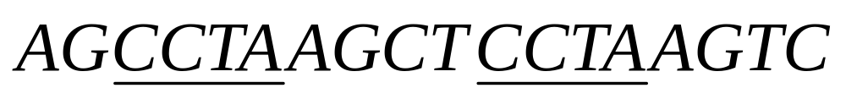
Consider the following example:
There are two occurrences of P in T
as shown below:

Slide 4
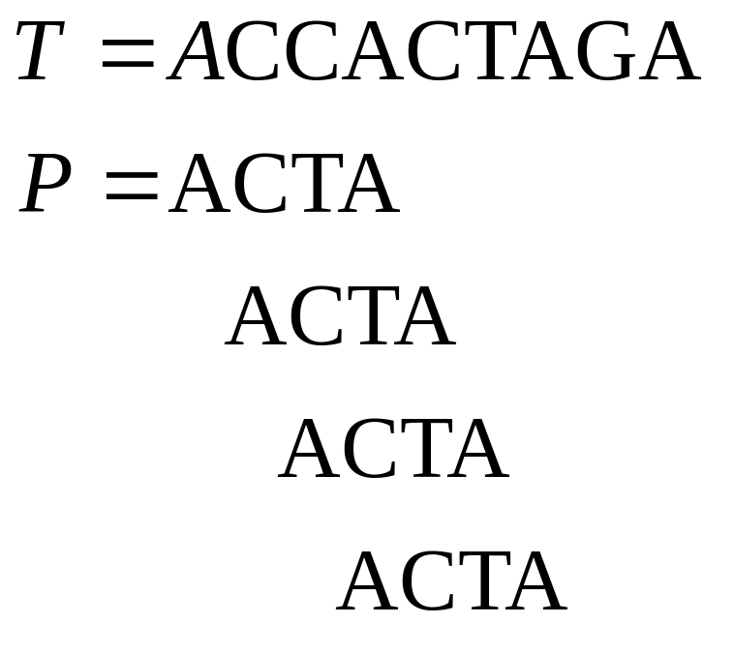
A brute force method for exact string
matching algorithm:

Slide 5
If the brute force method is used,
many characters which had been
matched will be matched again because
each time a mismatch occurs, the
pattern is moved only one step.

Slide 6
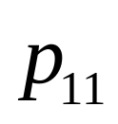
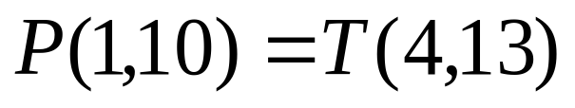
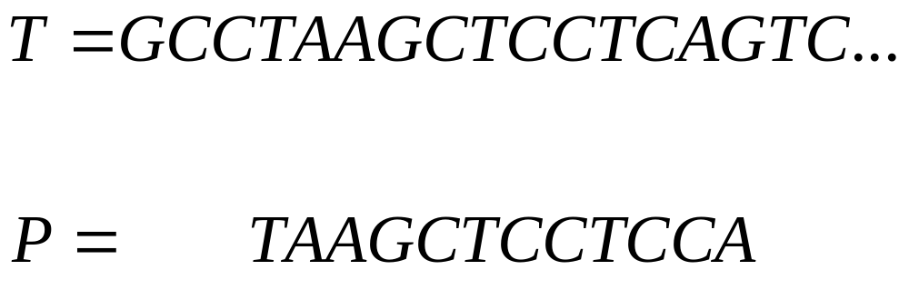


Let us consider the following case.
The mismatch occurs at .
That is, .

Slide 7
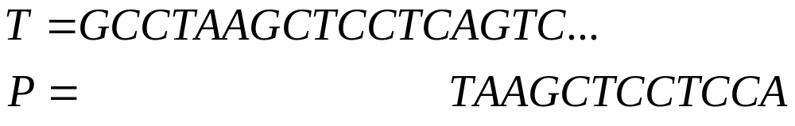
Besides, no suffix of T(4,9) is equal to any prefix of P(1,10) which means that if we move P less than 10 steps, there will be no matching. We may slide P all the way to the right as shown below.

Slide 8
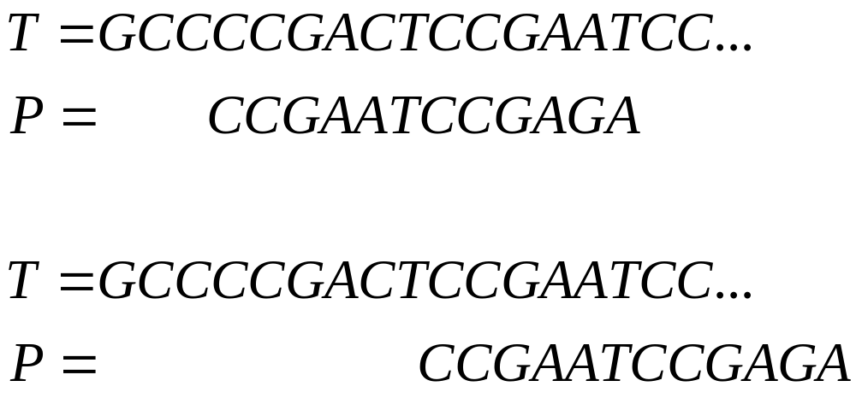
For the following case, since there is
a suffix of the window in T, namely
CCGA, which is a prefix of P, we can
only slide the window such that the prefix
matches with the suffix of the window,
as shown below.

Slide 9
There are many exact string matching
algorithms. Nearly all of them are
concerned with how to slide the
pattern.
In the following, we shall list the
important ones.

Slide 10
Backward Algorithm (1)
Boyer and Moore Algorithm (1, 2, 2-1, 3-1)
Colussi Algorithm (1)
Crochemore and Perrin Algorithm (5)
Galil Gianardo Algorithm (1)
Galil and Seiferas Algorithm (1)
Horsepool Algorithm (2-2)
Knuth Morris and Pratt Algorithm (1)
KMP Skip Algorithm (2)
Max-Suffix Matching Algorithm (2,3)
Morris and Pratt Algorithm (1)
Quick Searching Algorithm (2-2)

Slide 11
Raita Algorithm (2-2)
Reverse Factor Algorithm (1)
Reverse Colussi Algorithm (1,2)
Self Max-Suffix Algorithm (1)
Simon Algorithm (1)
Skip Search Algorithm (2-2, 4)
Smith Algorithm (2-2)
Tuned Boyer and Moore Algorithm (2-2)
Two Way Algorithm (5)
Uniqueness Algorithm (3-1, 3-2, 3-3)
Wide Window Algorithm (4)
Zhu and Takaoka Algorithm (2)

Slide 12
Although there are so many algorithms,
there are some common rules.
It is surprising that all of these algorithms are actually based upon
these rules.

Slide 13
Table of Rules
Rule 1: The Suffix to Prefix Rule
Rule 2: The Substring Matching Rule
  Rule 2-1: Character Matching Rule
  Rule 2-2: 1-Suffix Rule
  Rule 2-3: The 2-Substring Rule
Rule 3: The Uniqueness Property Rule
  Rule 3-1: Unique Substring Rule
  Rule 3-2: Longest Substring with a Unique Character Rule
  Rule 3-3: The Unique Pairwise Substring Rule
Rule 4: The Two Window Rule
Rule 5: Non-Tandem-Repeat Rule

Slide 14

Nearly all of the exact string matching algorithms use the slide window approach.
Whenever a mismatching is found, the pattern is moved to the right.

Slide 15
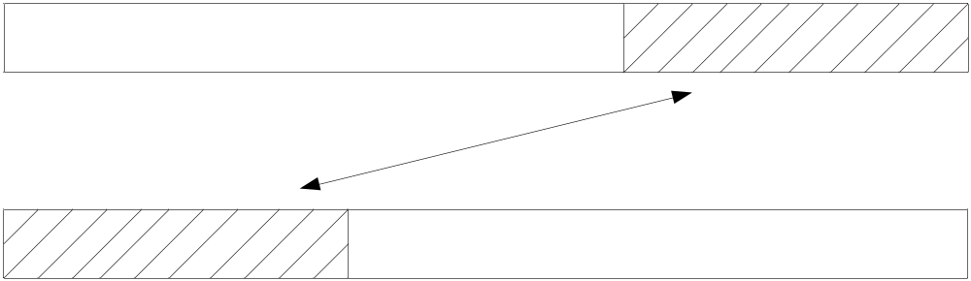
Rule 1: The Suffix to Prefix Rule
For a window to have any chance to match a pattern, in some way, there must be a suffix of the window which is equal to a prefix of the pattern.
T
P

Slide 16
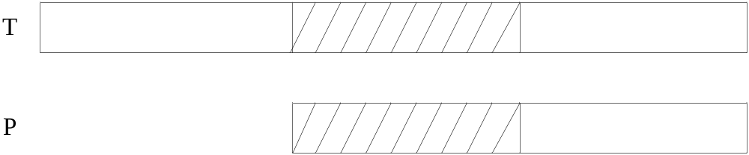
The Implication of Rule 1:
Find the longest suffix U of the window which is equal to some prefix of P. Skip the pattern as follows:

Slide 17
Example
T = GCATCGACAGACTATACAGTACG
P = GACGGATCA
∵The longest suffix of the window which is equal to a prefix of P is “GAC” = P(1, 3) , slide the window by 6.
T = GCATCGACAGACTATACAGTACG
P = GACGGATCA

Slide 18
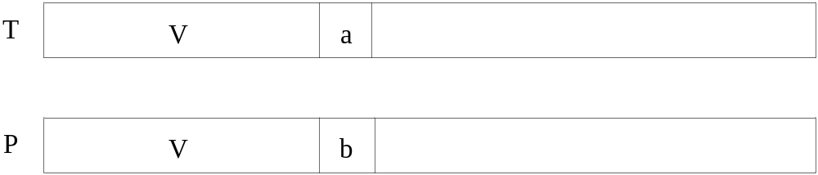
The MP Algorithm
Assume that a mismatch occurs as shown below and we have already found the longest suffix of the matched string V which is equal to a prefix of P.

Slide 19
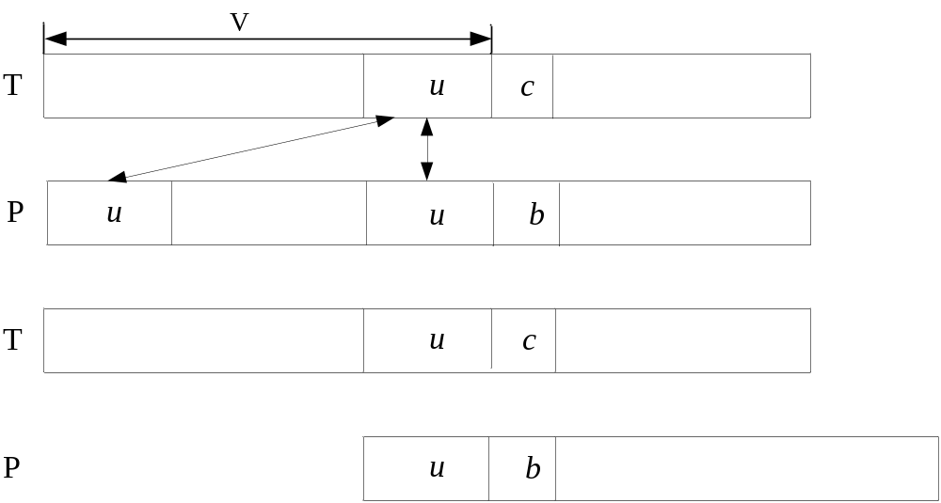
The MP Algorithm
Skip the pattern by using Rule 1.

Slide 20
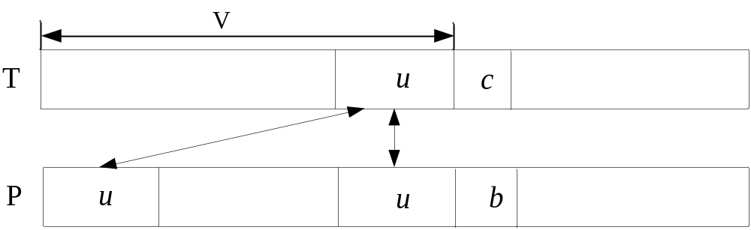
But, if we have to do the finding of the longest suffix in run time, the algorithm will be very inefficient. A preprocessing can eliminate the problem because u also exists in P.

Slide 21
MP Algorithm
The MP Algorithm pre-processes the pattern P and produces the prefix function to determine the number of steps the pattern skips.

Slide 22
Example
T = GCATCGACGAGAGTATACAGTACG
P = GACGACGAG
∵P(1, 2) = P(4, 5) = ‘GA’, slide the window by 3.
T = GCATCGACGAGAGTATACAGTACG
P = GACGACGAG
Note that the MP Algorithm knows it can skip 3 steps because of the preprocessing.
The prefix function can be obtained recursively.
Mismatch here

Slide 23
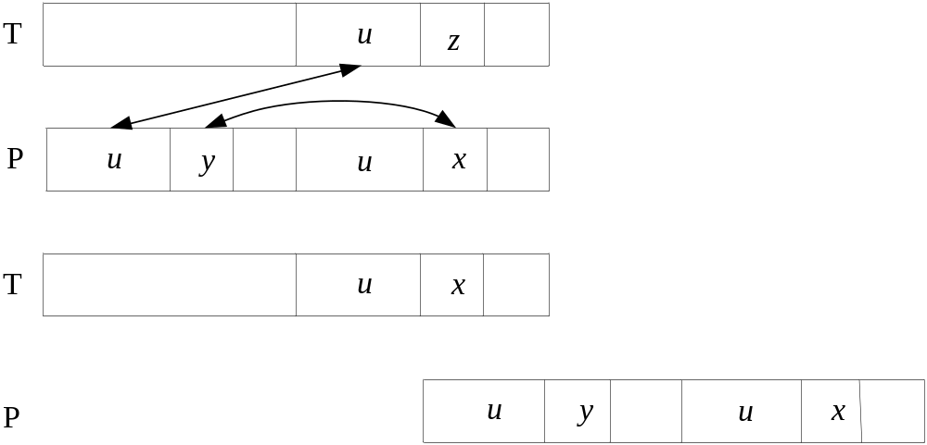
The KMP Algorithm
The KMP algorithm makes a further checking on P. If x = y, skip further.

Slide 24
Example
T = GCATCGACGAGAGTATACAGTACG
P = GACGACGAG
P(1, 2) = P(4, 5) = ‘GA’. But p₃ = p₆ = ‘C’.
Slide the window by 5.
T = GCATCGACGAGAGTATACAGTACG
P = GACGACGAG
Mismatch here

Slide 25
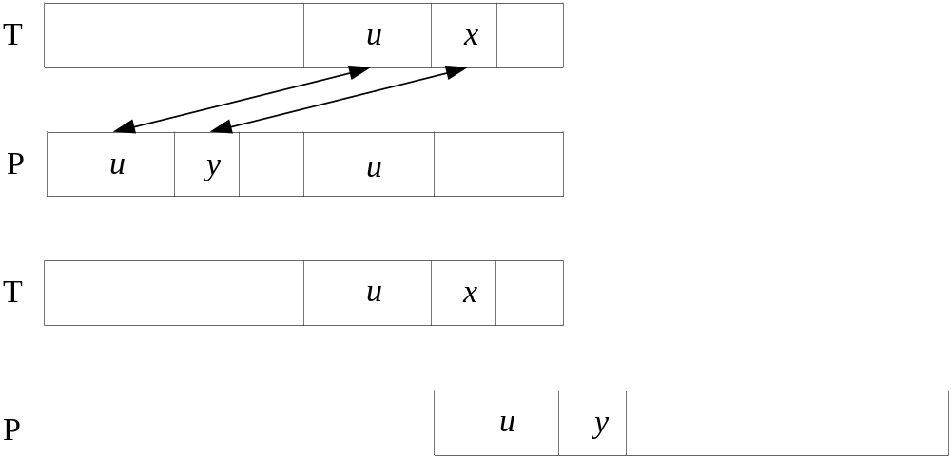
Simon’s Algorithm
Simon’s Algorithm improves the KMP Algorithm a little bit further. It checks whether y which is after prefix u in P is the character x after u in T. If not, skip further.

Slide 26
Example
T = GCATCGAGGAGAGTATACAGTACG
P = GAGGACGAG
∵ P(1, 2) = P(4, 5) = ‘GA’, and p₃ = ‘G’= t₁₁ .
Slide the window by 3.
T = GCATCGAGGAGAGTATACAGTACG
P = GAGGACGAG

Slide 27
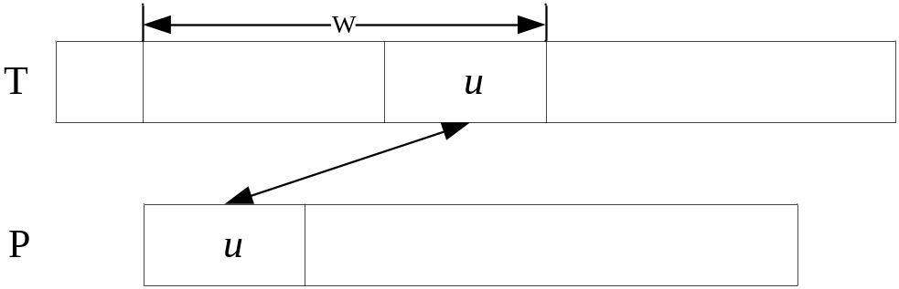
The Backward Nondeterministic Matching Algorithm
u is the longest suffix of the window which is equal to a prefix of P.
The Backward Nondeterministic Matching Algorithm uses Rule 1.
This algorithm also uses a pre-processing mechanism. But the finding of u is still done during the run-time, with the result of preprocessing.

Slide 28
Example
T = GCATCGAGGAGAGTATACAGTACG
P = GAGCGAAC
∵The longest prefix of P is “GAG”, which is equal to a suffix of the window of T.
Slide the window by 5.
T = GCATCGAGGAGAGTATACAGTACG
P = GAGCGAAC

Slide 29
The Reverse Factor Algorithm uses Rule 1, by incorporating the idea of suffix trees.
The Self Max Suffix Algorithm uses Rule 1, by noting in a special case, we don’t need to store any table for deciding how many steps we may jump.
The number of steps we jump is done in the run-time.

Slide 30
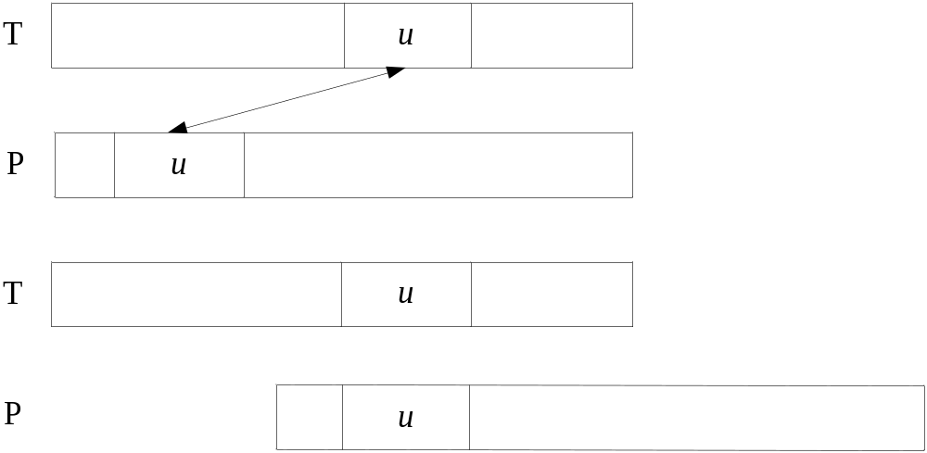
Rule 2: The Substring Matching Rule
For any substring u in T, find a nearest u in P which is to the left of it. If such an u in P exists, move P such then the two u’s match; otherwise, we may define a new partial window.

Slide 31
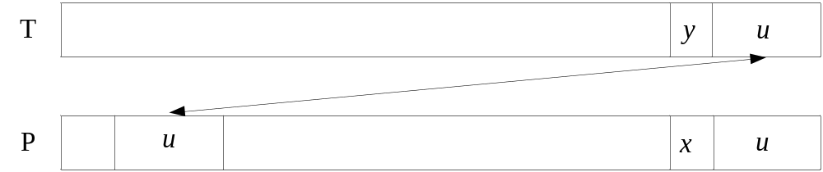
Boyer and Moore Algorithm
The Good Suffix Rule 1 in the BM Algorithm uses Rule 2, except u is a suffix.
If no such u exists to the left of x, the suffix u in P is unique in P. This is a very important property.

Slide 32
Example
T = GCATCGAGGAGAGTATACAGTACG
P = GGAGCCGAG
∵P(2, 4) = ‘GAG’
Slide the window by 5.
T = GCATCGAGGAGAGTATACAGTACG
P = GGAGCCGAG

Slide 33
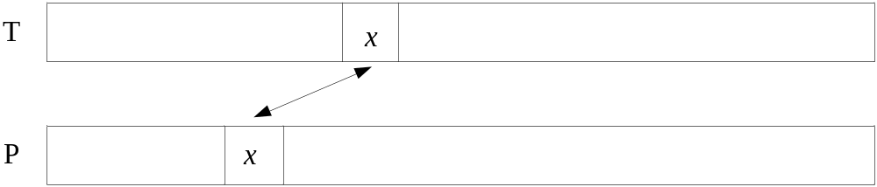
Rule 2-1: Character Matching Rule(A Special Version of Rule 2)
For any character x in T, find the nearest x in P which is to the left of x in T.

Slide 34
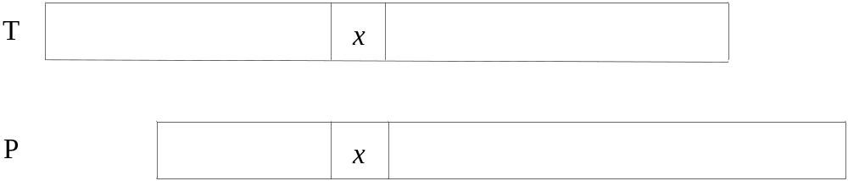
Implication of Rule 2-1
Case 1. If there is an x in P to the left of T, move P so that the two x’s match.

Slide 35
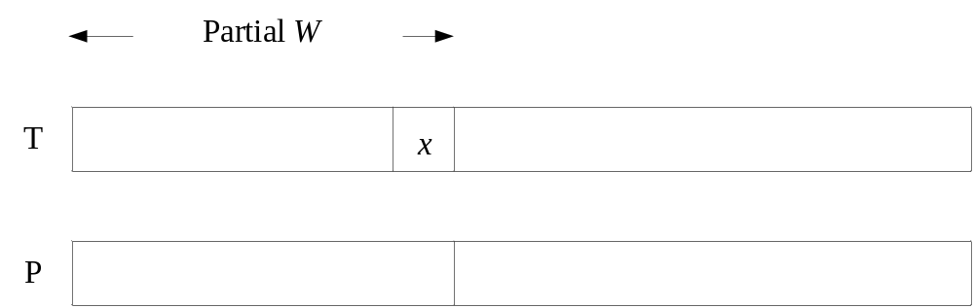
Case 2: If no such an x exists in P, consider the partial window defined by x in T and the string to the left of it.

Slide 36
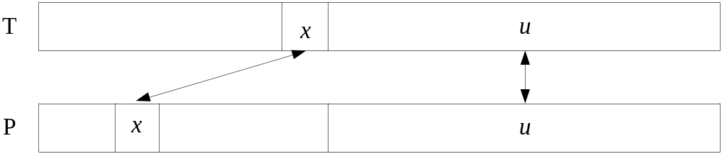
Boyer and Moore Algorithm
The Bad Character Rule in BM Algorithm uses Rule 2-1 in a limited way except it starts from the end as shown below:

Slide 37
Why does the BM Algorithm use Rule 2-1 in a limited way is beyond the scope of this presentation.

Slide 38
Example
T = GCATCGAGGAGCGTATACAGTACG
P = GAGGCCGCG
∵p₂ = ‘A’,
slide the window by 4.
T = GCATCGAGGAGCGTATACAGTACG
P = GAGGCCGCG

Slide 39
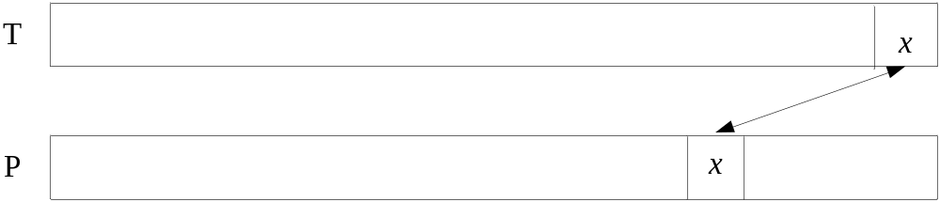
Rule 2-2: 1-Suffix Rule (A Special Version of Rule 2)
Consider the 1-suffix x. We may apply Rule 2-2 now.

Slide 40
The Skip Search Algorithm
The Skip Search Algorithm uses Rule 2-2 together with Rule 4 in a very clever way.

Slide 41
The Horspool Algorithm, Quick Search Algorithm, Raita Algorithm, Tuned Boyer-Moore and Smith algorithms use the Rule 2-2.

Slide 42
Rule 2-3: The 2-Substring Rule (A Special Version of Rule 2)
Consider the following case:
We match from right to left
T = GAATCAATCATGAA
P = TCATGAA
T = GAATCAATCATGAA
P = TCATGAA

Slide 43
T_{k}
T_{k+1}
 | u | x
P_{j}
P_{i}
P_{i+1}
 | u | x |  | v | x
 | u | x |  | v | x

Slide 44
T_{k}
T_{k+1}
 | u | x
P_{j}
P_{i}
P_{i+1}
 | u | x |  | v | x
 | u | x |  | v | x
Suppose the first mismatch occurs at T_{k} and P_{i}. Then T_{k+1} = P_{i+1} because we match from the right.
The important thing is we must know the largest j such that P_{j} = P_{i+1} = x.

Slide 45
We may use a simple preprocessing to construct a table in which Table(i) = j if j is the largest j such that P_{i} = P_{j} and j < i. If no such j exists. Table(i) = -1.
i
0
1
2
3
4
5
6
P
T
C
A
T
G
A
A
-1
-1
-1
0
-1
2
5

Slide 46
0
1
2
3
4
5
6
7
8
9
10
11
12
13
T
G
A
A
T
C
A
A
T
C
A
T
G
A
A
P
T
C
A
T
G
A
A
-1
-1
-1
0
-1
2
5
Mismatch occurs at P(4).
We know that T(5) = P(5) = A.
We know P(2) = P(5) = A.
We examine P(1). P(1) = T(4) = C.
Thus we may move the pattern as following:
G
A
A
T
C
A
A
T
C
A
T
G
A
A
T
C
A
T
G
A
A

Slide 47
That the preprocessing can be so simple is due to the following facts:
(1) We start from the right whose sign is.
(2) We only consider a substring less than 2.

Slide 48
Rule 3-1: Unique Substring Rule
The substring u appears in a prefix of P exactly once.
If the substring u matches with T(i, j), no matter whether a mismatch occurs in some position of P or not, we can slide the window by l.
T:
P:
The string s is the longest suffix of u which is equal to a prefix of P.
i
u
j
 |  | s
u
s |  |  | s
s |  | u
l

Slide 49
Note that the above rule also uses Rule 2.
It should also be noted that the unique substring is the shorter and the more right-sided the better.
A short u guarantees a short (or even empty) s which is desirable.
i
j
 | u
u
s |  |  | s
s |  | u
l

Slide 50
Example
T = GCATCGAGGCGAGTATACAGTACG
P = GGAGCCGAG
Unique substring u = ‘CG’
∵u = T(10, 11) = ‘CG’, and a mismatch occurs in p₁.
Within CG, suffix G is a prefix of P.
Slide the window by 6.
T = GCATCGAGGCGAGTATACAGTACG
P = GGAGCCGAG

Slide 51
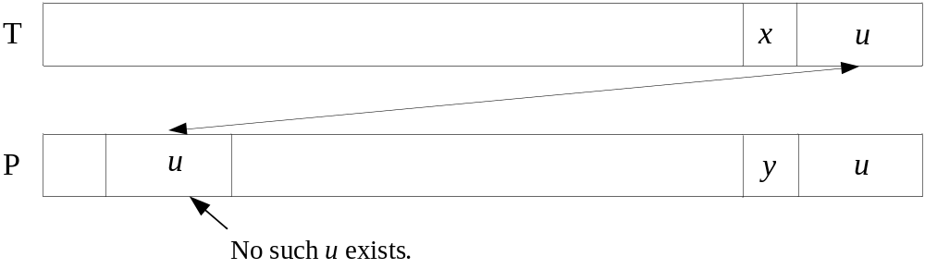
Boyer and Moore Algorithm
In Boyer and Moore Algorithm (BM Algorithm), there is a Good Suffix Rule 2 which is a combination of Rule 2 and Rule 4-1.
The Good Suffix Rule 2 is used after the Good Suffix Rule 1, which is actually Rule 2-1, fails to work.
When Good Suffix Rule 1 fails, it means that the suffix u in P is unique. That’s why Rule 3-1 can be used.

Slide 52
Mismatch here
Example
T = GCATCGGAGGACTATACAGTACG
P = GACGACGGAC
∵The suffix “GGAC” of window is unique in P, and P(1, 3) = GAC is a suffix of “GGAC”, slide the window by 7.
T = GCATCGGAGGACTATACAGTACG
P = GACGACGGAC

Slide 53
Rule 3-2: Longest Substring with a Unique Character Rule
Find the longest substring of P, P(i, j), where p_{j} is the unique character in P(i, j). Thus p_{i+1} = p_{j}
If p_{j} matches with t_{k} , we can slide the window by j-i+1 in next step.
T:
P:
k
 | x
 | x |  | x
i
j
 | x |  | x
j-i

Slide 54
Example
T = GCATCGCGGGCAGTATACAGTACG
P = GGAGCCGAG
The longest substring P(4, 8) = ‘GCCGA’, which has a unique character ‘A’ in P(4, 8).
∵p₈ = t₁₂ = ‘A’, and a mismatch occurs in p₁.
Slide the window by 5.
T = GCATCGCGGGCAGTATACAGTACG
P = GGAGCCGAG

Slide 55
Rule 3-3: The Unique Pairwise Substring Rule
The substring p_{i}p_{i+1}…p_{j-1}p_{j} is called an unique pairwise substring if it satisfies the condition that p_{i}p_{i+1}…p_{j-1}p_{j} occurs in the prefix p₁p₂…p_{j-1}p_{j} of P exactly once, and no p_{k}p_{k+1}…p_{k+j-i} exists in p₁p₂…p_{j-1}p_{j} such that p_{k} = p_{i} and p_{k+j-i} = p_{j}.
T:
P:
 | x |  | y
 | x |  | y
i
j
 | x |  | y

Slide 56
Example
T = GCATCCGCGCCAGTATACAGTACG
P = GCAGGCGAG
The substring CGA is an unique pairwise substring, and because p₆ = t₁₀ = ‘C’, p₈ = t₁₂ = ‘A’, we could slide the window by 6.
T = GCATCCGCGCCAGTATACAGTACG
P = GCAGGCGAG

Slide 57
Rule 4: The Two Window Rule
Open a window with length 2m. If (the length of a suffix of u_{l} which is equal to a prefix of P) + (the length of a prefix of u_{r} which is equal to a suffix of P) = m, output the position. Slide the window by m.
T:
P:
2m
 | u_{l} | u_{r}
m
2m

Slide 58
Example
T = GCATCGAGAGAGCGTATACAGTACG
P = AGAGC
The suffix of u_{l} which is equal to a prefix of P: “AG” and “AGAG”. Return the lengths: 2, 4.
The prefix of u_{r} which is equal to a suffix of P: “AGC”. Return the length: 3.
∵2+3 = 5 = m, find a position in T₉.
T = GCATCGAGAGAGCGTATACAGTACG
u_{l}
u_{r}
u_{l}
u_{r}

Slide 59
The Wide Window Algorithm uses the Rule 4.

Slide 60
Rule 5: The Non-Tandem-Repeat Rule
We divide pattern P into two parts uv in such a way that no suffix of u is a prefix of v.
u
v

Slide 61
Example:
P =
A
G
G
A
T
G
A
T
C
C
A
T
P =
A
G
G
A
T
G
A
T
C
C
A
T

Slide 62
i-j
i
i+j
i-j
i
j+1

Slide 63
Example:
T =
G
C
T
A
T
G
C
A
T
G
C
A
P =
C
A
T
G
C
A
C
A
T
G
C
A
C
A
T
G
C
A

Slide 64
Maximal Suffix: (alphabetically)
bacdabc
maximal suffix
cabcbaa
maximal suffix

Slide 65
Given a string S, divide it into uv such that v is the maximal suffix.
Then uv must follow the Non-tandem Repeat Rule.
Besides, v does not appear in u. Then the uniqueness rule can be used.

Slide 66
Final Sample Examples of Algorithms for Each Rule
Rule 1: The Suffix to Prefix Rule
Exemplary Algorithm: The MP Algorithm
T =
C
G
C
A
C
G
G
T
A
C
G
G
A
C
C
P =
C
G
G
A
C
C
G
G
A
C
C
G
G
A
C
C
G
G
A
C
C
G
G
A
C
C
G
G
A
C
C
G
G
A
C

Slide 67
Another MP Algorithm Example
T =
C
G
C
T
A
C
G
C
A
A
T
C
G
C
A
C
G
P =
C
G
C
A
C
G
C
G
C
A
C
G
C
G
C
A
C
G
C
G
C
A
C
G
C
G
C
A
C
G
C
G
C
A
C
G
C
G
C
A
C
G
C
G
C
A
C
G

Slide 68
Rule 2: The Substring Matching Rule
Exemplary Algorithm: The Tuned Boyer and Moore Algorithm.
T =
C
G
C
A
C
G
G
T
A
C
G
G
A
C
C
P =
C
G
G
A
C
C
G
G
A
C
C
G
G
A
C
C
G
G
A
C

Slide 69
Rule 3: The Uniqueness Rule
Exemplary Algorithm: Rule 3-3 (Unique Pairwise Substring Rule)
T =
A
T
C
A
T
C
G
C
A
C
C
C
P =
C
G
C
A
C
C
C
G
C
A
C
C
C
G
C
A
C
C

Slide 70
Rule 4: Two Window Rule
T =
C
G
C
A
C
G
G
T
A
C
C
T
T
A
C
G
G
T
P =
C
T
T
A
w₁
w₂
C
G
C
A
C
G
G
T
No prefix of P = a suffix of W₁.
No suffix of P = a prefix of W₂.
w₃
w₄
A
C
C
T
T
A
C
G
C
T
T
A
Matched!

Slide 71
Rule 5: Non Tandem Repeat
P =
A
G
C
G
A
C
(No suffix of u = a prefix of v).
u
v
T =
C
A
A
C
G
C
A
G
C
G
A
C
C
T
P =
A
G
C
G
A
C
A
G
C
G
A
C
A
G
C
G
A
C
A
G
C
G
A
C
A
G
C
G
A
C

Slide 72
References
[BM77] A fast string searching algorithm, BOYER, R.S., MOORE, J.S, Communications of the ACM., Vol. 20, 1977, p.p. 762-772.
[CTJ98] Very Fast String Matching Algorithm for Small Alphabets and Long Patterns, Christian, C., Thierry, L. and Joseph, D.P., Lecture Notes in Computer Science, Vol. 1448, 1998, pp. 55-64.
[C91] Correctness and Efficiency of Pattern Matching Algorithms, Colussi, L. Information and Computation, Vol, 95, 1991, pp. 225-251.
[C94] Reverse Colussi Algorithm, Colussi, L., Journal of Algorithms, 1994, 16(2):163-189.
[CCGJLPR94] Speeding up on two string matching algorithms, CROCHEMORE, M., CZUMAJ, A., GASIENIEC, L., JAROMINEK, S., LECROQ, T., PLANDOWSKI, W. and RYTTER, W. Algorithmica, Vol.12, 1994, pp.247-267.
[CCGJLPR92] Speeding up two string matching algorithms, CROCHEMORE, M., CZUMAJ, A., GASIENIEC, L., JAROMINEK, S., LECROQ, T., PLANDOWSKI, W. and RYTTER, Annual Symposium on Theoretical Aspects of Computer Science, Springer-Verlag, Berlin, 589-500,1992.
[CP91] Two Way Matching, Crochemore M., Perrin D., Journal of ACM 38(3):651-675, 1991.
[GG92] On the exact complexity of string matching: upper bounds, GALIL Z., GIANCARLO R., SIAM Journal on Computing, 21(3), 1992, pp. 407-437,
[H80] Practical fast searching in strings, HORSPOOL, R.N., Software - Practice & Experience, Vol,10(6), 1980, pp. 501-506.
[HFS05] The wide window string matching algorithm, He, Longtao, Fang, Binxing, Sui, Jie, Theoretical Computer Science, vol, 332, 2005, pp. 391-404.

Slide 73
[HS91] Fast string searching, Hume, A., Sunday, D. M., Software-Practice & Experience, vol. 21(11), pp. 1221-1248.
[LL07] String Matching Algorithms Based upon the Uniqueness Property, Lu, C. W., Lee, R. C. T., The 24th Workshop on Combinatorial Mathematics and Computation Theory, pp.385-392.
[KMP77] Fast pattern matching in strings, KNUTH, D.E., MORRIS, (Jr) J.H., PRATT, V.R., SIAM Journal on Computing 6(1), 1977, pp.323-350.
[MP70] A linear pattern-matching algorithm, Morris, J. H., Pratt, V. R., Technical Report 40, University of California, Berkeley,1970.
[NR98] A Bit-parallel Approach to Suffix Automata: Fast Extended String Matching, Navarro, G., Raffinot, M., Lecture Notes in Computer Science, vol. 1448, 1998, pp. 14-33.
[R92] Tuning the Boyer-Moore-Horspool string searching algorithm, RAITA, T. ,Software - Practice & Experience, 22(10),1992, pp. 879-884.
[R02] On maximal suffixes and constant-space versions of KMPalgorithm, Rytter, W., LATIN 2002: Theoretical Informatics : 5th Latin American Symposium, Cancun, Mexico, April 3-6, 2002. Proceedings.
[S90] A very fast substring search algorithm, SUNDAY, D.M., Communications of the ACM . 33(8) 1990, pp. 132-142.
[S93] String matching algorithms and automata, Simon, I. ,1st American Workshop on String Processing, pp. 151-157(1993).
[S91] Experiments with a very fast substring search algorithm, Software-Practice & Experience, vol. 21(10), pp. 1065-1074.
[ZT87] On improving the average case of the Boyer-Moore string matching algorithm , ZHU, R. F., TAKAOKA, T. , Journal of Information Processing, 10(3) , 1987 pp. 173-177.

