Slide 1
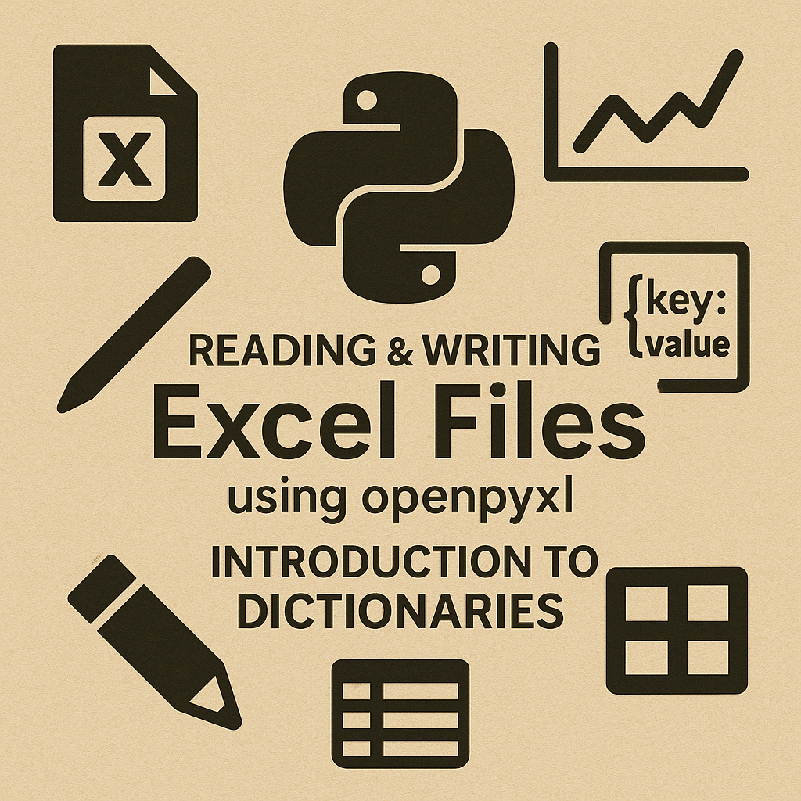

Slide 2
📊 Why Excel Automation Matters
• Excel everywhere
• Real-world automation
• Great practice with loops
• Prepares for Pandas

Slide 3
🎯 Goals for This Video
• Virtual environment
• Install openpyxl
• Read Excel
• Dictionaries
• Write Excel

Slide 4
📇 Definitions
• Workbook – entire Excel .xlsx file
• Worksheet – a tab inside the workbook
• Cell – smallest data container (e.g., A1)
• Row – horizontal group of cells
• Column – vertical group of cells
• Header Row – labels like Name, Email, Grade
• Cell Value – actual data or formula in a cell
• openpyxl – library for reading/writing .xlsx
• Virtual Environment – isolated Python setup
• Dictionary – key/value data structure

Slide 5
📁 Prepare the Project Folder
• Create folder
• Add sample Excel
• Open in VS Code

Slide 6
🐍 Creating a Virtual Environment
python -m venv venv
Activate with yourprojectroot/venv/scripts/activate.ps1
pip list
https://realpython.com/python-virtual-environments-a-primer/ - Friendly Intermediate
https://docs.python.org/3/library/venv.html - Official

Slide 7
🔧 Installing openpyxl
Need for Package Indexer
https://pypi.org/ - 99% of packages
Python Package Index find
• pip install openpyxl
• pip show

Slide 8
📄 Exploring Sample Excel File
• Columns
• Header row
• Table structure

Slide 9
📂 Loading a Workbook
• load_workbook()
• wb.active

Slide 10
🔁 Iterating Through Rows
• iter_rows(values_only=True)
• Skip header

Slide 11
🧩 Introducing Dictionaries
• Keys = column names
• Easier than tuples

Slide 12
🔄 Converting Rows to Dicts
• student['name']
• Clean, readable

Slide 13
🛠️ Using Dictionaries
• Filter
• Cleaning
• Add fields

Slide 14
📤 Creating a New Excel File
• Workbook()
• append()
• save()

Slide 15
🧵 Full Simple Workflow
Load →
Dicts →
Modify →
Save

Slide 16
🚀 Advanced Workflows
• Multi-sheet
• Formulas
• Templates
• Styling

Slide 17

📅 Advanced Case Study – Attendance
Student attendance Tracked
Many worksheets
Grades
Present/absent logic

Slide 18

🎨 Color Formatting
• PatternFill
• Red/yellow/green

Slide 19
💪 openpyxl Strengths
• Formatting
• Templates
• Charts
• Multi-sheet

Slide 20
⚠️ openpyxl Limitations
• Slow for large data
• No formula calc(can create)
• Manual steps

Slide 21
🧠 Skills Learned
How to set up and use a Python virtual environment
Installing and using openpyxl to read and write Excel files
Iterating through Excel worksheets and converting rows into Python dictionaries
Processing, transforming, and generating new structured data from spreadsheets
Creating new Excel files and saving results using Workbook() and append()
Working with multiple worksheets and merging them into a single summary
Applying basic cell formatting (colors) to communicate data meaning

Slide 22
References - URLs
Official - https://pypi.org/project/openpyxl/
Intermediate - https://realpython.com/openpyxl-excel-spreadsheets-python/
Beginner - https://automatetheboringstuff.com/3e/chapter14.html

Slide 23
➡️ Next Up: Pandas
• DataFrames
• Fast operations
• Merge and reshape

