Slide 1
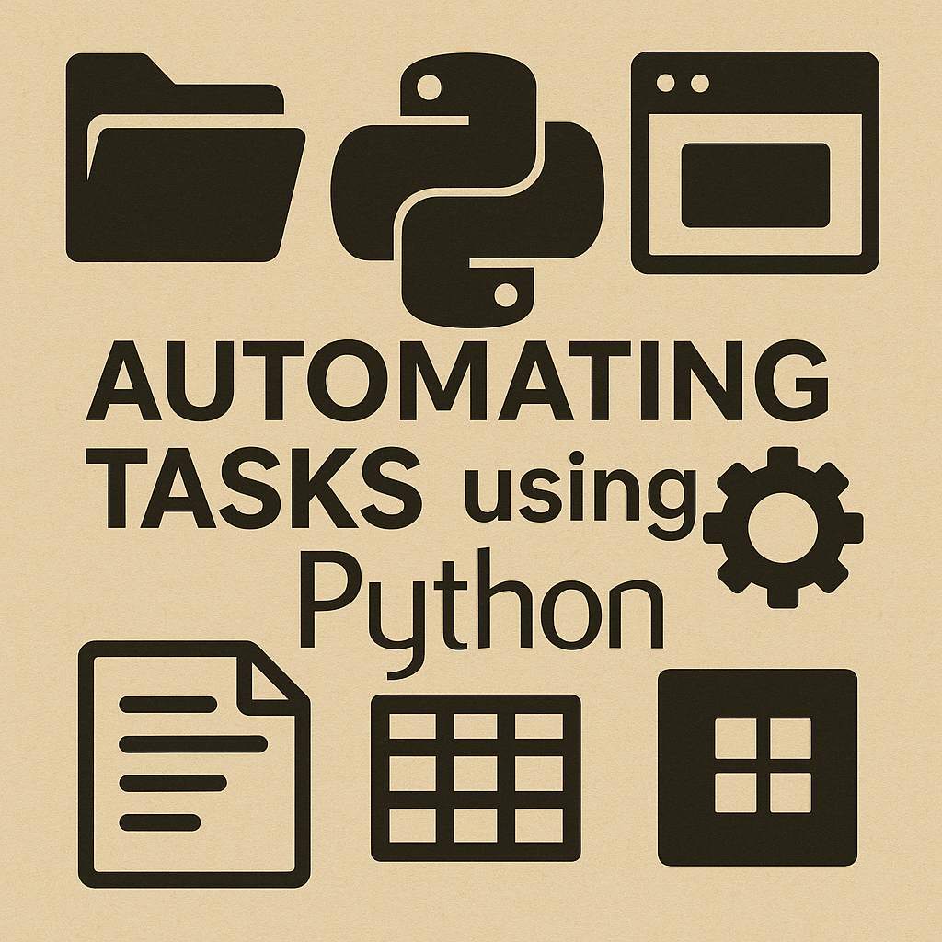
Course Materials: https://github.com/ValRCS/RTU_Automating_Tasks_With_Python

Slide 2

VIDEO 2 – Working with Text Files & String Processing
  Working with text files
  String methods
  Lists
  Loops
  Branching / logic

Slide 3
Quick Review from Video 1
Running Python files
Using VS Code & Terminal
print(), variables

Slide 4
What Are Text Files?
Plain text vs formatted
UTF-8
Why automation starts with text

Slide 5
Reading a Text File
open("file", "r")
with open(...) as f
read(), readlines()

Slide 6

Basic String Processing
  .strip()
  .lower() / .upper()
  .replace()
  .find()
  .split()

Slide 7

Lists
  Store many pieces of text
  Indexing
  Processing lines

Slide 8

Loops
  for loops
  Iterate lines
  Clean / count / filter

Slide 9

Branching / Logic
if / elif / else
"in" for substring detection
Filtering

Slide 10

Mini Automation Script
Read → clean → filter → write
Realistic small example

Slide 11

Writing to a File
  w = overwrite
  a = append
  Write lines with \n

Slide 12

Common Mistakes
  Missing encoding
  Forgetting strip()
  Using read() incorrectly

Slide 13
Exercise
Load file
Clean lines
Filter
Save

Slide 14
Summary
Files
Strings
Lists
Loops
Logic

