Slide 1
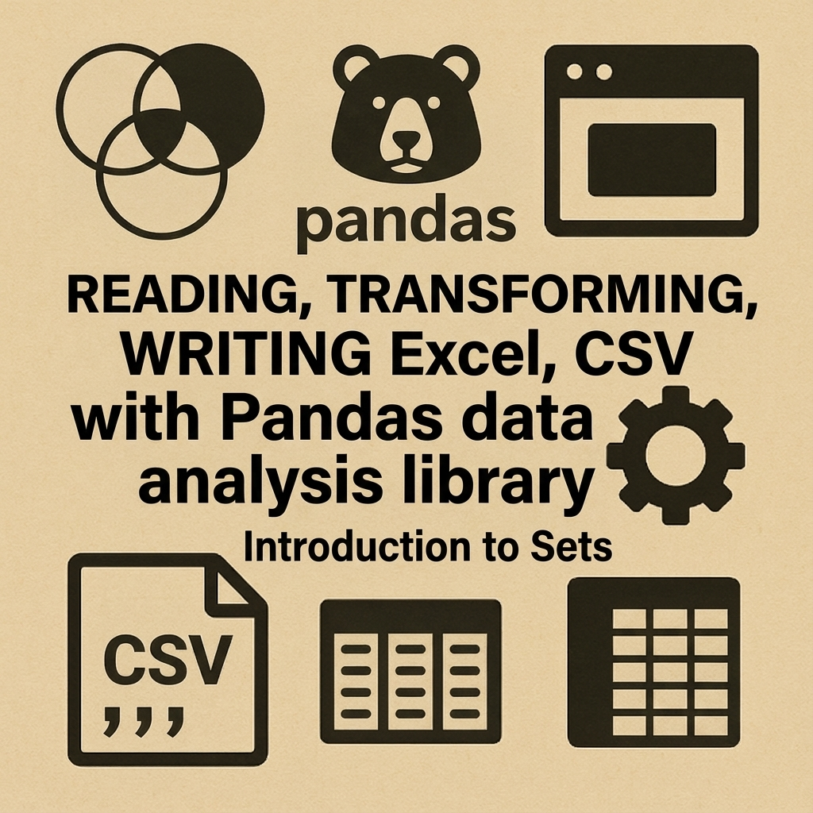

Slide 2
🎯
Today’s Goals
Jupyter Notebooks
for Interactive Python
Pandas Data Analysis Library
Sets Data Structure in Python

Slide 3
📊 Why pandas?
Fast, powerful data analysis toolkit
Works great with CSV & Excel
Cleaner & faster than pure Python loops
Industry-standard for data tasks
References:
  https://pandas.pydata.org/about/index.html
  https://pandas.pydata.org/docs/user_guide/10min.html
  https://numpy.org/doc/stable/user/whatisnumpy.html

Slide 4
📦 Virtual Environment Reminder
Keeps project dependencies isolated
Prevents conflicts with system Python
Packages stored per project
References:
  https://docs.python.org/3/library/venv.html
  https://realpython.com/python-virtual-environments-a-primer/
  https://packaging.python.org/en/latest/guides/installing-using-pip-and-virtual-environments/

Slide 5
📦 Activating Your venv
python -m venv venv
Activate venv
Install pandas & Jupyter
Verify with pip list
References:
  https://docs.python.org/3/library/venv.html#creating-virtual-environments
  https://code.visualstudio.com/docs/python/environments
  https://pip.pypa.io/en/stable/installation/

Slide 6
📊 Installing pandas & Jupyter
pip install pandas
pip install jupyter
Confirm installation in venv
References:
https://pandas.pydata.org/docs/getting_started/install.html
https://jupyter.org/install
https://pip.pypa.io/en/stable/user_guide/

Slide 7
📓 Jupyter Notebooks in VS Code
Install Python + Jupyter extensions
Create .ipynb file
Select venv kernel
Great for data exploration
References:
  https://code.visualstudio.com/docs/datascience/jupyter-notebooks
  https://code.visualstudio.com/docs/python/python-tutorial
  https://marketplace.visualstudio.com/items?itemName=ms-toolsai.jupyter

Slide 8
📓 Notebook Basics
Run code in cells
Outputs appear below code
Use Markdown cells for notes
Restart kernel clears variables
References:
  https://jupyter-notebook.readthedocs.io/en/stable/notebook.html
  https://docs.jupyter.org/en/latest/
  https://ipython.readthedocs.io/en/stable/interactive/htmlnotebook.html

Slide 9
📊 Introducing pandas
import pandas as pd
Series and DataFrame
DataFrame = table-like structure
References:
  https://pandas.pydata.org/docs/getting_started/intro_tutorials/01_table_oriented.html
  https://pandas.pydata.org/docs/user_guide/dsintro.html
  https://realpython.com/pandas-python-explore-dataset/

Slide 10
📊 Why DataFrames Are Powerful
Labeled rows & columns
Handles multiple data types
Vectorized operations
Easy filtering/joining/grouping
References:
  https://pandas.pydata.org/docs/user_guide/dsintro.html#dataframe
  https://pandas.pydata.org/docs/user_guide/basics.html
  https://pandas.pydata.org/docs/user_guide/10min.html

Slide 11
📊 Pandas Data Model & NumPy Foundation
Columns are NumPy ndarrays
Each column has strict dtype
NumPy provides speed
pandas adds labels + ops
References:
  https://pandas.pydata.org/docs/user_guide/basics.html#dtypes
  https://numpy.org/doc/stable/reference/arrays.ndarray.html
  https://pandas.pydata.org/docs/user_guide/basics.html#numpy-interop

Slide 12
📄 Reading CSV Files
pd.read_csv
Preview with head()
Inspect with info()
Type detection
References:
  https://pandas.pydata.org/docs/reference/api/pandas.read_csv.html
  https://pandas.pydata.org/docs/user_guide/io.html#csv-text-files
  https://realpython.com/python-csv/

Slide 13
📊 Reading Excel Files
pd.read_excel
Supports multiple sheets
Handles missing values
Preview first rows
References:
  https://pandas.pydata.org/docs/reference/api/pandas.read_excel.html
  https://pandas.pydata.org/docs/user_guide/io.html#excel-files
  https://openpyxl.readthedocs.io/en/stable/

Slide 14
📊 Viewing Data Efficiently
head(), tail()
describe() for numerics
shape for dims
columns to inspect names
References:
  https://pandas.pydata.org/docs/user_guide/basics.html
  https://pandas.pydata.org/docs/reference/api/pandas.DataFrame.info.html
  https://pandas.pydata.org/docs/reference/api/pandas.DataFrame.describe.html

Slide 15
📊 Selecting Data (Rows & Columns)
df['col']
df[['a','b']]
Boolean filtering
loc and iloc basics
References:
  https://pandas.pydata.org/docs/user_guide/indexing.html
  https://pandas.pydata.org/docs/reference/api/pandas.DataFrame.loc.html
  https://pandas.pydata.org/docs/reference/api/pandas.DataFrame.iloc.html

Slide 16
📊 Cleaning & Transforming Data
Rename columns
Create new columns
Convert types
Handle missing data
References:
  https://pandas.pydata.org/docs/user_guide/basics.html
  https://pandas.pydata.org/docs/user_guide/reshaping.html
  https://pandas.pydata.org/docs/reference/api/pandas.DataFrame.fillna.html

Slide 17
📊 Sorting & Filtering
sort_values
Logical conditions
Combine filters with & and |
Filter examples
References:
  https://pandas.pydata.org/docs/reference/api/pandas.DataFrame.sort_values.html
  https://pandas.pydata.org/docs/user_guide/indexing.html#boolean-indexing
  https://pandas.pydata.org/docs/user_guide/basics.html#basics-filtering

Slide 18
📊 Saving CSV & Excel
to_csv
to_excel
Multi-sheet support
Avoid path mistakes
References:
  https://pandas.pydata.org/docs/reference/api/pandas.DataFrame.to_csv.html
  https://pandas.pydata.org/docs/reference/api/pandas.DataFrame.to_excel.html
  https://pandas.pydata.org/docs/user_guide/io.html#excel-writer

Slide 19
🔗 Introducing Python Sets
Unordered unique collection
Fast membership test
Use {} or set()
References:
  https://docs.python.org/3/library/stdtypes.html#set
  https://realpython.com/python-sets/
  https://docs.python.org/3/tutorial/datastructures.html#sets

Slide 20
🔗 Set Operations
union
intersection
difference
Find new/missing values
References:
  https://docs.python.org/3/library/stdtypes.html#set-types-set-frozenset
  https://realpython.com/python-sets/#set-operations
  https://docs.python.org/3/howto/functional.html

Slide 21
🔗 Using Sets with pandas
set(df['col'])
Compare across files
Detect mismatches
Check consistency
References:
  https://pandas.pydata.org/docs/user_guide/basics.html#basics-duplicate-values
  https://pandas.pydata.org/docs/reference/api/pandas.Series.unique.html
  https://pandas.pydata.org/docs/reference/api/pandas.Index.isin.html

Slide 22
⚙️ Automation Workflow — Overview
Combine many CSVs
Clean structure
Summaries & aggregates
Save outputs
References:
https://pandas.pydata.org/docs/getting_started/intro_tutorials/
https://pandas.pydata.org/docs/user_guide/io.html
https://realpython.com/pandas-python-explore-dataset/

Slide 23
⚙️ Automation Step 1 — Load Many Files
Use glob
Loop filenames
Read CSVs
Store DataFrames
References:
https://docs.python.org/3/library/glob.html
https://pandas.pydata.org/docs/reference/api/pandas.read_csv.html
https://docs.python.org/3/library/os.html

Slide 24
⚙️ Automation Step 2 — Merge All Data
pd.concat
Verify row counts
Clean column names
Drop duplicates
References:
  https://pandas.pydata.org/docs/reference/api/pandas.concat.html
  https://pandas.pydata.org/docs/user_guide/merging.html
  https://pandas.pydata.org/docs/user_guide/basics.html#basics-reindexing-and-alignment

Slide 25
⚙️ Automation Step 3 — Aggregate Data
groupby for summaries
Average per course
Counts per group
Use sets for unique IDs
References:
  https://pandas.pydata.org/docs/reference/api/pandas.DataFrame.groupby.html
  https://pandas.pydata.org/docs/user_guide/groupby.html
  https://pandas.pydata.org/docs/reference/api/pandas.core.groupby.DataFrameGroupBy.agg.html

Slide 26
📊 Automation Step 4 — Export Final Output
Save merged data
Save summaries
Multi-sheet Excel
Check paths
References:
  https://pandas.pydata.org/docs/user_guide/io.html#excel-files
  https://pandas.pydata.org/docs/reference/api/pandas.ExcelWriter.html
  https://pandas.pydata.org/docs/reference/api/pandas.DataFrame.to_excel.html

Slide 27
💡 Wrap-Up — What You Learned
pandas basics
Jupyter workflows
Sets for comparisons
Automation pipeline
References:
  https://pandas.pydata.org/docs/getting_started/intro_tutorials/
  https://jupyter.org/documentation
  https://docs.python.org/3/library/stdtypes.html#set

