Slide 1

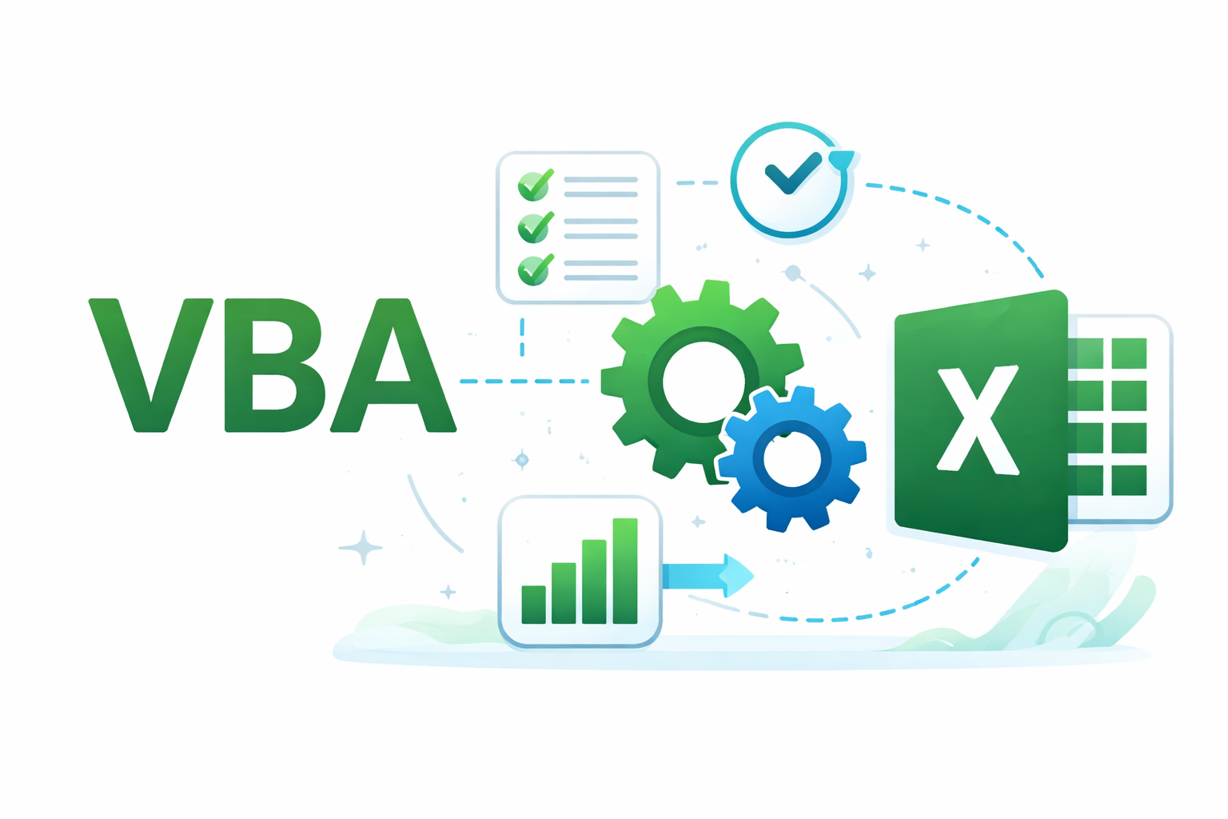
VBA in Excel
Introduction to Automation and Scripting

Slide 2
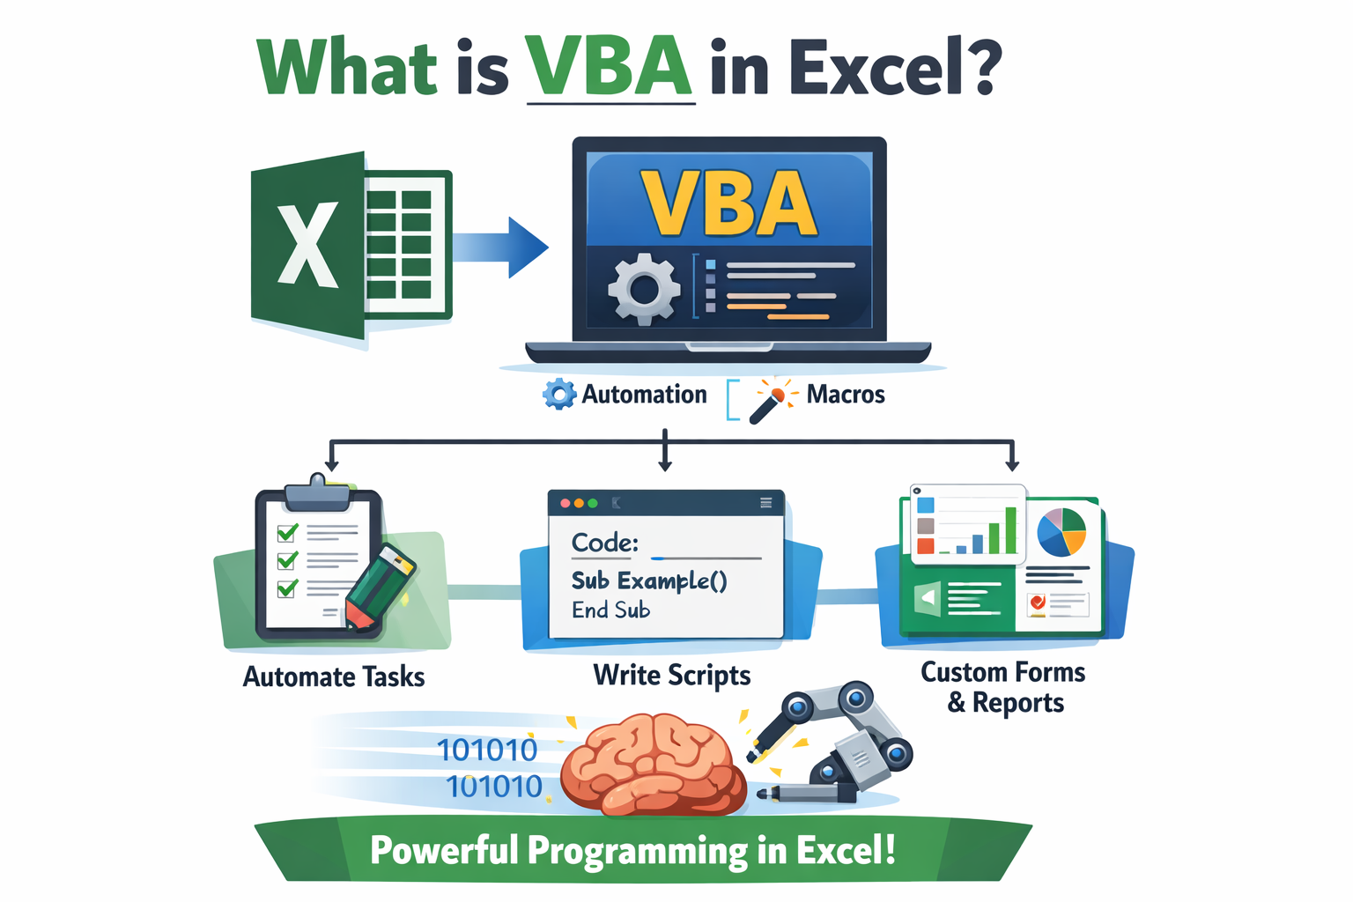
What is VBA?
• VBA = Visual Basic for Applications
• Built-in programming language in Excel
• Used to automate repetitive tasks
• Enables creation of macros and custom logic

Slide 3
What Can VBA Do?
• Automate formatting and reporting
• Process large datasets
• Create custom user forms
• Reduce manual work and errors

Slide 4
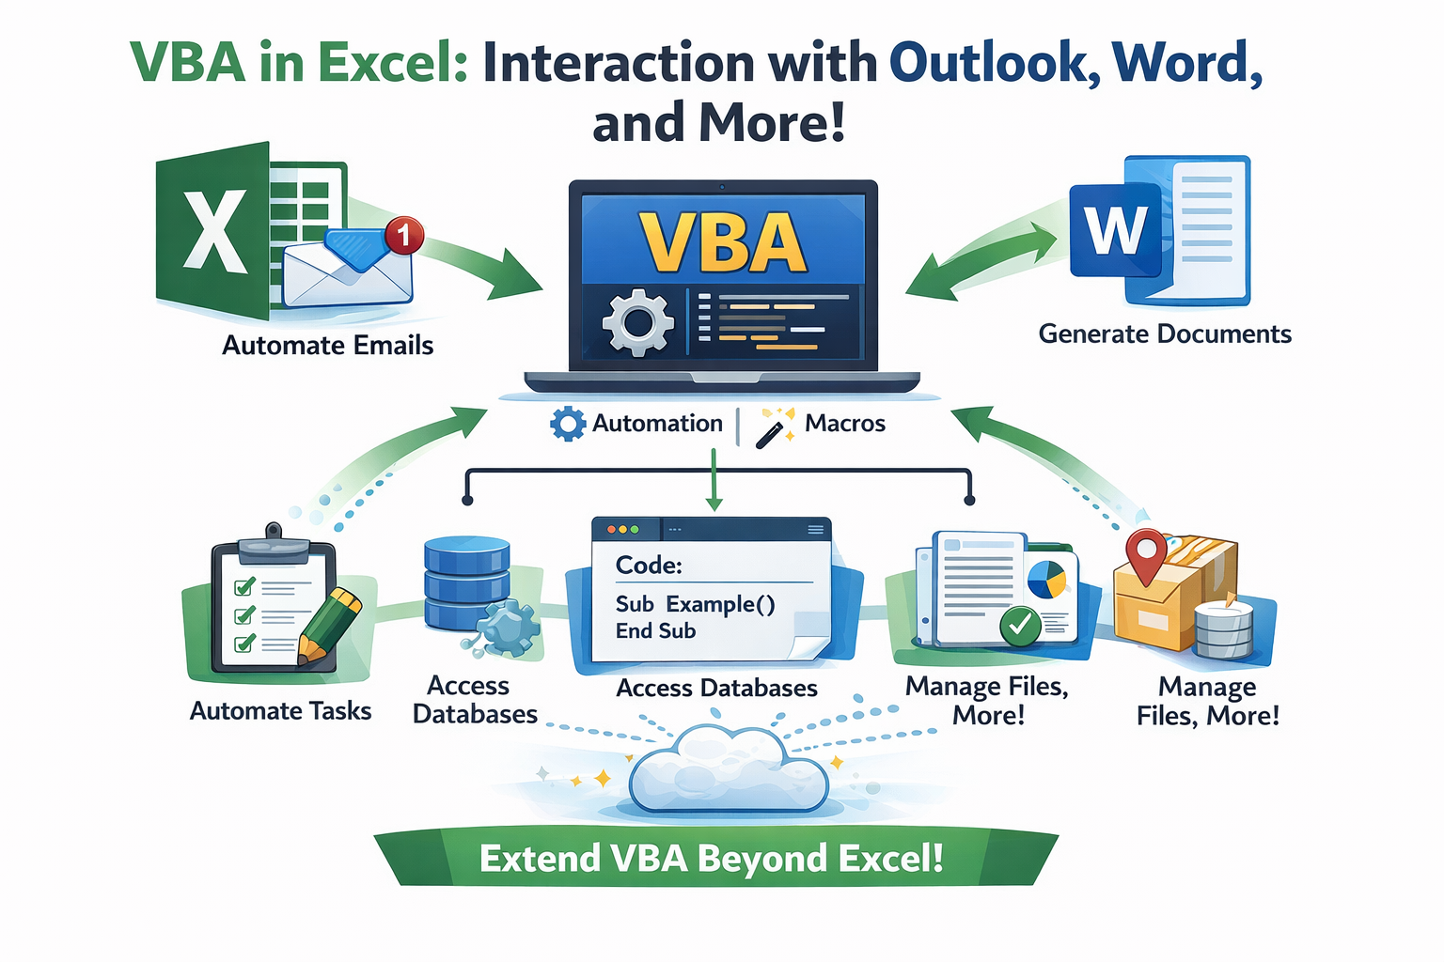
VBA Beyond Excel
• Send emails via Outlook
• Generate Word documents
• Work with files and databases
• Integrate across Microsoft Office

