Slide 1

Webscraping Project : Asco Annual meeting 2021
By Vallari Shah
Notes:
NOTE:
To change the image on this slide, select the picture and delete it. Then click the Pictures icon in the placeholder to insert your own image.

Slide 2
Introduction and Aims
Plan to scrape American Society of Clinical Oncology website for this year’s ASCO annual meeting abstract
Premier conference in the world for oncology research
Major clinical scientific and drug breakthrough presented here annually
Useful for governmental organizations and pharmaceuticals of competitor drugs/organizations as well as investors in biotechnology/health sector.

Slide 3
The website
Initial abstract page detailed number of abstracts
Button to proceed to abstracts sequentially or search facility
Abstracts also available in PDF after conference in supplementary part of journal publication
No way to analysed data without webscraping or scraping the pdf of JCO journal

Slide 4
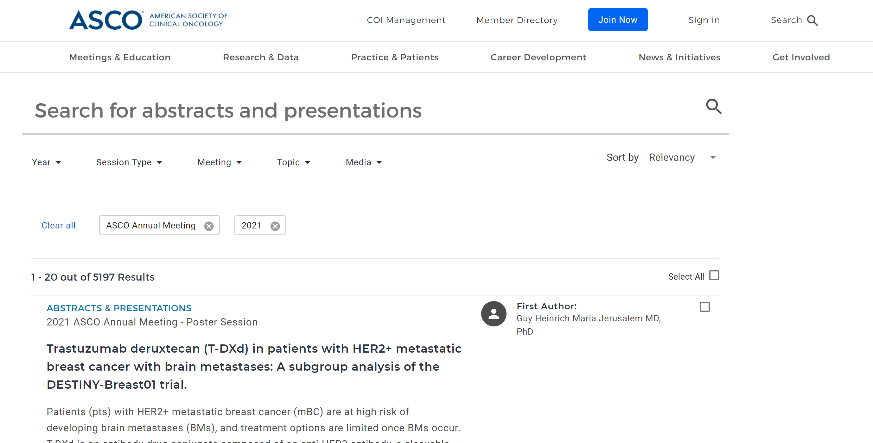
Plan: initial page
Scrape number of total abstracts through initial page
Calculate number of pages if 20 abstracts per page
Change pages (URL changes per page so used scrapy)
Scrape URLs for each abstract for all pages (260 pages in this case)
For each URL – scrape information per abstract

Slide 5
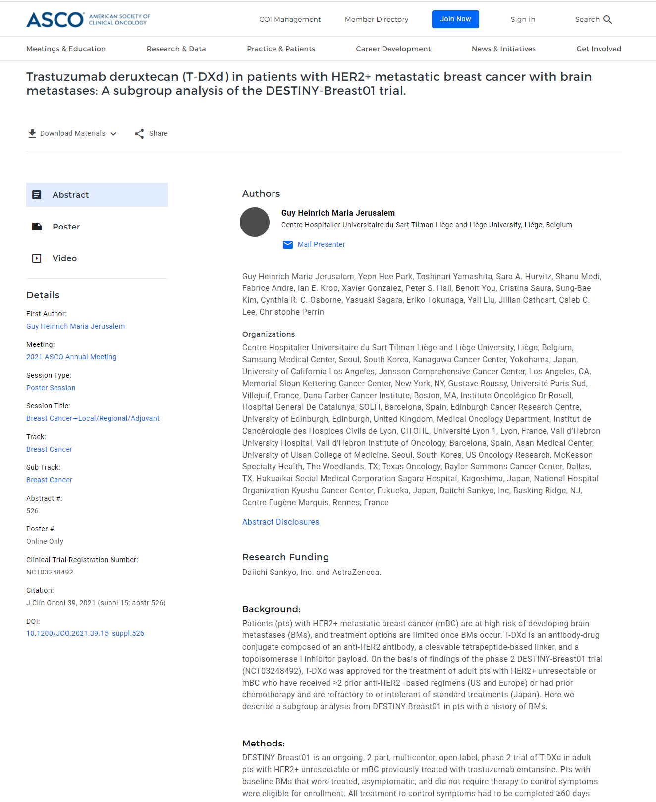
Plan: next page
Visit each abstract page and
scrape further information
Scrape abstract title
Scrape meta data from side panel
Scrape authors
Scrape organisations
Scrape research funding
Scrape abstract text

Slide 6
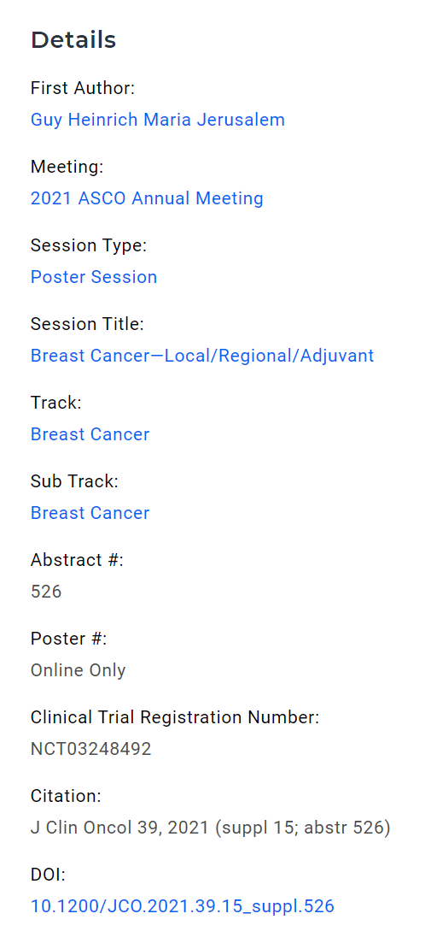
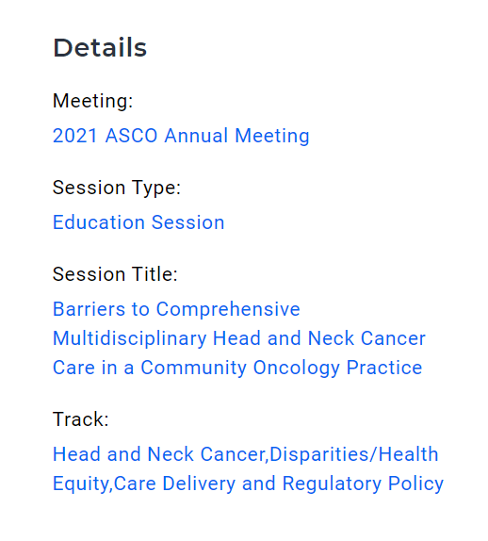
Challenges/problems
Problem 1:
Changing data headings in side panel according to different abstracts
Therefore could not use position to extract data
Had to extract data according to heading instead
Also changing paths according to type of data – either href or text – if statement inserted to capture all data

Slide 7

Challenges/problems
Problem 2:
HTTP 504 error: no response from server
Just over 3000 abstracts scraped from scrapy script everytime it was run
I ran this 3 times – and obtained over 4665 of the abstracts out of a total of 5197 abstracts
In future – I plan to run an extra script to try the server more than once through a middleware script I found but I have run out of time for the project to try this.

Slide 8
Github page
https://github.com/ValShah/Web_scraping_project

Slide 9
Data cleaning
Removed all abstracts from education sessions
Removed all abstracts from other non primary research sessions
Remaining 2182 abstracts analysed

Slide 10
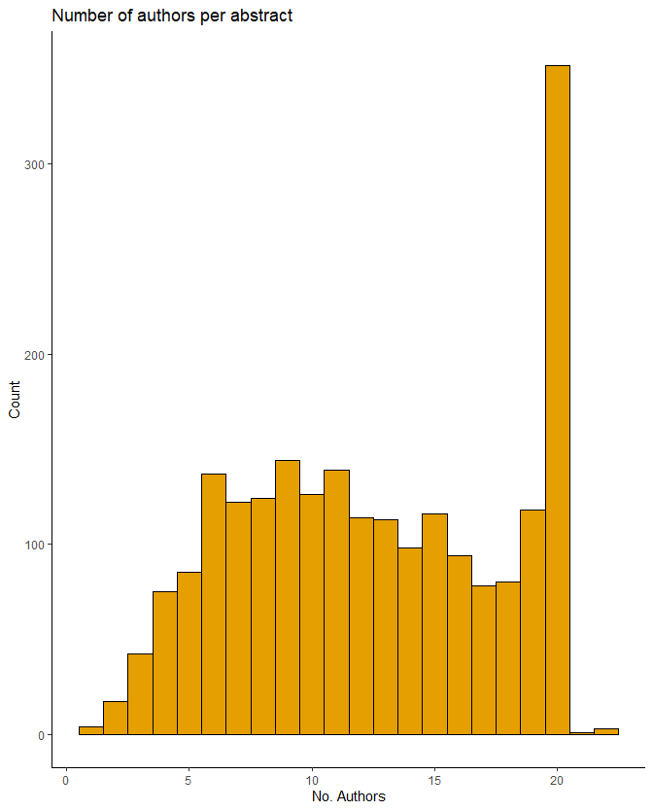
Analysis: Number of authors per abstract
Text analysis of authors list:
Number of authors per abstract

Slide 11
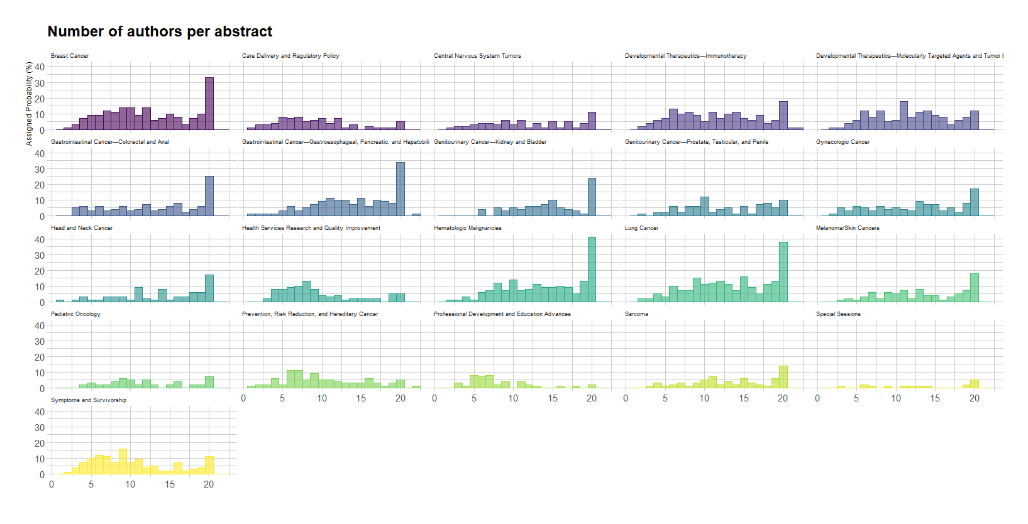
Analysis: Authors per track
Number of authors per track

Slide 12
Analysis Results: Top authors (first and last)
Top 20 First Authors | n
Anthony W. Tolcher | 4
Neeraj Agarwal | 4
Sandra P. D'Angelo | 4
Timothy A. Yap | 4
Alison M. Schram | 3
Bradley Alexander McGregor | 3
David S. Hong | 3
Filip Janku | 3
Ishwaria Mohan Subbiah | 3
Karim Fizazi | 3
Mark Christopher Markowski | 3
Patrick Y. Wen | 3
Scott Kopetz | 3
Vivek Subbiah | 3
Abdul Rafeh Naqash | 2
Abdulazeez Salawu | 2
Aibin Liang | 2
Ainhoa Madariaga | 2
Akshara Singareeka Raghavendra | 2
Alberto Hernando-Calvo | 2
Top 20 Last Authors | n
Toni K. Choueiri | 9
Jun Guo | 8
Aditya Bardia | 6
Heinz-Josef Lenz | 6
Takayuki Yoshino | 6
Vivek Subbiah | 6
Areej El-Jawahri | 5
Benjamin Besse | 5
Hope S. Rugo | 5
Jeffrey S. Ross | 5
Manmeet Singh Ahluwalia | 5
Mark M. Awad | 5
Narjust Duma | 5
Sibylle Loibl | 5
Binghe Xu | 4
Dirk Schadendorf | 4
Elena Garralda | 4
Emmanuel S. Antonarakis | 4
Georgina V. Long | 4
Ivo Abraham | 4
First and last author to find most common first and last authors
Generally accepted as most influential in work performed

Slide 13
Future work to do
Perform network analysis of authors and their respective institutions to see which institutions most influential per type of cancer and networks between institutions/countries
Issues: author institutions not separated by anything to allow distinguishing first institution
Not possible with just regular expressions
Not possible to find institutions ending in countries as some just end in state e.g. in US
The same institution called by different names
Analysis is possible but will need further analysis but I ran out of time for this

Slide 14
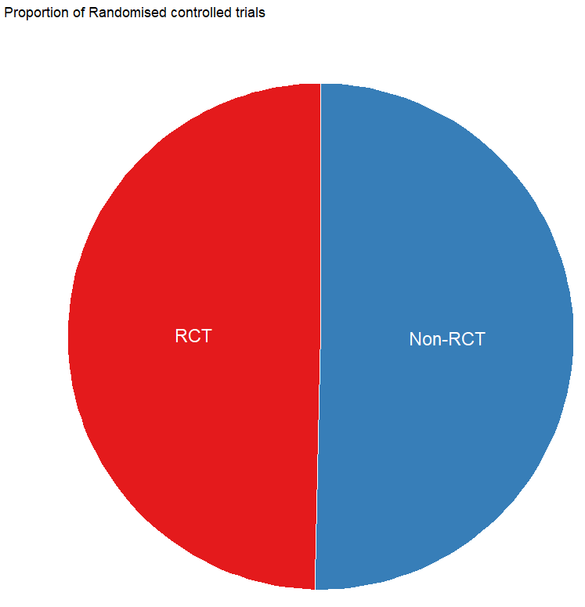
Quality of research
Clinical trial evidence – highest standard generally considered to be randomised controlled trials (RCTs)
Total % RCTs analysed in all abstracts
Next, I analysed per cancer type – proportion of abstracts from RCTs

Slide 15
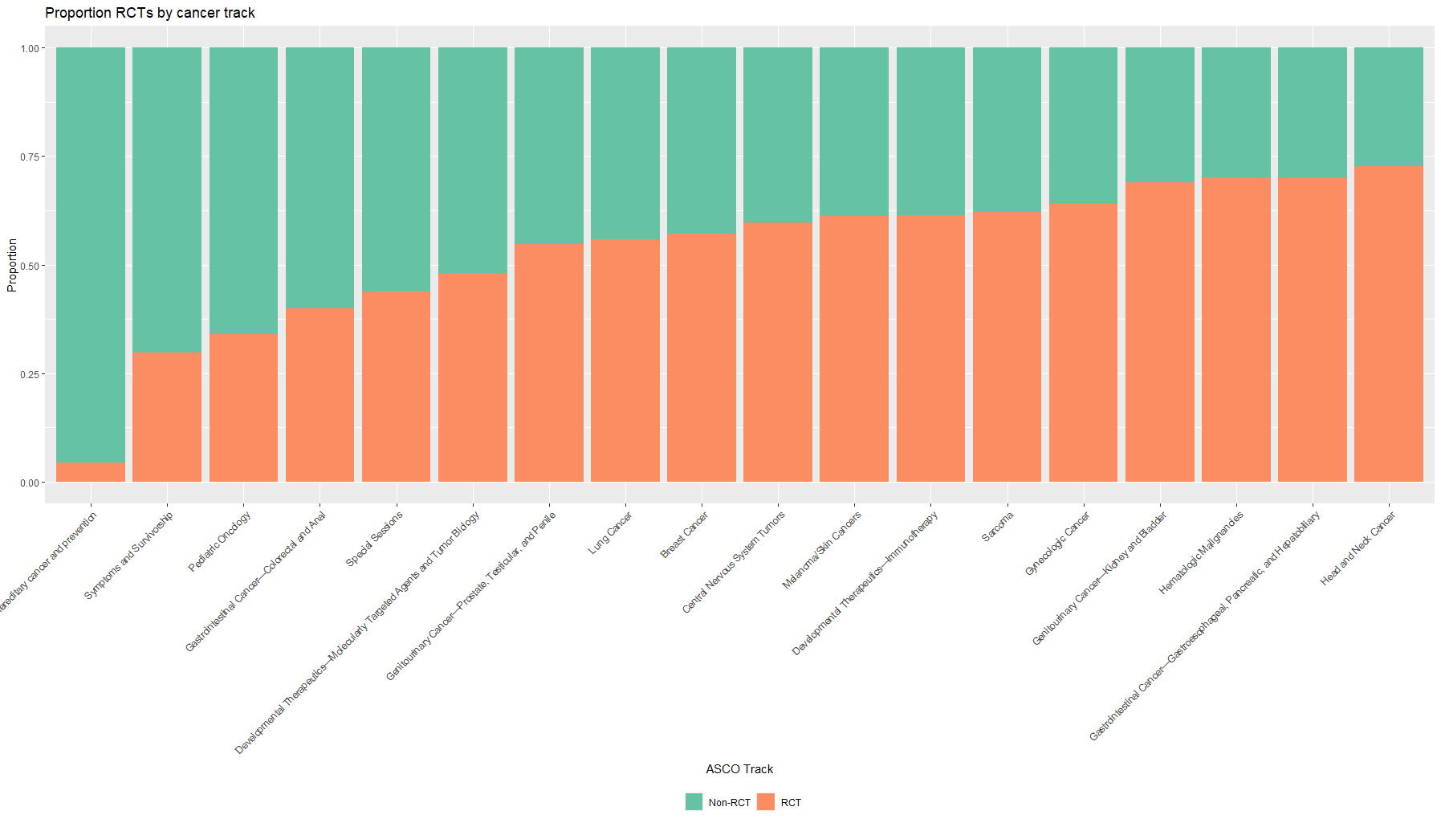
Proportion of RCT’s per track
Highest proportion of RCTS in
Head and neck
Upper Gastrointestinal
Hematologic cancers
Lowest
Prevention and hereditary cancer
Symptoms and survivorship
Pediatric oncology

Slide 16
Future Work
Improve scraping so server error 504 does not influence which abstracts scraped
Further text analysis of author institutions
To allow network analysis by author institution/country per cancer type
To allow plotting of where RCTs are taking place in the world (through plotting on map)

Slide 17
Future Work
Analyse abstract title data – will need natural language processing
Analysis of text from abstract to scrape new drugs coming through pre-clinical work – will need natural language processing
Also scrape previous years abstracts to analyse trends in research
Analyse other conference websites related to cancer to develop wealth of data on cancer research

