Slide 1


Contract testing with
Spring Cloud Contract
January, 2020

Slide 2

About me
Valerii Timofeev
Title:
Software Test Automation Engineer
Project:
EBS-CRDI
Email: valerii_timofeev@epam.com

Slide 3
Agenda ? ? Delete. словами
Introduction
Demo
Additional features
Questions

Slide 4
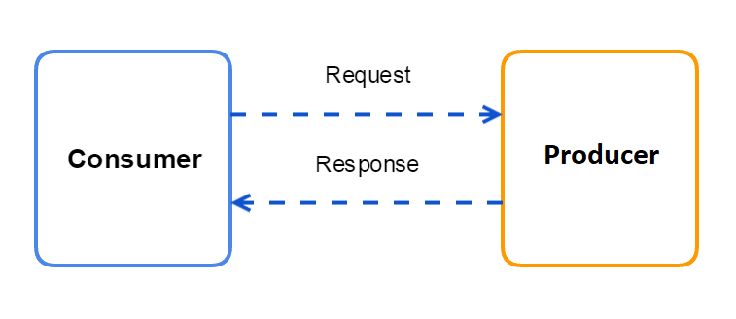
Terminology
https://www.novatec-gmbh.de/wp-content/uploads/2017/06/Microservices-Testing-02-2.png

Slide 5
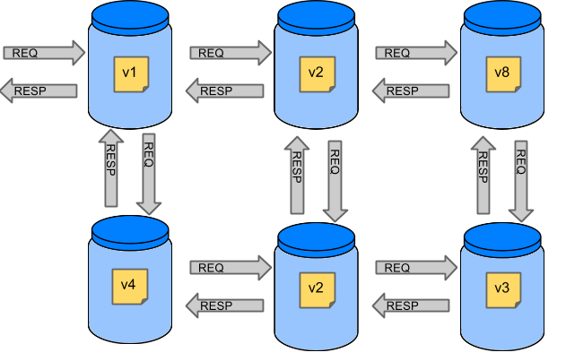
Why Do You Need It? Схему с оркестратором!
https://cloud.spring.io/spring-cloud-contract/reference/html/images/Deps.png

Slide 6
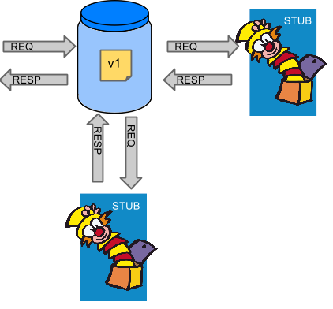
Stubbing
https://cloud.spring.io/spring-cloud-contract/reference/html/images/Stubs2.png

Slide 7
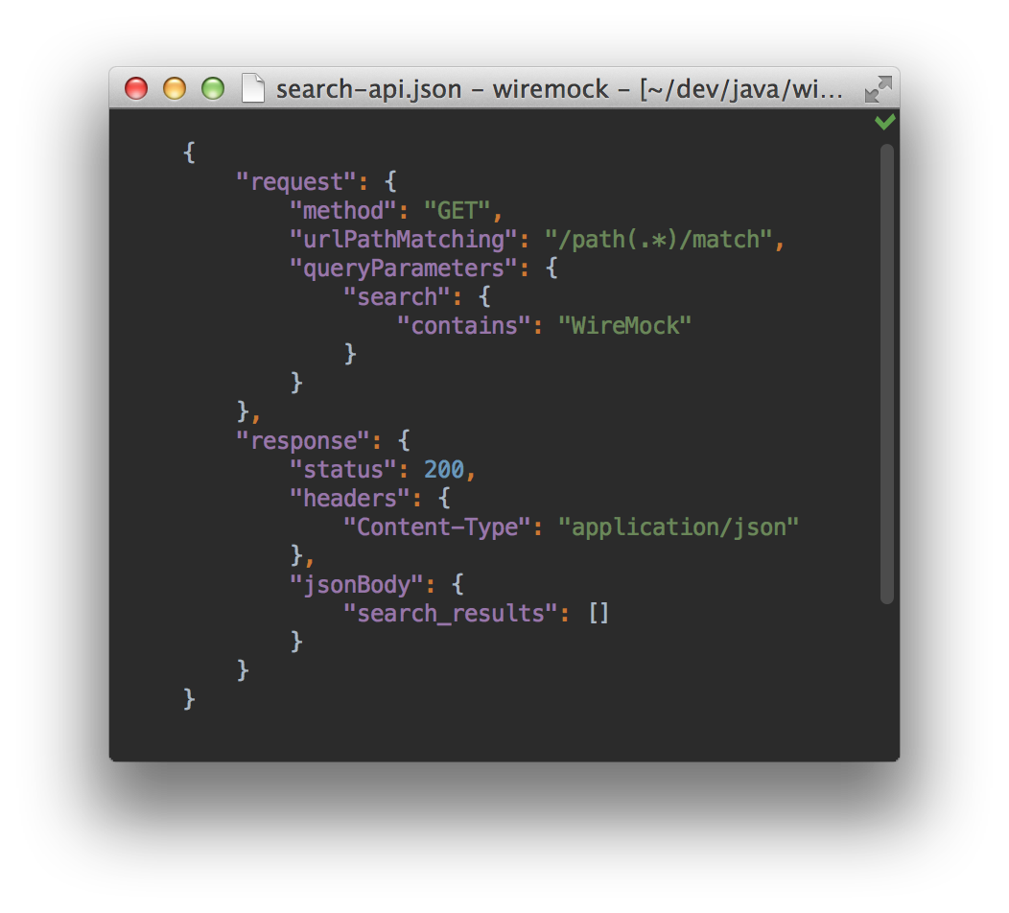
WireMock
http://wiremock.org/images/small-json-idea-shot.png

Slide 8
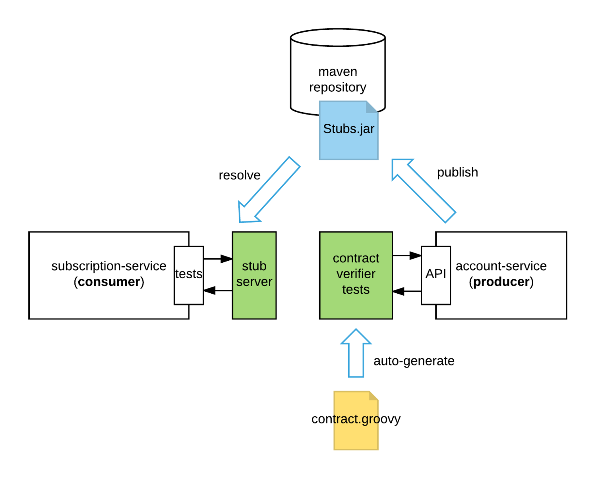
Demo. Кажется что контракт решает проблему с оркестратором.
ПРОБЛЕМА ПОНЯТНЕЕ ОБЪСНИТЬ
Показывать по плану
Когда показываю, нужно объяснять любое действие
Открыть все приложения
НЕ ДОЛЖНО БЫТЬ ворнингов
https://specto.io/img/blog/cdc_spring_cloud_contract-db1b2b0585.png

Slide 9
Additional features Убрать вложенность. Отдельные слайды
Contract Testing in a non-JVM World
DSL
Ignoring Contracts
Contracts in Progress
Passing Values from Files
Regular Expressions
Passing Optional Parameters
Stateful Contracts (Scenarios)
Generating Contracts with REST Docs
WireMock features
Stubbing in runtime
Messaging contract tests (Kafka, RabbitMQ)

Slide 10
Summary

Slide 11
Links
https://git.epam.com/Valerii_Timofeev/contract-tests
https://cloud.spring.io/spring-cloud-contract/reference/html/​
https://github.com/spring-cloud-samples/spring-cloud-contract-samples/tree/2.0.x​
https://habr.com/ru/post/424057/
http://wiremock.org/
https://docs.pact.io/​

