Slide 1
Contract testing with Spring Cloud Contract
January, 2020

Slide 2

About me
Valerii Timofeev
Title:
Software Test Automation Engineer
Project:
EBS-CRDI
Email: valerii_timofeev@epam.com

Slide 3
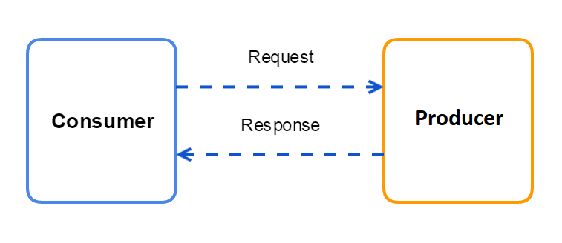
Terminology
https://www.novatec-gmbh.de/wp-content/uploads/2017/06/Microservices-Testing-02-2.png

Slide 4
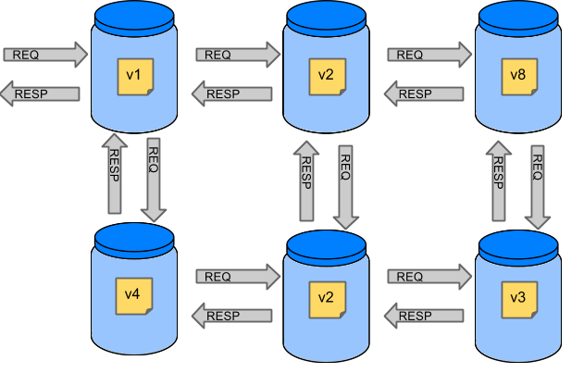
End 2 End testing
https://cloud.spring.io/spring-cloud-contract/reference/html/images/Deps.png

Slide 5

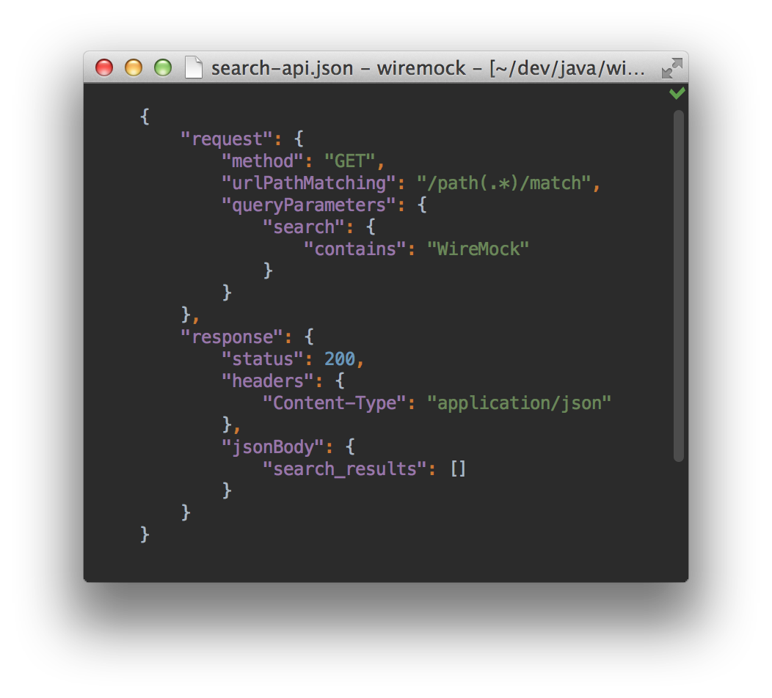
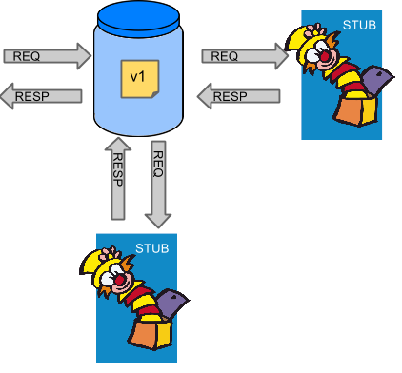
Integration/Unit testing
WireMock

Slide 6
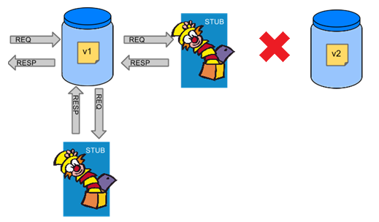
Integration/Unit testing

Slide 7
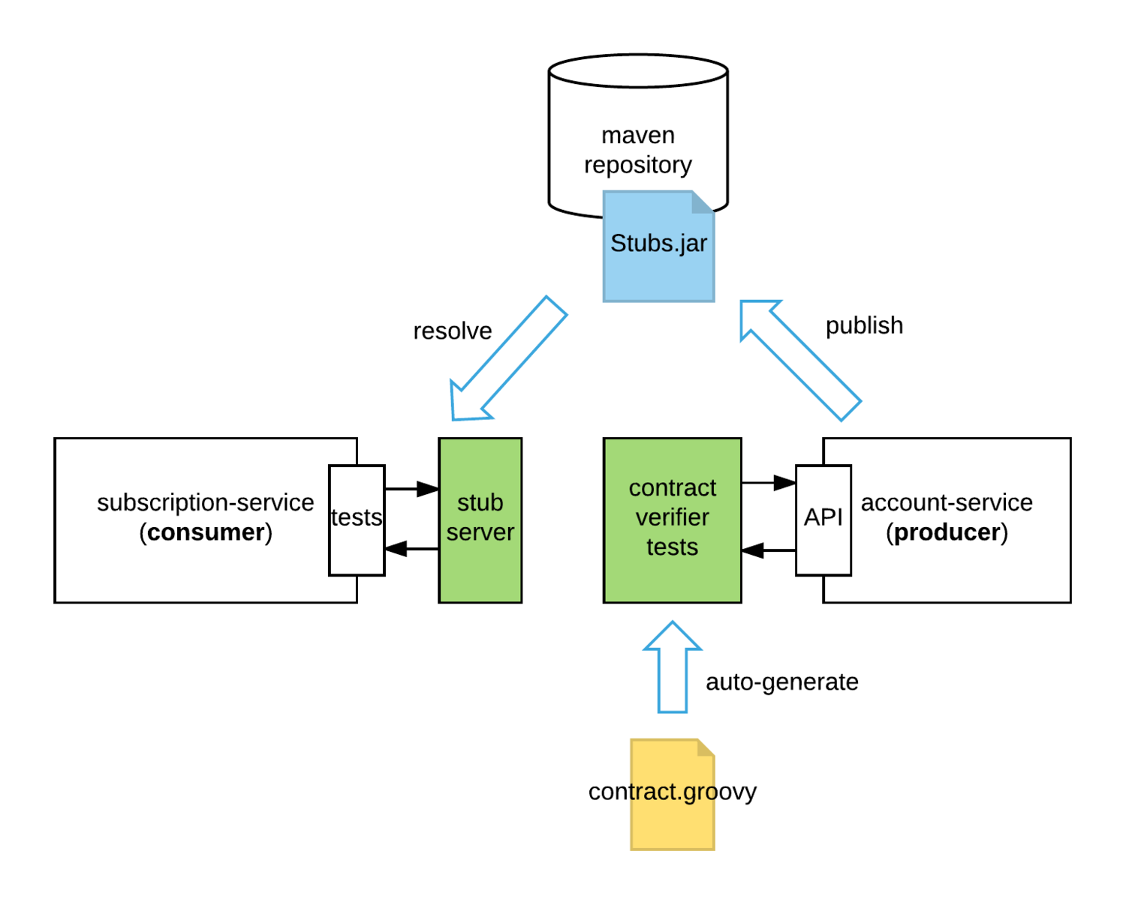
Demonstration
https://specto.io/img/blog/cdc_spring_cloud_contract-db1b2b0585.png

Slide 8
Additional features. Contract DSL
Ignoring Contracts
org.springframework.cloud.contract.spec.Contract.make {
ignored()
}
Passing Values from Files
body(file("request.json"))
Passing Optional Parameters
body(
email: $(consumer(optional(regex(email()))), producer('abc@abc.com')),
callback_url: $(consumer(regex(hostname())), producer('http://partners.com’))
)

Slide 9
Contract Testing for a non-Spring Application
JUnit 4 Rule
@Rule public StubRunnerRule rule = new StubRunnerRule()
.downloadStub("com.example","artifact-id", "0.0.1")
.repoRoot(" git://git@github.com:spring-cloud-samples/spring-cloud-contract-nodejs-contracts-git.git")
.stubsMode(StubRunnerProperties.StubsMode.REMOTE);
JUnit 5 Extension
@Rule public StubRunnerExtension stubRunnerExtension = new StubRunnerExtension() .downloadStub("com.example","artifact-id", "0.0.1")
.repoRoot("git://git@github.com:spring-cloud-samples/spring-cloud-contract-nodejs-contracts-git.git") .stubsMode(StubRunnerProperties.StubsMode.REMOTE);

Slide 10
WireMock features. Scenarios
Stateful Behaviour
my_contracts_dir\
scenario1\
1_login.groovy
2_showCart.groovy
3_logout.groovy
Stubbing in runtime
stubFor(get(urlEqualTo("/some/thing"))
.willReturn(aResponse()
.withStatus(200)
.withStatusMessage("Everything was just fine!")
.withHeader("Content-Type", "text/plain")));

Slide 11
Messaging contract tests (Kafka, RabbitMQ)
def dsl = Contract.make {
description 'Some description’
// Label by means of which the output message can be triggered
label 'some_label’
// input to the contract
input {
// the contract will be triggered by a method
triggeredBy('bookReturnedTriggered()’)
}
// output message of the contract
outputMessage {
// destination to which the output message will be sent
sentTo('output’)
// the body of the output message
body('''{ "bookName" : "foo" }'‘’)
// the headers of the output message
headers { header('BOOK-NAME', 'foo’)
}
}
}

Slide 12
Summary
Fast feedback to verify the integration between microservices
Simple workflow for Consumer-Driven Contract testing with minimal coding
Can be used not only for Java Spring Boot Application
CAVEATS
CI environment configuration
Use random port for stubs requires a more complex setup for tests
No model classes generation

Slide 13
Links
https://git.epam.com/Valerii_Timofeev/contract-tests
https://cloud.spring.io/spring-cloud-contract/reference/html/​
https://github.com/spring-cloud-samples/spring-cloud-contract-samples/tree/2.0.x​
https://github.com/swagger-api/swagger-codegen/tree/master/
http://wiremock.org/
https://docs.pact.io/​

