Slide 1
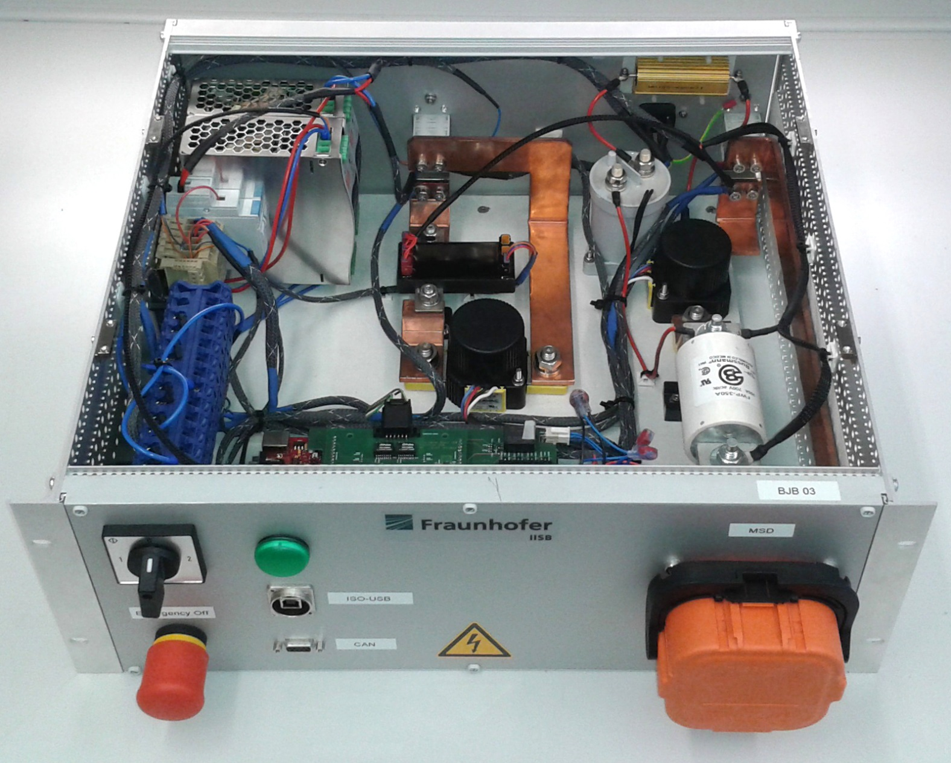
Precharge Contactor
Precharge Resistor
12V Power Supply
Current
Sensor
Main Contactors
BMS-Master
DC Fuse
Power
Switch
Emergency
Stop
Button
Manual Service
Disconnect
Isolated
CAN
Isolated USB for BMS Firmware Update

