Slide 1



LLMOps Spotlight
valantic DAA Acadamy
Notes:
A 041 : title page guilloche right : customer logo

Slide 2
You can‘t improve what you don‘t measure.
Valantic DAA Acadamy : LLMOps Spotlight

Slide 3
Classic AI Cycle
Valantic DAA Acadamy : LLMOps Spotlight
5%
Lean Business Case
Deployment in Shadowmode
Historical Simulation
Monitor Business Impact
Gather background information
Accessing the situation
Determine data science goals
Plan the project
10%
Business Value
Business Understanding
30%
Plan technical solution
Build technical solution
Integrate technical solution
Deploys technical solution
Integration
Collect initial data
Describe data
Explore data
Verify data quality
15%
Data Understanding
Validation
5%
Evaluate the results
Review the process
Determine the next steps
Data Preparation
Select right Data
Clean data
Extend data
Format data
25%
Modelling
10%
Select modeling technique
Build model
Assess model
mit der etablierten CRISP-DM Methode
3
mit der etablierten CRISP-DM Methode

Slide 4
mlflow Demo
Notes:
Demo 1-1 easy intro
Demo 1-2 custom metrics
Demo 1-3 chat with advanced metrics (LLM-as-a-Judge) → Sprung zu LiteLLM

Slide 5
LiteLLM Demo
Notes:
Kurzer Abholer & Overview
→ Endpunkt für LLM-as-a-Judge Mlflow

Slide 6
Blue Guardrails Demo
Notes:
Overview (Überblickssilde)
One step beyond LLM-as-a-Judge
root-cause analysis example
Abgesehen von tracing und error claim: Experiments Feature Modellvergleich
Wenn möglich Fokus auf claim-level und Experimente

Slide 7
Notes:
A 044 : dividerpage

Slide 8
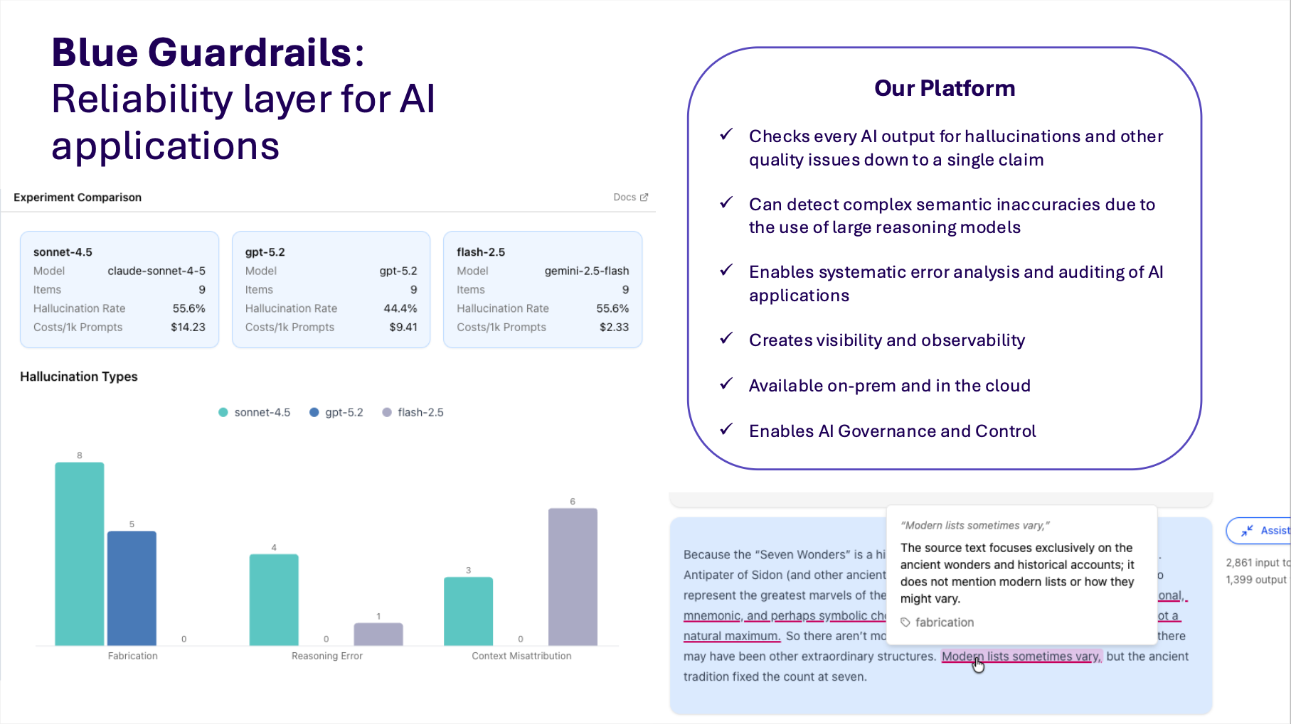
Notes:
A 044 : dividerpage

Slide 9
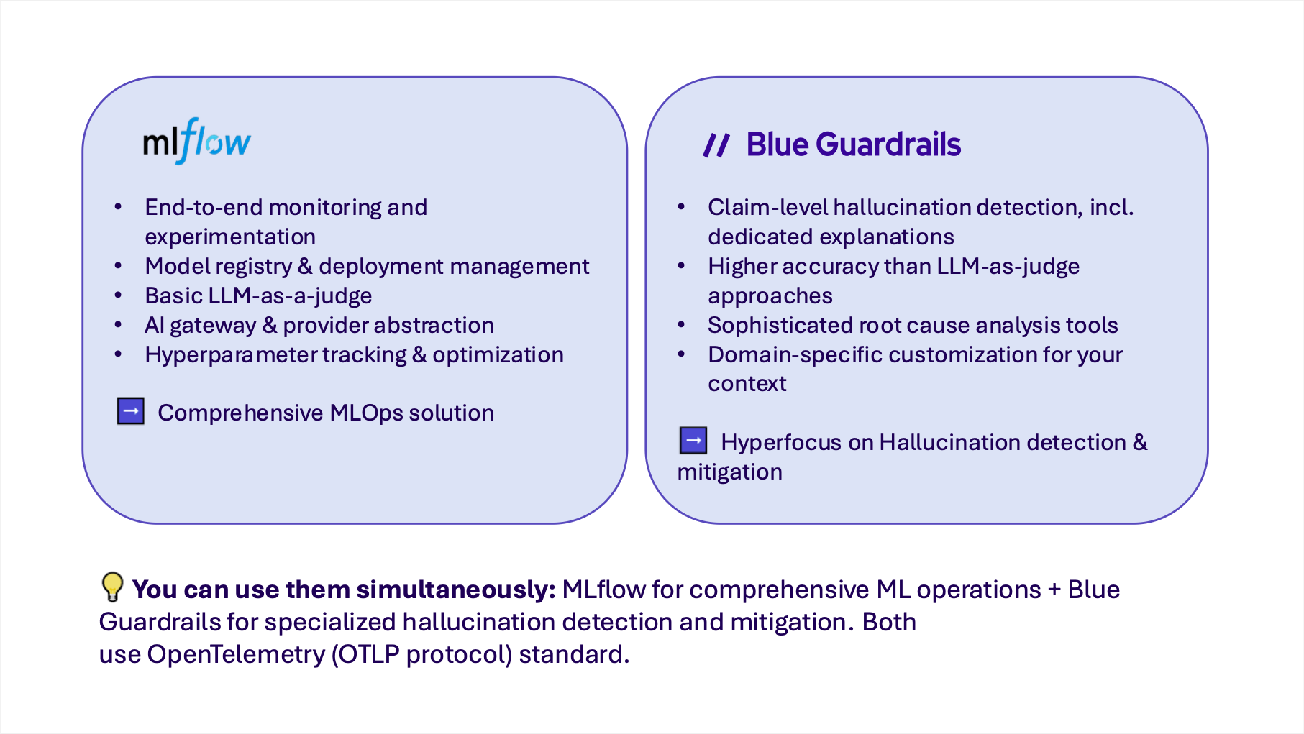
Notes:
A 044 : dividerpage

