Slide 1


Snug Sleep with

Slide 2
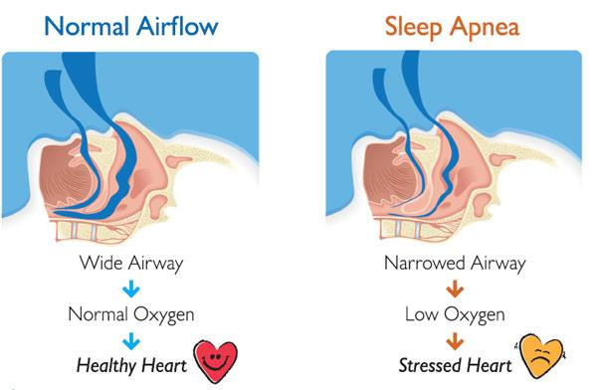
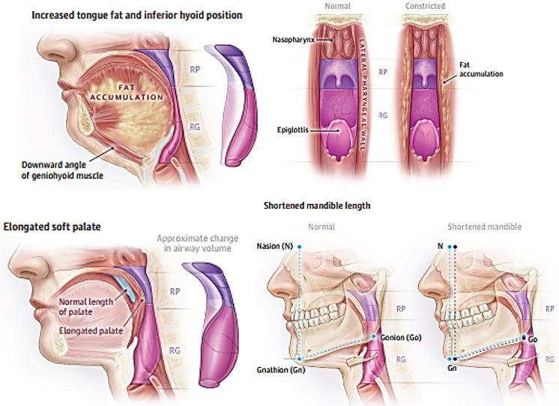

Slide 3
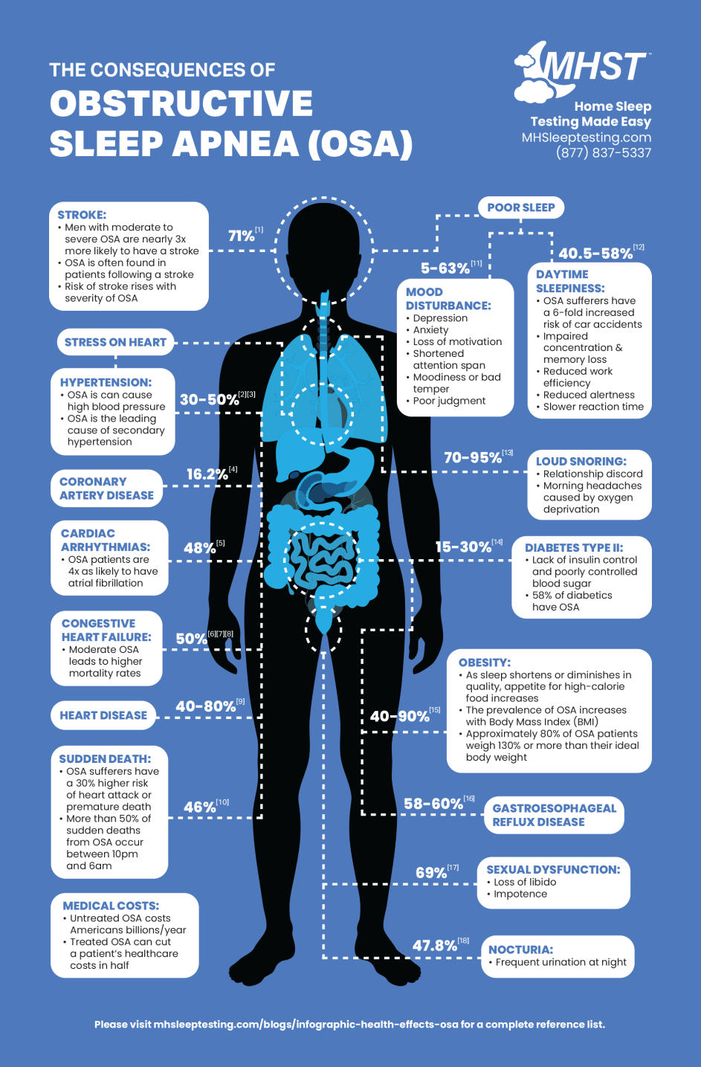
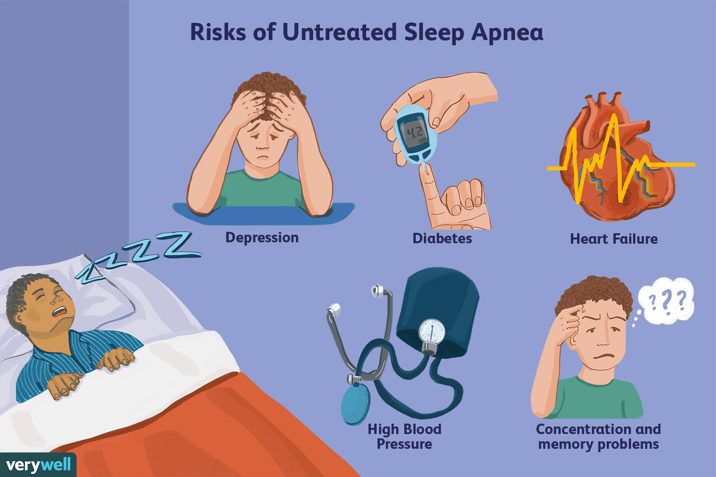
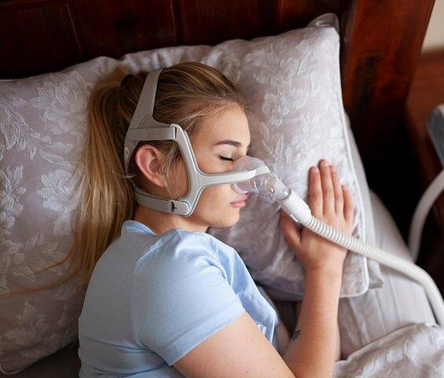
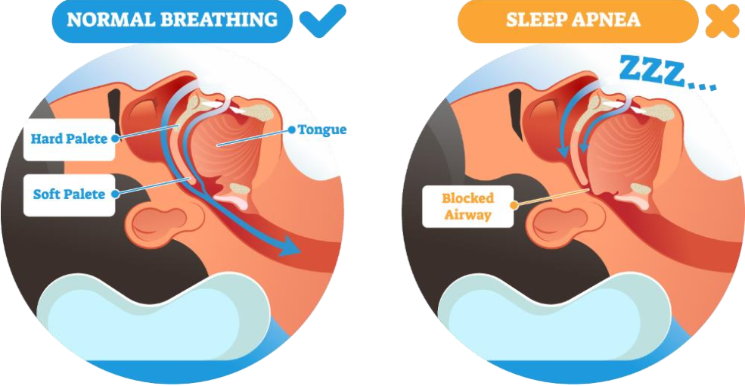

Slide 4

Problem
Obstructive sleep apnea (OSA) is a disease that characterized by episodes of complete collapse of the airway or partial collapse with an associated decrease in oxygen saturation or arousal from sleep.
Prevalence:
In our country, on average, 1 person out of every 4 men and 1 person out of every 10 women are suffering from this disease, which in some countries reaches 50%.
Risk Factors:
Age Weight
Male gender underlying diseases
Smoking and alcohol use Sleeping pills and sedatives
Acetazolamide and theophyllines , etc

Slide 5
Primary Complications:
Excessive fatigue during the day Morning headaches Forgetfulness and difficulty concentrating
Mood problems
Sexual problems
Frequent urination
Snoring and night sweats
Secondary Complications:
Heart failure
high blood pressure diabetes
Heart attack and stroke Alzheimer
depression
Economic Burden:
The economic burden ofundiagnosed obstructive sleep apnea in the United States is over 150 billion dollars. This cost is related to productivity reduction, complications caused by this disease on physical and mental health, and road accidents caused by sleepiness, so that 25% of accidents in Europe are related to this disease.
Effective treatment can prevent
40,000 accidents per year.

Slide 6
Primary Objectives:
Early detection of obstructive sleep apnea
Monitoring the severity, depth, and duration of respiratory interruptions during sleep
Reducing diagnosis and treatment costs
Preventing secondary complications such as cardiovascular diseases, stroke, depression, and road accidents
Utilizing artificial intelligence to analyze respiratory data
Enabling remote interaction between patients and physicians through telemedicine

Slide 7
Project Scope:
In-Scope:
Wearable respiratory monitoring device
Patient mobile application
Physician web-based dashboard
Data collection from acoustic, mechanical, thermal, and pulse oximeter sensors
Visualization of sleep and breathing graphs
Emergency alert system in critical conditions
AI-based analysis and apnea detection
Out of Scope:
Mass production of hardware
Medical treatment or drug prescription
Clinical decision-making beyond diagnostic support

Slide 8
System Requirements:
Functional Requirements
User registration and authentication
Collection of respiratory and physiological data during sleep
Analysis of collected data to detect obstructive sleep apnea
Visualization of apnea severity and sleep patterns using charts
Real-time alerts in emergency situations
Secure data transmission to the physician’s system
Storage and management of patient medical history
Generation of diagnostic reports for physicians

Slide 9
System Requirements:
Non-Functional Requirements
High diagnostic accuracy
Acceptable processing speed and system responsiveness
User-friendly and intuitive user interface
High system reliability and availability
Data privacy and security compliance
Scalability for future expansion
Accessibility for general users

Slide 10
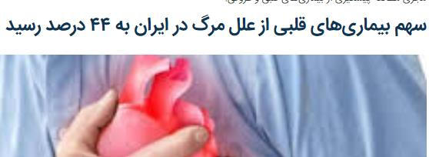




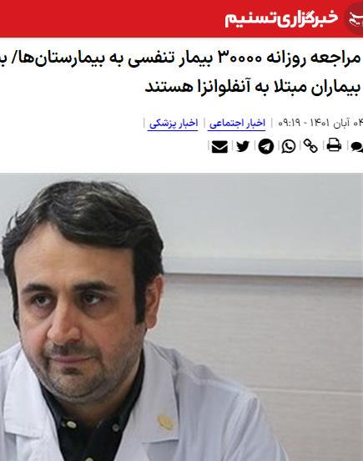
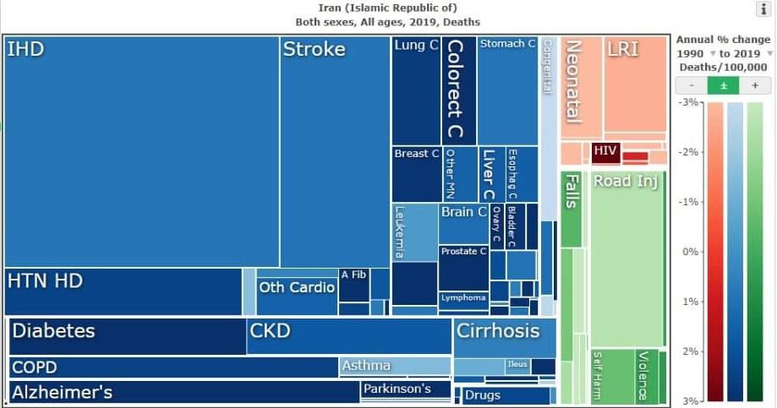
statistics

Slide 11
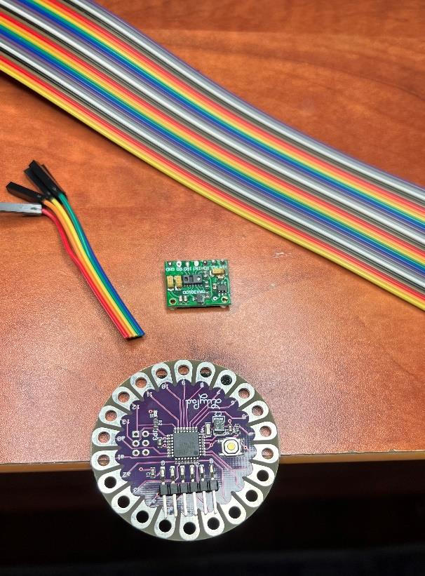
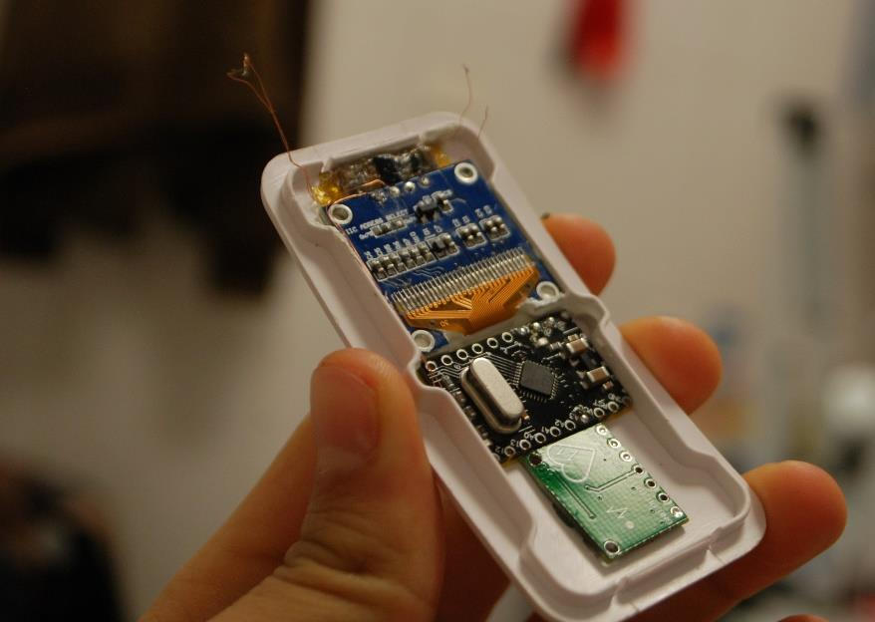
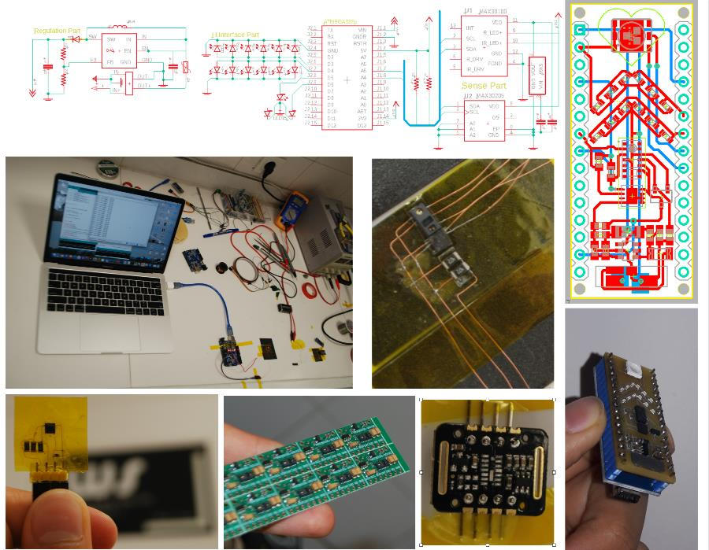
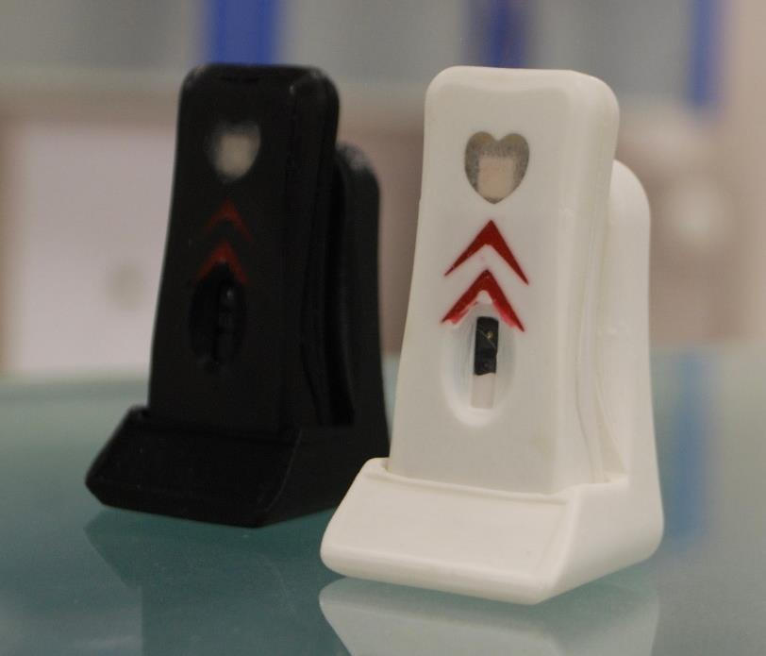
MVP

Slide 12
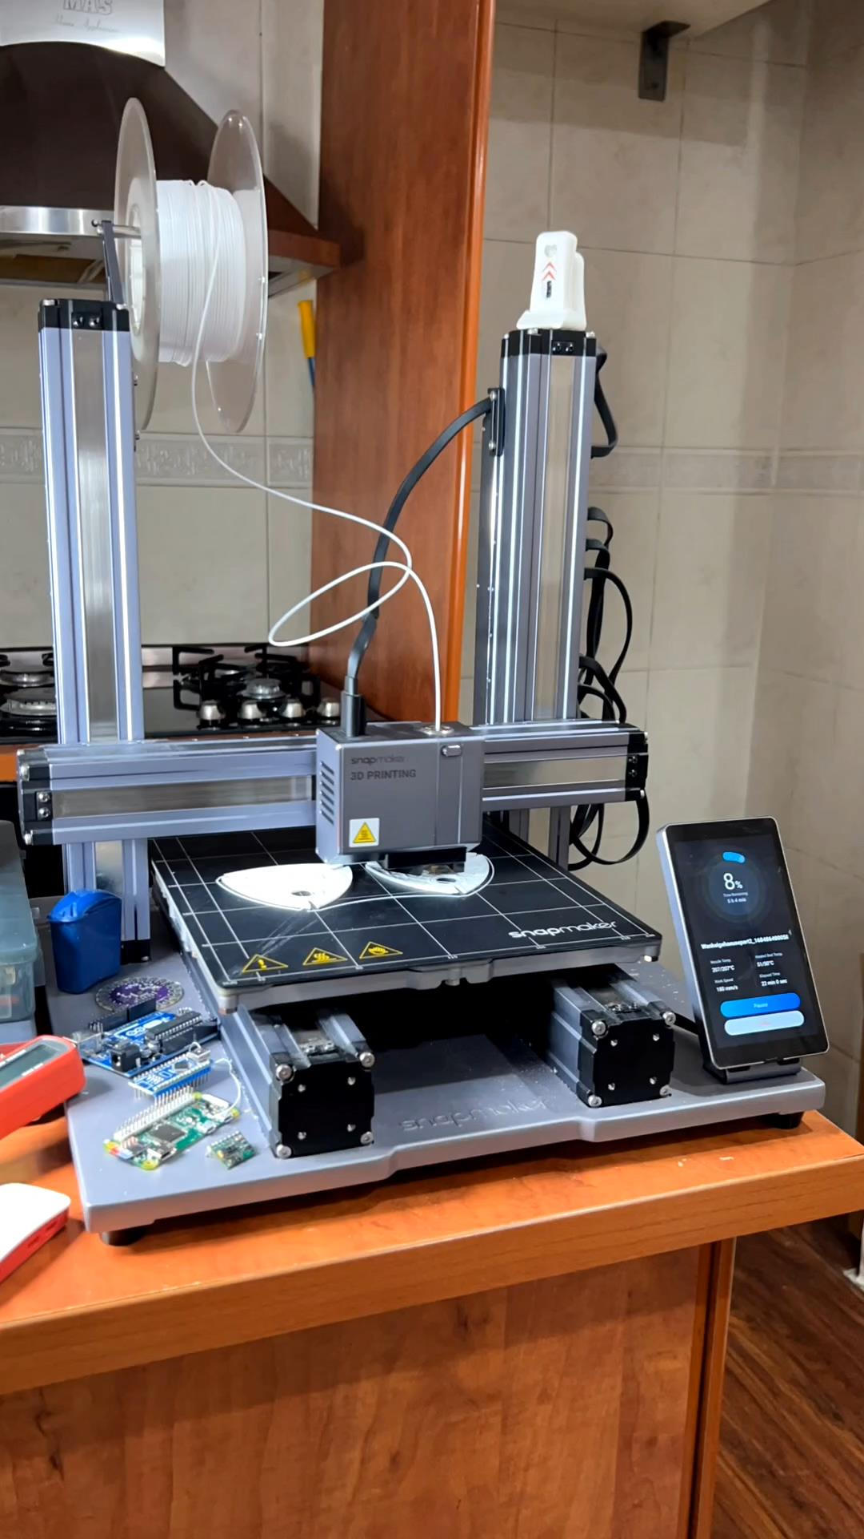
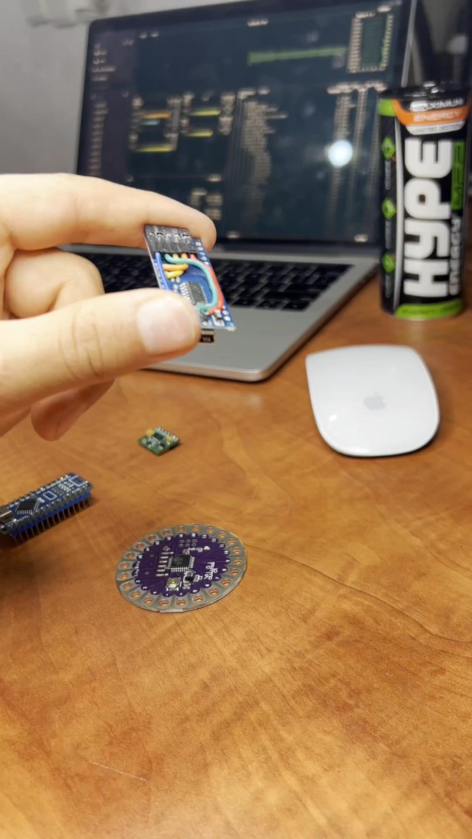

Slide 13
UML Diagrams

Slide 14
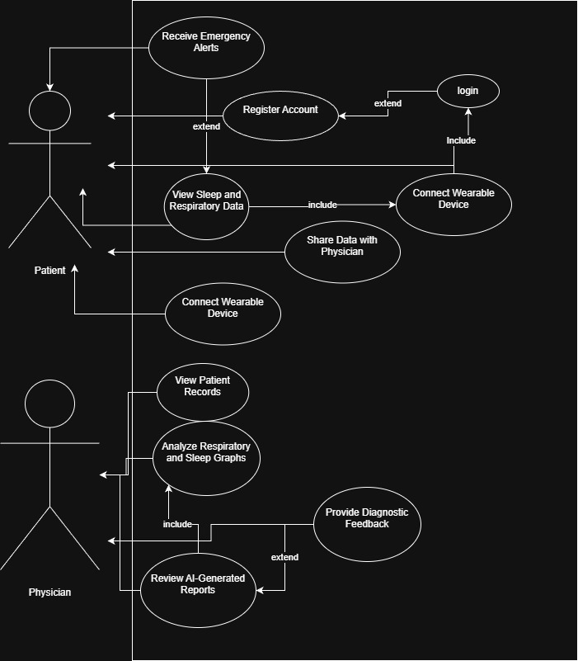
Use Case Digram

Slide 15
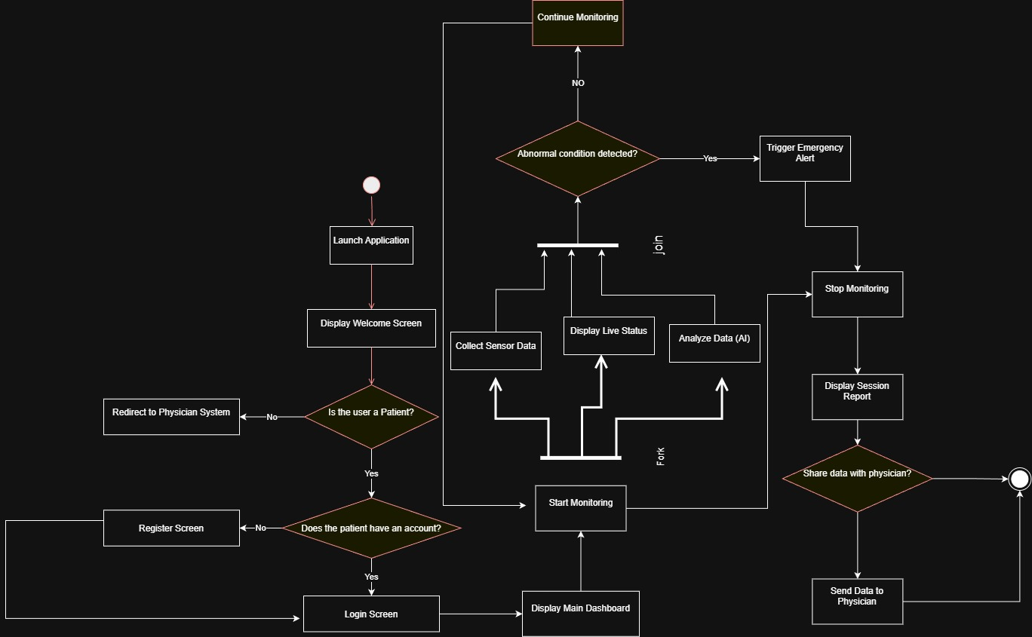
Activity Diagram

Slide 16
Wire Frames

Slide 17

