Slide 1
EMPLOYEE TURNOVER ANALYSIS
STUDENT NAME: V. VALARMATHI
REGISTER NO: 312200891
DEPARTMENT: B.COM general
COLLEGE: Pachaiyappas college for women’s kanchipuram

Slide 2
PROJECT TITLE
EMPLOYEE TURNOVER ANALYSIS

Slide 3


AGENDA
Problem Statement
Project Overview
End Users
Our Solution and Proposition
Dataset Description
Modelling Approach
Results and Discussion
Conclusion
3/21/2024 Annual Review

Slide 4

PROBLEM STATEMENT
The problem statement for employee turnover is that it's a serious issue for many organizations, and it can negatively impact their performance and profitability.
Here are some things to consider when analyzing employee turnover:
Why employees leave
High turnover can be a sign of a morale issue, but not all employees who leave are unhappy. Some reasons employees leave include retirement, family circumstances, changing professions, or starting a business.
Who leaves
Turnover analysis can help HR departments identify which departments are losing the most employees, and when they're leaving.

Slide 5

PROJECT OVERVIEW
Collect data
Gather relevant data on employee turnover. This could include information on employee work details, such as the number of projects they worked on, average monthly working hours, and salary level.
2. Clean and prepare data
Before conducting any analysis, it's important to clean and prepare the data.
3. Conduct descriptive analysis
4. Conduct trend analysis
nalyze turnover data over time to reveal trends and patterns.
.

Slide 6

WHO ARE THE END USERS?
The end user of employee turnover analysis is the HR department. This analysis helps the HR department understand who is leaving the company, including:
Which department has the most leavers
When most employees leave
If there are any demographic groups that leave more often than others

Slide 7

OUR SOLUTION AND ITS VALUE PROPOSITION
Employee turnover analysis can help identify the root causes of employee turnover and implement strategies to improve retention. Here are some ways that employee turnover analysis can help:
Identify who is leaving
Turnover analysis can help identify which departments have the most employees leaving, when most employees leave, and if there are any demographic groups that leave more often than others.
Identify reasons for leaving
Turnover analysis can help identify the top reasons for leaving, such as lack of career development, poor work-life balance, or challenging job characteristics.
Develop strategies to retain employees
Turnover analysis can help identify high-value employees who are at risk of leaving and develop strategies to retain them

Slide 8
Dataset Description
Projects worked on
Average monthly hours
Time spent at the company
Promotions in the last five years
Salary level
Employee satisfaction
Work-life balance
Job role
Age
Gender

Slide 9
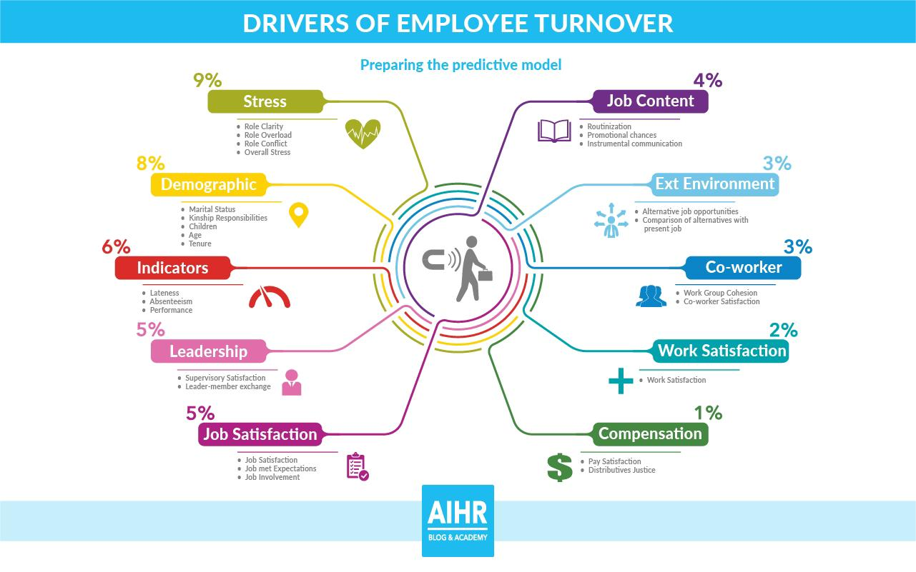

THE "WOW" IN OUR SOLUTION
3/21/2024 Annual Review
9

Slide 10
MODELLING
:
Data collection: Gather relevant data from HR records, exit interviews, employee surveys, and other sources.
Data cleaning: Clean the data by removing duplicates, handling missing values, and addressing inconsistencies.
Descriptive statistics: Get an overview of the turnover data using descriptive statistics.
Trend analysis: Analyze turnover data over time to identify patterns and trends.
Survival analysis: Use metrics like the Concordance, or C-index, to analyze employee turnover.
10

Slide 11
MODELLING
Purpose: To visualize the data in an easily interpretable format, making trends and patterns more apparent.
Implementation: Various types of charts (e.g., bar charts, line charts, pie charts) will be created based on the pivot table outputs. For instance, a line chart could show the trend of an employee’s productivity over time, while a bar chart could compare performance across different departments.
4. Conditional Formatting
Purpose: To highlight specific data points that meet certain conditions, making it easier to spot trends, outliers, or areas of concern.
Implementation: Conditional formatting will be applied to cells based on rules, such as highlighting cells in red if an employee’s performance falls below a certain threshold, or in green if targets are exceeded. This immediate visual cue helps in quickly identifying critical areas needing attention.
11

Slide 12
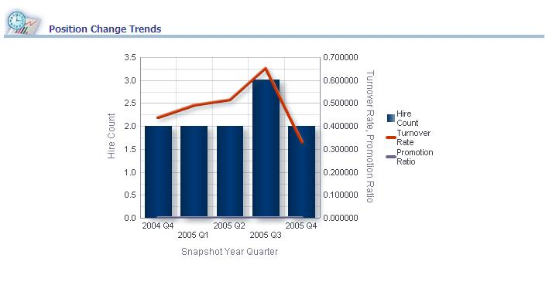
RESULTS
12

Slide 13
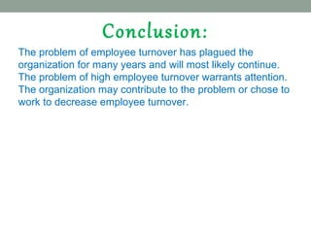
conclusion

