Slide 1
Session 7
Ensemble Methods
Why one tree is never enough —
and how to build a forest that’s far more reliable than any single tree
Bagging
Random Forest
Boosting
Reduce variance
with parallel trees
Diverse trees →
better predictions
Correct errors
sequentially

Slide 2
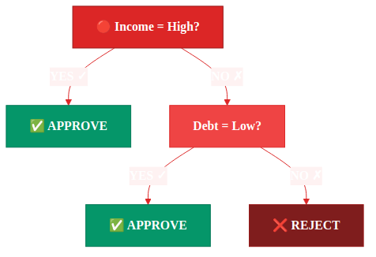
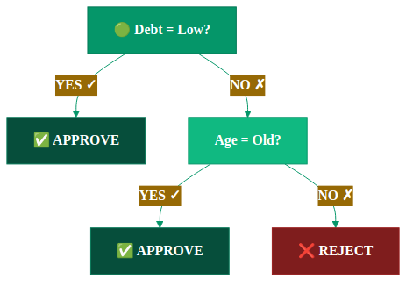
The Problem: Decision trees are often instable
WHY — Business Intuition
BankEU — 10 Applications
Tree A — trained on rows 1–8
Tree B — trained on rows 3–10
#
Income
Debt
Age
Loan?
Root split: Income = High?
Root split: Debt = Low?
1
High
Low
Old
YES
2
Low
High
Young
NO
3
High
Low
Young
YES
4
Low
Low
Old
YES
5
Low
High
Old
NO
6
High
High
Young
NO
7
High
Low
Old
YES
8
Low
Low
Young
NO
9
High
High
Old
YES
10
Low
High
Young
NO
Remove just 2 rows → the ROOT split changes completely. This is HIGH VARIANCE — the core problem ensembles solve.
Session 7 — Ensemble Methods | 3 / 31

Slide 3
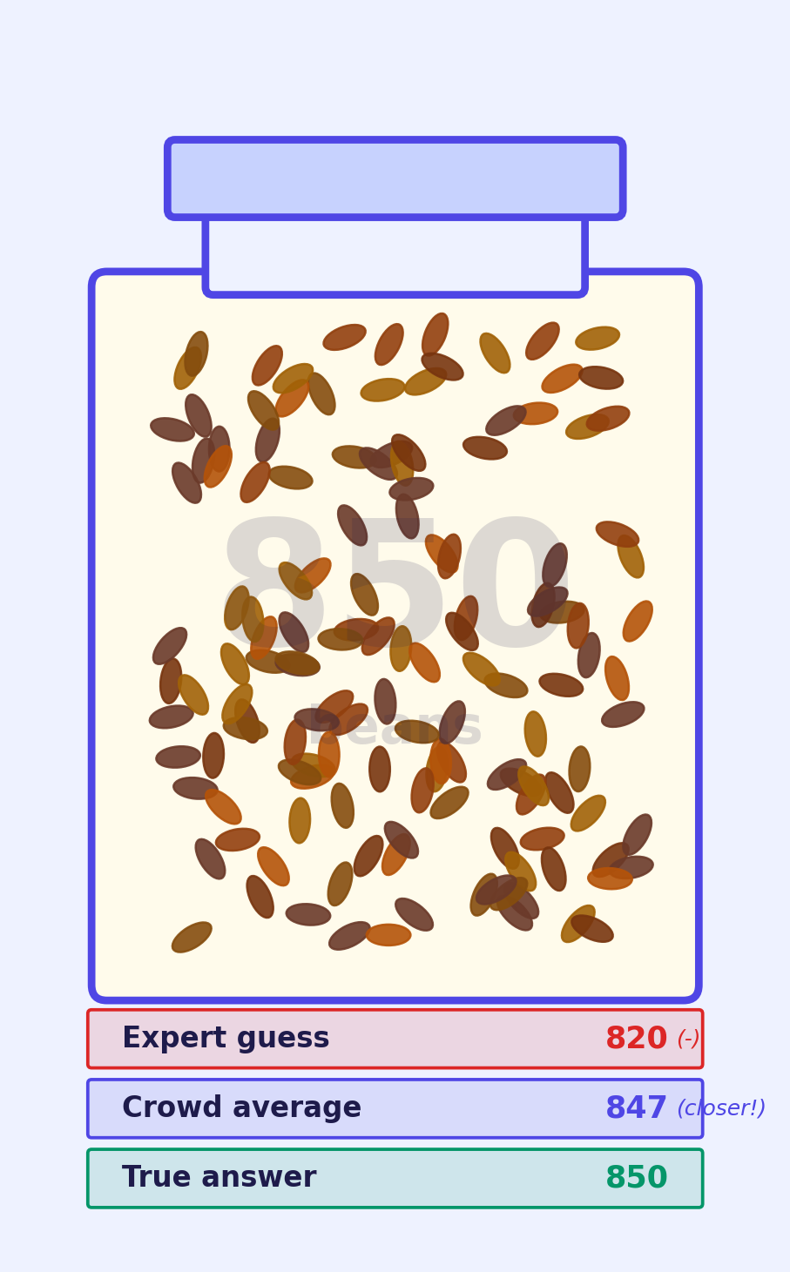
The Core Idea: Wisdom of Crowds
Can many weak models beat one strong model?
WHY — Business Intuition
The Jar of Beans
The Math (Condorcet's Theorem)
If each model has 60% accuracy and they vote independently:
800 people each guess the number of beans.
3 models
64.8%
Their average:
P = 0.6³ + 3(0.6²)(0.4) = 0.648
847
11 models
75%
True answer:
P(majority) = 75%
850
101 models
98%
Expert
guess: 820
P(majority) = 98%
The ONE condition:
Each model must make DIFFERENT errors.
If they all fail on the same cases, averaging does nothing.
The crowd beats the expert — not because each person is smart, but because their errors cancel out.
Session 7 — Ensemble Methods | 4 / 37

Slide 4
Part 1: Bagging
Bootstrap Aggregating — How to create diverse trees from one dataset
Part of Session 7 — Ensemble Methods
Session 7 — Ensemble Methods | 5 / 31

Slide 5
Why Bootstrap Sampling? The Business Motivation
Before the math — why does this trick actually help?
WHY — Business Intuition
The problem: we only have ONE dataset. We can't go collect more BankEU loan data.
How do we train 100 different trees that all make DIFFERENT mistakes?
🎲 The Lottery Analogy
🗞️ The Journalist Analogy
🏦 The BankEU Business Case
Imagine shuffling 10 loan applications and drawing 10 with replacement. Some applications appear twice — row 3 might be drawn on draw 1 AND draw 6. Some never appear.
Result: Each draw of 10 is a slightly different dataset.
A journalist interviews 10 people about a policy. Two interviewers each talk to 10 people — but since they draw from the same pool, they each get a slightly different mix.
Result: Two journalists write different stories from the same population.
Your credit team has 1,000 historical loan decisions. Bootstrap lets you simulate 'what if we had slightly different data?'
Each simulated dataset trains a different tree. Their combined vote is more robust than any single model trained on your one real dataset.
This is bootstrap sampling.
Each tree = one journalist's story.
100 trees = 100 slightly different models.
Key: bootstrapping doesn't create new data — it creates VARIATION in training sets. That variation means trees make DIFFERENT errors, and different errors cancel out when we vote.
Session 7 — Ensemble Methods | new / 37

Slide 6
Step 1: Bootstrap Sampling — By Hand
WHAT — Mathematics
Draw N samples WITH replacement from the original dataset
Original Dataset (N=10)
Bootstrap Sample 1
Bootstrap Sample 2
Bootstrap Sample 3
1 (High/Low/Old → YES)
Row 1 ★
Row 2
Row 3
2 (Low/High/Young → NO)
Row 1 ★
Row 4
Row 6
3 (High/Low/Young → YES)
Row 3
Row 7 ★
Row 9
4 (Low/Low/Old → YES)
Row 5 ★
Row 7 ★
Row 2 ★
Roll the dice
🎲 🎲 🎲
5 (Low/High/Old → NO)
Row 5 ★
Row 9
Row 2 ★
6...
Row 7
Row 1
Row 8
7...
Row 2
Row 3
Row 1
8...
Row 9
Row 6
Row 4
9...
Row 4
Row 10
Row 7
10...
Row 6
Row 5
Row 10
Row 1 appears TWICE. Row 8 never appears.
Row 7 appears TWICE. Row 8 never appears.
Row 2 appears TWICE. Row 5 never appears.
★ = duplicated rows | Each sample is size N=10, but has ~6-7 unique rows (≈63.2%) and 3-4 repeated ones. Each tree trains on a different subset — so they'll make different errors!
Session 7 — Ensemble Methods | 6 / 31

Slide 7
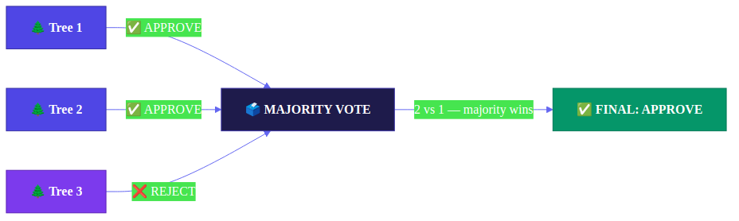
Step 2: Majority Vote — How Three Trees Decide
Each tree votes independently; the majority overrules any single wrong tree
WHAT — Mathematics
New applicant to classify: Income = HIGH Debt = LOW Age = YOUNG → Approve or Reject?
🌲 Tree 1 & Tree 2
🌲 Tree 3 (wrong)
🗳️ Majority wins
Both trained on samples where High Income + Low Debt → approval. They vote APPROVE.
Its bootstrap sample had many young rejections. It votes REJECT — but it's outvoted.
2 vs 1: the wrong tree's error is corrected. This is the power of ensemble averaging.
Session 7 — Ensemble Methods | 7 / 31

Slide 8
Implementing Bagging in sklearn
HOW — Code
BaggingClassifier: the explicit version before Random Forest
from sklearn.ensemble import BaggingClassifier
from sklearn.tree import DecisionTreeClassifier
from sklearn.model_selection import cross_val_score
from sklearn.datasets import load_breast_cancer
import numpy as np
X, y = load_breast_cancer(return_X_y=True)
from sklearn.model_selection import train_test_split
X_train, X_test, y_train, y_test = train_test_split(
X, y, test_size=0.2, stratify=y, random_state=42)
# ── Explicit Bagging ──────────────────────────────
bag = BaggingClassifier(
estimator=DecisionTreeClassifier(max_depth=None),
n_estimators=100, # number of trees
max_samples=1.0, # fraction of rows per tree
max_features=1.0, # ALL features (pure bagging)
bootstrap=True, # sample WITH replacement
bootstrap_features=False,
oob_score=True, # free validation!
n_jobs=-1,
random_state=42
)
bag.fit(X_train, y_train)
print(f"OOB score: {bag.oob_score_:.3f}")
print(f"Test score: {bag.score(X_test, y_test):.3f}")
scores = cross_val_score(bag, X, y, cv=5, scoring='roc_auc')
print(f"CV AUC: {scores.mean():.3f} ± {scores.std():.3f}")
estimator=DecisionTreeClassifier
Any sklearn estimator works here — SVM, KNN, even LogReg. Bagging is not tree-specific. Trees are just the most common choice because they're fast and high-variance.
max_features=1.0 (all features)
This is the key difference from Random Forest. Bagging uses ALL features at every split. RF will use only √p features. This is why RF creates more diverse trees.
bootstrap=True
Each tree trains on a random sample drawn WITH replacement. Set bootstrap=False to sample without replacement — that's called Pasting, not Bagging.
oob_score=True
Each tree doesn't see ~37% of rows. Those rows form the Out-Of-Bag set. Evaluating on OOB gives a free validation score — no cross-validation needed.
Session 7 — Ensemble Methods | new / 37

Slide 9
Why Do Bootstrap Samples Have ~63.2% Unique Rows?
A useful mathematical fact — explained from scratch
WHAT — Mathematics
Step-by-step Derivation
What This Means in Practice
1
Dataset has N=10 rows. We draw 10 times with replacement.
≈63%
of rows appear in each bootstrap sample (the training set)
2
Probability that row #1 is NOT picked on draw 1: 9/10 = 0.9
≈37%
of rows are left out (called Out-of-Bag or OOB rows)
3
Probability that row #1 is missed on ALL 10 draws:
(9/10)¹⁰ = 0.9¹⁰ ≈ 0.349
Free!
OOB rows act like a built-in validation set — often reducing the need for cross-validation during tuning, though a held-out test set remains best practice.
4
So probability row #1 IS included:
1 − 0.349 = 0.651 ≈ 65%
Diverse
Each sample has different OOB rows, so each tree sees a different 'test set'
5
As N → ∞: 1 − (1 − 1/N)ᴺ → 1 − 1/e ≈ 0.632
OOB Score in sklearn: RandomForestClassifier(oob_score=True) → free validation at no extra cost!
Session 7 — Ensemble Methods | 8 / 31

Slide 10
OOB Score: Built-in Validation for Random Forest
The 37% of rows each tree never saw become its personal test set
WHAT — Mathematics
How OOB Works — Step by Step
OOB Score in Practice
1
Bootstrap creates each training set
Metric
OOB
5-Fold CV
Tree 42 is trained on rows: {1,1,3,5,6,6,8,9,9,10}.
Rows 2, 4, 7 never appeared → these are OOB for Tree 42.
Accuracy
0.961
0.958
Training time
1 forest fit
~5 model fits
2
OOB rows are used for evaluation
Data used
~63%/tree; all rows contribute across forest
80% train / 20% validate; every row validated once
Tree 42 predicts row 2 (which it never trained on).
This is a genuine out-of-sample prediction.
Reliability
Good for bagging (N>500, trees≥100)
More general; robust across model types
3
Every row is OOB for ~37% of trees
When to trust OOB score
Row 2 is OOB for Tree 42, Tree 15, Tree 67…
Each row gets evaluated by ~37 trees out of 100.
✅ N > 500 rows — enough OOB samples per tree
✅ n_estimators ≥ 100 — stable OOB estimate
4
Aggregate all OOB predictions
⚠️ Very small datasets (N < 200) — use CV instead
For each row, average the predictions from the trees that didn't see it.
Compare to true label → OOB score.
sklearn usage:
⚠️ Highly imbalanced classes — OOB may be misleading
rf = RandomForestClassifier(oob_score=True)
rf.fit(X_train, y_train)
print(rf.oob_score_) # e.g. 0.961
Session 7 — Ensemble Methods | new / 37

Slide 11
Part 2: Random Forest
Bagging + one extra trick that changes everything
Part of Session 7 — Ensemble Methods
Session 7 — Ensemble Methods | 9 / 31

Slide 12
The Problem with Plain Bagging: Correlated Trees
Bagging alone doesn't create enough diversity
WHY — Business Intuition
The Exam Panel Analogy
Random Forest Solution
❌
Bad Panel (Bagging alone)
At each split, each tree can only consider a RANDOM SUBSET of features.
You hire 5 interviewers, all from the same school, all with the same specialty. They all like the same candidates and all hate the same ones. Majority vote adds nothing — they always agree.
Our dataset has 3 features:
• Income
• Debt
• Age
With √p rule (√3 ≈ 1-2):
Tree 1 sees: Income, Debt
Tree 2 sees: Debt, Age
Tree 3 sees: Income, Age
Now they MUST split differently!
Each notices different patterns.
✓
Good Panel (Random Forest)
You hire 5 interviewers from different backgrounds: finance, tech, HR, strategy, operations. They notice different things. Now the majority vote is genuinely informative.
In ML: if Income is the strongest feature, ALL trees will use Income as their root split.
They'll be almost identical — and majority vote won't help.
√p for classification | p/3 for regression
Session 7 — Ensemble Methods | 10 / 31

Slide 13
Why Does Random Forest Outperform a Single Tree?
The business case for using 100 trees instead of one
WHY — Business Intuition
BankEU scenario: you trained ONE decision tree. It gets 78% accuracy.
Your manager asks: 'Can we do better without hiring a data scientist for weeks?'
🌿 Single Decision Tree
🌲🌲 Bagging (100 trees)
🌳🌲🌴 Random Forest
Strengths:
Strengths:
Strengths:
✓ Fast to train
✓ More stable than 1 tree
✓ Diverse trees → uncorrelated errors
✓ Fully interpretable
✓ OOB score = free validation
✓ OOB score built in
✓ Visualisable
✓ Any base estimator works
✓ Feature importance for free
Weaknesses:
Weaknesses:
Weaknesses:
✗ Unstable — change 3 rows → new tree
✗ All trees can split on same feature first
✗ Slower than 1 tree
✗ Overfits training data easily
✗ Correlated trees = less diversity
✗ Often outperformed by tuned gradient boosting on structured/tabular data
✗ One bad split ruins everything
✗ Slightly harder to explain
✗ Still not great for very noisy data
Use when stakeholders demand explanation (e.g. EU AI Act audit). Otherwise, upgrade.
Better than one tree. But trees are still too similar. We can do better.
The sweet spot: 5 minutes to train, 87%+ accuracy, interpretable importance scores.
Session 7 — Ensemble Methods | new / 37

Slide 14
Random Forest: Full Algorithm
Bagging + random feature subsets = diverse, stable forest
WHAT — Mathematics
1
Bootstrap
sklearn
→ 63.2% unique, 36.8% OOB
Draw N samples with replacement from training data
from sklearn.ensemble import (
RandomForestClassifier
)
rf = RandomForestClassifier(
n_estimators=100,
max_features="sqrt",
oob_score=True,
n_jobs=-1,
random_state=42
)
rf.fit(X_train, y_train)
# Free OOB validation!
print(rf.oob_score_)
# Feature importance
rf.feature_importances_
2
Random Features
→ forces diversity between trees
At each node split, randomly select √p features to consider
3
Grow Full Tree
→ each tree has low bias, high variance
Train unpruned decision tree on the bootstrap sample
4
Repeat 1-3
→ more trees = more stable; test error usually plateaus rather than worsens
Grow n_estimators trees (typically 100-500)
5
Aggregate
→ variance cancels out across trees
Classification: majority vote | Regression: average prediction
Key params: n_estimators ↑ = more stable (not overfit) | max_features controls diversity | min_samples_leaf controls tree depth
Session 7 — Ensemble Methods | 11 / 31

Slide 15
Random Forest: Feature Subsets in Action
Tracing exactly how two trees split differently on the same node
WHAT — Mathematics
BankEU dataset: 3 features (Income, Debt, Age). √3 ≈ 1.7 → each node considers 2 randomly selected features.
Let's trace the ROOT NODE split for Tree 1 and Tree 2 from scratch.
Tree 1 — Root Node
Tree 2 — Root Node
Features available at this node:
Features available at this node:
✓ Income
✓ Debt
(not in this node's random subset)
✗ Age
✗ Income
✓ Debt
✓ Age
Now evaluate each allowed feature:
Now evaluate each allowed feature:
Split on Income = High?
Split on Debt = Low?
Left (High): 4 YES, 1 NO → Gini = 1 − (4/5)² − (1/5)² = 0.32
Right (Low): 1 YES, 4 NO → Gini = 1 − (1/5)² − (4/5)² = 0.32
Weighted: (5/10)×0.32 + (5/10)×0.32 = 0.32
Left (Low): 5 YES, 1 NO → Gini = 0.28
Right (High): 0 YES, 4 NO → Gini = 0
Weighted Gini = 0.167
Split on Age = Old?
Split on Debt = Low?
Left (Old): 3 YES, 1 NO → Gini = 0.375
Right (Young): 2 YES, 4 NO → Gini = 0.44
Weighted: (4/10)×0.375 + (6/10)×0.44 = 0.414
Left (Low): 5 YES, 1 NO → Gini = 1−(5/6)²−(1/6)² = 0.28
Right (High): 0 YES, 4 NO → Gini = 0
Weighted: (6/10)×0.28 + (4/10)×0 = 0.167
→ Tree 1 splits on DEBT (Gini 0.167 < 0.32) — Age was never even considered
→ Tree 2 also splits on DEBT (0.167 beats 0.414) — Income was never considered
Session 7 — Ensemble Methods | Deep Dive — RF Feature Subsets / undefined
Both picked Debt here — but on deeper nodes, the random subsets force different paths → trees eventually diverge. With more features (30, 100), √p subsets create much more diversity.

Slide 16
Feature Importance: How Does Random Forest Know What Matters?
Mean Decrease in Impurity — explained step by step
WHAT — Mathematics
How It's Calculated (MDI)
Example: BankEU Loan Model
1
For each tree, look at every split made on feature F.
Income
0.55
55%
2
Calculate how much that split reduced impurity (Gini / Entropy) × the number of samples it affected.
Debt
0.30
3
Sum this across all trees.
30%
4
Normalize so all importances sum to 1.0.
Age
0.15
15%
Interpretation: Feature importance = 0.42 means this feature reduced impurity
by 42% of the total reduction across all trees and all splits.
Interpretation:
“Income accounts for 55% of the
total impurity reduction. Age barely
matters compared to debt levels."
⚠ MDI is biased toward high-cardinality features (many unique values). Use Permutation Importance (sklearn's permutation_importance()) for more reliable results, especially with categorical data.
Session 7 — Ensemble Methods | 13 / 31

Slide 17
Part 3: Boosting
A completely different strategy — learn from your mistakes, sequentially
Part of Session 7 — Ensemble Methods
Session 7 — Ensemble Methods | 14 / 31

Slide 18
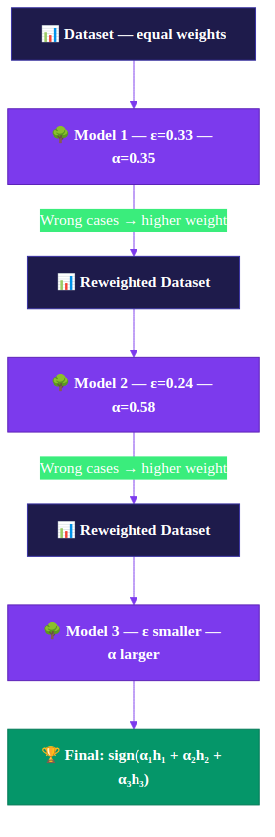
Boosting: Sequential Error Correction
Each model focuses on the mistakes the previous model made
WHY — Business Intuition
The Tutor–Student Analogy
The Algorithm
Week 1
Student takes test → 60% score. Tutor notes which 4 problems were WRONG.
Week 2
New study plan focused entirely on those 4 wrong topics. Score: 75%.
Week 3
3 new errors appear. Tutor focuses again on only those. Score: 85%.
Final
All study sessions combined = the full knowledge. Score: 92%.
Bagging: parallel, independent trees → reduces VARIANCE
Boosting: sequential, each fixes last one's errors → reduces BIAS
Session 7 — Ensemble Methods | 15 / 31

Slide 19
AdaBoost — Step by Step (Round 1)
6 data points, starting weights = 1/6 each
WHAT — Mathematics
Simplified dataset: 6 applicants | + = Approve | − = Reject
Round 1 Calculations
#
Income
Debt
Label
Weight (Round 1)
Tree 1
Predicts
Correct?
Error Rate (ε)
ε = sum of weights of wrong predictions
= 0.167 + 0.167 = 0.333
1
High
Low
+
1/6 = 0.167
+
✓
2
Low
High
−
1/6 = 0.167
−
✓
Model Weight (α)
α = 0.5 × ln((1−ε)/ε)
= 0.5 × ln(2) ≈ 0.347
3
High
High
+
1/6 = 0.167
+
✓
4
Low
Low
−
1/6 = 0.167
+
✗ WRONG
Update Weights
(wrong cases)
w_new = w_old × e^α
= 0.167 × e^0.347 ≈ 0.236
5
High
Low
+
1/6 = 0.167
+
✓
6
Low
High
−
1/6 = 0.167
+
✗ WRONG
Update Weights
(correct cases)
w_new = w_old × e^(−α)
= 0.167 × e^(−0.347) ≈ 0.118
After Round 1: Wrong predictions (rows 4, 6) get HIGHER weights → next tree must focus on them!
Normalize
Divide all weights so they
sum to 1.0
→ See next slide for Round 2 and how weight updates change the focus
Session 7 — Ensemble Methods | 16 / 31

Slide 20
AdaBoost Round 2: How Weights Change Training
The tree doesn't just 'notice' hard cases — weights change the Gini calculation
WHAT — Mathematics
Updated weights after Round 1: Rows 4 & 6 (wrong) → 0.236 each | Rows 1,2,3,5 (correct) → 0.118 each | Total = 1.0
Round 2 Dataset with NEW Weights
Weighted Gini at Root Node
#
Income
Debt
Label
Weight
Visual weight
The key insight: Gini is now computed using WEIGHTS, not counts.
A misclassified row with weight 0.236 counts more than a correct row with 0.118.
1
High
Low
+
0.118
█
2
Low
High
−
0.118
█
Try split: Income = High?
3
High
High
+
0.118
█
Left branch (Income=High): rows 1,3,5 Weights: 0.118, 0.118, 0.118 → sum = 0.354 Labels: +, +, + (all positive) Weighted Gini = 0 (pure!) Right branch (Income=Low): rows 2,4,6 Weights: 0.118, 0.236, 0.236 → sum = 0.59 + weight: 0 (none) − weight: 0.59 Weighted Gini = 0 (pure!)
4
Low
Low
−
0.236
███ ← was WRONG
5
High
Low
+
0.118
█
6
Low
High
−
0.236
███ ← was WRONG
Weighted Gini = 0. Tree 2 splits on Income = perfect pure split!
Round 2 Final Prediction:
Why did this happen?
Tree 2 rule: Income=High → +, Income=Low → − Tree 2 error: rows 2,3 (Low/+ and High/−) ε₂ = 0.118 + 0.118 = 0.236 α₂ = 0.5 × ln((1−0.236)/0.236) ≈ 0.583 α₂ > α₁ (0.583 > 0.347) → Tree 2 gets MORE vote weight! Better model = louder vote. That's AdaBoost.
Rows 4 & 6 (Low income, wrong in Round 1) now carry double the weight.
Tree 2 'sees' them as much more important and builds a rule that correctly classifies them.
After this round, rows 4 & 6 will have their weights REDUCED again.
Session 7 — Ensemble Methods | Deep Dive — AdaBoost Round 2 / undefined

Slide 21
AdaBoost — Weight Evolution Across Rounds
Wrong predictions grow in importance until they're corrected
WHAT — Mathematics
How weights change across 3 rounds
Weight Visualization
(Round 3)
Row
Label
Round 1
(equal)
Round 2
(wrongs ↑)
Round 3
(new wrongs ↑)
Final
Focus
Row 1: 0.083
1
+
0.167
0.118
0.083
Low
Row 2: 0.083
2
−
0.167
0.118
0.083
Low
Row 3: 0.236
3
+
0.167
0.118
0.236
HIGH
Row 4: 0.167
4
−
0.167
0.236
0.167
Med
Row 5: 0.083
5
+
0.167
0.118
0.083
Low
Row 6: 0.347
6
−
0.167
0.236
0.347
VERY HIGH
AdaBoost Formula Summary
Final prediction = sign( α₁·h₁(x) + α₂·h₂(x) + α₃·h₃(x) )
Where: αᵢ = model weight (higher α = better model got more say)
hᵢ(x) = weak model i's prediction (+1 or −1)
sign() converts the sum to a class label
KEY: A model with lower error gets a HIGHER α (more vote weight). As error → 0, α grows very large. A model at random chance (50%) gets α = 0.
Session 7 — Ensemble Methods | 18 / 31

Slide 22
Why Gradient Boosting? When Random Forest Isn't Enough
Moving from variance reduction to bias reduction — a different problem
WHY — Business Intuition
You've deployed Random Forest on BankEU. AUC = 0.84. Your manager says the regulator wants 0.90+.
RF with 500 trees gives 0.845. Adding more trees doesn't help. You've hit RF's ceiling.
Why Random Forest Has a Ceiling
How Gradient Boosting Fixes This
All trees are equally weighted
Each tree targets the RESIDUAL errors
A tree that gets 70% accuracy votes the same as one that gets 90%. Good and bad trees cancel each other out less efficiently.
Tree 2 doesn't learn the whole problem — it only learns to predict what Tree 1 got WRONG. Maximum efficiency: no repeated work.
Trees are trained independently
Each tree contributes an additive correction
Tree 50 doesn't know Tree 49 already handles high-income cases well. It wastes capacity redoing the same work.
Each new tree is scaled by a learning rate η. No voting — just additive corrections, each one reducing the remaining error by a small step.
Averaging reduces variance, not bias
Sequential: each tree makes the previous smarter
If ALL trees are slightly wrong in the same direction (systematic bias), averaging doesn't fix it — it just gives you the average wrong answer.
After 200 trees, the ensemble has specialised models for every tricky region of the data. RF's 200 trees all try to solve the whole problem.
Session 7 — Ensemble Methods | new / 37
Rule of thumb: RF first (fast, stable baseline) → if you need more accuracy: XGBoost → if you need speed on big data: LightGBM

Slide 23
Gradient Boosting: Fit the Residuals
Each tree corrects the ERRORS (residuals) of all previous trees
WHAT — Mathematics
Worked Example: Predict loan amount (€) from income level
What's happening?
Row
Income
True
Amount (€)
Round 0
(avg = 23k)
Residual 1
(true − pred)
Tree 2
Predicts
New Pred
(R0 + T2)
1. Round 0: Predict the mean (€23k) for everyone
1
Low
15k
23k
−8k
−7k
16k
2. Calculate residuals = errors
2
Medium
22k
23k
−1k
0k
23k
3
Medium
25k
23k
+2k
+2k
25k
3. Tree 2 learns to predict those RESIDUALS
4
High
28k
23k
+5k
+6k
29k
5
High
35k
23k
+12k
+11k
34k
4. New prediction = old + η × tree2 (this example uses η=1 for clarity)
5. Repeat — each tree reduces remaining error
Algorithm: F_m(x) = F_{m-1}(x) + η · h_m(x)
Where η = learning rate (typically 0.01–0.3 in practice; η=1 above for illustration), h_m = new tree fitted on residuals, F_m = updated prediction
Session 7 — Ensemble Methods | 19 / 31

Slide 24
Why Is It Called GRADIENT Boosting?
Residuals are not arbitrary — they are the gradient of the loss function
WHAT — Mathematics
Building the Connection
Why Does This Matter?
1
Start with a Loss Function (MSE)
For MSE loss: the gradient is just the residual — simple and intuitive.
But the 'Gradient' in the name means we can swap the loss function:
• Log-loss → classification
• MAE → robust to outliers
• Custom loss → business-specific
The algorithm stays the same. Only the pseudo-residuals change.
XGBoost uses second-order gradients (Hessian) for even better convergence — see next deep dive.
We want to minimise: L(y, F) = ½(y − F)²
Where y = true value, F = our current prediction.
(The ½ is just for clean derivatives.)
2
Compute the Gradient of L w.r.t. F
∂L/∂F = ∂[½(y−F)²]/∂F = −(y − F)
This is the derivative: 'which direction and how far
should F move to reduce the loss?'
3
The Negative Gradient IS the Residual
−∂L/∂F = y − F = residual !
When we fit a tree on (y − F_prev), we are fitting
the NEGATIVE GRADIENT of the loss.
This is gradient DESCENT on the loss function.
Concrete Numbers
Row 1: y=15k, F₀=23k Loss: ½(15−23)² = 32 Gradient: −(15−23) = +8 → F is too high, push DOWN Residual: 15−23 = −8 ✓ Same! F₁ = 23 + 0.1 × (−8) = 22.2k New loss: ½(15−22.2)² = 25.9 < 32 ✓
4
Update Rule = Gradient Descent Step
F_new = F_old + η × (−gradient)
= F_old + η × (y − F_old)
= F_old + η × residual
η is the learning rate — step size in gradient descent.
Summary: Fitting trees on residuals = gradient descent in function space. The learning rate η is the step size. More trees = more steps toward minimum loss.
Session 7 — Ensemble Methods | Deep Dive — The Gradient in Gradient Boosting / undefined

Slide 25
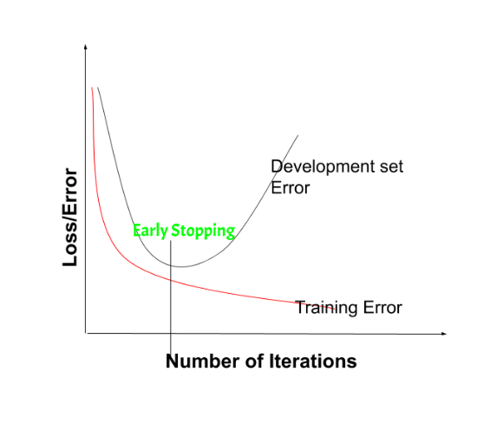
Gradient Boosting: Learning Rate & Overfitting
The critical tradeoff: speed vs. generalization
WHAT — Mathematics
Learning Rate (η) Explained
Early Stopping (Essential!)
η = 1.0
(too fast)
Each tree corrects 100% of the error. Aggressive, can overfit training data.
Train error always goes down.
Validation error goes down... then up!
Stop when validation error starts rising.
❌ Too risky
η = 0.1
(recommended)
Each tree corrects only 10%. Needs more trees but generalizes better.
✓ Use this
η = 0.01
(too slow)
Each tree corrects only 1%. Needs thousands of trees. Very slow.
⚠ Too slow
# XGBoost with early stopping
xgb = XGBClassifier(
n_estimators=1000,
learning_rate=0.05,
early_stopping_rounds=20
)
xgb.fit(
X_train, y_train,
eval_set=[(X_val, y_val)],
verbose=False
)
# Model stops before overfitting!
Rule: Lower η → need more n_estimators. Use early stopping to find the sweet spot automatically.
Session 7 — Ensemble Methods | 21 / 31

Slide 26
XGBoost & LightGBM: Why Industry Uses Them
Gradient Boosting + regularization + engineering = state of the art
HOW — Code
Gradient Boost
(sklearn)
XGBoost
LightGBM
The foundation.
Simple, educational, slow on large data.
Adds L1+L2 regularization, second-order gradients, parallel splits, pruning.
Leaf-wise growth instead of level-wise. Histogram-based splits. Fastest.
✓ Easy to understand
✓ Fast, accurate, handles missing data
✓ Often substantially faster than XGBoost on large datasets
✗ Slow, no GPU
✗ Many hyperparams
✗ Can overfit on small data
GradientBoostingClassifier(
n_estimators=100,
learning_rate=0.1,
max_depth=3
)
XGBClassifier(
n_estimators=300,
learning_rate=0.05,
max_depth=5,
reg_alpha=0.1, # L1
reg_lambda=1.0 # L2
)
LGBMClassifier(
n_estimators=300,
learning_rate=0.05,
num_leaves=31,
min_child_samples=20
)
Session 7 — Ensemble Methods | 22 / 31
Industry default: Try XGBoost or LightGBM first. They outperform sklearn's GradientBoosting on most real datasets.

Slide 27
XGBoost: The Objective Function — Full Math
Loss + Regularization — why this makes XGBoost better than plain Gradient Boosting
WHAT — Mathematics
Obj(θ) = Σᵢ L(yᵢ, ŷᵢ) + Σₖ Ω(fₖ)
Training Loss (fit the data) + Regularization (keep the model simple)
Σᵢ L(yᵢ, ŷᵢ)
Sum over all N training examples of the loss between true label yᵢ and prediction ŷᵢ.
For regression: MSE = Σ(yᵢ − ŷᵢ)²
For classification: Log-loss = −Σ[yᵢlog(ŷᵢ) + (1−yᵢ)log(1−ŷᵢ)]
Purpose:
Training Loss
Pushes predictions toward the truth. Lower = better fit.
Σₖ Ω(fₖ)
Sum over all K trees. For each tree:
Ω(f) = γT + ½λΣⱼwⱼ²
γ = penalty per leaf (T = number of leaves)
λ = L2 penalty on leaf weights wⱼ
α = L1 penalty (makes some weights exactly 0)
Purpose:
Regularization Term
Penalises complexity. Forces trees to be smaller and weights to be smaller.
With regularization: XGBoost builds fewer, simpler trees that generalise better.
γ>0 forces pruning. λ>0 shrinks leaf scores toward zero — like weight decay in neural nets.
Plain Gradient Boosting has NO Ω term — it's just Σ L(yᵢ, ŷᵢ).
With no penalty on complexity, it will keep growing trees until it overfits.
Session 7 — Ensemble Methods | Deep Dive — XGBoost Objective / undefined

Slide 28
Bagging vs Boosting: Why Does the Distinction Matter?
Two ensemble strategies solving two completely different problems
WHY — Business Intuition
Analogy: Two Ways to Build a Better Hiring Process
Bagging: Ask 100 interviewers to evaluate the same candidate independently and vote. Good because no single interviewer's bias dominates.
Boosting: Run 5 rounds of interviews. Each round focuses on the specific gaps the last round missed. Good because each round builds on the last.
Bagging / Random Forest
Boosting (AdaBoost / XGBoost)
⚠ Solves: OVERFITTING (high variance)
⚠ Solves: UNDERFITTING (high bias)
Use when you see these symptoms:
Use when you see these symptoms:
→ Your model scores 99% train, 75% test
→ Train accuracy is 75%, test is 74% — both bad
→ Small changes to training data flip predictions
→ Adding more features doesn't help much
→ You have lots of noisy or mislabelled data
→ You need every % of accuracy you can get
Prescription:
Prescription:
Random Forest: train 100 uncorrelated trees,
average their votes.
XGBoost: 500 sequential trees, each one
correcting the previous one's mistakes.
Train: 92% Test: 89% ← the gap closes
Train: 95% Test: 91% ← higher overall
Session 7 — Ensemble Methods | new / 37
Next slide: the full head-to-head comparison table so you always know which one to reach for.

Slide 29
Bagging vs Boosting: Complete Comparison
Two strategies, two problems they solve
Bagging / Random Forest
Boosting (AdaBoost / XGBoost)
Training
Parallel — trees are independent
Sequential — each tree depends on previous
What it fixes
High Variance (overfit)
High Bias (underfit)
Base learner
Full deep trees (low bias)
Shallow trees / stumps (weak learners)
Weighting
Equal vote for all trees
AdaBoost: weighted by accuracy (α); GB: additive steps scaled by η
Overfitting risk
Low (averaging reduces it)
Higher — needs regularization / early stop
Speed
Fast (parallel)
Slower (sequential)
Interpretability
Feature importance
Feature importance + SHAP
Missing values
Needs imputation
XGBoost handles natively
When to use
Noisy data, quick baseline
When you need max accuracy
Session 7 — Ensemble Methods | 24 / 31

Slide 30
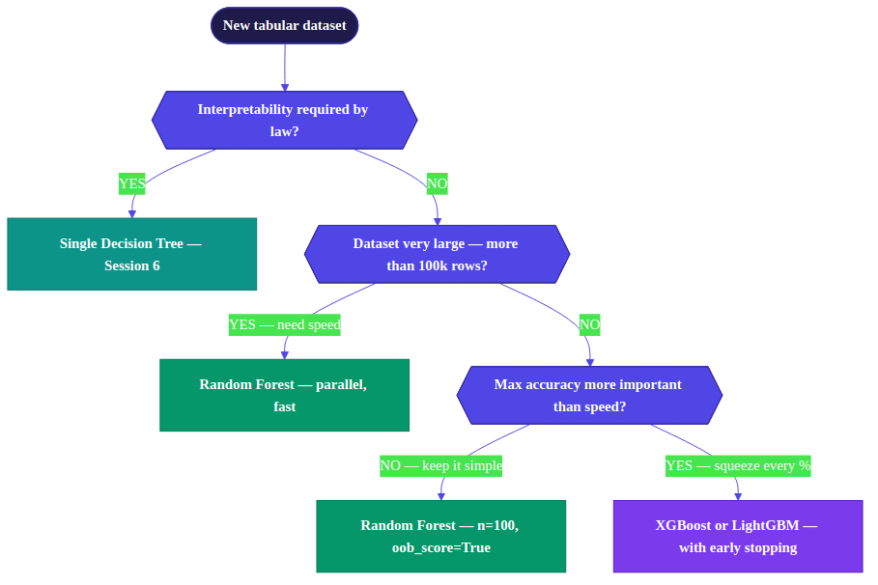
Which Method Should I Use? — Decision Framework
WHY — Business Intuition
Noisy data:
Max accuracy:
5-min baseline:
Need explanation:
Session 7 — Ensemble Methods | 25 / 31
Random Forest
XGBoost / LightGBM
Random Forest
Decision Tree → then RF

Slide 31
Code: Complete Ensemble Workflow
Load data → fit RF & XGBoost → compare → interpret
HOW — Code
from sklearn.ensemble import (
RandomForestClassifier,
GradientBoostingClassifier
)
from xgboost import XGBClassifier
from sklearn.model_selection import cross_val_score
from sklearn.datasets import load_breast_cancer
import numpy as np
import pandas as pd
# 1. Load data
X, y = load_breast_cancer(return_X_y=True)
feature_names = load_breast_cancer().feature_names
from sklearn.model_selection import train_test_split
X_train, X_test, y_train, y_test = train_test_split(
X, y, test_size=0.2, stratify=y, random_state=42)
# 2. Models
rf = RandomForestClassifier(
n_estimators=100, oob_score=True,
n_jobs=-1, random_state=42)
xgb = XGBClassifier(
n_estimators=200, learning_rate=0.05,
max_depth=4, eval_metric='logloss',
random_state=42)
# 3. Cross-validate (5-fold)
for name, model in [("RF", rf), ("XGB", xgb)]:
scores = cross_val_score(
model, X, y, cv=5, scoring='roc_auc')
print(f"{name}: {scores.mean():.3f} "
f"± {scores.std():.3f}")
# 4. Fit RF, check OOB
rf.fit(X_train, y_train)
print(f"OOB score: {rf.oob_score_:.3f}")
# 5. Feature importance
importances = pd.Series(
rf.feature_importances_,
index=feature_names
).sort_values(ascending=False)
What Each Step Does
cross_val_score
Always use CV — never just train/test split for ensemble comparison
oob_score=True
Free validation using the 37% of data not seen by each tree
n_jobs=-1
Use all CPU cores — RF is embarrassingly parallel
learning_rate=0.05
Low LR + many trees = better generalization for XGBoost
feature_importances_
Which features matter most? Use for business explanation
Session 7 — Ensemble Methods | 26 / 31

Slide 32
Hyperparameter Tuning: What to Adjust and Why
Ordered by importance — start with the most impactful
Random Forest
HOW — Code
XGBoost / LightGBM
n_estimators
↑ more stable; test error typically plateaus. Cost: slower training.
learning_rate (η)
Use 0.05-0.1. Lower = better, needs more trees.
HIGH
HIGH
default: 100
default: 0.3
max_features
n_estimators
Set to 1000, use early stopping to find best.
HIGH
"sqrt" for classification, "log2" or 0.3 for regression.
HIGH
default: "sqrt"
default: 100
max_depth
3-6 typical. Deeper → more complex → overfit risk.
HIGH
max_depth
Limit if overfitting. Start unconstrained.
MED
default: 6
default: None
reg_alpha (L1)
Sparse solutions — use when many irrelevant features.
MED
min_samples_leaf
↑ prevents tiny leaves, reduces overfit on small data.
default: 0
MED
default: 1
reg_lambda (L2)
Smooth solutions — increase if overfitting.
MED
class_weight
"balanced" for imbalanced classes.
default: 1
HIGH
default: None
subsample
0.8 = use 80% of rows per tree. Reduces overfit.
MED
default: 1.0
Start: keep defaults except n_estimators=300, learning_rate=0.05, early stopping. Only tune max_depth if still overfitting.
Session 7 — Ensemble Methods | 27 / 31

Slide 33
Common Mistakes — and How to Fix Them
What goes wrong in practice, and what to do instead
1
✗ Using train accuracy to compare RF vs XGBoost
4
✗ Not using early stopping with XGBoost
✓ Prefer cross-validation over a single train/test split. RF and XGBoost both overfit training data — CV gives a more reliable estimate of generalisation.
✓ Set n_estimators=1000, early_stopping_rounds=20. Without it, XGBoost will silently overfit to training data.
2
✗ Setting n_estimators too low (e.g. 10 trees)
5
✗ Confusing feature importance between RF and XGBoost
✓ Start with 100–500. More trees = more stable predictions. Adding trees rarely hurts accuracy — the main cost is training time.
✓ RF MDI is biased toward high-cardinality features. XGBoost importance has multiple types (gain, cover, weight). Use SHAP for reliable interpretation.
3
✗ Using boosting on very noisy labels
6
✗ Thinking more trees always means slower inference
✓ Boosting amplifies noise — it focuses more and more on 'hard' examples that may just be mislabeled. Use RF on noisy data.
✓ Inference is generally fast even with 500 trees, since they run in parallel. For latency-sensitive production systems, measure prediction time explicitly.
Session 7 — Ensemble Methods | 28 / 31

Slide 34
Connecting to Business: What Do You Tell a Stakeholder?
The WHY lens — translating model results to business language
WHY — Business Intuition
Scenario: You trained a Random Forest on BankEU loan data. How do you present results to the credit committee?
Q: Why should we trust 100 trees more than 1?
Each tree makes different errors on different data. When 80 out of 100 trees agree an applicant should be rejected, that's a very robust signal — much stronger than any single model.
Q: What's the most important factor in rejections?
Feature importance shows Income accounts for 55% of the model’s total impurity reduction. Debt ratio accounts for 30%. Age contributes little. This is actionable — focus underwriting rules on income verification.
Q: How accurate is the model?
On held-out data (OOB), the model correctly classifies 87% of applicants. More importantly: it catches 92% of future defaults (recall on the bad class).
Q: Can you explain why applicant 42 was rejected?
This requires SHAP (Session 8). For now: RF gives you which features matter most, not why for individual predictions.
Session 8 Preview: SHAP values will let you explain INDIVIDUAL predictions — the final piece of the explainability puzzle
Session 7 — Ensemble Methods | 29 / 31

Slide 35
Session 7 Summary: What You Now Know
Six things that should be clear before you leave
1
4
Ensembles work because uncorrelated errors cancel out — this is the Wisdom of Crowds, not magic.
Boosting trains sequentially, each model fixing the errors of the previous. It reduces bias — weak learners become strong.
2
5
Bagging trains trees in parallel on bootstrap samples. It reduces variance — the instability of single trees.
XGBoost/LightGBM are gradient boosting + regularization + engineering. Use them with early stopping for best results.
3
6
Random Forest adds random feature subsets at each split. This forces tree diversity and prevents correlated errors.
Start with Random Forest as your baseline. Switch to XGBoost when you need to squeeze out more accuracy.
Session 7 — Ensemble Methods | 30 / 31

