Slide 1
S E S S I O N 9
Clustering &
Dimensionality Reduction
Discovering structure without labels

Slide 2
Today's Roadmap
01
The Unsupervised Shift
15 min
02
K-Means Clustering
40 min
03
Hierarchical Clustering
25 min
04
DBSCAN
20 min
05
PCA
35 min
06
t-SNE
15 min
07
Putting It Together
20 min

Slide 3
The Unsupervised Shift
WHY
Supervised
Unsupervised
We have labels y
Goal: predict y from X
Sessions 1–8
→
No labels — only X
Goal: discover structure
Today's session
Business examples: customer segmentation, anomaly detection, data compression, recommendation engines, visualization of high-dimensional data

Slide 4
The Curse of Dimensionality
WHY
As dimensions increase:
Concrete example
Distances between points become nearly equal
10 points in 1D: well-covered
10 points in 2D: sparse grid
10 points in 10D: each point
is essentially alone
Need 10¹⁰ points to cover
10D as densely as 1D!
Data becomes sparse — neighborhoods unreliable
Noise accumulates across features
Models need exponentially more data
This is why we need dimensionality reduction: fewer dimensions → more meaningful distances, less noise, better clustering.

Slide 5
C A S E S T U D Y
CustomerScope
A retail company wants to segment its 10,000 customers
for targeted marketing — but has no predefined groups.
Features available:
Annual spending
Product categories
Visit frequency
Recency of last visit
Avg basket size
Online vs in-store ratio

Slide 6
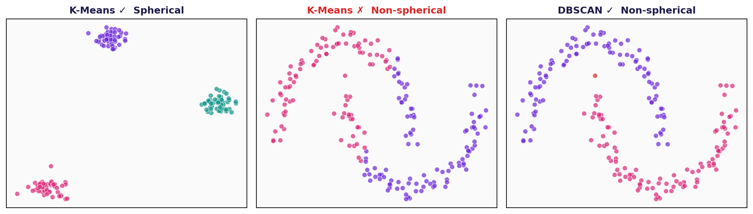
K-Means Clustering
WHY
"Group similar customers without predefined categories"
You have 10,000 customers and 6 features.
Marketing wants 3–5 actionable segments.
K-Means is the simplest, most widely used clustering algorithm.
It partitions data into K groups by minimizing within-cluster distances.
Key assumption: K-Means assumes spherical, equally-sized clusters. We'll see alternatives for other shapes.

Slide 7
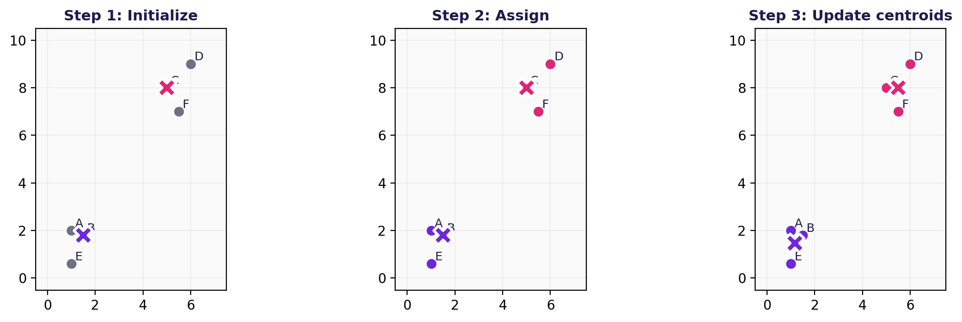
K-Means: The Algorithm
WHAT
1
Choose K (number of clusters)
2
Initialize K centroids (randomly or k-means++)
3
Assign each point to its nearest centroid
4
Recompute centroids as cluster means
5
Repeat steps 3–4 until convergence
K-Means iteration: initialize → assign → update centroids
Convergence = assignments no longer change (or WCSS change < threshold).

Slide 8
K-Means: Worked Example
WHAT
6 points, K = 2. Initial centroids: μ₁ = B(1.5, 1.8), μ₂ = C(5, 8)
Point | Coords | d(μ₁) | d(μ₂) | Assign
A | (1, 2) | 0.54 | 7.21 | C₁
B | (1.5, 1.8) | 0.00 | 7.14 | C₁
C | (5, 8) | 7.14 | 0.00 | C₂
D | (6, 9) | 8.35 | 1.41 | C₂
E | (1, 0.6) | 1.28 | 8.37 | C₁
F | (5.5, 7) | 6.49 | 1.12 | C₂
New centroids:
μ₁ = mean(A, B, E) = (1.17, 1.47)
μ₂ = mean(C, D, F) = (5.50, 8.00)
WCSS = Σ ||xᵢ − μₖ||²
= (0.54² + 0² + 1.28²)
+ (0² + 1.41² + 1.12²) = 5.17
Repeat assign → update until centroids stop moving. Here, convergence happens after iteration 2.

Slide 9
K-Means: Objective Function
WHAT
J = Σ(k=1..K) Σ(xᵢ ∈ Cₖ) ‖ xᵢ − μₖ ‖²
J
Total within-cluster sum of squares (WCSS) — lower is better
K
Number of clusters (hyperparameter you choose)
Cₖ
Set of points assigned to cluster k
μₖ
Centroid (mean) of cluster k: μₖ = (1/|Cₖ|) Σ xᵢ
‖ xᵢ − μₖ ‖²
Squared Euclidean distance from point to its centroid
K-Means is an iterative optimization: it minimizes J, but may find a local minimum, not the global one. → Use multiple restarts (n_init).

Slide 10
K-Means++: Smart Initialization
WHAT
Random initialization can lead to poor convergence. K-Means++ spreads initial centroids apart:
1.
Pick the first centroid μ₁ uniformly at random from the data
Intuition
Points far from existing centroids have higher probability of being chosen as the next centroid.
This ensures centroids are spread across the data, avoiding the 'all centroids in one cluster' trap.
2.
For each point x, compute D(x) = distance to nearest existing centroid
3.
Pick next centroid with probability proportional to D(x)²
4.
Repeat steps 2–3 until K centroids are chosen
sklearn default: init='k-means++'. Always use it. Random init is almost never better.

Slide 11
K-Means: Implementation
HOW
from sklearn.cluster import KMeans
from sklearn.preprocessing import StandardScaler
# Always scale before clustering!
scaler = StandardScaler()
X_scaled = scaler.fit_transform(X)
kmeans = KMeans(n_clusters=4, init='k-means++',
n_init=10, random_state=42)
labels = kmeans.fit_predict(X_scaled)
# Access results
centroids = kmeans.cluster_centers_
inertia = kmeans.inertia_ # WCSS value
Key Parameters
n_clusters
K — number of clusters
init
'k-means++' (default, recommended)
n_init
Number of restarts (default 10)
random_state
For reproducibility
Always StandardScaler before K-Means. Features on different scales distort Euclidean distance.

Slide 12
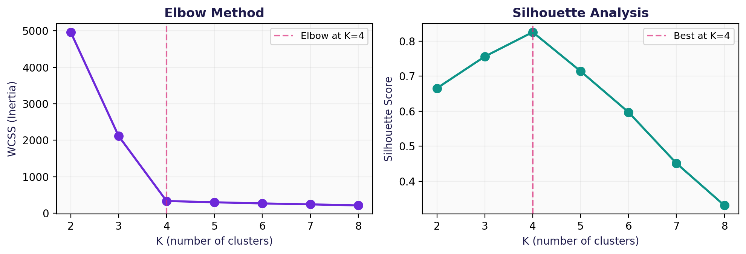
Choosing K
WHAT
Silhouette score: s(i) = (b − a) / max(a, b) where a = mean distance to points in same cluster, b = mean distance to nearest other cluster. Range [−1, +1]. Higher = better.

Slide 13
Choosing K: Implementation
HOW
from sklearn.metrics import silhouette_score
import matplotlib.pyplot as plt
# Elbow method
wcss = []
K_range = range(2, 10)
for k in K_range:
km = KMeans(n_clusters=k, n_init=10, random_state=42)
km.fit(X_scaled)
wcss.append(km.inertia_)
plt.plot(K_range, wcss, 'o-')
plt.xlabel('K'); plt.ylabel('WCSS')
plt.title('Elbow Method'); plt.show()
# Silhouette analysis
for k in range(2, 8):
km = KMeans(n_clusters=k, n_init=10,
random_state=42)
labels = km.fit_predict(X_scaled)
score = silhouette_score(X_scaled, labels)
print(f"K={k}: silhouette={score:.3f}")
# Pick K with highest silhouette score
# (also consider business requirements)
Neither method gives a definitive answer. Always combine with domain knowledge: does K=4 produce segments marketing can actually act on?

Slide 14
K-Means: Pitfalls
Assumes spherical clusters
Fails on elongated or ring-shaped groups
Sensitive to initialization
Use k-means++ and multiple restarts (n_init)
Must choose K in advance
K-Means fails on non-spherical shapes — DBSCAN handles them
Elbow/silhouette help but are heuristics
Sensitive to scale
Always standardize features first
Outliers distort centroids
Consider removing outliers or using K-Medoids
K-Means is a starting point, not the final answer. Always try at least one alternative.

Slide 15
Distance Metrics
WHAT
Clustering results depend entirely on how you measure 'closeness':
Metric | Formula | Best for | Sensitive to scale?
Euclidean | √Σ(xᵢ − yᵢ)² | Dense, spherical clusters | Yes — always scale
Manhattan | Σ|xᵢ − yᵢ| | Sparse / high-dim data | Yes — always scale
Cosine | 1 − (x·y)/(‖x‖‖y‖) | Text / direction matters | No (normalized)
K-Means always uses Euclidean distance
(because the centroid update formula assumes it). For other metrics, use K-Medoids.
Rule of thumb: if features are numeric with different units → Euclidean + StandardScaler. If features are counts or frequencies → consider Cosine.

Slide 16
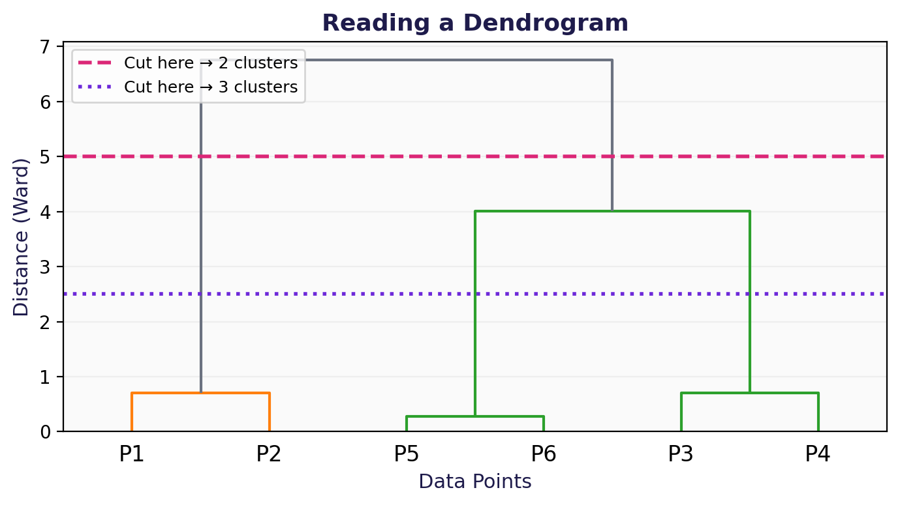
Hierarchical Clustering
WHY
When you want to explore cluster structure at multiple levels — without choosing K upfront.
Agglomerative (bottom-up) algorithm:
1.
Start: each point is its own cluster
2.
Merge the two closest clusters
3.
Repeat until one cluster remains
4.
Cut the dendrogram at desired level → your clusters
Unlike K-Means, hierarchical clustering produces a full hierarchy. You choose the number of clusters after seeing the structure.

Slide 17
Linkage Methods
WHAT
"Distance between two clusters" can mean different things:
Linkage | Measures | Tendency
Single | Min distance between any pair | Chains (elongated)
Complete | Max distance between any pair | Compact, equal-size
Average | Mean pairwise distance | Balanced
Ward | Increase in total WCSS after merge | Compact, similar to K-Means
Recommendation: start with Ward linkage — it produces compact clusters similar to K-Means and is the most commonly used in practice.

Slide 18
Reading a Dendrogram
WHAT
How to read:
Y-axis
= merge distance. Higher = more dissimilar clusters being merged.
Horizontal line
= a merge event. The two branches below it are the clusters that merged.
Cut horizontally
to get clusters. Cut at height 5 → 2 clusters. Cut at 2.5 → 3 clusters.
Tall vertical gaps
= natural cluster boundaries. Look for the biggest jump in merge distance.
The dendrogram is a decision tool: it shows you what K values are natural for your data.

Slide 19
Hierarchical Clustering: Code
HOW
from sklearn.cluster import AgglomerativeClustering
from scipy.cluster.hierarchy import dendrogram, linkage
import matplotlib.pyplot as plt
# Fit clustering
hc = AgglomerativeClustering(n_clusters=4,
linkage='ward')
labels = hc.fit_predict(X_scaled)
# Visualize dendrogram (uses scipy, not sklearn)
Z = linkage(X_scaled, method='ward')
dendrogram(Z, truncate_mode='level', p=5)
plt.xlabel('Samples')
plt.ylabel('Distance')
plt.title('Dendrogram')
plt.show()
Tips
truncate_mode='level'
limits depth of the dendrogram display (useful for large datasets)
linkage='ward'
good default — minimizes variance within clusters
n_clusters=None + distance_threshold
cut the dendrogram at a specific distance instead of specifying K
Scalability:
O(N²) memory, O(N³) time — avoid for N > 10,000

Slide 20
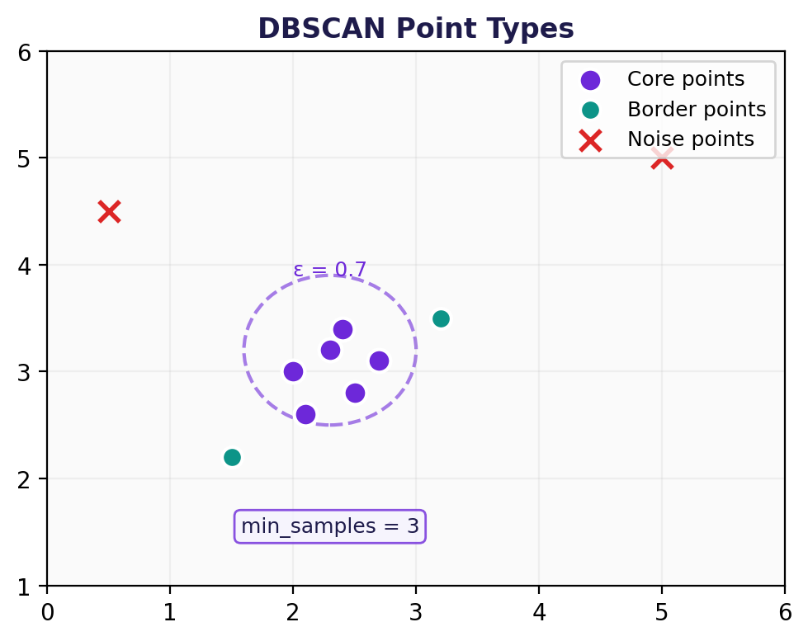
DBSCAN
Density-Based Spatial Clustering of Applications with Noise
WHAT
Two parameters:
eps (ε)
radius of neighborhood
min_samples
minimum points to form a dense region
Three types of points:
Core point
≥ min_samples within ε
Border point
Within ε of core, < min_samples neighbors
Noise point
Neither core nor border → outlier (label = −1)
Key advantage: DBSCAN doesn't need K, discovers arbitrary-shaped clusters, and identifies outliers natively.

Slide 21
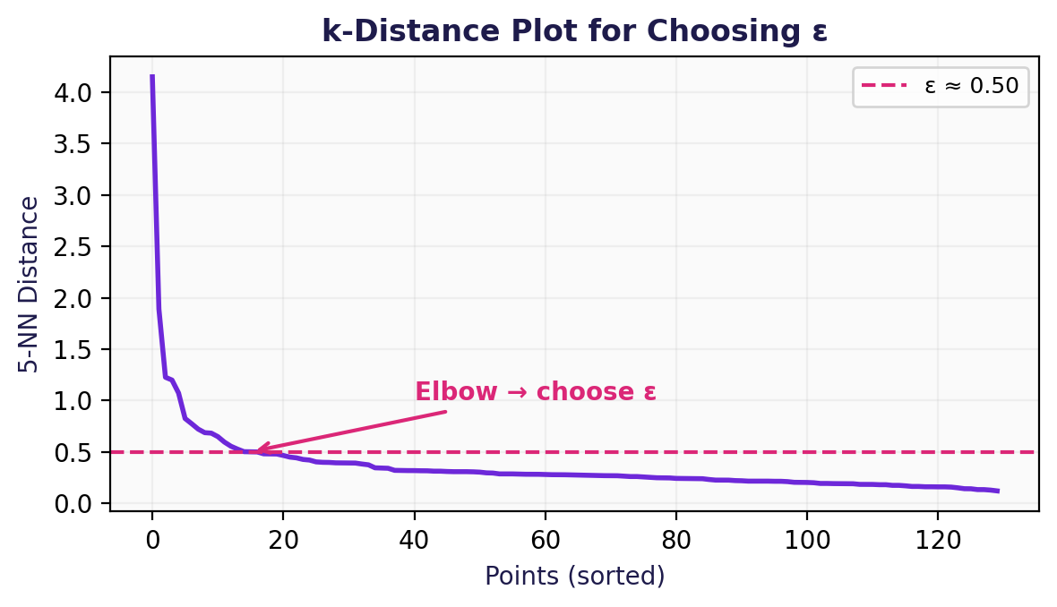
DBSCAN: Choosing ε
WHAT
The k-distance plot is the standard method for selecting ε:
1. For each point, compute distance to its k-th nearest neighbor (k = min_samples)
2. Sort distances in decreasing order and plot them
3. Look for the 'elbow' — the sharp bend where noise transitions to clusters
4. The y-value at the elbow ≈ your ε
from sklearn.neighbors import NearestNeighbors
nn = NearestNeighbors(n_neighbors=5)
nn.fit(X_scaled)
distances, _ = nn.kneighbors(X_scaled)
k_dist = np.sort(distances[:, 4])[::-1]
plt.plot(k_dist)
plt.ylabel('5-NN Distance'); plt.show()

Slide 22
DBSCAN: Implementation
HOW
from sklearn.cluster import DBSCAN
db = DBSCAN(eps=0.5, min_samples=5)
labels = db.fit_predict(X_scaled)
n_clusters = len(set(labels)) - (1 if -1 in labels else 0)
n_noise = list(labels).count(-1)
print(f"Clusters: {n_clusters}, Noise: {n_noise}")
Rules of thumb
min_samples ≥ D + 1
(D = number of dimensions)
eps: use k-distance plot
(see previous slide)
HDBSCAN:
auto-selects ε, handles varying density. Try it next!
Strengths | Limitations
No need to choose K | Sensitive to ε and min_samples
Detects arbitrary cluster shapes | Struggles with varying density
Identifies outliers (label = −1) | Less effective in very high dimensions
No assumption of cluster shape | Cannot handle clusters of very different densities

Slide 23
Clustering Methods: When to Use What
 | K-Means | Hierarchical | DBSCAN
Choose K? | Yes (required) | Optional (cut dendrogram) | No (auto-detected)
Cluster shape | Spherical only | Depends on linkage | Arbitrary
Outlier handling | Poor | Poor | Built-in (label = −1)
Scalability | Fast: O(NKt) | Slow: O(N²) to O(N³) | Moderate: O(N log N)
Interpretability | Centroids | Dendrogram | Density regions
Best for | Equal-sized, round groups | Exploring hierarchy | Irregular shapes + noise
Decision framework: start with K-Means (fast baseline), check dendrogram for hierarchy, try DBSCAN if shapes are non-spherical or you suspect outliers.

Slide 24
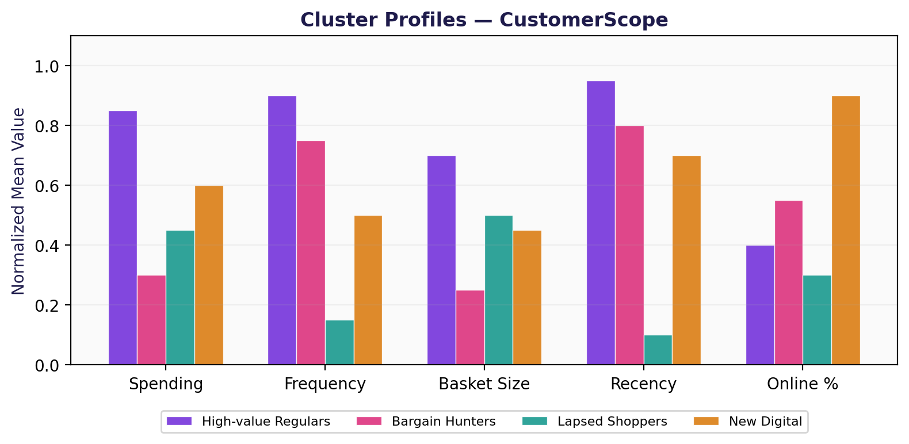
Cluster Profiling
HOW
After clustering: what do these groups actually mean?
Profiling steps:
1. Compute mean feature values per cluster
2. Normalize to compare features on different scales
3. Visualize with bar charts or radar plots
4. Name each cluster based on dominant traits
5. Validate with domain experts
This is the business-critical step. Clusters that can't be named and acted upon are useless — even if the silhouette score is high.

Slide 25
Principal Component Analysis
WHY
Reduce dimensions while preserving maximum information.
Visualization
Project 50 features onto 2D for human understanding
Noise reduction
Drop low-variance components that mostly capture noise
Speed
Fewer features → faster downstream models (KNN, SVM)
Multicollinearity
Correlated features? PCA creates uncorrelated components
PCA is not feature selection — it creates new features (linear combinations of all originals). You lose individual feature interpretability.

Slide 26
PCA: The Mathematics
WHAT
Covariance Matrix
S = (1/N) Σₙ (xₙ − x̄)(xₙ − x̄)ᵀ
Eigendecomposition
S · v = λ · v
S
Covariance matrix (symmetric, positive semi-definite)
v
Eigenvectors → principal component directions (orthogonal)
λ
Eigenvalues → variance captured by each direction
x̄
Mean of the data — subtract it to center the data first

Slide 27
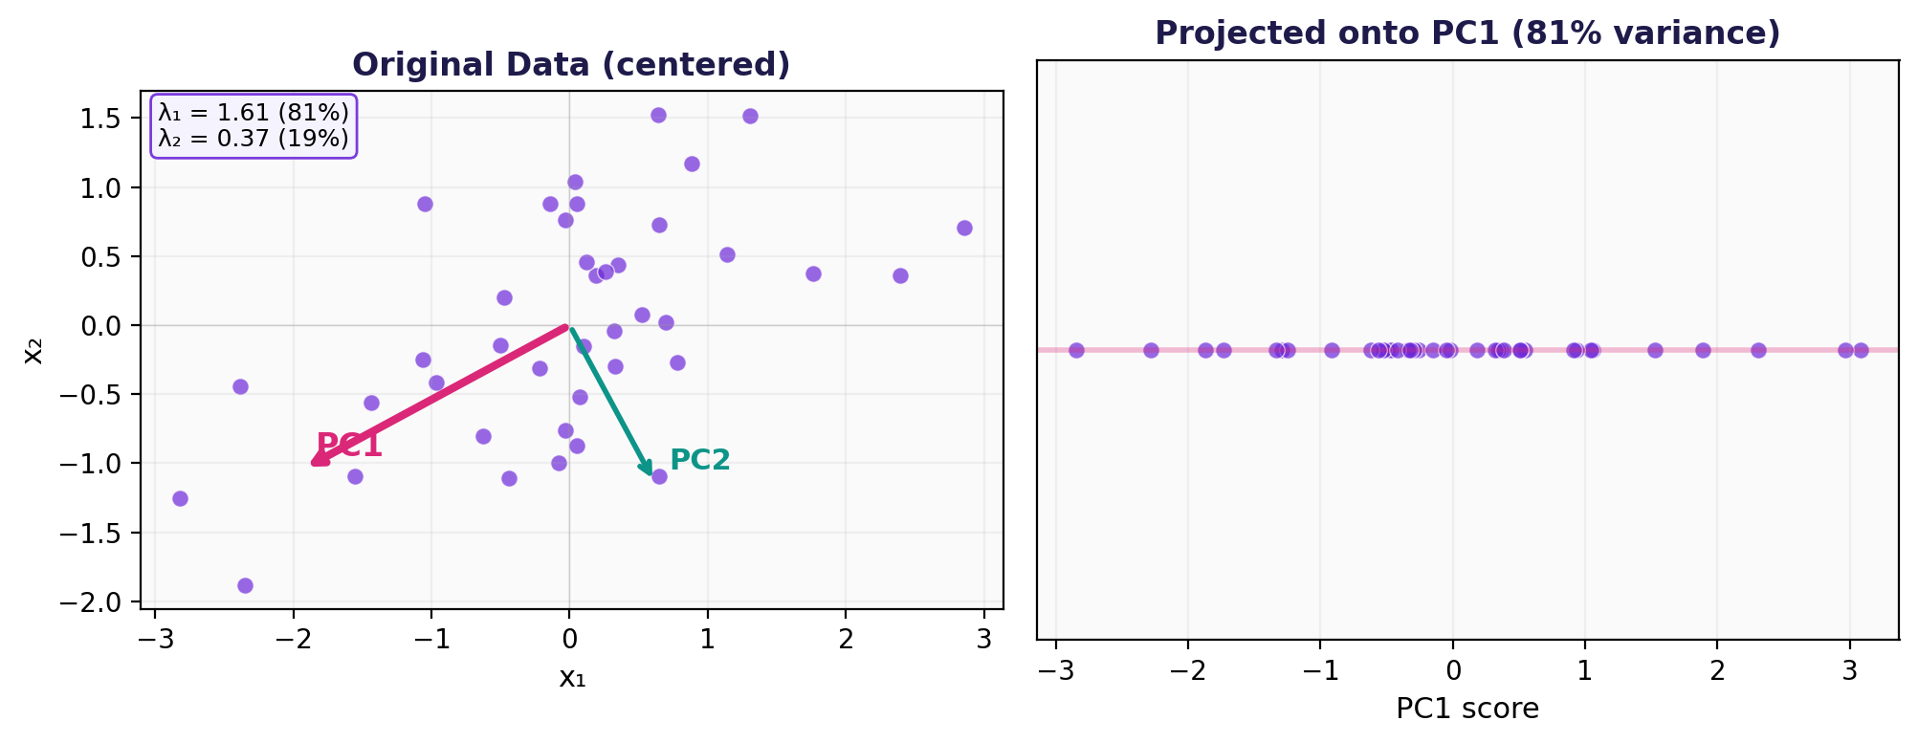
PCA: Worked Example
WHAT
PC1 captures 81% of variance → projecting onto PC1 alone preserves most structure. PC2 adds 19% more — keeping both retains 100%.

Slide 28
PCA: Step by Step
1
Standardize the data (zero mean, unit variance)
Choosing k
Compute the covariance matrix S
Scree plot:
Plot eigenvalues, look for the 'elbow' (similar to K-Means!)
Cumulative variance:
Keep k components that explain ≥ 90–95% of total variance
Example:
λ = [4.5, 2.1, 0.3, 0.1]
Cumulative: 64%, 94%, 98%, 100%
→ k = 2 captures 94%
2
3
Compute eigenvectors and eigenvalues of S
4
Sort eigenvectors by decreasing eigenvalue
5
Keep top k eigenvectors (your principal components)
6
Project data onto the k-dimensional subspace
Always standardize before PCA! Without it, the feature with the largest scale dominates the first component.

Slide 29
PCA: Implementation
HOW
from sklearn.decomposition import PCA
from sklearn.preprocessing import StandardScaler
# Step 1: Standardize
X_scaled = StandardScaler().fit_transform(X)
# Step 2: Fit PCA
pca = PCA(n_components=2)
X_pca = pca.fit_transform(X_scaled)
# Step 3: Explained variance
print(pca.explained_variance_ratio_)
# e.g. [0.45, 0.28] → 73% in 2 components
# Step 4: Component loadings (NEW!)
import pandas as pd
loadings = pd.DataFrame(
pca.components_.T,
columns=['PC1', 'PC2'],
index=feature_names
)
print(loadings) # Shows which features
# contribute to each PC
Component Loadings
pca.components_
tells you what each PC 'means':
Example loadings for PC1:
Spending: 0.62
Frequency: 0.55
Basket: 0.48
Online: −0.12
→ PC1 ≈ 'overall engagement'
Loadings bridge interpretability and math: they explain what each PC captures in business terms.

Slide 30
PCA: What It Is Not
✗
PCA selects the best features
→ PCA creates new features — linear combinations of all originals
✗
High variance = useful
→ Maximum variance direction may not be the most informative for your task
✗
PCA works on any structure
→ PCA is linear — it cannot capture nonlinear relationships (use kernel PCA or t-SNE)
✗
PCA components are interpretable
→ Components are mathematical blends — look at loadings to interpret them
✗
Skip standardization
→ Without scaling, high-variance features dominate PCA entirely

Slide 31
t-SNE: Nonlinear Visualization
WHAT
PCA preserves global variance. But what about local structure?
Core idea: if two points are close in high-dimensional space, they should remain close in 2D. Preserves local neighborhoods.
Parameters
Warnings
perplexity controls neighborhood size (try 5–50)
Inter-cluster distances on the plot may be unreliable
Results vary with random seed — run multiple times
Cluster sizes on the plot can be misleading
Visualization only never use as a preprocessing step
Also worth knowing: UMAP — faster alternative, often better global structure preservation. Worth trying as a drop-in replacement.
 | PCA | t-SNE
Type | Linear | Nonlinear
Preserves | Global variance | Local neighborhoods
Use for | Preprocessing + visualization | Visualization only

Slide 32
t-SNE: Implementation
HOW
from sklearn.manifold import TSNE
import matplotlib.pyplot as plt
# Fit t-SNE (always on scaled data)
tsne = TSNE(n_components=2, perplexity=30,
random_state=42)
X_tsne = tsne.fit_transform(X_scaled)
# Color by cluster labels from K-Means
plt.scatter(X_tsne[:, 0], X_tsne[:, 1],
c=kmeans_labels, cmap='viridis',
alpha=0.6, s=20)
plt.title('t-SNE visualization')
plt.xlabel('t-SNE 1'); plt.ylabel('t-SNE 2')
plt.colorbar(label='Cluster')
plt.show()
Practical tips
Apply PCA first
if you have many features (>50). Reduces noise and speeds up t-SNE.
Try different perplexity
values (5, 15, 30, 50) — results change significantly.
Run multiple seeds
to check if structure is consistent.
UMAP alternative:
pip install umap-learn
t-SNE is non-parametric: you can't transform new test data. Fit on training only, or use PCA for production pipelines.

Slide 33
A Critical Warning
Clustering will always return groups
— even if no natural clusters exist.
Run K-Means on completely random, uniform data.
It will happily produce K clusters. They mean nothing.
A pretty 2D scatter plot is not proof of meaningful structure.
Always validate: domain expertise + evaluation metrics + stability checks

Slide 34
The Unsupervised Pipeline
Scale
Reduce
Cluster
Evaluate
Visualize
Interpret
→
→
→
→
→
StandardScaler
PCA
K-Means / DBSCAN
Silhouette / Elbow
t-SNE / PCA 2D
Domain expertise
CustomerScope — Full Pipeline
1. Scale 6 features → StandardScaler
2. PCA → 3 components capture 92% variance
3. K-Means (K=4) → 4 customer segments
4. Silhouette = 0.58 → decent separation
5. t-SNE scatter confirms visual grouping
6. Profile clusters: 'High-value regulars', 'Bargain hunters', 'Lapsed shoppers', 'New digital'

Slide 35
Key Takeaways
Unsupervised learning discovers structure without labels
K-Means is simple but assumes spherical clusters — always try alternatives
DBSCAN handles arbitrary shapes and identifies outliers natively
Hierarchical clustering reveals multi-level structure via dendrograms
PCA reduces dimensions linearly — always standardize first
t-SNE is for visualization only — don't trust distances on the plot
Clustering always produces groups — validate with metrics and domain knowledge
The profiling step turns math into business insight

