Slide 1
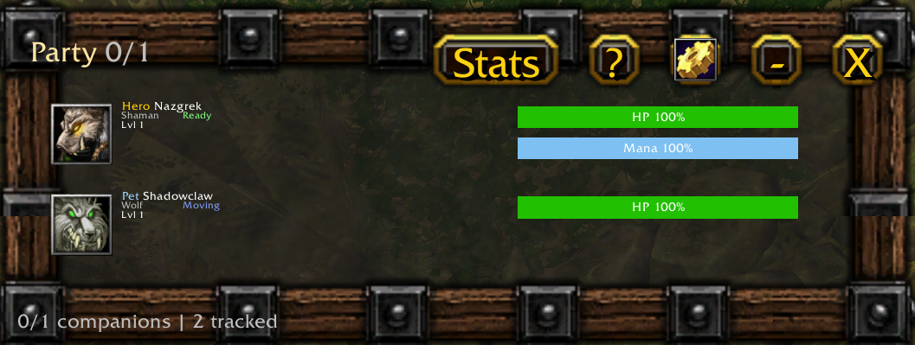
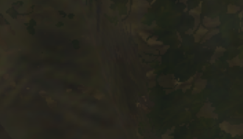
Hero Nazgrek
Shaman Ready
Level 1
Pet Shadowclaw
Wolf Ready
Level 1

Slide 2
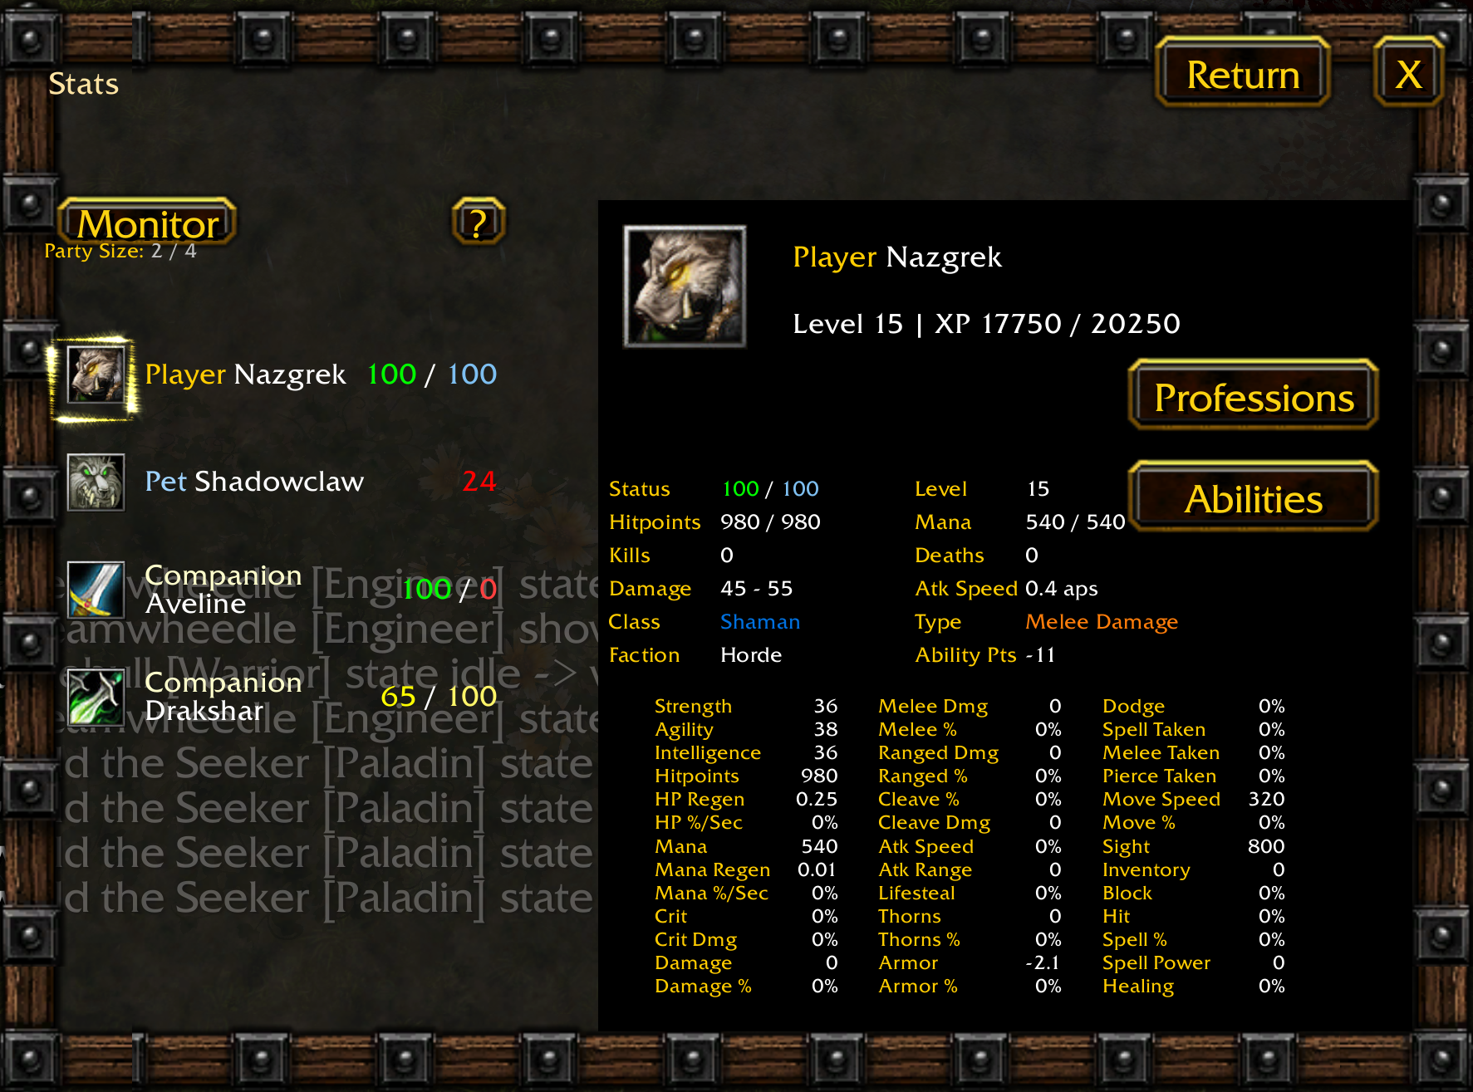




Party: 2 / 4

Slide 3
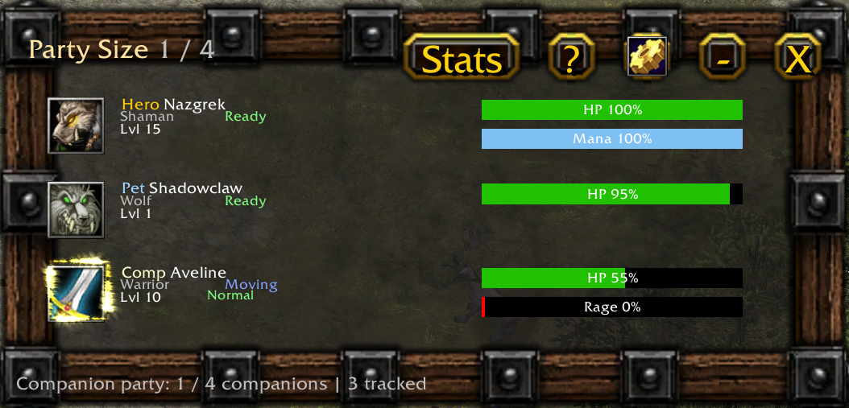

Slide 4


Slide 5
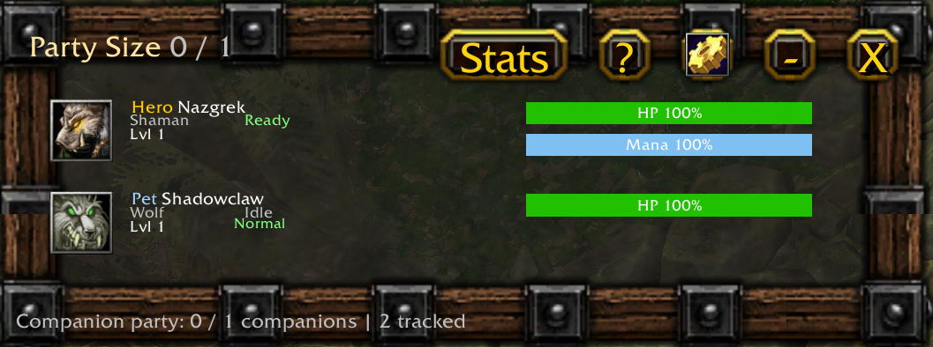

Slide 6
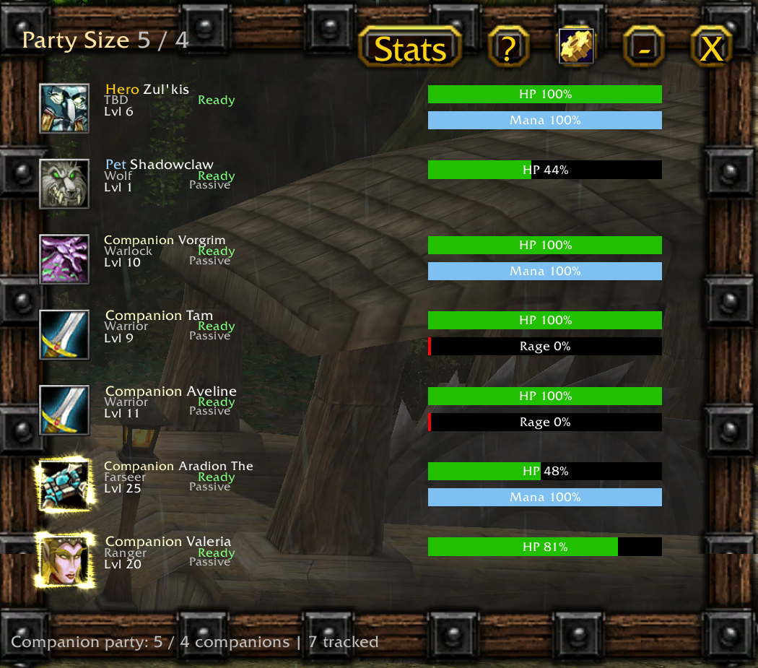

Slide 7


