Slide 1
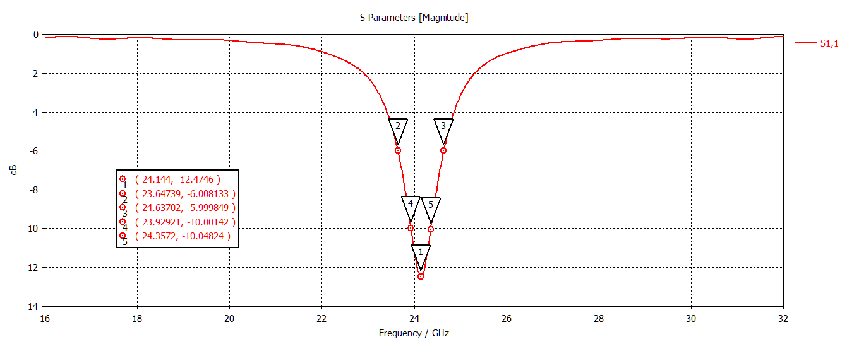
R = 1.87

Slide 2
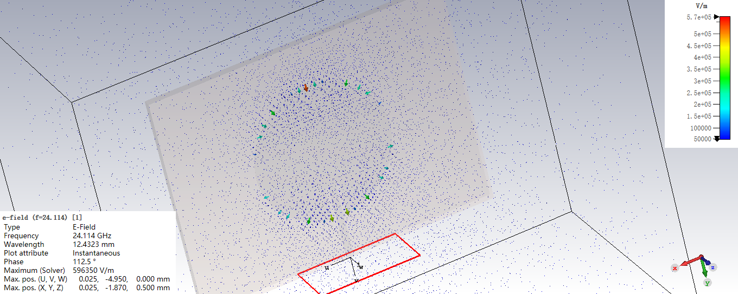
2D/3D Results\E-Field\e-field (f=24.114) [1]

Slide 3
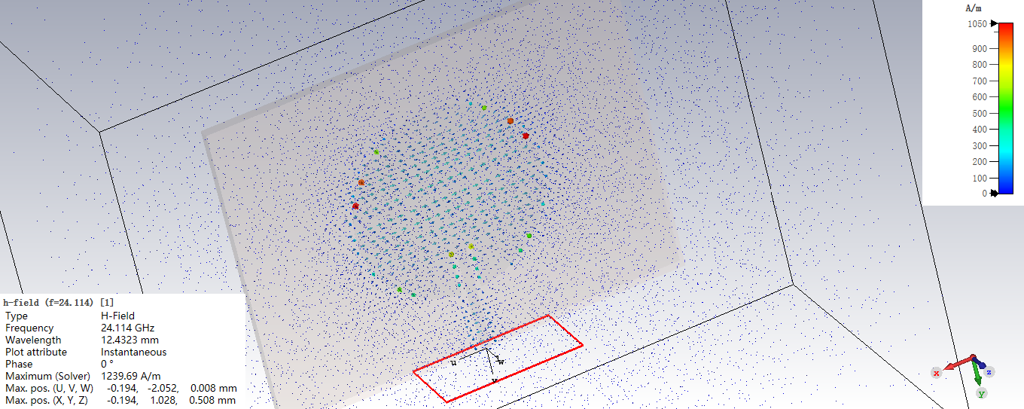
2D/3D Results\H-Field\h-field (f=24.114) [1]

Slide 4
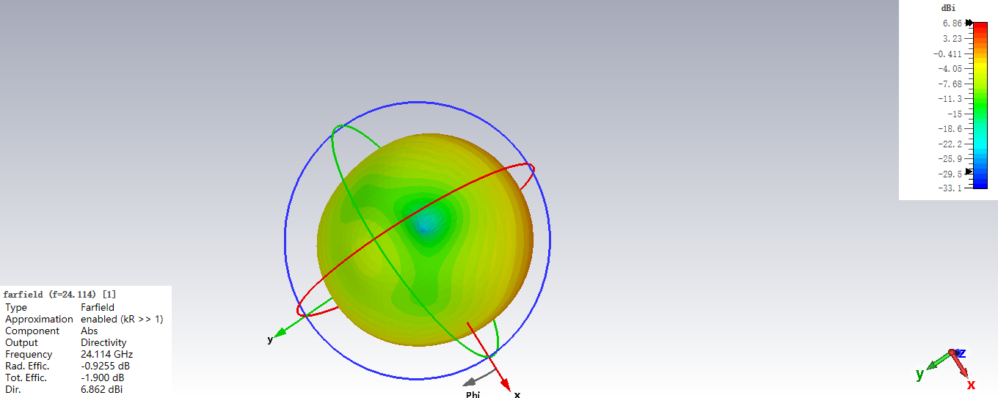
Farfields\farfield (f=24.114) [1]

Slide 5
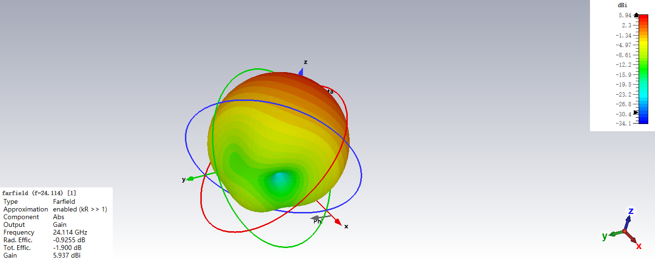
Farfields\farfield (f=24.114) [1]

Slide 6
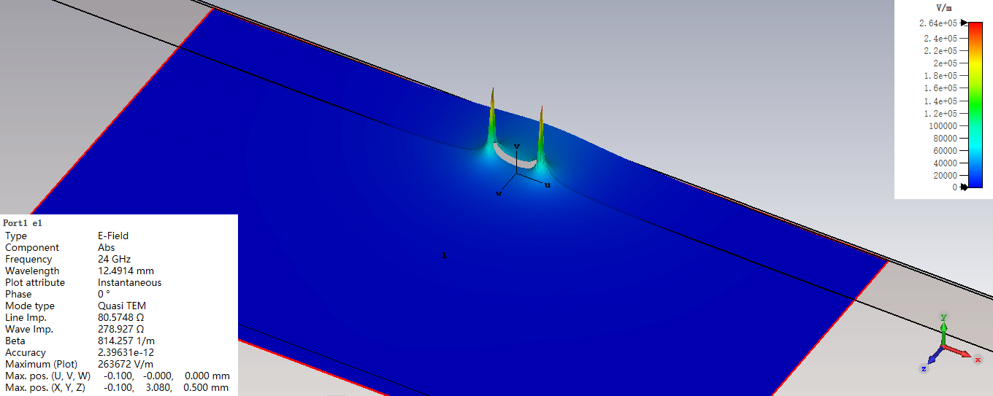
2D/3D Results\Port Modes\Port1\e1

Slide 7
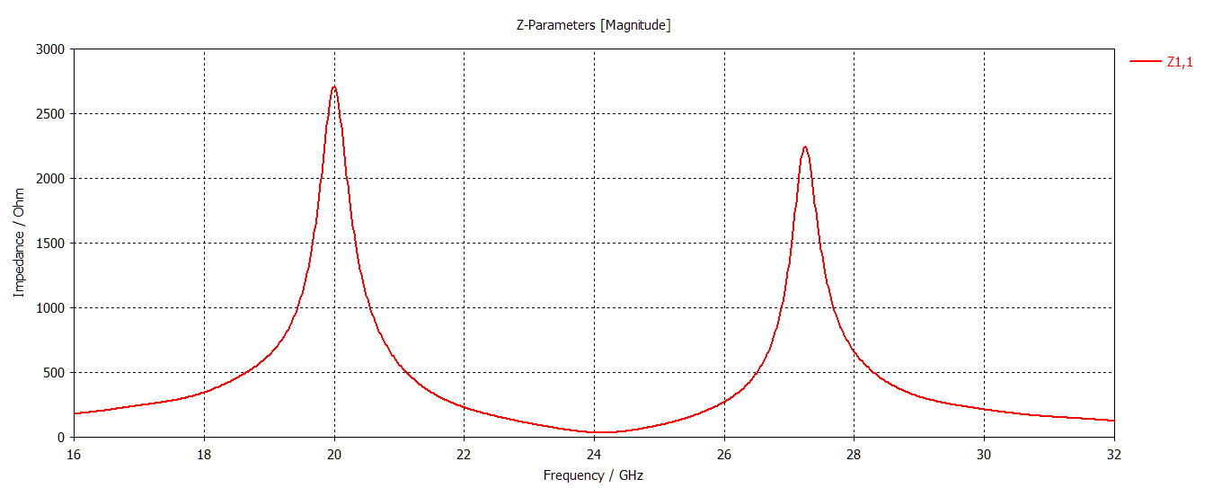
1D Results\Z Matrix

Slide 8
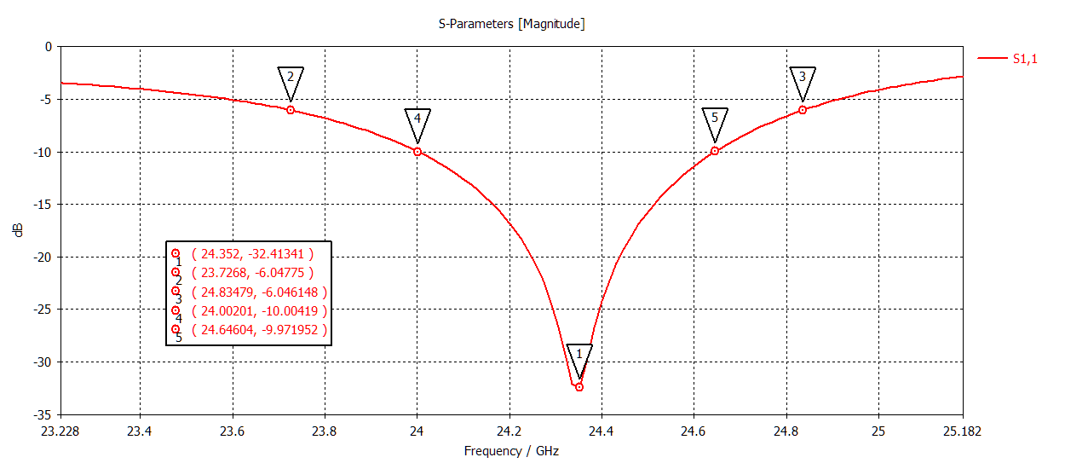
R = 1.8

Slide 9
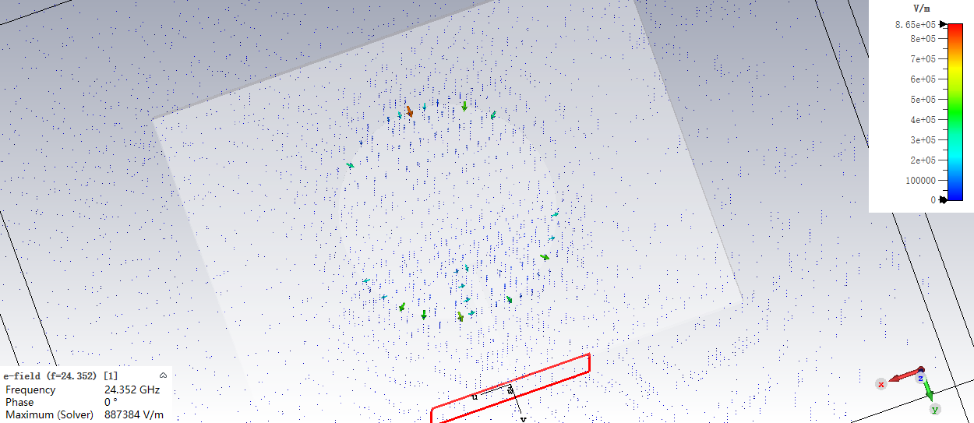
2D/3D Results\E-Field\e-field (f=24.352) [1]

Slide 10
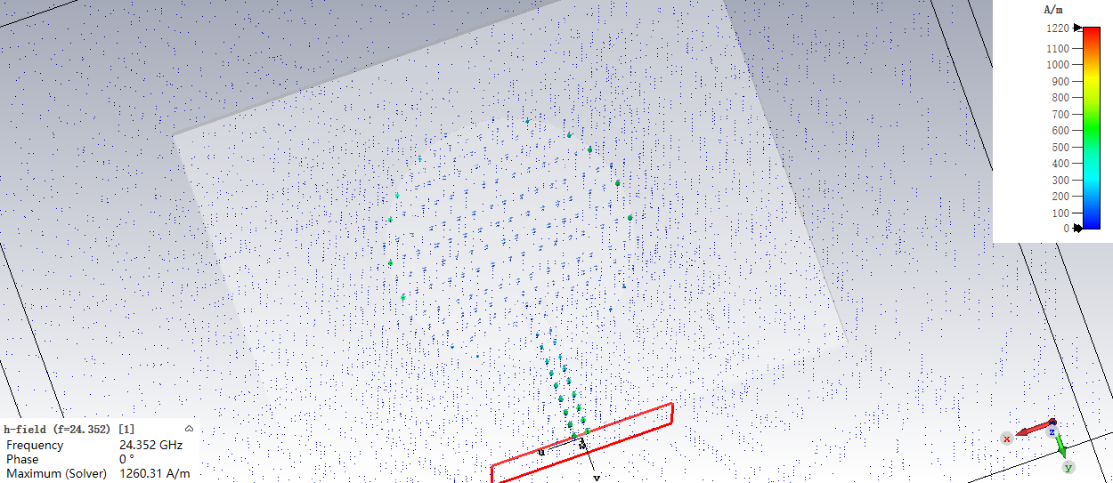
2D/3D Results\H-Field\h-field (f=24.352) [1]

Slide 11
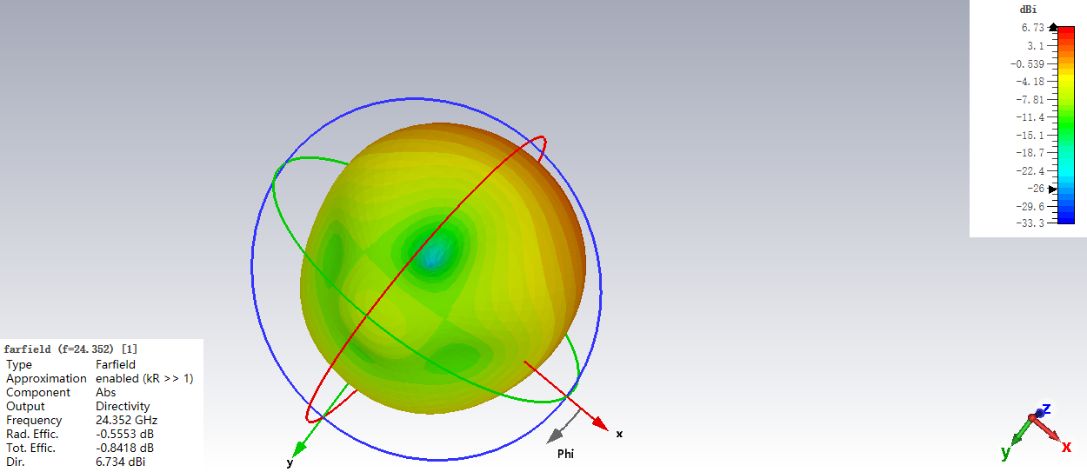
Farfields\farfield (f=24.352) [1]

Slide 12

Farfields\farfield (f=24.352) [1]

Slide 13
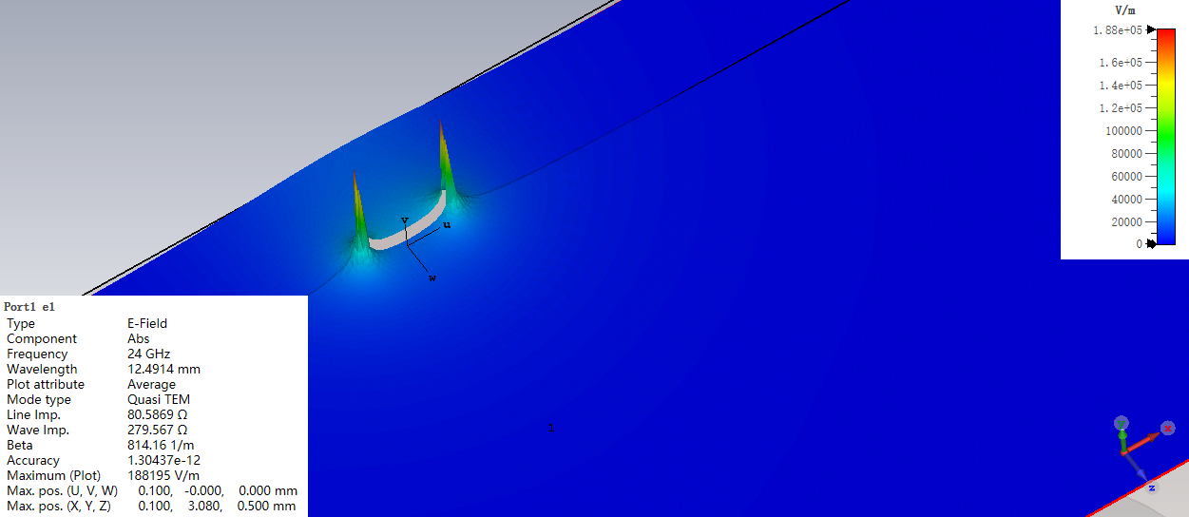
2D/3D Results\Port Modes\Port1\e1

Slide 14
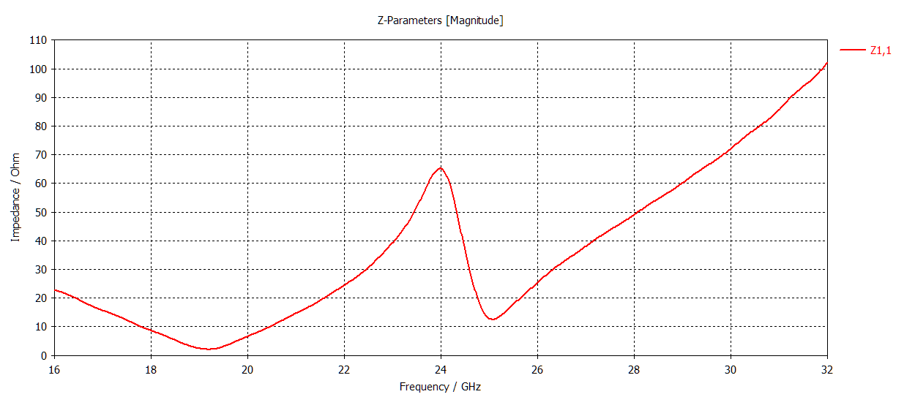
Schematic

Slide 15
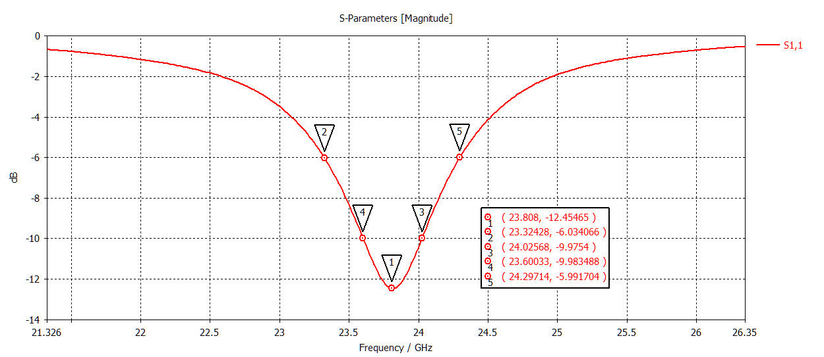
R = 1.9

Slide 16
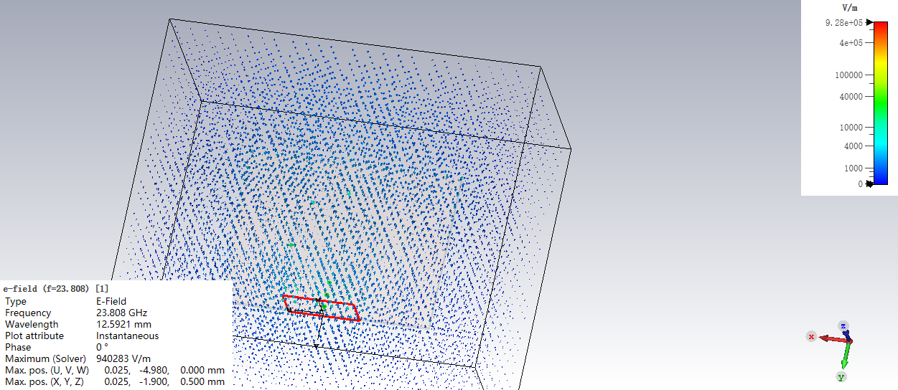
2D/3D Results\E-Field\e-field (f=23.808) [1]

Slide 17
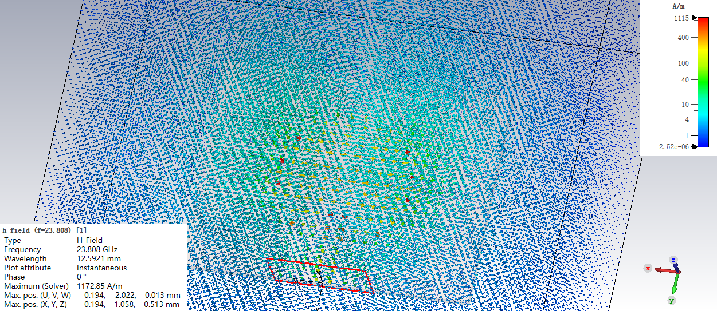
2D/3D Results\H-Field\h-field (f=23.808) [1]

Slide 18
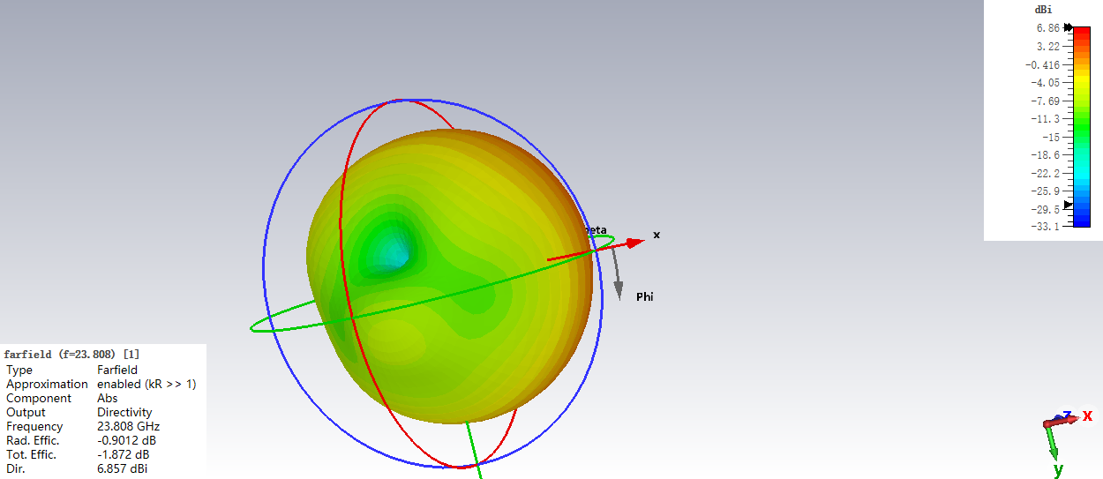
Farfields\farfield (f=23.808) [1]

Slide 19
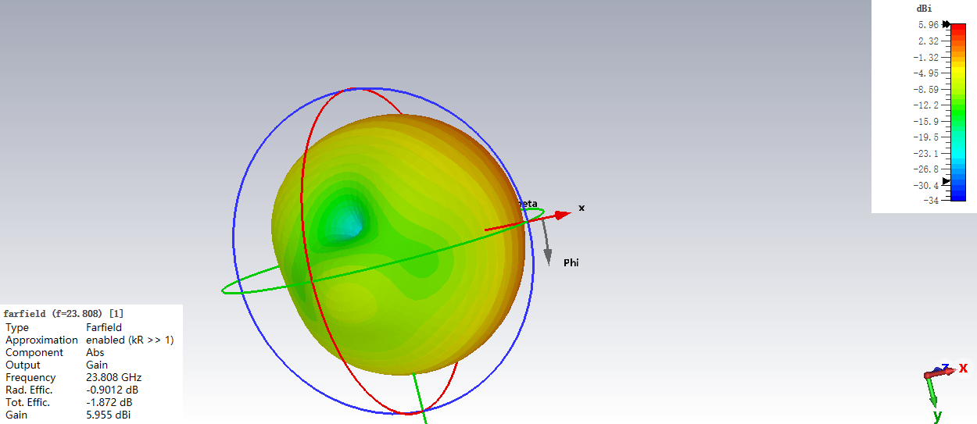
Farfields\farfield (f=23.808) [1]

Slide 20
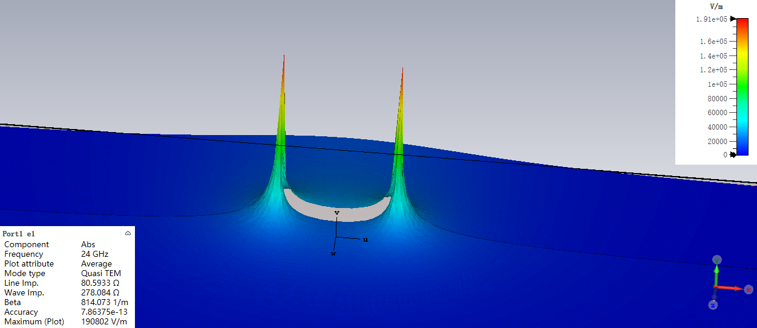
2D/3D Results\Port Modes\Port1\e1

Slide 21
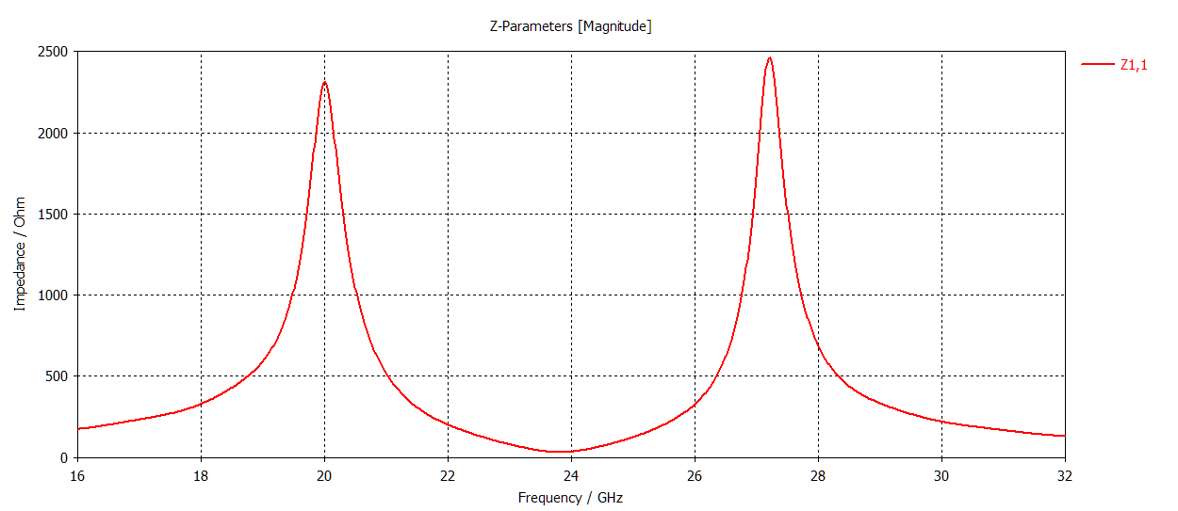
1D Results\Z Matrix

