Slide 1
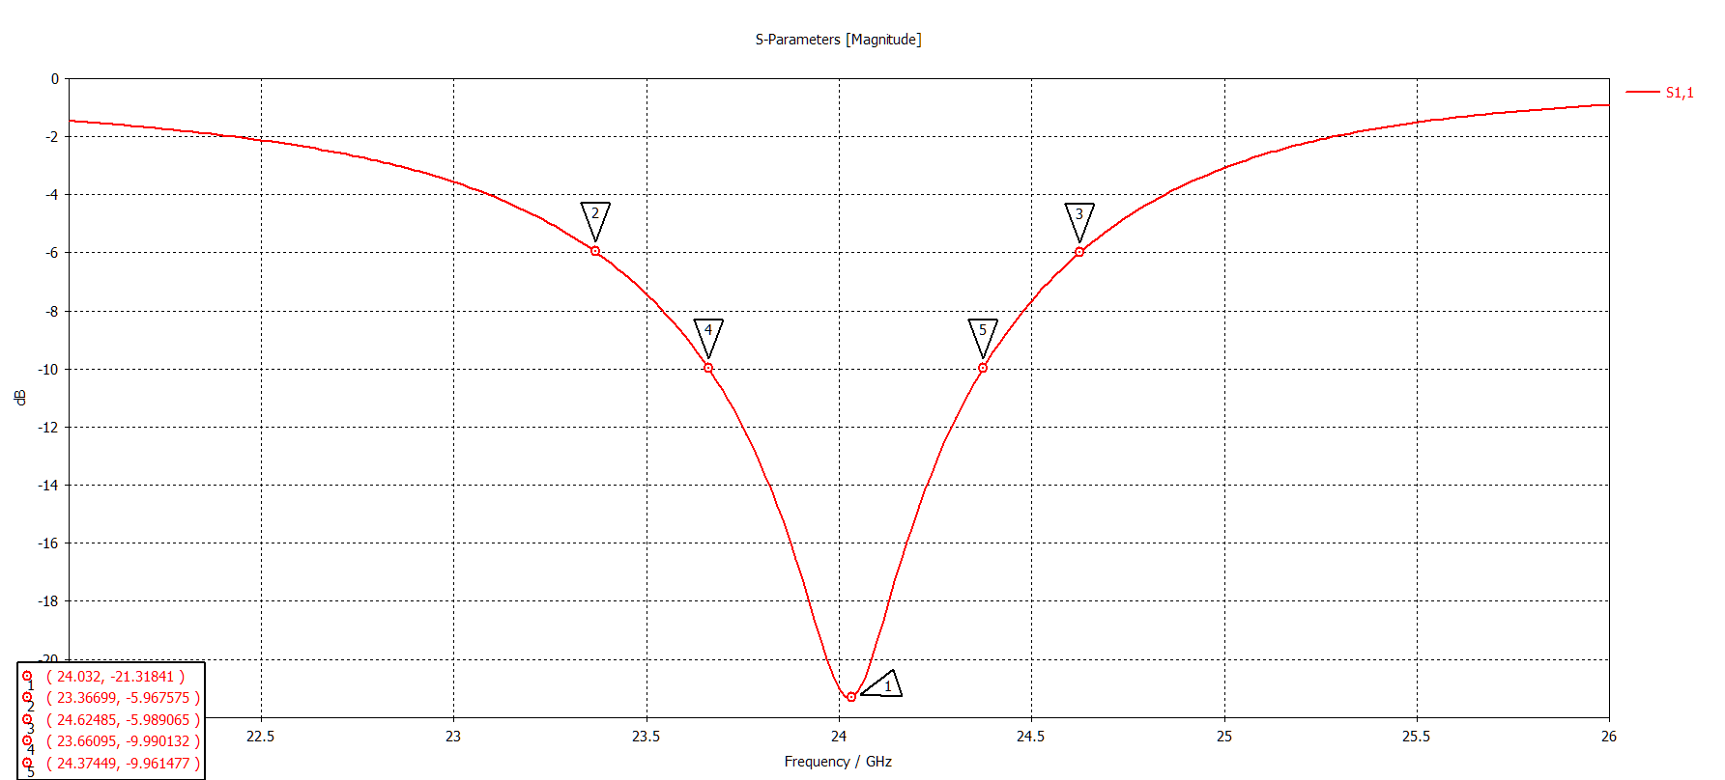
W=4.08

Slide 2
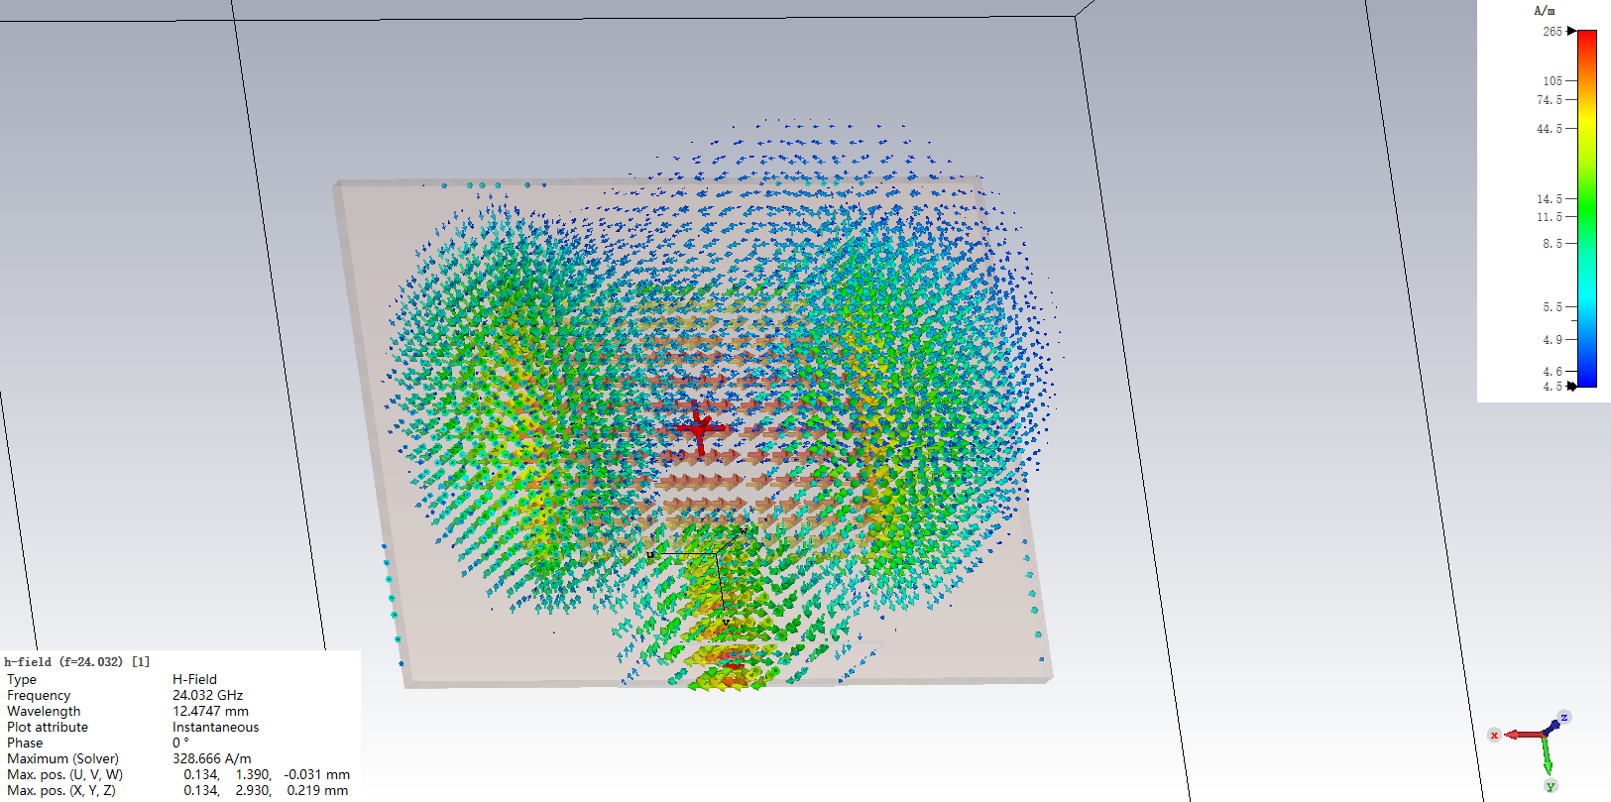
2D/3D Results\H-Field\h-field (f=24.032) [1]

Slide 3
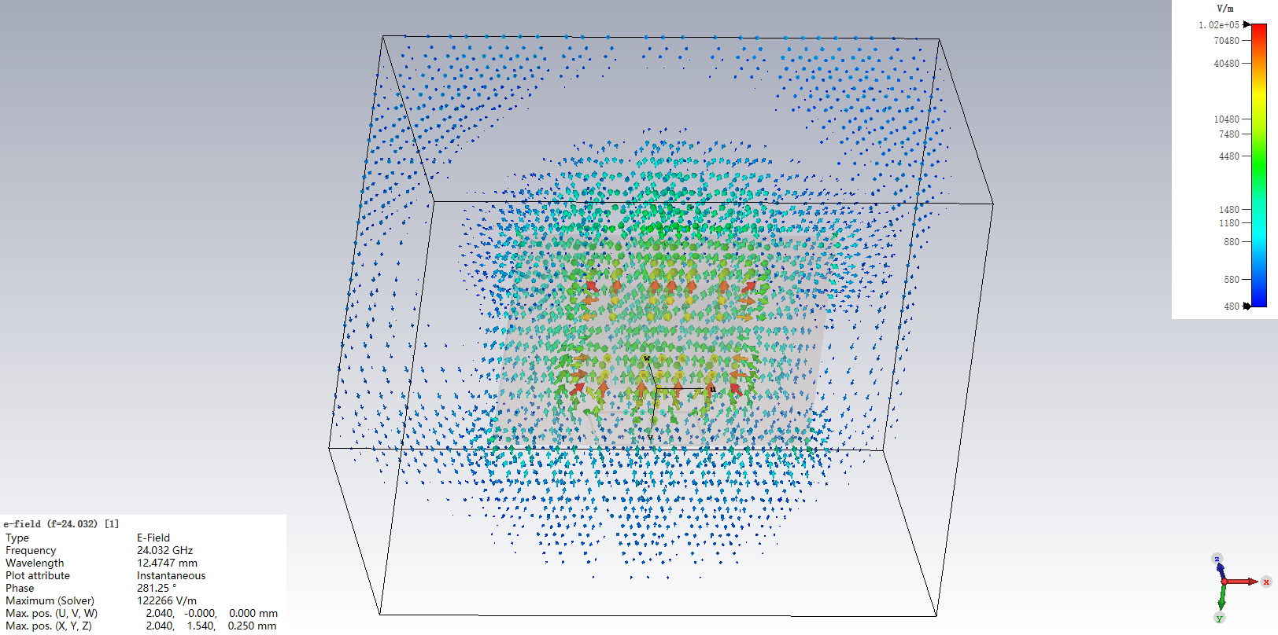
2D/3D Results\E-Field\e-field (f=24.032) [1]

Slide 4
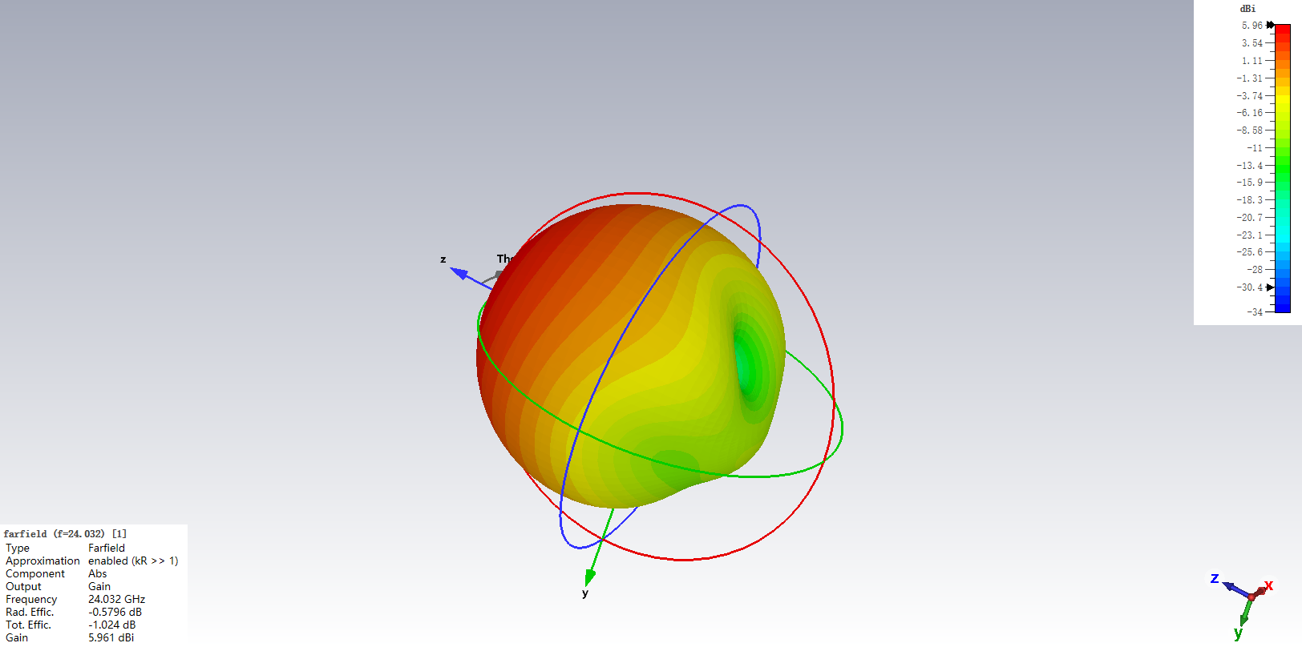
Farfields Gain

Slide 5

Farfields Directivity

Slide 6
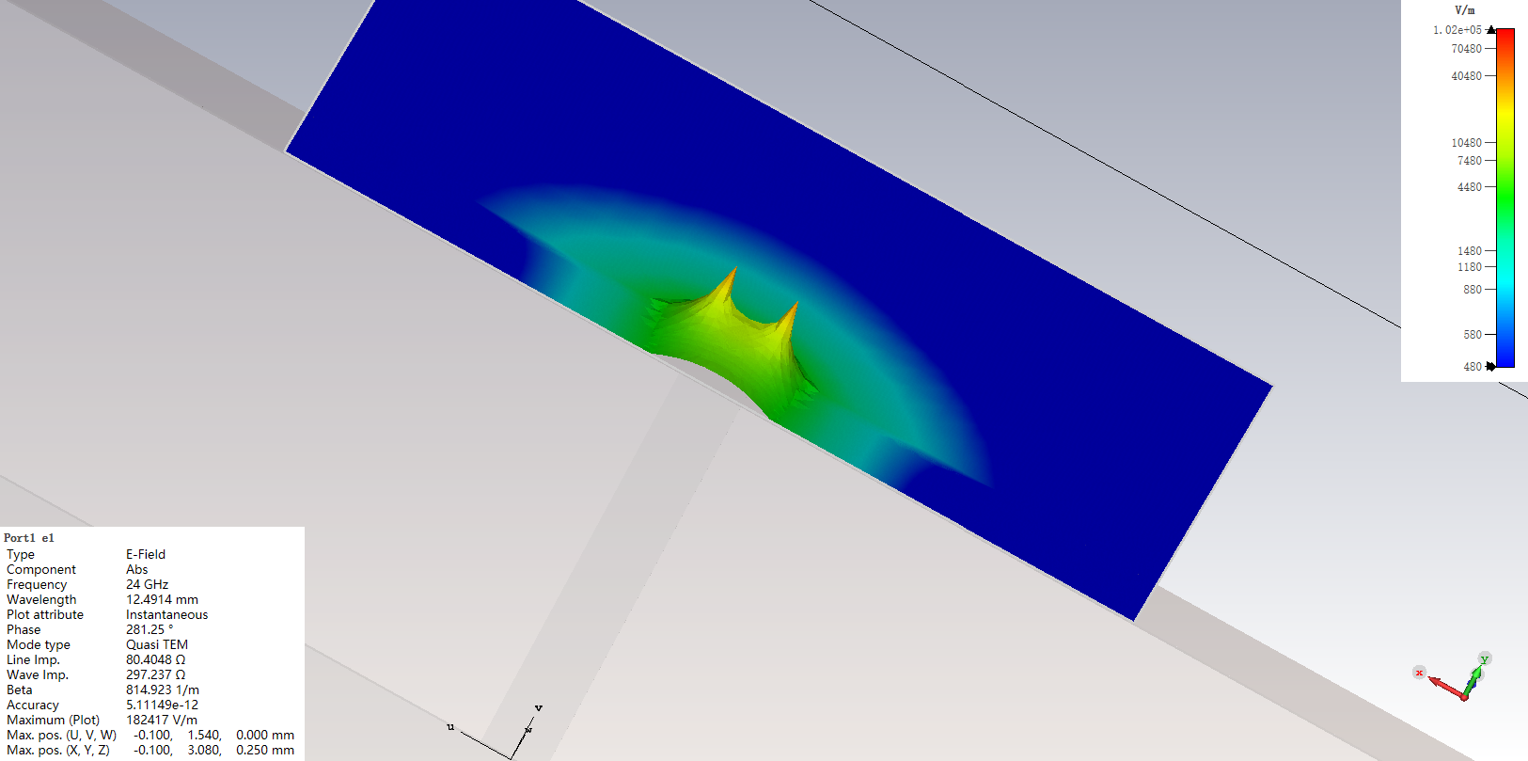
2D/3D Results\Port Modes\Port1\e1

Slide 7
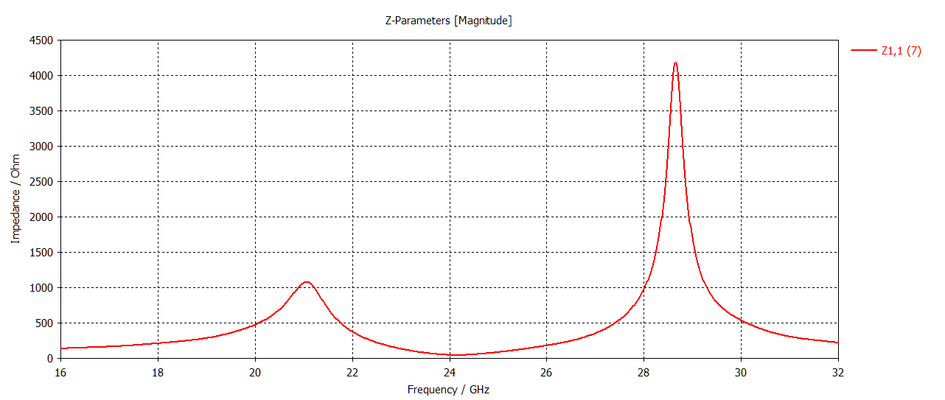
Schematic

Slide 8
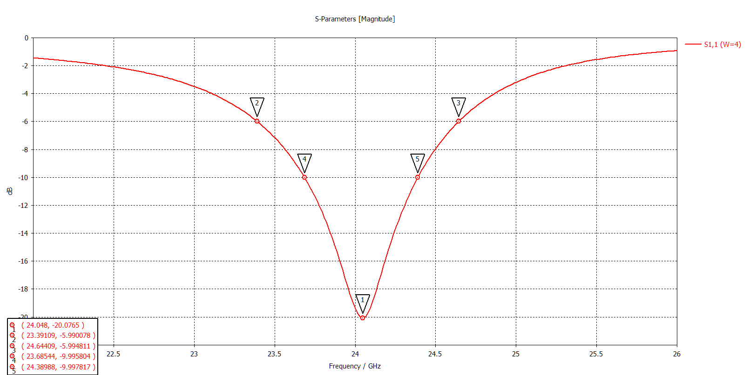
W=4.00

Slide 9
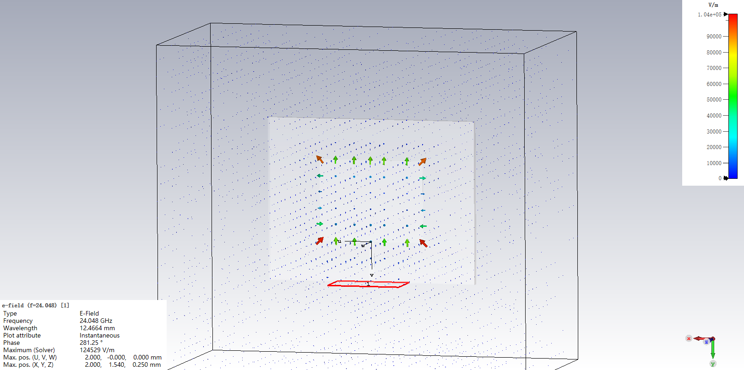
2D/3D Results\E-Field\e-field (f=24.048) [1]

Slide 10
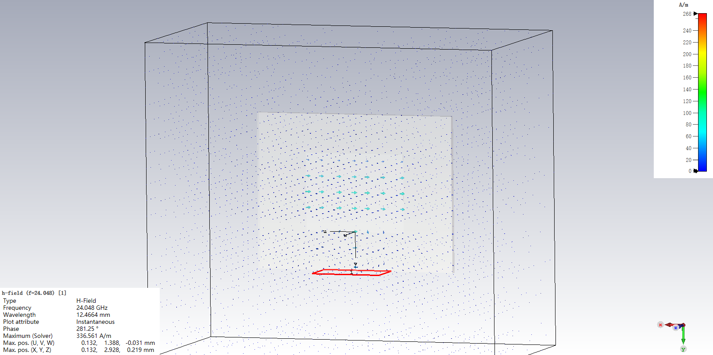
2D/3D Results\H-Field\h-field (f=24.048) [1]

Slide 11
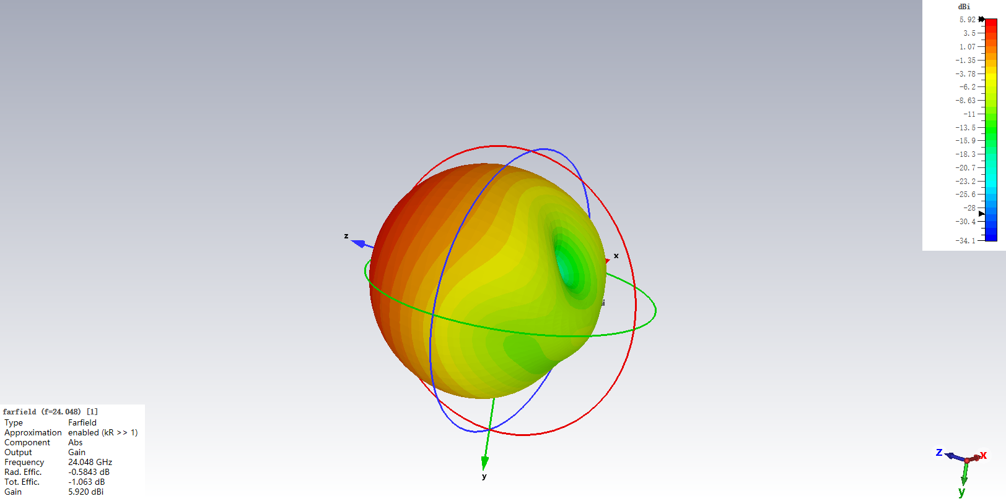
Farfields Gain

Slide 12

Farfields Directivity

Slide 13
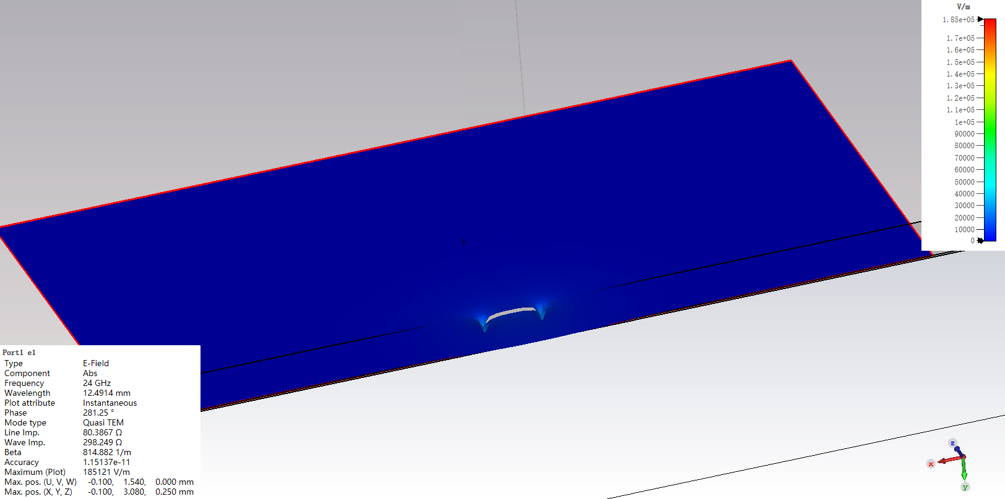
2D/3D Results\Port Modes\Port1\e1

Slide 14
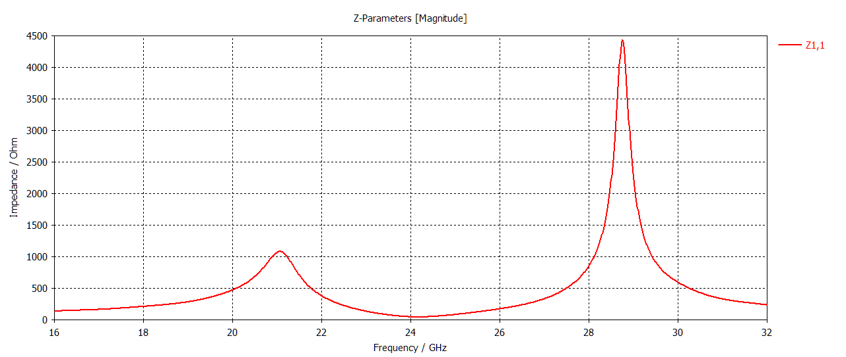
1D Results\Z Matrix\Z1,1

Slide 15
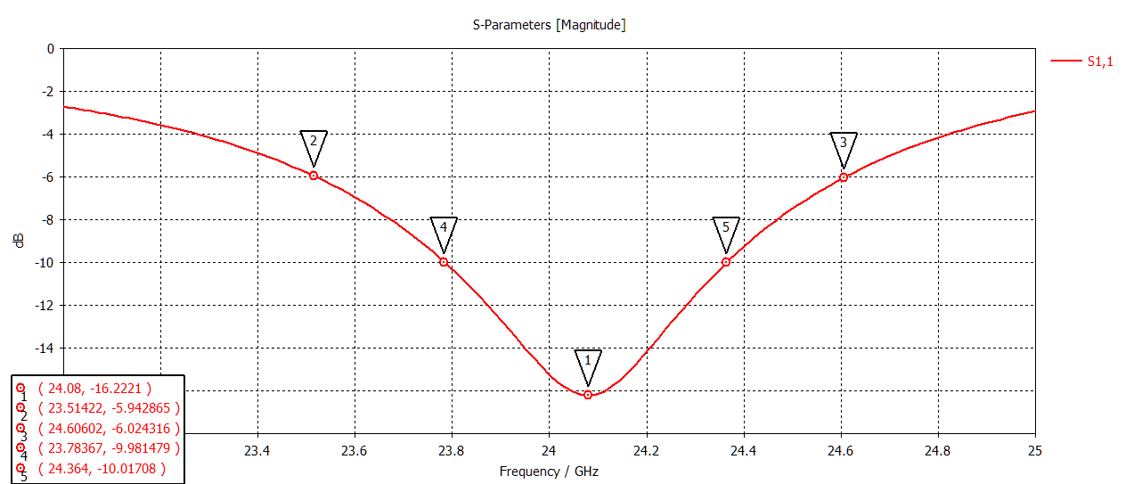
W=4.20

Slide 16
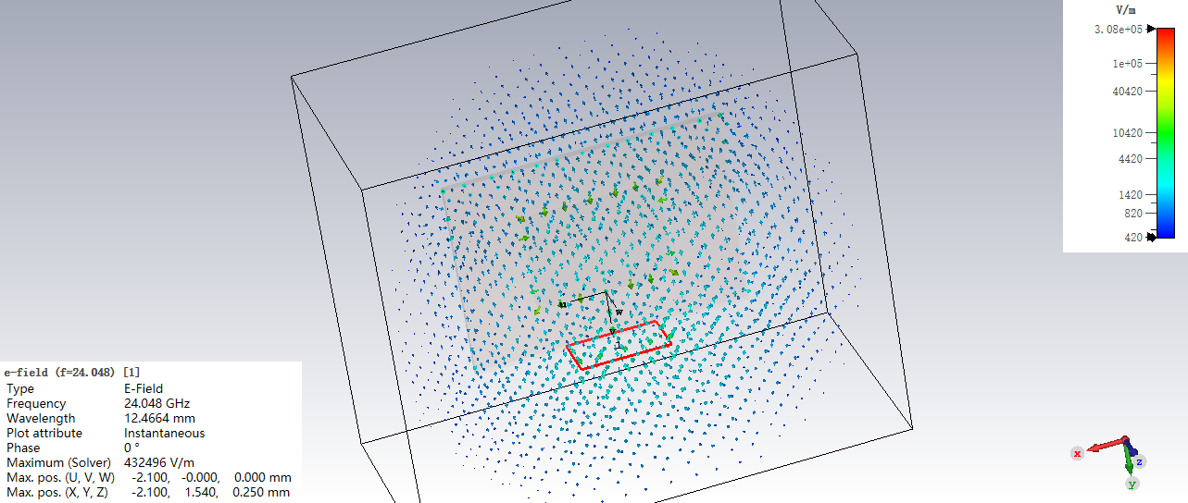
2D/3D Results\E-Field\e-field (f=24.048) [1]

Slide 17
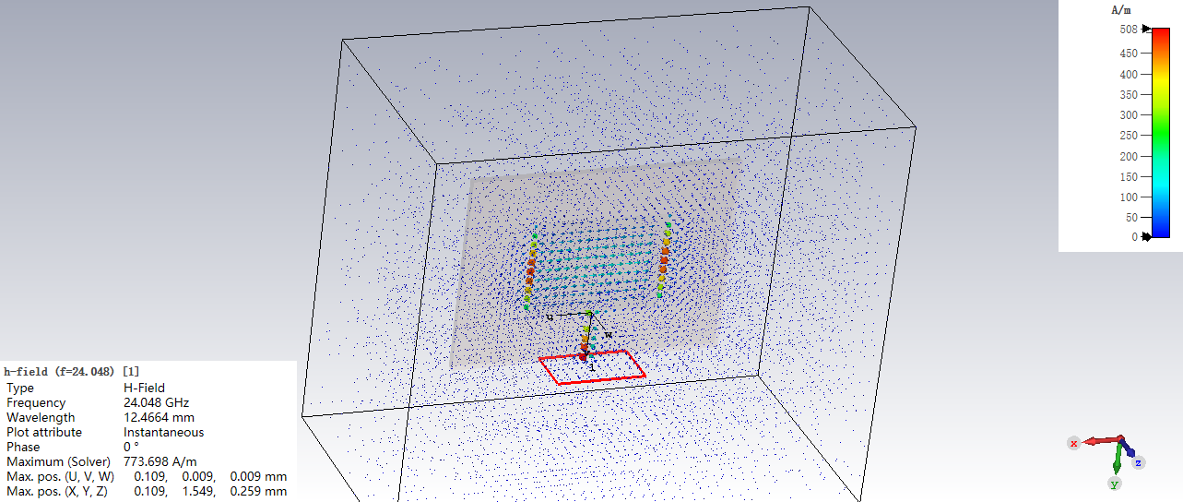
2D/3D Results\H-Field\h-field (f=24.048) [1]

Slide 18
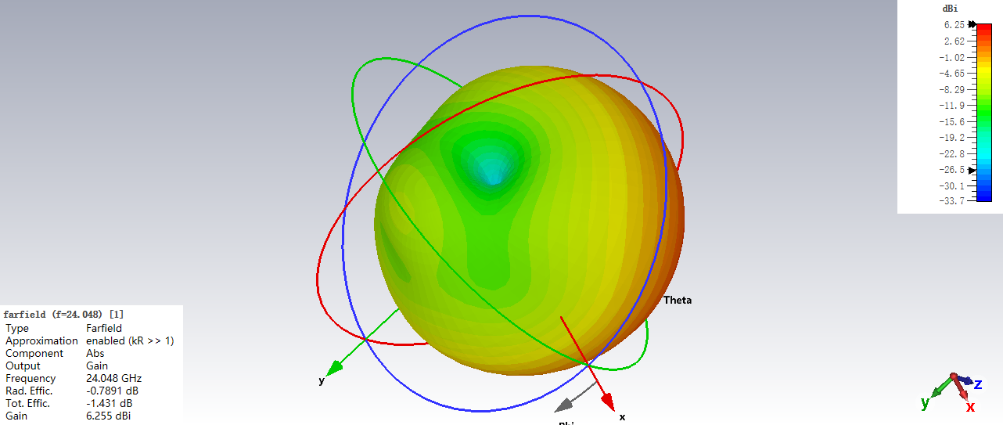
Farfields\farfield (f=24.048) [1]

Slide 19

Farfields\farfield (f=24.048) [1]

Slide 20
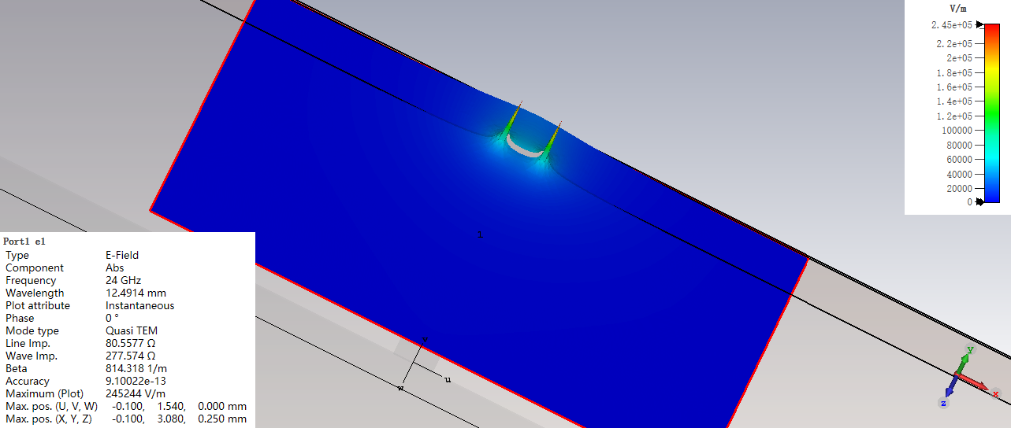
2D/3D Results\Port Modes\Port1\e1

Slide 21
Schematic

