Slide 1
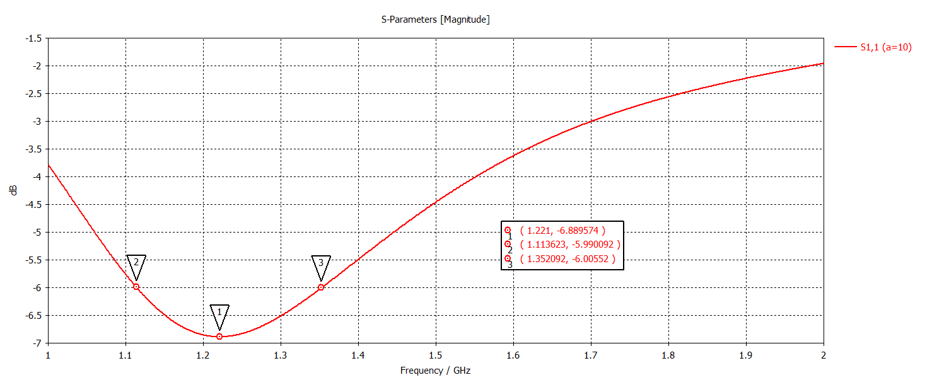
f_min and Bandwitdh in -10dB & -6 Db

Slide 2
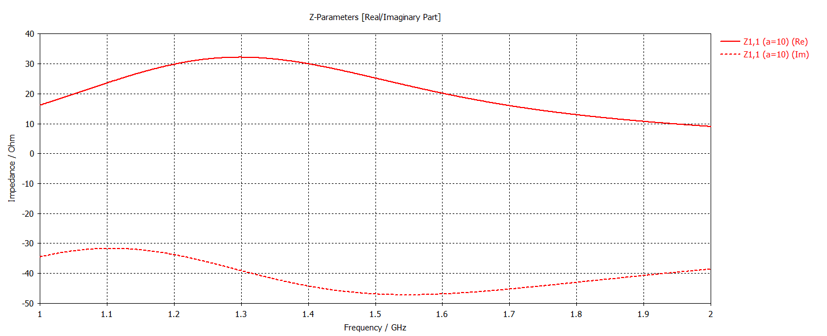
f_R (R=50 Ohms)& f_X (X=0 Ohms)

Slide 3
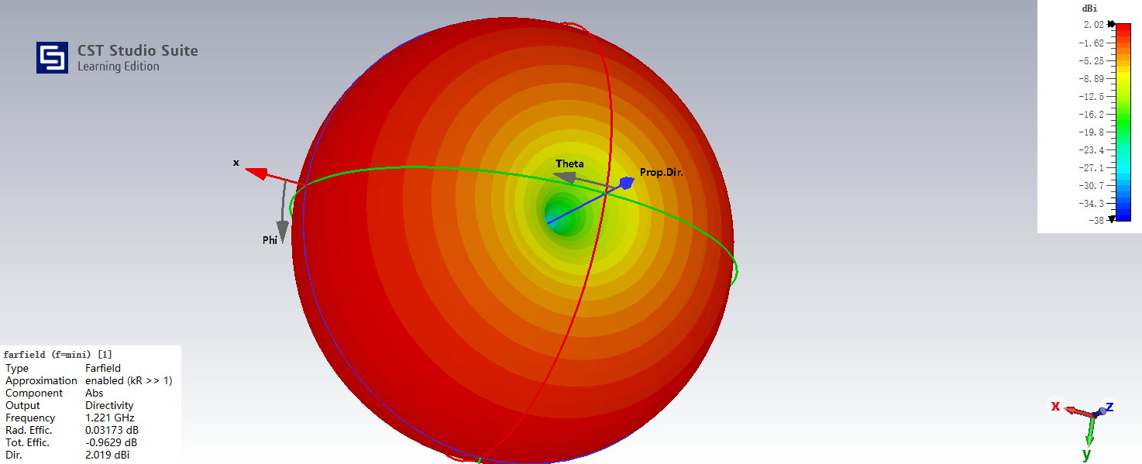
Farfields\farfield (f=mini) [1]

Slide 4
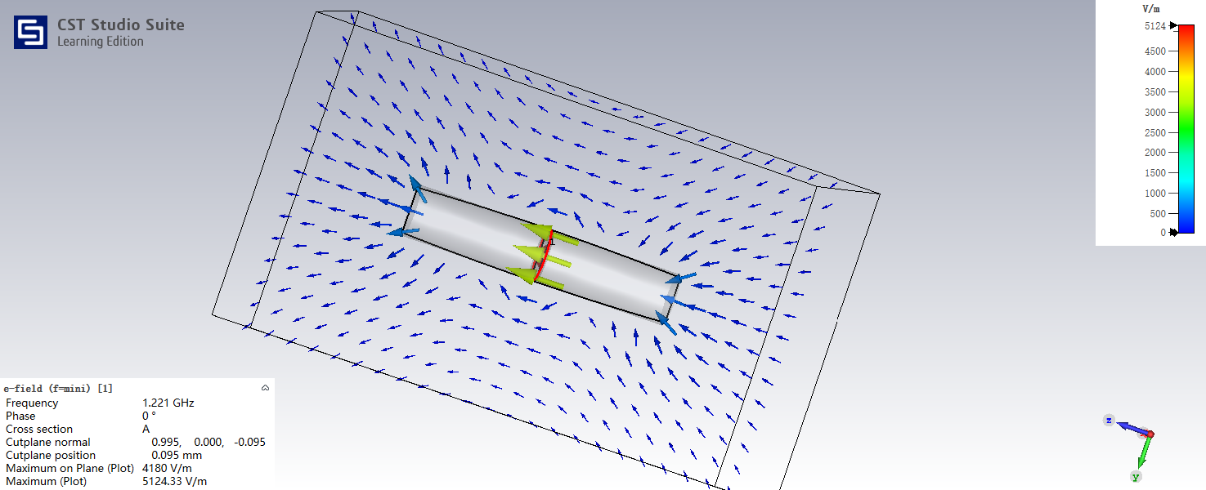
2D/3D Results\E-Field\e-field (f=mini) [1]

Slide 5
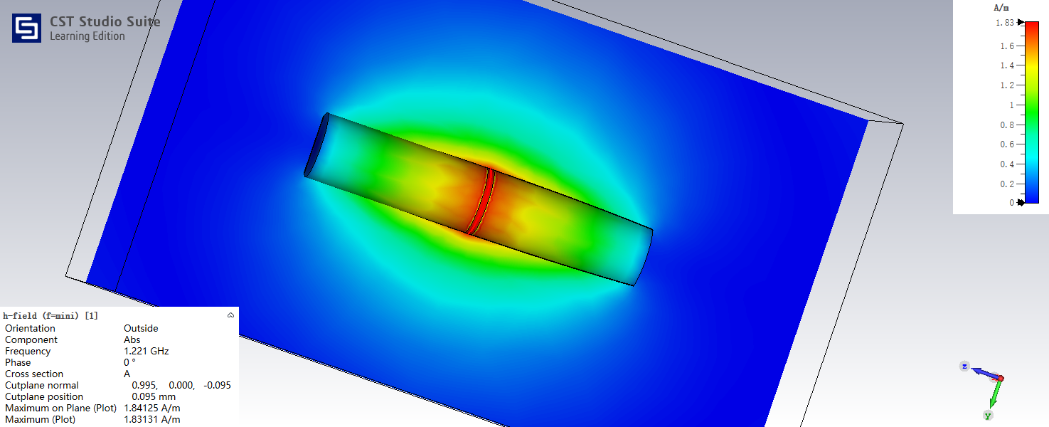
2D/3D Results\H-Field\h-field (f=mini) [1]

Slide 6
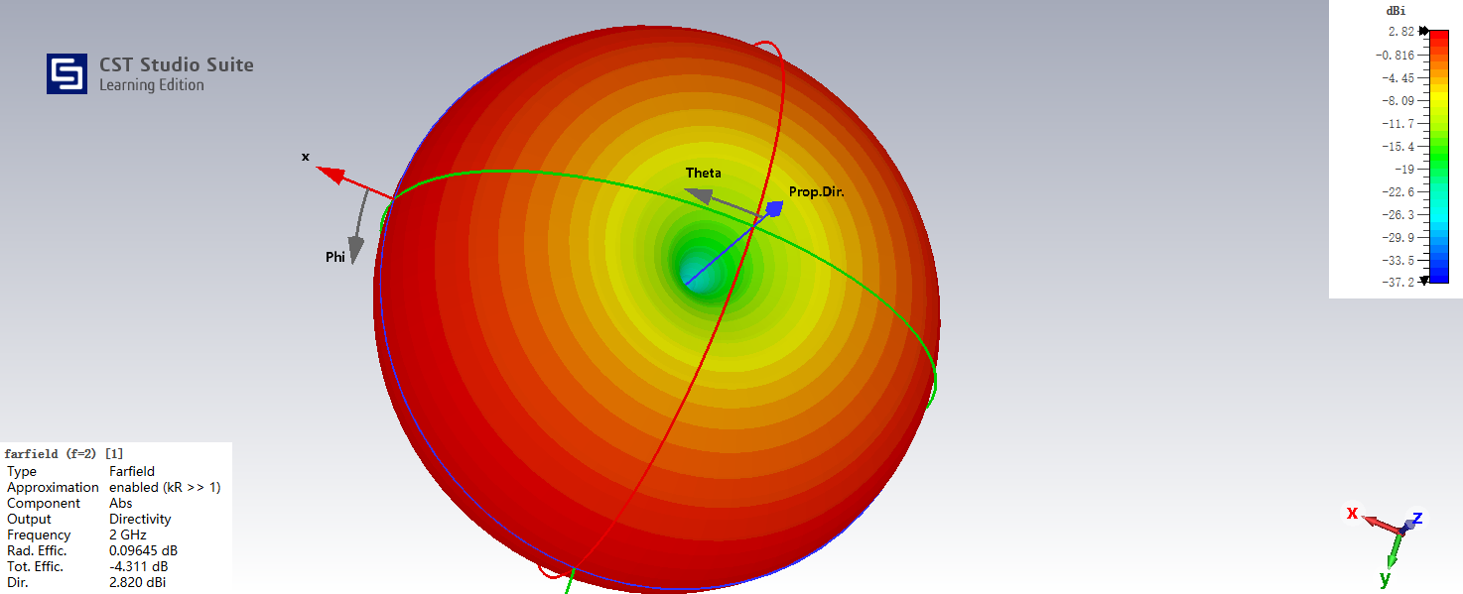
Farfields\farfield (f=2) [1]

Slide 7
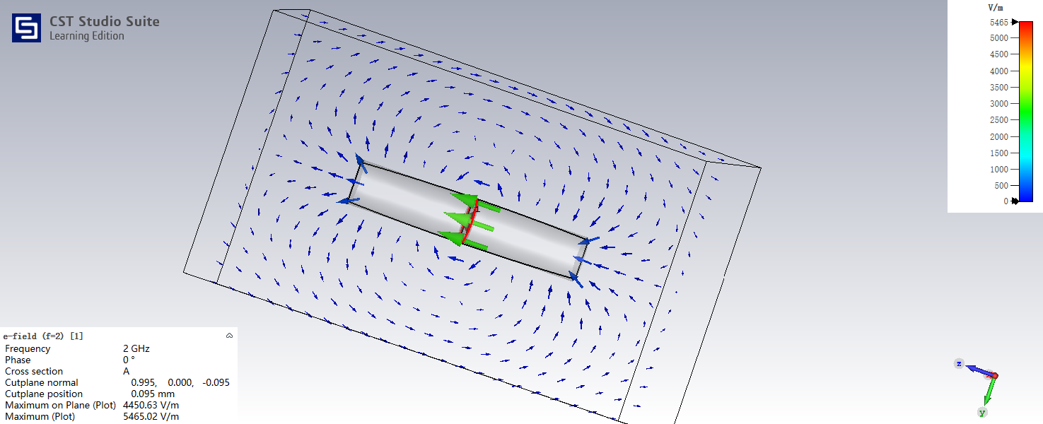
2D/3D Results\E-Field\e-field (f=2) [1]

Slide 8
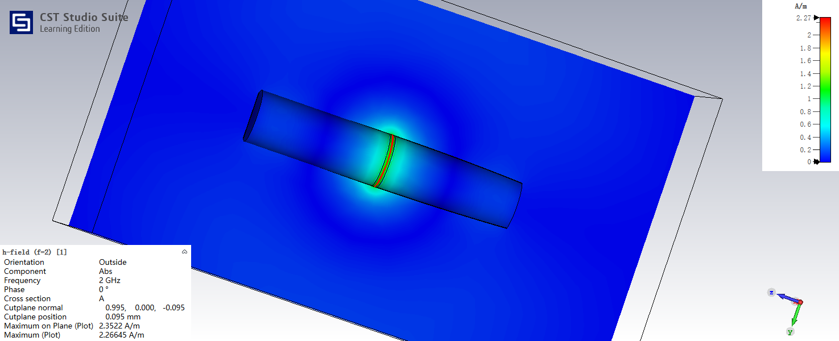
2D/3D Results\H-Field\h-field (f=2) [1]

