Slide 1
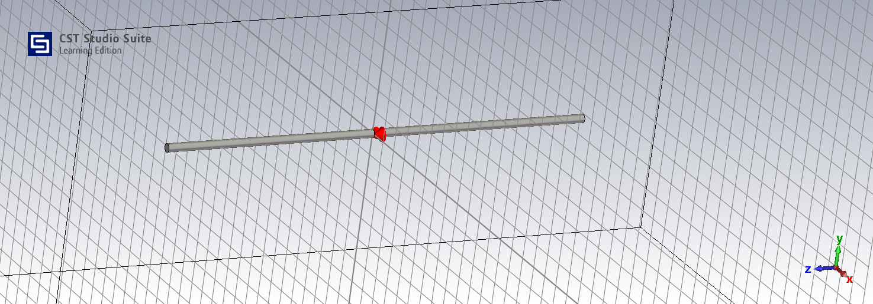
L1=50mm a=1mm g=2mm

Slide 2
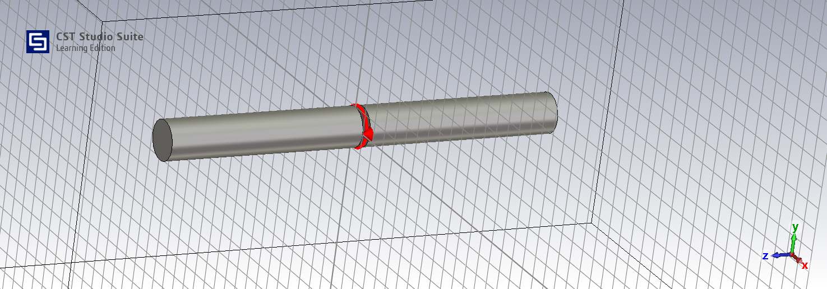
L1=50mm a=5mm g=2mm

Slide 3
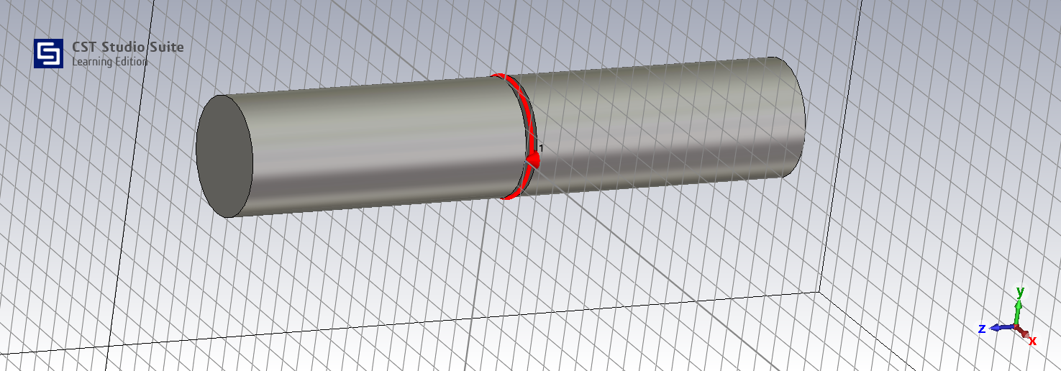
L1=50mm a=10mm g=2mm

