Slide 1
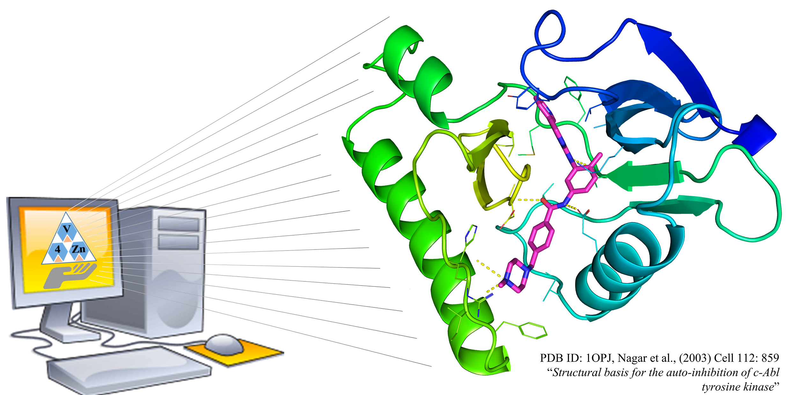
AMDock
Assisted Molecular Docking with
AutoDock Vina and AutoDock4
USER MANUAL

Slide 2
Figure 1. Workflow in AMDock

Slide 3
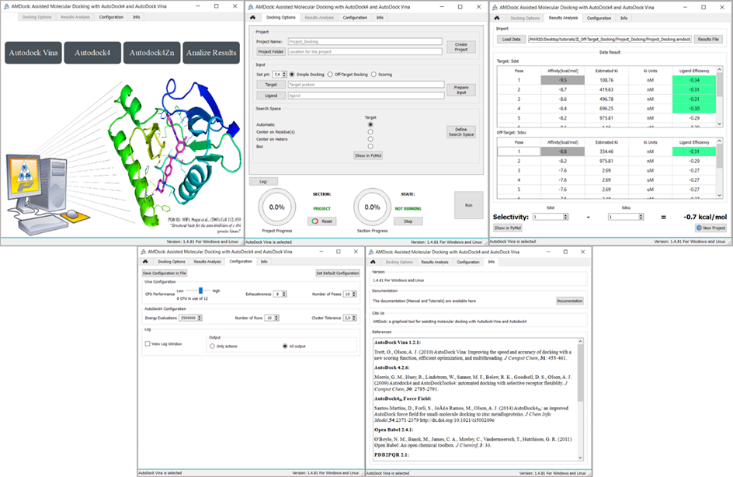
Figure 2. AMDock components. From left to right: Home, Docking Options, Results Analysis, Configuration and Info.

Slide 4
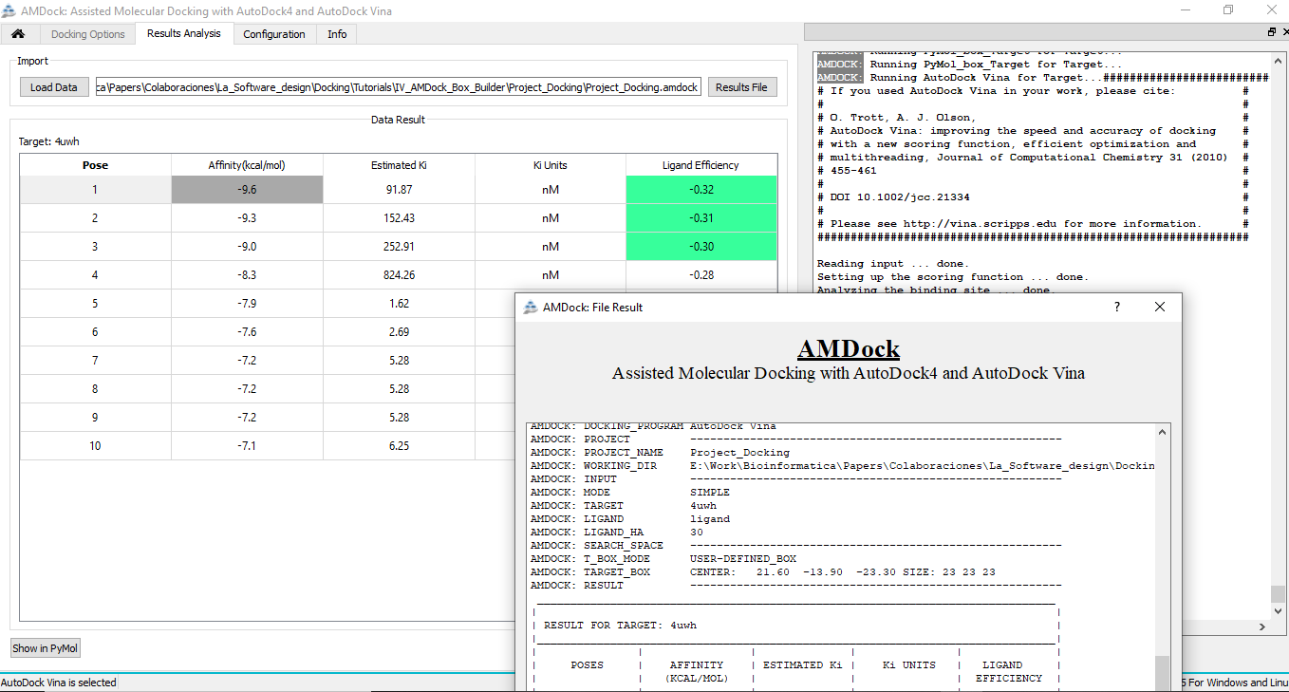
Figure 3. AMDock Result Analysis Tab. Behind left to right: Result table and Log record. The AMDock output table is shown in the front.

Slide 5
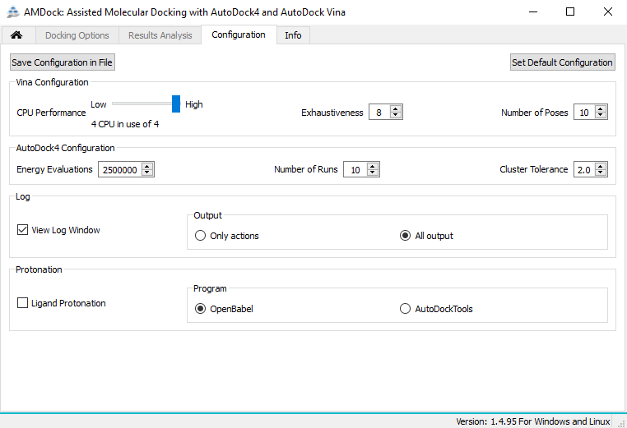
Figure 4. AMDock Configuration Tab.

Slide 6
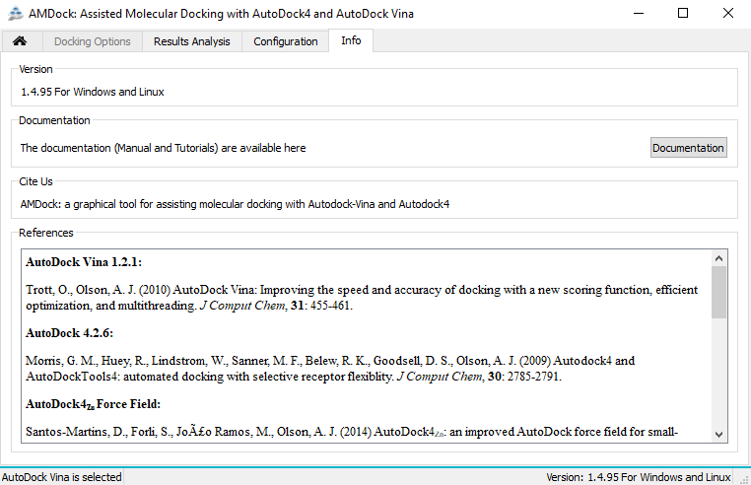
Figure 5. AMDock Info Tab.

